Slide 1




Optimal Fantasy Cricket Team: Availability-Aware Scoring and Exact Constrained XI Selection
+9.47 pp
top-11 capture vs last-5 baseline (66.63% vs 57.16%)
0.886
Final Model v3 Technical Report
appearance ROC-AUC
• A single gradient-boosted model lifts top-11 capture from 57.16% to 66.63% over a last-5 baseline, maintaining an auditable and leakage-safe pipeline.
19.478
MAE, down 32.8% from the last-5 baseline

Slide 2



Problem Overview & Prediction Task
Turning two announced squads into the single best legal fantasy XI, with availability built into every score.
Goal
Goal: Two announced squads to exactly one legal 11-player XI
Key Target
Predicted points = f(availability, form, career, context)
Non-players score 0
Availability
Form & career
Ranking
Recent team selection rate and days since last match
Rolling mean points over the last 3, 5 and 10 matches plus career record
Predicted points order candidates; absent players score 0
Legal XI constraints
11
Exactly 11 players
drawn from both teams, within every role range.
WK 1-4
BAT 3-6
AR 1-4
BOWL 3-6
→
players allowed per role
Statistical model ranks; decision layer guarantees legality

Slide 3







High-Level Architectural Walkthrough
From raw match files to a validated XI: five stages, each with a single job.
1. Acquire
2. Score
3. Featurize
4. Point Model
5. Optimize
(Cricsheet JSON)
→
(Delivery-level rules)
→
(Prior state only)
→
(Gradient boosting, MAE loss)
→
(Exact role-count enumeration)
Ball-by-ball T20 / IT20 files
Recent XIs as candidate pools
Single source of truth
Fantasy points per delivery
Rule-based, reproducible
Non-players score 0
Career, form, availability
Schedule and context
No future information
Histogram gradient boosting
22 pre-match features
Availability learned from features
Legal 11 by construction
Role ranges, both teams
Rechecked before CSV
Auditable
Leakage-safe
Legal by construction
Every score and feature traces back to source files and stated rules.
Features read only state that existed before each match date.
The optimizer, not the model, enforces the XI rules.

Slide 4
Feature Engineering Strategies
Seven feature groups, all computed from prior state so every row is safe to train on.
Group | Features
Career | Runs, wickets, batting, bowling, fielding
Recent Form | Mean points, last 3, 5 and 10
Form Shape | Last-5 standard deviation
Availability | Team selection rate, known candidate
Schedule | Days since last match
Team & Opponent | Team form, opponent points allowed
Context | Venue level, team type, gender
State read before update
1. Sort matches by date
Fixes what counts as prior
↓
2. Read prior state
Only history before the match
↓
3. Write feature
Row is built from that snapshot
↓
4. Finish same-date rows
Same-day matches cannot see each other
↓
- Permutation importance: team_selection_rate5 (+2.26 MAE) and days_since_last (+2.17) rank highest
5. Update state as batch
State moves forward once per date
Hard data cutoff 2025-12-31

Slide 5
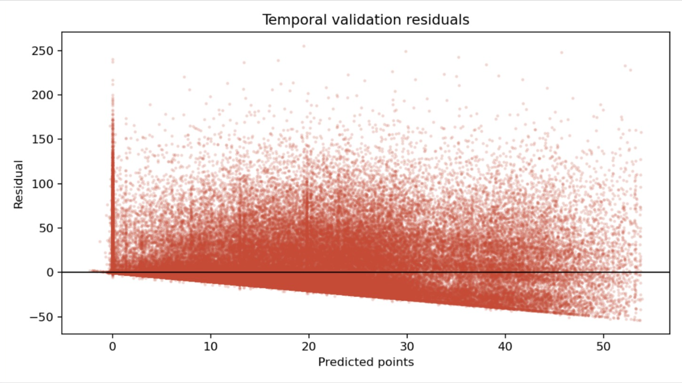
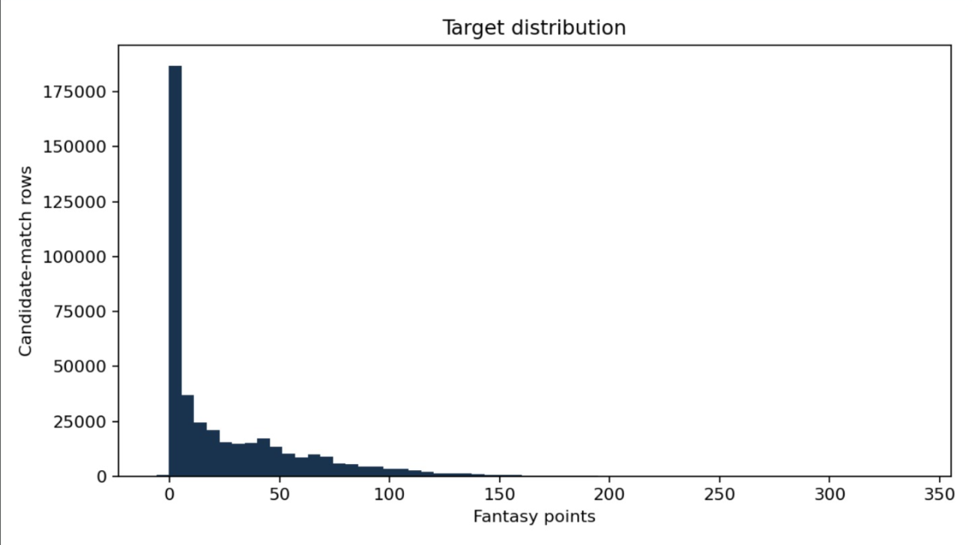
Design Choices & Model Composition
A single gradient-boosted point model with availability-aware features, using data through December 2025 only.
1. Point model
HistGradientBoosting, MAE loss, 250 iterations, 31 leaves.
19.478
66.63%
MAE (validation)
Top-11 capture
2. Availability-aware features
Recent selection and recency let one model learn appearance.
27.14 / 5.53
0.886
MAE: played / absent
Appearance ROC-AUC

Slide 6

Exact Constrained XI Selection
An exact optimizer enumerates every feasible role-count split instead of relying on greedy picks.
Exact role-count optimizer
What the optimizer uses
Inputs: predicted points, roles and teams
predicted points: ranking score per candidate
roles: fixture roles override inferred roles
role ranges: WK 1-4, BAT 3-6, AR 1-4, BOWL 3-6
teams: at least one player from each side
↓
Enumerate feasible role-count splits (20 in total)
split: all splits within role ranges summing to 11
pick: take the best players per sorted role list
Why it is exact
↓
Guarantees: 11 total, role ranges, both teams
Enumerates every feasible role-count split
Never returns an illegal XI
Minimum-loss swap adds the missing side if needed
↓
Rechecks before CSV

Slide 7





Limitations & Next Iterations
Where the current model falls short, and how the next version addresses it.
Limitations
Next Steps
Ceiling scores underpredicted
Two-stage appearance model
Top-end outcomes sit above what the point model predicts.
Appearance probability plus conditional points.
Inferred roles can fail
Authoritative roles
Roles are inferred, so a player can land in the wrong role group.
Replace inferred roles with a trusted role source.
Candidate pools are approximations
Ranking or quantile objective
Squads are approximated from each team's five most recent XIs.
Recover the upside compressed by MAE training.
Goal for the next iteration: better ceiling estimates and more reliable roles behind every selection

