Slide 1
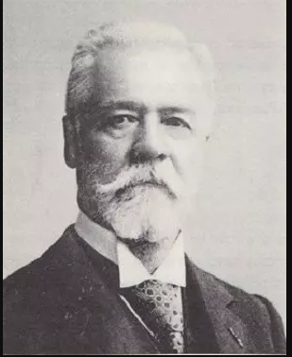
Henri Fayol’s
14 Principles of Management

Slide 2
BREIF
Henri Fayol, also known as the Father of Modern Management, gave a new perspective on the concept of management.
He introduced a general theory that can be applied to all levels of management and every department.
Today, Fayol’s theory is practiced by the management to organize and regulate the internal activities of an organization.

Slide 3

1ST PRINCIPLE
DIVISION OF WORK
Henri believed that segregating work in the workforce amongst the workers will enhance the quality of the product.
Similarly, he also concluded that the division of work improves the productivity, efficiency, accuracy and speed of the workers.
This principle is appropriate for both the managerial as well as a technical work level.

Slide 4
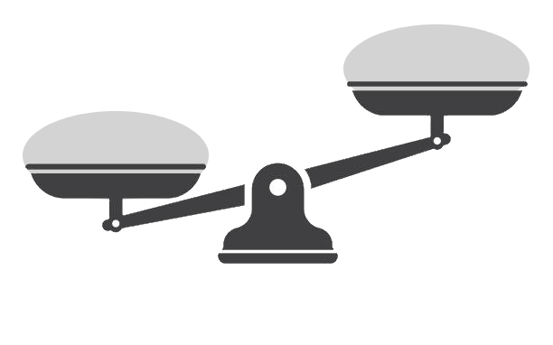
2nd PRINCIPLE
AUTHORITY AND RESPONSIBILITY
Henri believed that in an ideal organization, authority and responsibility must be perfectly balanced.
A manager who have the authority to assign tasks to his/her subordinates must also be responsible for getting that task done through that employee.
AUTHORITY
RESPONSIBILITY

Slide 5

3rd PRINCIPLE
DISCIPLINE
Discipline refers to the respect for rules, agreements, and the organizational structure within a company.
It emphasizes the importance of obedience and respect among employees toward their managers and the established rules of the organization.
Fayol believed that discipline is crucial for maintaining order and ensuring smooth operations.

Slide 6

4th PRINCIPLE
UNITY OF COMMAND
Henri believed that an employee should have only one boss and follow his command.
If an employee has to follow more than one boss, there begins a conflict of interest and can create confusion.
This can also lead to conflicts in tasks that are being performed by the employee.

Slide 7

5th PRINCIPLE
UNITY OF DIRECTION
According to Henri, whoever is engaged in the same activity should have a unified goal.
This means all the people working in a company should have one goal and motive which will make the work easier and achieve the set goal easily.

Slide 8
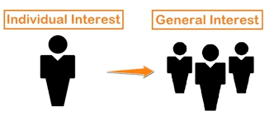
6th PRINCIPLE
SUBORDINATION OF INDIVIDUAL INTEREST
According to Henri, a company should work unitedly towards the interest of the company rather than personal interest.
Individual Interest of an employee or a worker must be subordinated by the general interest of the organization.

Slide 9

7th PRINCIPLE
REMUNERATION
Henri believed that, an employee must be properly remunerated for the services they render to the organization.
Their efforts and perspective must be valued and appreciated by the organization.

Slide 10
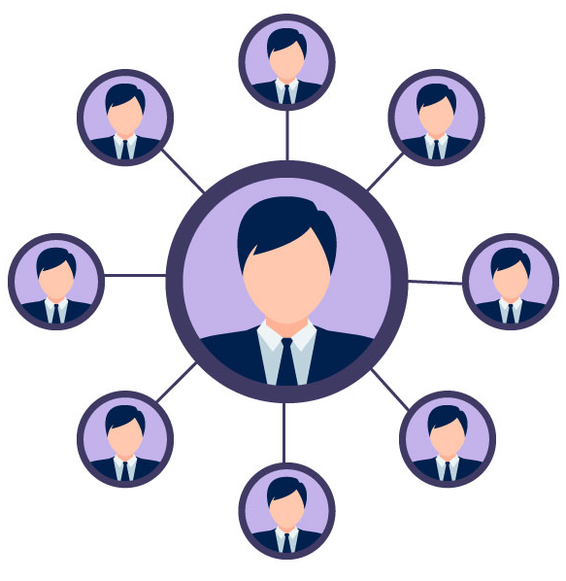
8th PRINCIPLE
CENTRALIZATION
Henri insisted that there should be a central point in an organization which can exercise control over the entire organization.
The extent of authority must depend on the skills, experience and quick decision making skills of the manager.

Slide 11
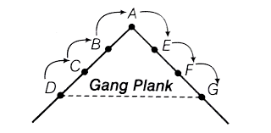
9th PRINCIPLE
SCALAR CHAIN
Henri gave the scalar chain, which refers to the clear hierarchy or chain of command in an organization, where communication and authority flow in a specific way.
In the scalar chain, there is an arrangement called Gang Plank, in which two managers working at the same level can communicate directly for quick decision making.

Slide 12

10th PRINCIPLE
ORDER
According to this principle, there should be a proper place for everything and everyone.
Henri Fayol emphasized on two types of order: material order and social order.
In material order, there must be a plan for everything. It ensures to fix a place for various material tools.
Whereas in social order, there must be an appointed place for every employee, which ensures a proper and fixed place/cabin for each employee.

Slide 13

11th PRINCIPLE
EQUITY
According to Henri, all employees and workers must be treated equally.
There should not be any discrimination amongst employees based on religion, caste, language, or nationality.
It improves satisfaction and motivation of the employee, creating relation between manager and employees

Slide 14

12th PRINCIPLE
STABILITY OF TENURE
According to this principle, there must be a reasonable stability of the jobs of the employees.
Employees must not be terminated or resigned very soon.
Longer tenures helps employees to develop relations with the organization and thus they are encouraged to do quality work.

Slide 15

13th PRINCIPLE
INITIATIVE
Henri Fayol suggested that employees at all levels should be encouraged to take initiative in work.
It motivates employees to work better and to take more interest in the organization.
This increase the mental growth and feeling of belongingness in employees. It increases the commitment of employees toward the organization.

Slide 16

14th PRINCIPLE
ESPIRIT DE CORPS
Esprit de Corps emphasizes unity and harmony among employees, fostering collaboration and boosting morale.
By promoting group cohesion, it encourages loyalty and reduces conflicts, increasing commitment to organizational goals.
It advocates for open communication to build trust and a sense of belonging, improving overall team efficiency.

Slide 17
A presentation by Abhiraj Sagar
THANK YOU

