Slide 1

BASE PAPER REVIEW
FPGA Implementation of PRESENT Algorithm
with Improved Security
Lightweight Cryptography for Resource-Constrained IoT Devices
PRESENT Cipher
SPN / 64-bit Block
4-bit Iterative Design
Key-Dependent S-box
Presenting By :
Kaviya M
Abhirajan R
Vallish Kumar Reddy, Rao Surya, Akhil Reddy, P. Sathish Kumar
Dept. of Electronics & Communication Engineering, Amrita School of Engineering, Bengaluru
Proceedings of ICECA 2019 (IEEE), pp. 404–409

Slide 2




Introduction & Motivation
Explosive Growth of IoT
Billions of web-connected smart objects, sensors and embedded controllers now communicate and act on each other's data with minimal human involvement.
This Paper's Twin Objectives
Growing Security Threats
01
Low-end, resource-constrained nodes (RFID tags, sensors, controllers) are highly vulnerable to data breaches and physical attacks.
Area Minimization
A 4-bit iterative architecture that trims hardware footprint — ideal for RFID tags and other resource-constrained devices.
Need for Lightweight Cryptography (LWC)
Conventional cryptography is too costly to embed in constrained devices; LWC saves area, power and cost while still securing data.
02
FPGAs + PRESENT for Hardware Security
Security Improvement
Reconfigurable FPGA hardware is well suited to symmetric ciphers; PRESENT (ISO/IEC 29192-2, 2012) is a leading ultra-lightweight block cipher.
A modified key-dependent S-box architecture to better resist cryptanalysis in IoT deployments prone to data breaches.

Slide 3

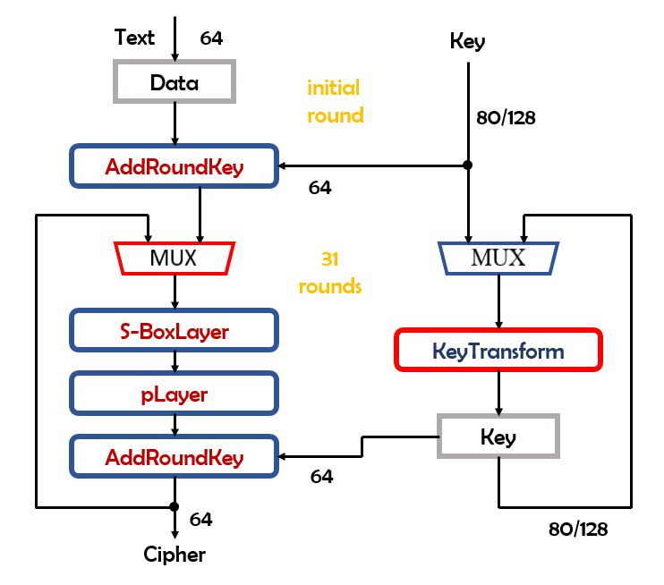
PRESENT Cipher: Algorithm Overview
Ultra-lightweight Substitution-Permutation Network (SPN) block cipher; standardized as ISO/IEC 29192-2 (2012)
Fixed 64-bit plaintext block; key size of 80-bit or 128-bit
31 rounds, each combining AddRoundKey → S-boxLayer → pLayer
S-box layer: 16 × 4-bit non-linear substitution boxes (the “heart” of PRESENT)
pLayer: bit permutation that ensures the Avalanche effect
Key schedule: 61-bit key rotation, S-box update on top bits, 5-bit round-counter XOR
Fig. 1 — PRESENT block diagram (initial round + 31 rounds)

Slide 4

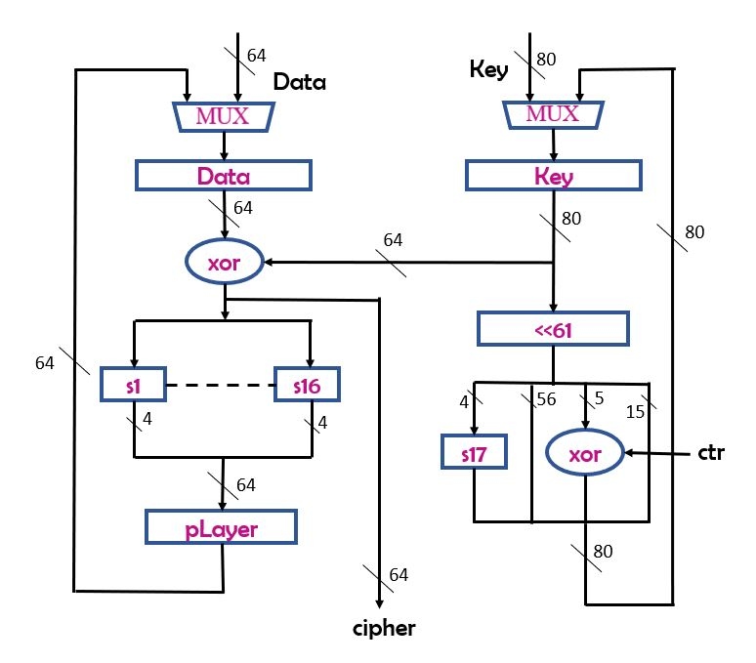
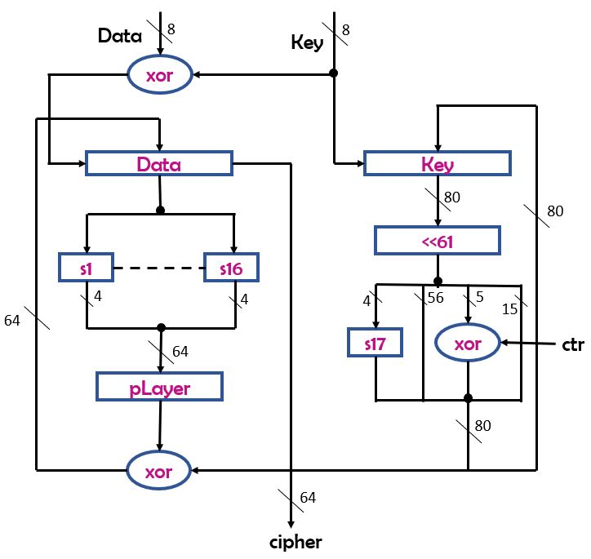
Existing Hardware Architectures (Literature)
Loop-Based Architecture [13]
8-bit Iterative Architecture [14]
One full encryption round executed per clock cycle
Reuses the same datapath across all 31 rounds → power-efficient
80-bit & 64-bit MUXes switch between load and encrypt states
Latency: 32 cycles — but larger MUXes increase area
Loads data & key 8 bits/cycle: 10 cycles (80-bit key) or 16 cycles (128-bit)
Smaller 8-bit 2:1 MUX → reduced area vs. loop-based design
Latency: 41 cycles (80-bit) / 47 cycles (128-bit)
Hardware: 149 FF, 77 XOR gates, 17 S-boxes, P-box + bit rotator

Slide 5

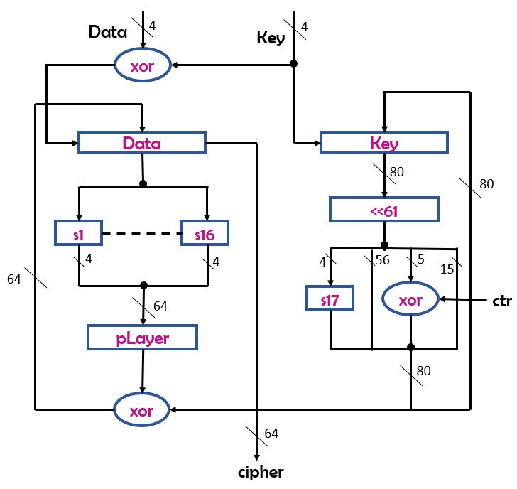
Proposed Architectures
1. 4-bit Iterative Architecture
Multiplexer width reduced from 8-bit to 4-bit → slightly smaller area than [14]
Data load takes 20 cycles (80-bit key) / 32 cycles (128-bit key)
Total latency: 51 cycles (80-bit) / 63 cycles (128-bit)
Hardware: 149 FF, 73 XOR gates, 17 S-boxes (P-box & bit rotator need no extra logic)
2. Modified Key-Dependent S-box Architecture
Pool of 16 candidate S-boxes (from [12]) meeting differential & linear cryptanalysis criteria
Each round, XOR-reduction of key bits produces a 4-bit value that selects the active S-box
Selector key copy is shifted independently of normal key update → decryption becomes practical (fixes [12]'s flaw)
Expands attacker's search space by 2⁴ (16×) over conventional PRESENT
Fig. 4 — 4-bit Iterative Architecture
(16 S-box pool enables the key-dependent design)

Slide 6

Results & Conclusion
Resource Usage — FPGA xc6slx25-3fgg484 (Spartan-6)
Key Takeaways
Architecture | FF | LUT | Slices | IOB | Latency
Loop-Based [13] – 80-bit | 149 | 239 | 68 | 210 | 32
Loop-Based [13] – 128-bit | 197 | 322 | 103 | 258 | 32
Iterative-8 [14] – 80-bit | 149 | 171 | 47 | 83 | 41
Iterative-8 [14] – 128-bit | 197 | 208 | 57 | 83 | 47
Proposed 4-bit – 80-bit | 149 | 175 | 46 | 75 | 51
Proposed 4-bit – 128-bit | 197 | 206 | 57 | 75 | 63
4-bit iterative design trims LUTs vs. the 8-bit design, but raises latency by ~25%
Modified key-dependent S-box raises the brute-force search space by 16× (2⁴) with a modest area cost
Resolves the impractical-decryption flaw of the original key-dependent S-box concept [12]
Both designs verified via Xilinx ISE simulation for the paper's test vector
Future scope: further area optimization of the key-dependent architecture
[13] Loop-Based and [14] 8-bit Iterative are the reference architectures; Proposed 4-bit” uses fewer Slices and IOBs than [14]; LUT savings (3–4 fewer) are evident on Spartan-3 and Virtex-4 targets. Latency increases by 10–16 extra cycles.

Slide 7

THANK YOU
Core Reference:
[4] C. A. Lara-Nino, A. Diaz-Perez and M. Morales-Sandoval, "Lightweight Hardware Architectures for the PRESENT Cipher in FPGA," IEEE TCAS-I, vol. 64, no. 9, pp. 2544-2555, Sept. 2017. [11] ISO/IEC 29192-2: Information Technology - Security Techniques - Lightweight Cryptography - Part 2: Block Ciphers, Jan. 2012. [12] S. S. M. AlDabbagh and I. F. T. A. Shaikhli, "Improving PRESENT Lightweight Algorithm," ACSAT 2013, Kuching, pp. 254-258. [13] Rolfes C., Poschmann A., Leander G., Paar C., "Ultra-Lightweight Implementations for Smart Devices - Security for 1000 Gate Equivalents," CARDIS 2008, LNCS vol. 5189, Springer. [14] N. Hanley, M. O'Neill, "Hardware Comparison of the ISO/IEC 29192-2 Block Ciphers," IEEE ISVLSI, pp. 57-62, Aug. 2012.
Base Paper: V. K. Reddy, R. Surya, A. Reddy, P. Sathish Kumar, “FPGA Implementation of PRESENT Algorithm with Improved Security,” Proc. ICECA 2019, IEEE, pp. 404–409.

