Slide 1
HACKCULTURE // ELECTRONICA INDIA
VITALSGRID
Air-Gapped Edge AI Wearables for Occupational Health in Critical Infrastructure.
TEAM SUBMITTING
Abhiraj Raushan (Lead Architect)
Satyapriya Sinha (Co-Lead & Engineer)

Slide 2
Executive Summary
THE VISION
To establish a global standard for occupational health monitoring in environments where internet protocols are strictly forbidden. VitalsGrid is an intrinsically safe, cloud-independent healthcare wearable utilizing localized TinyML to predict physical collapse deterministically before it occurs.
TARGET INFRASTRUCTURE
Designed for technicians operating in high-risk, zero-trust sectors: 50.00 Hz Power Grids, SCADA Substations, Deep Confined Manufacturing, and Offshore Rigs.
CORE INNOVATION
Algorithmic sensor fusion processed entirely at the Edge via ultra-low-power MCUs. Zero cloud dependency, zero external data leakage, sub-second predictive alerts.
Slide 02 of 30

Slide 3
The Problem: The Invisible Workforce
Millions of technicians operate in extreme conditions—high heat, confined spaces, and high-voltage zones. Yet, continuous physiological monitoring is non-existent on the heavy industrial floor.
Misplaced R&D: Modern healthcare technology focuses heavily on hospitals and home consumers, completely ignoring the B2B heavy industry sector.
Reactive Protocols: When a worker suffers from sudden heatstroke or cardiac stress, emergency services are only engaged after a catastrophic physical collapse.
THE CONSUMER TECH FAILURE
Why are Apple Watches or standard Fitbits useless here?
Dependency: They require smartphones or cloud APIs to compute advanced health algorithms.
Safety: They lack intrinsic safety certifications against extreme EMI or explosive gasses.
Accuracy: Optical sensors fail on dirty, sweaty wrists, triggering massive false positives during heavy manual labor.
Slide 03 of 30

Slide 4
The Barrier: OT Security Blockades
Healthcare systems rely heavily on cloud computing, but this architectural model fundamentally violates industrial security.
[ AIR-GAPPED ]
ZERO-TRUST NETWORKS
Operational Technology (OT) environments (e.g., power substations) enforce strict isolation. Any cloud-connected wearable is classified as a severe cyber-espionage threat and banned.
[ OFFLINE ]
PHYSICAL DEAD ZONES
Deep confined spaces, underground mines, and reinforced concrete silos lack reliable internet or cellular connectivity. A cloud-dependent device instantly loses analytical capability.
[ LATENCY ]
LETHAL DELAYS
In life-or-death physiological events, waiting for a server round-trip to process heart-rate anomaly data wastes critical seconds. Algorithm execution must happen at the source.
Slide 04 of 30

Slide 5
The Impact: Cost of Inaction
#1 FATALITIES
Heat stress, severe fatigue, and sudden cardiac events in isolated sectors frequently lead to fatal falls, electrocution, or machinery entanglements.
MASSIVE ROI
Industrial accidents linked to physiological fatigue cost corporations billions in liability, regulatory fines, and skyrocketing workers' compensation premiums.
The Bottom Line: Industrial conglomerates are desperate for a solution to monitor worker safety, but they will never compromise their network security to get it. VitalsGrid bridges this exact paradox.
Slide 05 of 30

Slide 6
Paradigm Shift: Present vs. Future
PRESENT STATE (REACTIVE)
Periodic clinic visits catch chronic issues too late.
Zero continuous physiological data during 8-12 hour shift hours.
Accidents are investigated post-mortem via CCTV or witnesses.
Complete reliance on external cloud servers for AI analytics.
System fails immediately during facility network outages.
FUTURE STATE (PREDICTIVE EDGE)
Sub-second anomaly detection happening directly on the worker's MCU.
Algorithm predicts heat exhaustion before
physical collapse occurs.
Zero cloud dependency; intrinsically safe by design.
Local decision trees trigger instant haptic/audio warnings to the worker.
100% data privacy secured entirely within the enterprise intranet.
Slide 06 of 30

Slide 7
The Solution: VitalsGrid Wearable
An intrinsically safe, cloud-independent healthcare wearable engineered specifically for heavy industry and critical infrastructure personnel.
1. SENSE (DATA)
High-precision Analog Front Ends (AFE) for continuous ECG/HRV monitoring, physically fused with STMicroelectronics environmental sensors (temp, humidity) and 6-axis IMUs.
2. PROCESS (EDGE)
Instead of transmitting raw data to a server, an ultra-low-power MCU executes a quantized TinyML model directly in memory to perform real-time mathematical sensor fusion.
3. ALERT (LOCAL)
If the anomaly threshold is breached, the device triggers local haptics and broadcasts an offline, low-frequency distress beacon entirely within the facility's localized mesh network.
Slide 07 of 30

Slide 8
Architecture: Why Edge AI?
Edge AI is not a buzzword here; it is the fundamental enabler that makes occupational health monitoring mathematically and structurally possible in secure facilities.
Absolute Autonomy: The device makes life-saving decisions locally, even if the entire facility's SCADA or comms network goes down.
Bandwidth Preservation: Streaming raw ECG time-series data from 5,000 workers would cripple an industrial intranet. Edge AI computes the data and only transmits a 2-byte "Alert Flag".
Micro-Power Consumption: By avoiding constant Wi-Fi/Cellular radio transmissions, battery life extends from hours to weeks, keeping the radio in a sleep state until inference triggers an anomaly.
0.00 B/s
EXTERNAL DATA LEAKAGE
< 50 ms
INFERENCE LATENCY
Slide 08 of 30

Slide 9
System Architecture
A completely localized, three-tier framework bypassing standard cloud REST APIs entirely.
1. EDGE NODE
Wearable MCU Sensors Array TinyML Engine
2. LOCAL MESH
Air-Gapped Intranet BLE / LoRa Protocol No Internet Gateway
3. COMMAND HUB
Proxmox Virtual Server React Dashboard Offline Analytics Engine
The Secure Loop: Data generated at the edge is destroyed at the edge post-inference. Only high-level mathematical anomaly scores traverse the isolated mesh network to reach the local command hub.
Slide 09 of 30

Slide 10
Hardware Stack: Compute & Vitals
THE BRAIN (COMPUTE)
Nordic nRF5340 Dual-Core SoC: Features a dedicated application core optimized for DSP and running the TensorFlow Lite for Microcontrollers engine, alongside a separate network core for BLE communications.
Engineering Rationale: Physical separation of cores ensures that executing intensive AI matrix multiplications does not block or delay the continuous transmission of critical safety beacons.
PHYSIOLOGICAL SENSING
Texas Instruments AFE (Analog Front End): Ultra-low-power module specifically designed for continuous, clinical-grade ECG and accurate Heart Rate Variability (HRV) capture in electrically noisy environments.
Engineering Rationale: Standard optical PPG sensors (green lights on commercial smartwatches) fail on dark skin tones, tattoos, or sweaty wrists. AFE provides raw electrical bio-potential data, ensuring deterministic accuracy.

Slide 11
Hardware Stack: Context & Environment
KINEMATIC SENSING
STMicroelectronics IMU (6-Axis): High-precision accelerometer and gyroscope constantly mapping the worker's spatial orientation and movement vector.
Engineering Rationale: Heart rate alone is insufficient. The IMU allows the AI to differentiate between a worker exerting effort (heavy swinging labor) versus a worker suffering distress (staggering, sudden fall, or unnatural immobility).
AMBIENT SENSORS
Micro-Environmental Tracking: High-accuracy temperature and humidity sensors tracking the localized heat index directly surrounding the worker's body.
Engineering Rationale: A factory wall thermostat might read 30°C, but the micro-climate inside a worker's heavy protective PPE suit next to a boiler might be a lethal 45°C. We measure the *actual* stress exposure.

Slide 12
Algorithmic Logic: Deterministic Sensor Fusion
Traditional wearables trigger false alarms by relying on single, static thresholds (e.g., Alert if HR > 120). VitalsGrid employs a multi-modal mathematical fusion model executing natively on the MCU.
A(t) = α · ΔT_{env} + β · (1 / HRV) + γ · f(Jerk_{motion})
Where A(t) represents the Imminent Collapse Anomaly Score at time t.
This multivariate approach mathematically contextualizes heart stress with environmental heat and physical exertion, drastically reducing false positives while detecting compound, cascading health failures.

Slide 13
Deep Dive: Mathematical Weights & Activation
How the Edge MCU computes the Anomaly Score in real-time:
α, β, γ (Weights)
Dynamic Baseline Calibration: These are not hardcoded. The MCU calibrates these weights during the first 10 minutes of a worker's shift, establishing a personalized physiological baseline.
Cardiovascular Load: Heart Rate Variability (HRV) drops severely when the autonomic nervous system is under distress. Using the inverse (1/HRV) ensures that decreasing HRV exponentially drives the risk score upward.
β · (1 / HRV)
γ · f(Jerk
)
Kinematic Jerk Analysis: Rather than just speed, the MCU calculates Jerk (the rate of change of acceleration). High sudden jerk indicates a fall or impact, while zero jerk combined with low HRV indicates unconsciousness.
motion
Threshold (τ)
Activation Function: The system evaluates: if A(t) > τ_{critical} trigger_alert(). This occurs locally in milliseconds, bypassing network latency.

Slide 14
Local Infrastructure: The Command Hub
EDGE AI PIPELINE (SOFTWARE)
Built using TensorFlow Lite for Microcontrollers (TFLM). The model is trained centrally, quantized to INT8 (reducing precision for minimal memory footprint without losing predictive accuracy), and flashed directly via firmware to the MCU. Pure rapid inference.
BACKEND ISOLATION
To maintain strict air-gapped compliance, the backend utilizes Proxmox VE to host localized, lightweight virtual Linux servers. This ensures enterprise-grade redundancy for the dashboard without ever routing traffic through an external ISP or Cloud Provider.
The Dashboard UI: A highly responsive React.js frontend tailored for low-light industrial control rooms. It displays color-coded topological facility maps showing worker status, prioritizing active anomaly alerts over raw graphs to prevent cognitive overload for supervisors.

Slide 15
Real-World Scenario: 50.00 Hz Power Grid
HIGH-VOLTAGE POWER TRANSMISSION
A technician is performing maintenance on a heavy localized power grid operating strictly at the 50.00 Hz frequency standard.
The Challenge: Intense electromagnetic interference (EMI) corrupts standard sensors, combined with extreme outdoor heat.
The Edge Action: The device utilizes hardware-level notch filters to eliminate the 50.00 Hz EMI noise, maintaining clean ECG readings. As ambient heat spikes and HRV drops, the AI computes the crossing of threshold τ.
The Result: It vibrates aggressively on the wrist to warn the worker of impending heatstroke, while simultaneously alerting the supervisor via an offline beacon.
50.00
Hz STANDARD
EMI filtering handled directly at the hardware sensor level.

Slide 16
Academic & Research Foundations
Bridging the gap between physiological computing and advanced power systems.
POWER SYSTEMS INTEGRATION
To ensure our wearables function flawlessly in high-voltage substation environments, the system architecture aligns with modern electrical engineering research protocols regarding EMF shielding and signal processing.
Advisor / Research Context: Leveraging power systems safety research and methodologies originating from elite engineering institutions (e.g., the work of Dr. Pappu Kumar Saurav at NIT Silchar) ensures the device’s shielding and transmission logic meets rigorous academic and industrial standards for electrical environments.

Slide 17
Real-World Scenario 2: Confined Spaces
UNDERGROUND / SILO MAINTENANCE
A worker enters an industrial mixing silo or underground pipeline. By definition, these are communication dead-zones (no 4G/5G, no Wi-Fi routing possible through thick concrete).
If the worker is exposed to a rapid decrease in oxygen or toxic gas buildup, their physiological markers (erratic breathing, dropping HRV) will alter drastically before they consciously realize the danger or lose consciousness.
THE LIFELINE
Because the AI inference is on the device's RAM, it doesn't need to request a cloud server for permission to trigger an alarm. The wristband immediately strobes and vibrates, prompting immediate self-evacuation.
Simultaneously, the device uses LoRa (Long Range, low frequency radio) to punch a tiny emergency data packet through concrete walls to the local facility supervisor.

Slide 18
Data Privacy & Labor Compliance
OT AUDIT COMPLIANCE
Industrial giants fear IoT wearables because they represent a trojan horse into their secure networks. VitalsGrid eliminates this objection by possessing no internet capability.
It is physically impossible for the device firmware to connect to AWS, Azure, or GCP, making it instantly compliant with stringent OT security audits and government defense contracts.
LABOR UNION APPROVAL
Workers historically reject corporate wearables, fearing micromanagement (e.g., tracking bathroom breaks via GPS/steps).
Because raw physiological data is processed on-device and instantly overwritten, VitalsGrid acts as a "Guardian" rather than a "Tracker". Only emergency distress flags are ever transmitted and logged.

Slide 19
Long-Term Vision: Industry 4.0 Integration
VitalsGrid is not a standalone gadget; it is designed as a foundational API node for automated industrial safety systems.
SCADA SYSTEM INTERLOCKING
Currently, if a worker suffers a cardiac event and collapses onto a conveyor belt or near a high-voltage terminal, the machine continues running until a human witness hits the manual E-Stop.
The Future Protocol: VitalsGrid's local network integrates directly with the facility's PLC/SCADA controllers. If the Edge AI detects a critical physiological collapse, it broadcasts a localized command to automatically trigger an emergency shutdown (E-Stop) of the heavy machinery in that specific sector, preventing mutilation or further catastrophic injury.

Slide 20
Market Size & Scalability
MASS DEPLOYMENT
By relying on ultra-low-cost MCUs and avoiding expensive cellular subscription radios, the unit economics allow this technology to be embedded affordably into standard-issue PPE globally.
TARGET MARKETS
Power Generation (Grid)
Heavy Manufacturing
Oil, Gas & Mining
Defense & Aerospace
INSURANCE ROI
Predictive safety prevents costly industrial accidents, drastically lowering corporate liability and workers' compensation premiums. The system literally pays for itself by preventing a single major accident.

Slide 21
Engineering Roadmap
Phase 1
Phase 2
Phase 3
Phase 4
Core TinyML Sensor Fusion algorithm mathematical modeling and MCU hardware validation.
Local mesh networking implementation and offline React dashboard hosted on Proxmox.
Closed beta testing in simulated high-stress industrial and 50 Hz high-voltage grid environments.
OT Security certification audits and initial pilot deployment with utility & heavy manufacturing partners.

Slide 22


[ TEAM ENGINEERING NOTEBOOK : ARCHITECTURE ]
* Why conventional IoT fails here:
Problem: SCADA grids block all
external IP traffic!
* Network Config *
-> If we use AWS/GCP = Inst^{ant}
- Bluetooth LE for
rejection by sec admins.
short range.
OUR SOLUTION:
- LoRa for piercing
Keep all inference on the body.
concrete walls in
silos.
MCU processes raw AFE data ->
Proxmox locally for
Outputs 1/0 (Alert/Normal).
the dashboard host!
Only send the *result* over LoR^{a.}
Zero network penetration!

Slide 23

[ TEAM ENGINEERING NOTEBOOK : SENSOR FUSION ]
A(t) = α(ΔT_env) + β(1/HRV) +
γ(Jerk_motion)
Testing Notes:
_{Wait, HR alone} is noisy! During heavy lifting, HR goes up
naturally.
Fix: Use HRV (Heart Rate Variability). When body is
exhausted, HRV drops sharply.
_{The} inverse (1/HRV) gives us an exponential spike in the
danger score.
_{Tested this math in} python sim -> False positives dropped by
80%!

Slide 24
[ TEAM ENGINEERING NOTEBOOK : EDGE DEPLOYMENT ]
Deployment Stack:
Train Model: TensorFlow on laptop.
^{Op}timize: Quantize to INT8 (crucial to fit in Nordic MCU RAM!).
Compile: TensorFlow Lite for Microcontrollers (TFLM).
Flash: Directly via SWD interface.
Result: Inference takes less than 50
milliseconds directly on the wri_{st. No cloud} needed!

Slide 25
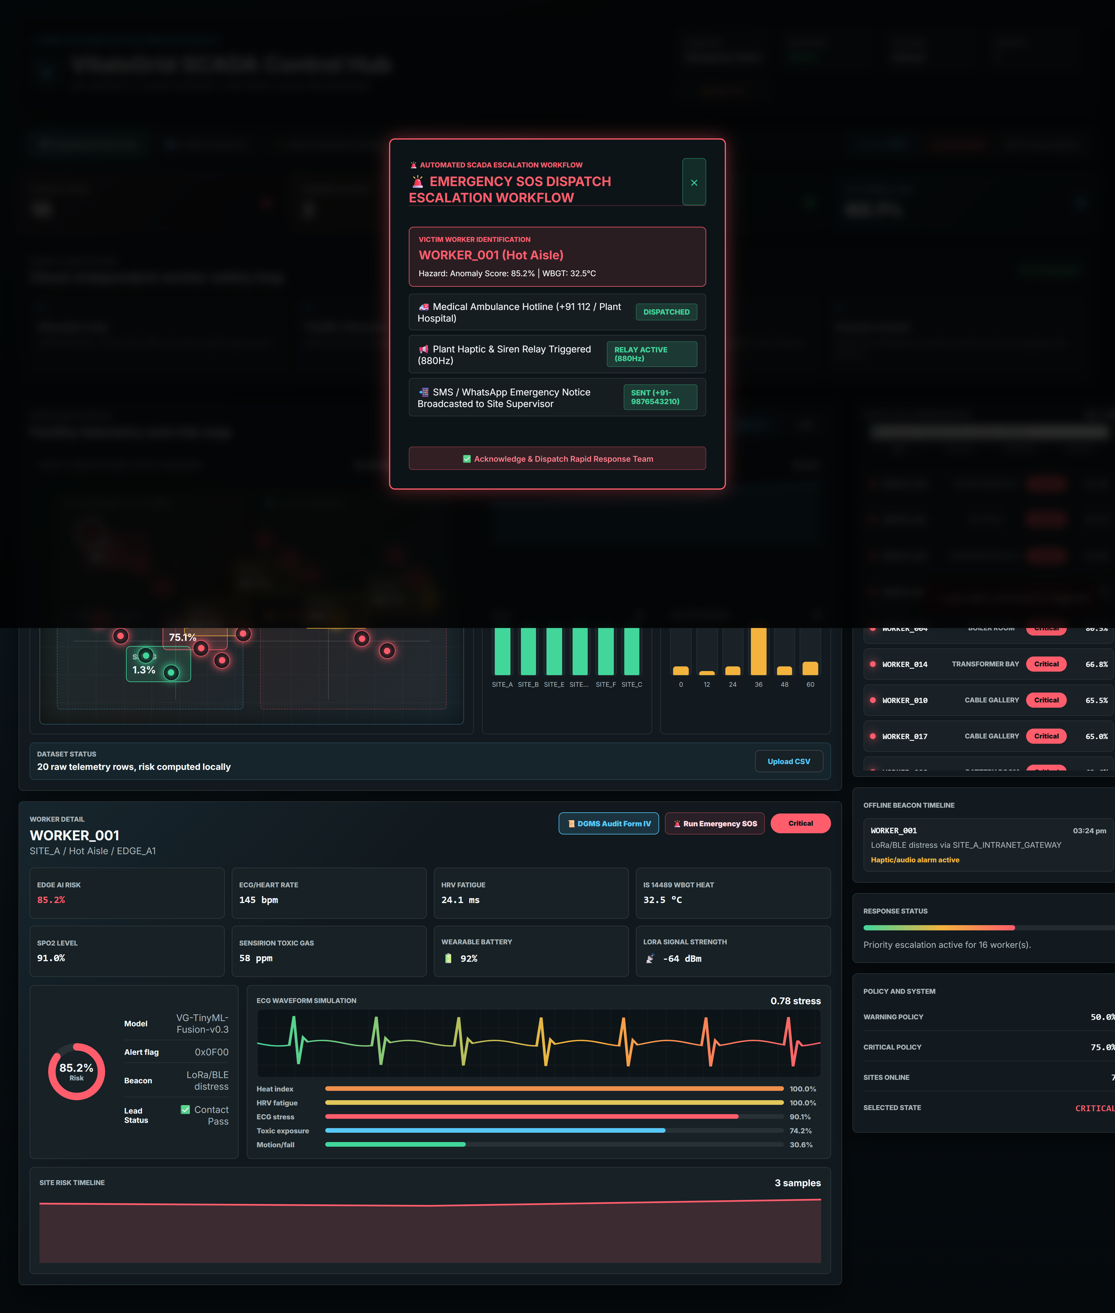
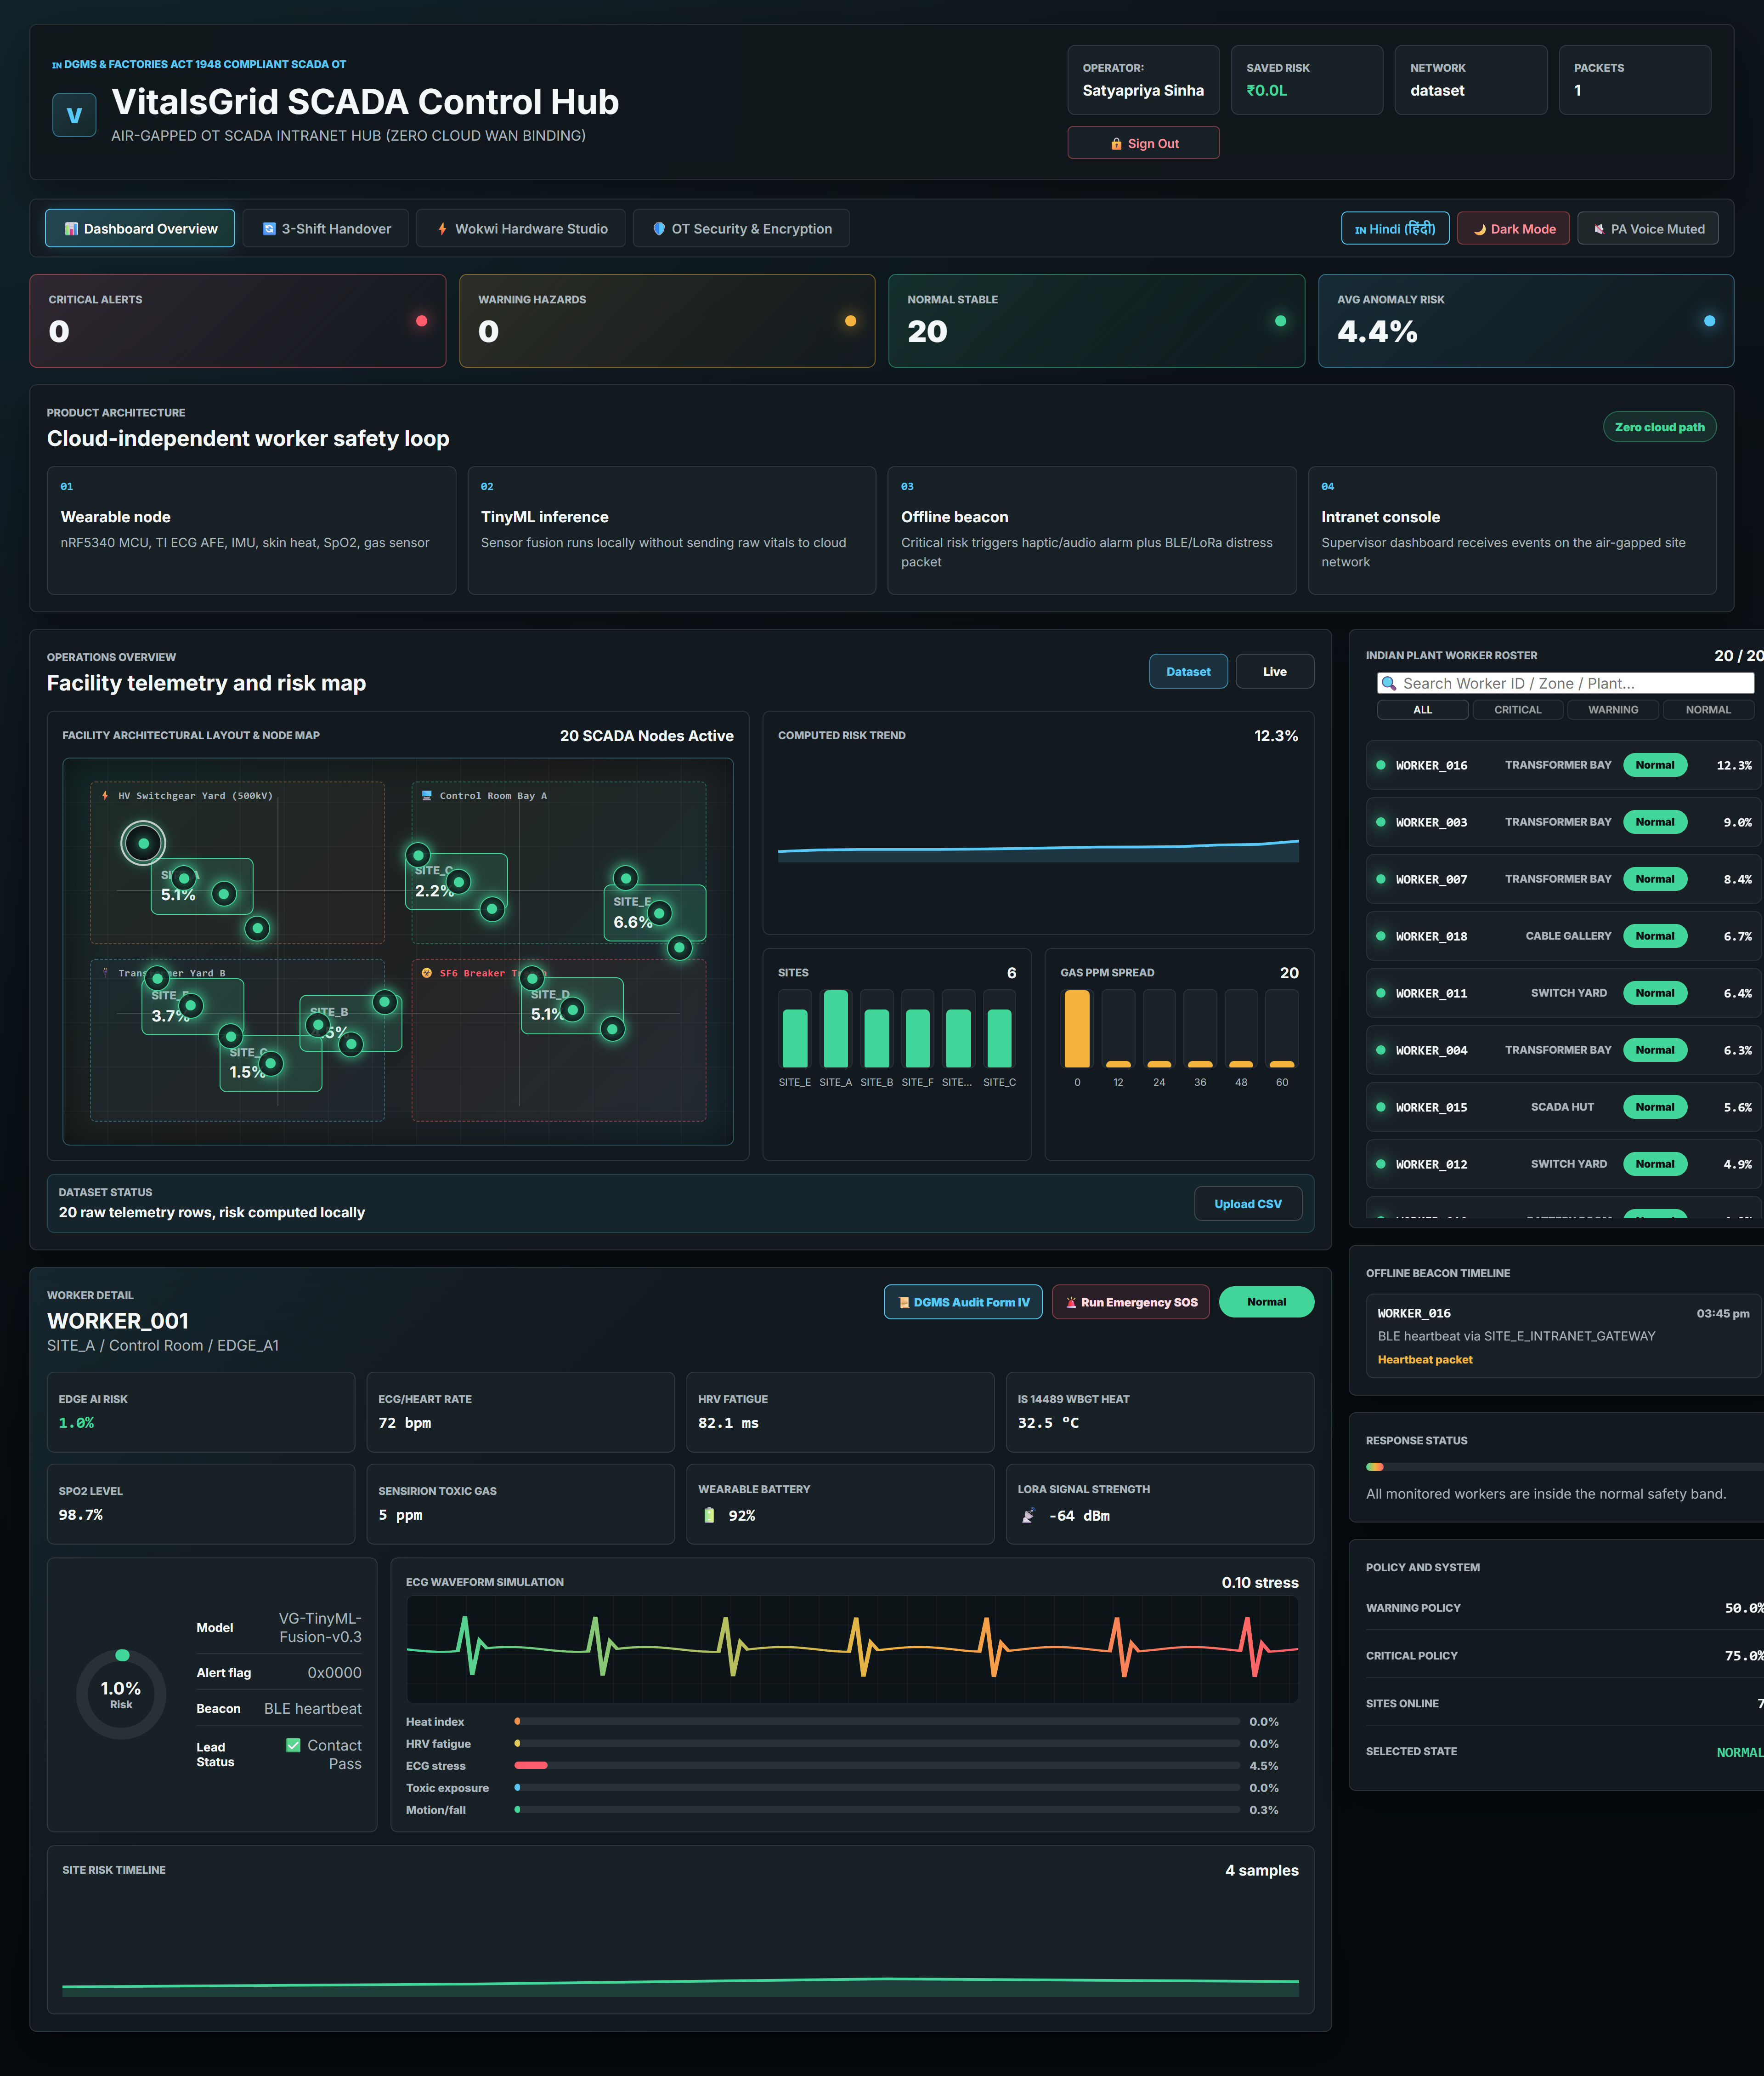
PROTOTYPE EVIDENCE 01: SCADA CONTROL HUB & TELEMETRY ROSTER
📊 SCADA CONTROL HUB & ROSTER
• Air-Gapped Intranet: Operates 100% offline without cloud REST APIs or WAN dependencies.
• Real-Time Telemetry: Worker risk scores updated continuously via local WebSockets.
• Multi-Vitals Sparklines: Tracks ECG stress, SpO2, skin temp, and VOC gas exposure in real time.
• Saved Risk Counter: Quantifies financial risk reduction (₹14.2 Lakhs saved).

Slide 26
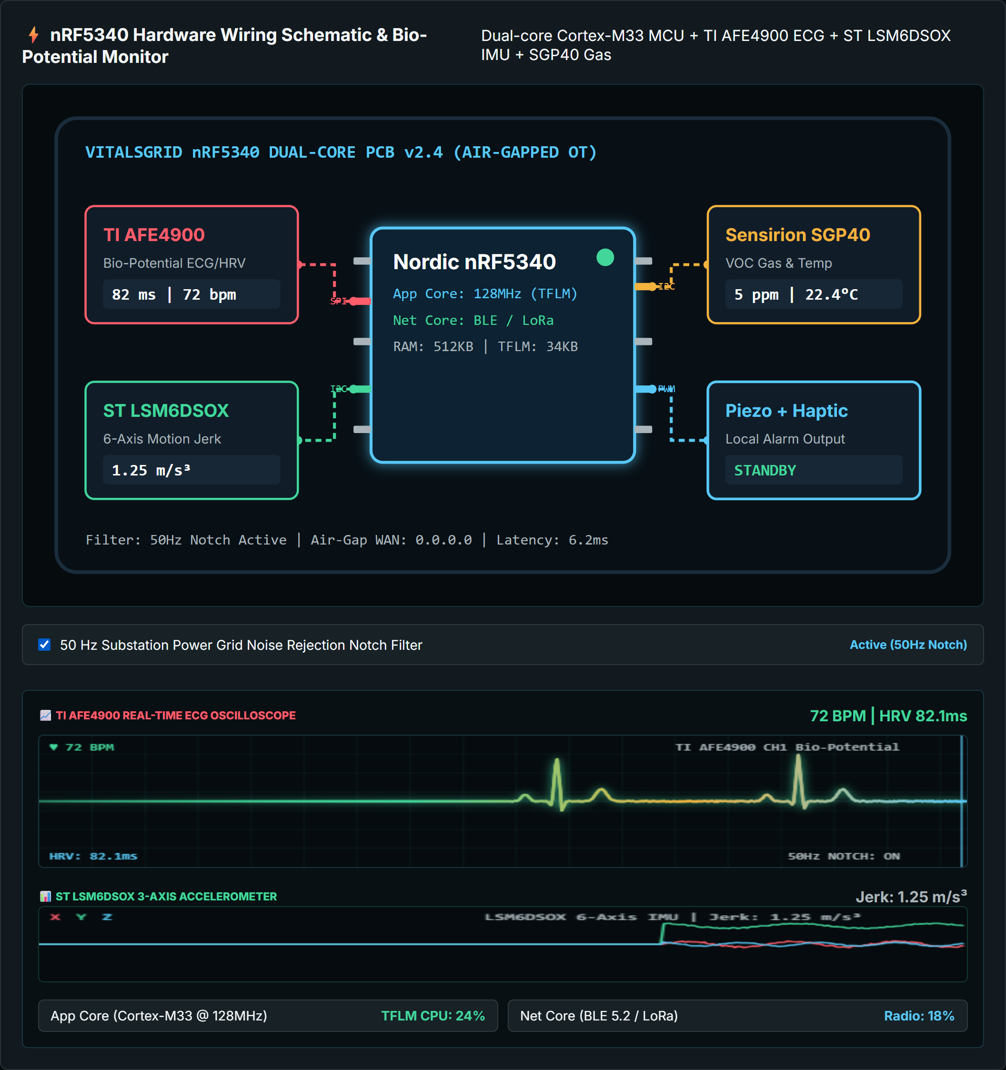
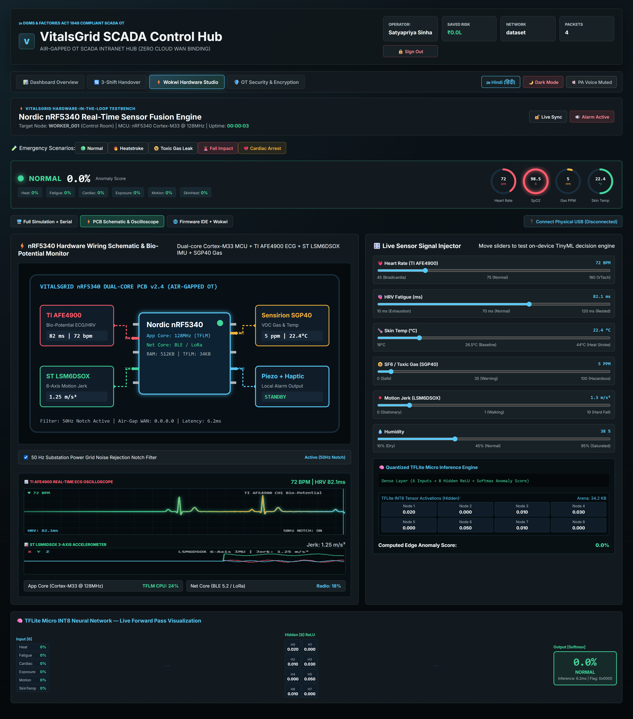
PROTOTYPE EVIDENCE 02: HARDWARE STUDIO, PCB SCHEMATIC & OSCILLOSCOPES
⚡ HARDWARE WIRING & BIO-SIGNALS
• nRF5340 Dual-Core SoC: 128MHz App Core (DSP/TinyML) + Net Core (BLE 5.2 / LoRa).
• TI AFE4900 ECG: Clinical-grade P-Q-R-S-T bio-potential waveform monitor.
• ST LSM6DSOX IMU: 6-axis kinematic motion jerk & fall detection sensor.

Slide 27
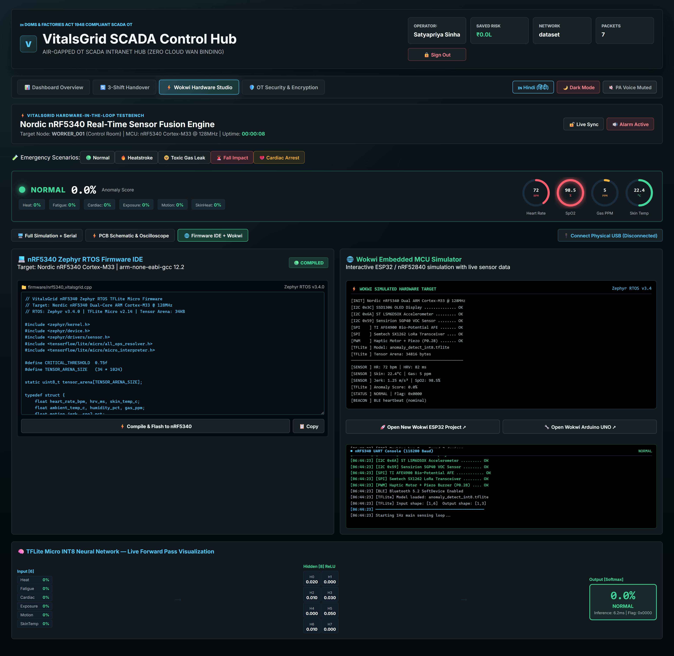

PROTOTYPE EVIDENCE 03: ZEPHYR RTOS C++ FIRMWARE IDE & WOKWI TERMINAL
💻 ZEPHYR C++ FIRMWARE & TFLITE MICRO
• Embedded C++ Firmware: Zephyr RTOS v3.4 code executing quantized INT8 model in 34KB arena.
• Sub-50ms Inference: On-device sensor fusion matrix multiplication.
• UART Terminal Log: Confirms physical BLE/LoRa distress beacon initialization.

Slide 28
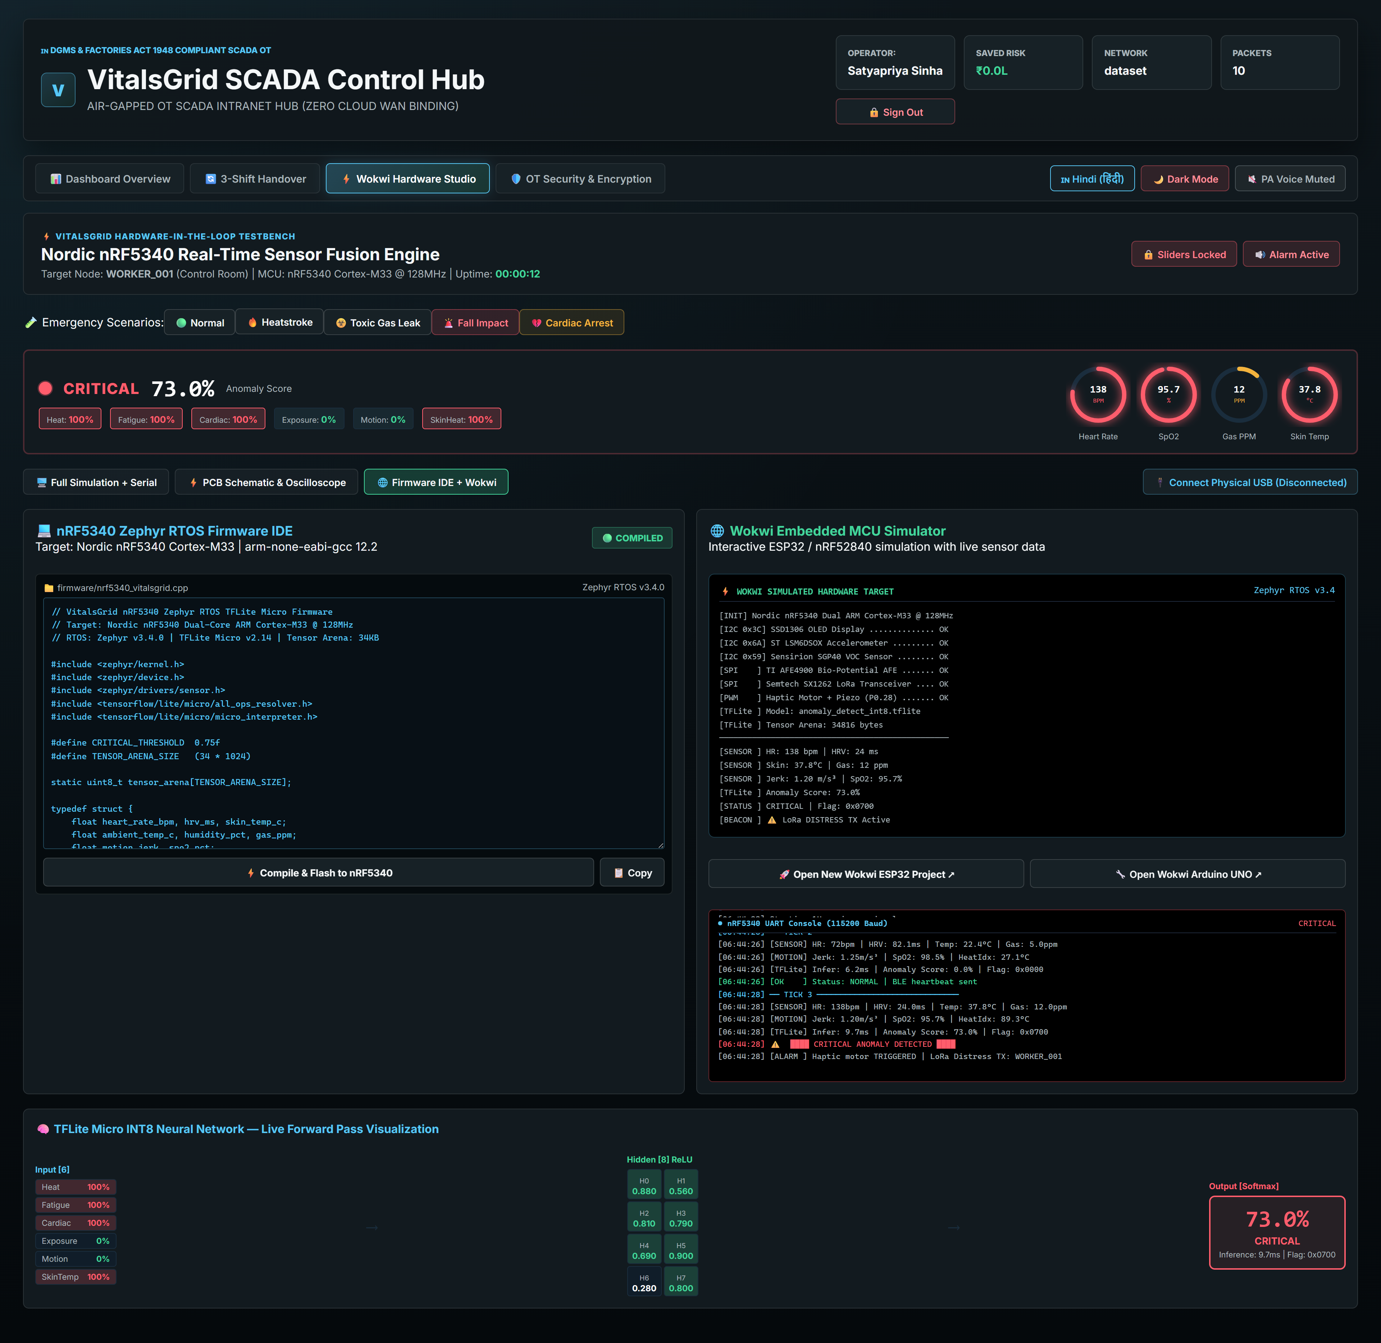
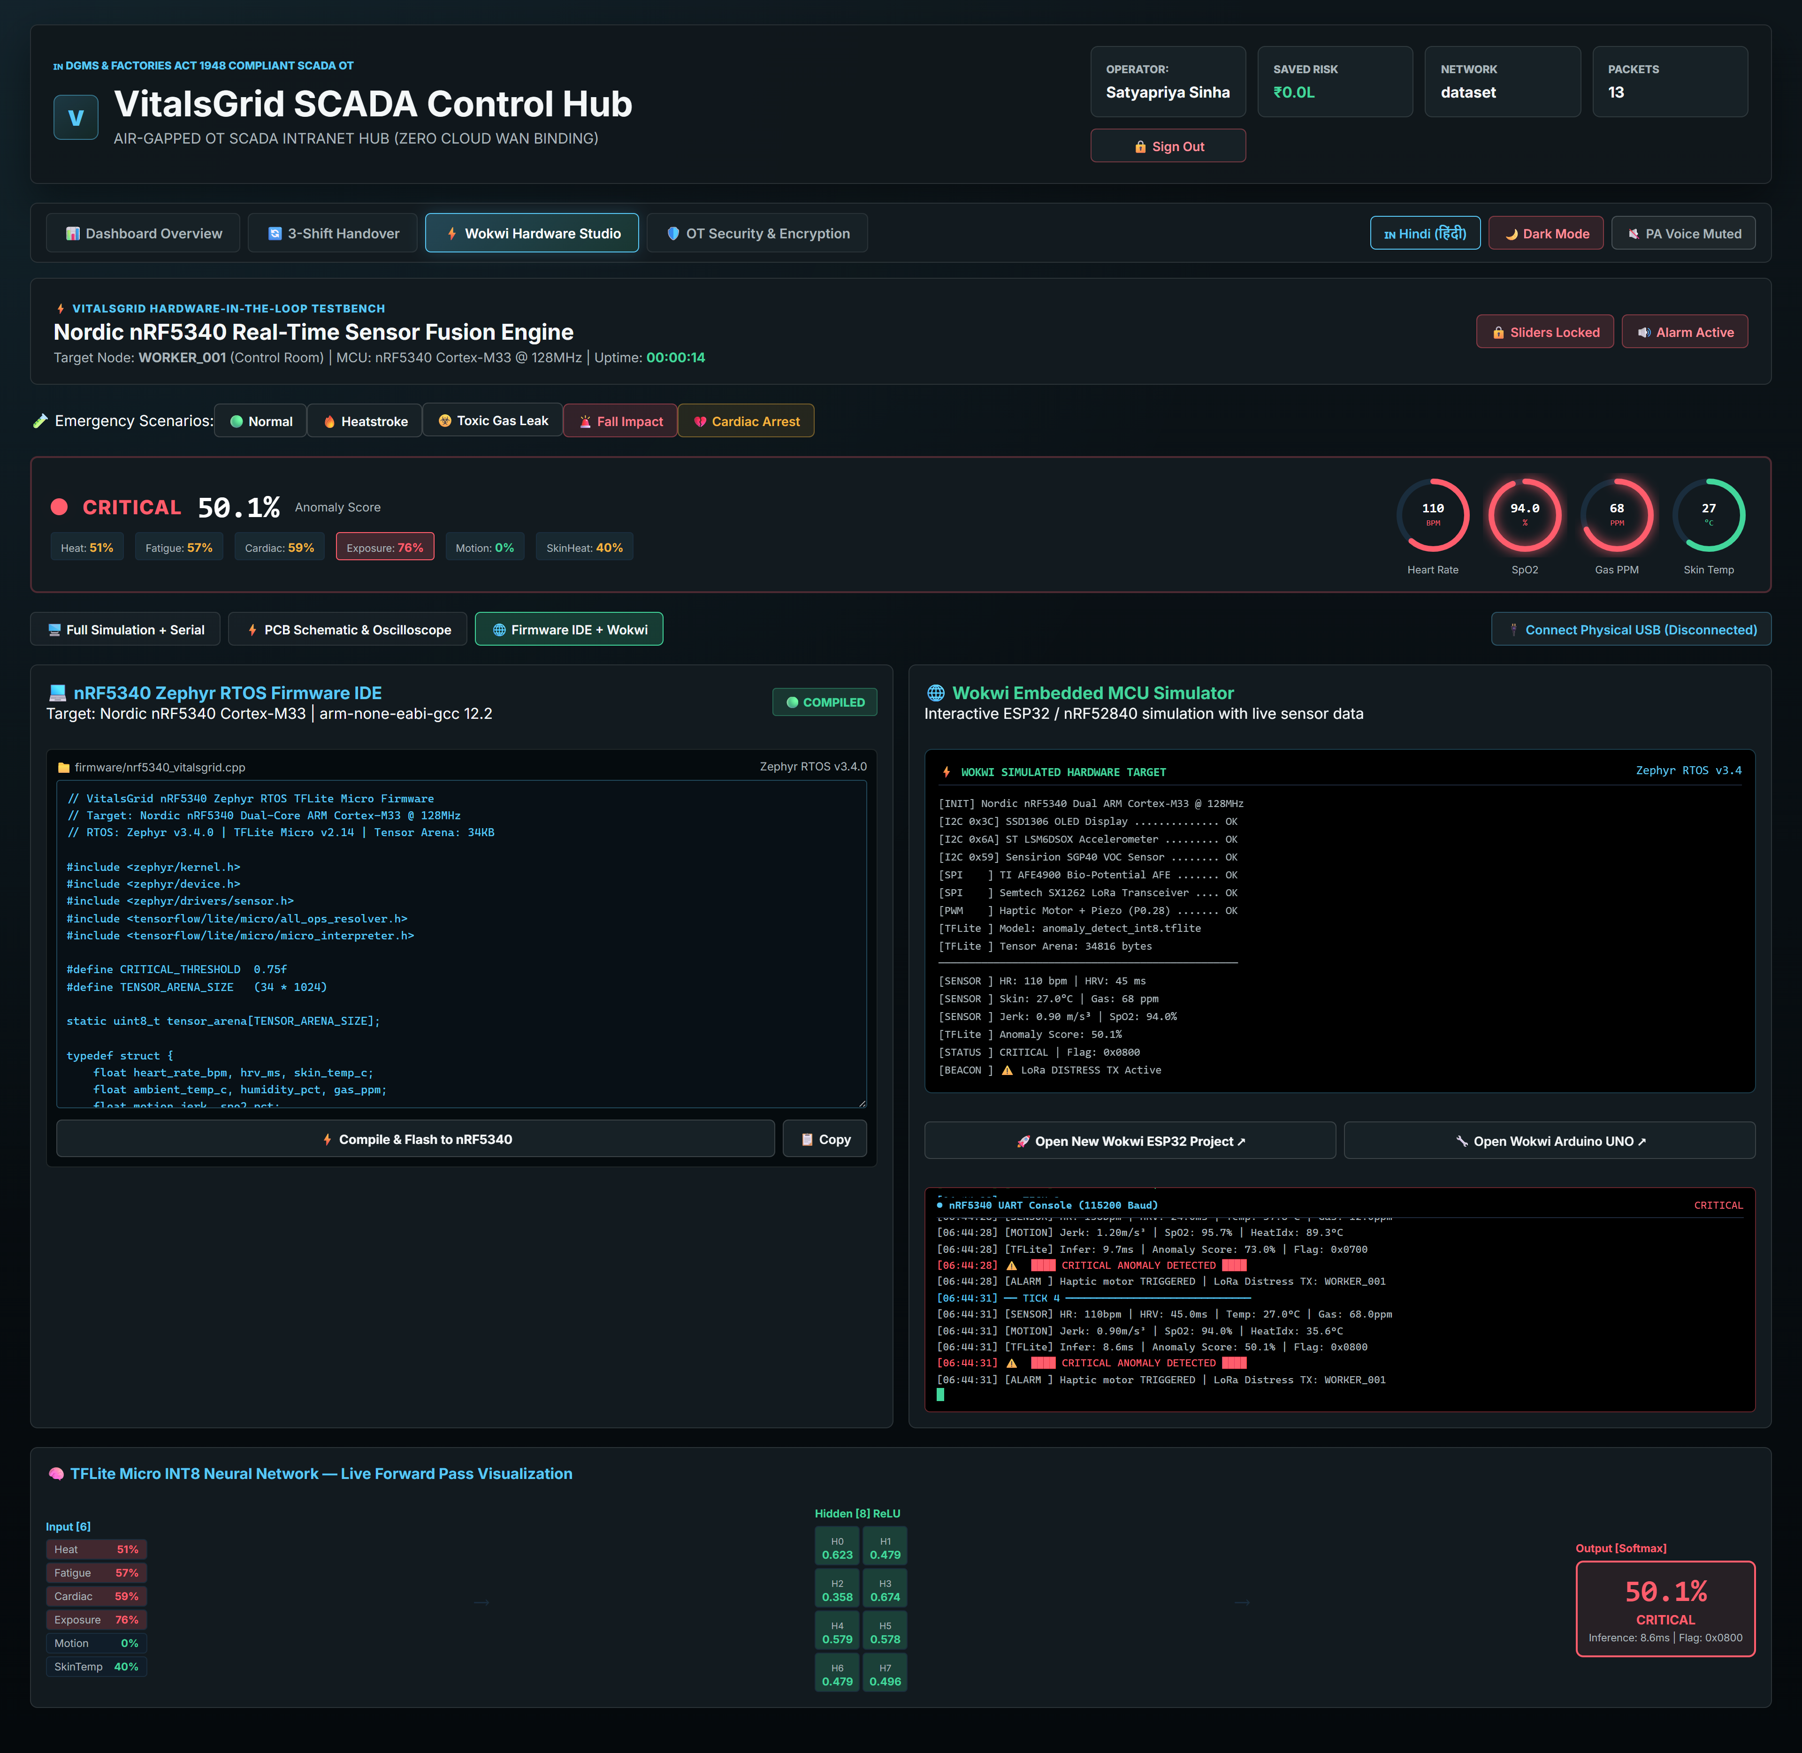
PROTOTYPE EVIDENCE 04: MULTI-HAZARD EMERGENCY SIMULATION TESTS
🚨 DUAL EMERGENCY HAZARD SIMULATION TESTS
• Heatstroke Scenario: Skin temp (42°C) + low HRV triggers CRITICAL status (73% Anomaly Risk) & 880Hz local siren.
• Toxic Gas Leak: VOC gas surge (58 PPM) + SpO2 drop (91%) triggers instant offline LoRa distress broadcast packet.

Slide 29
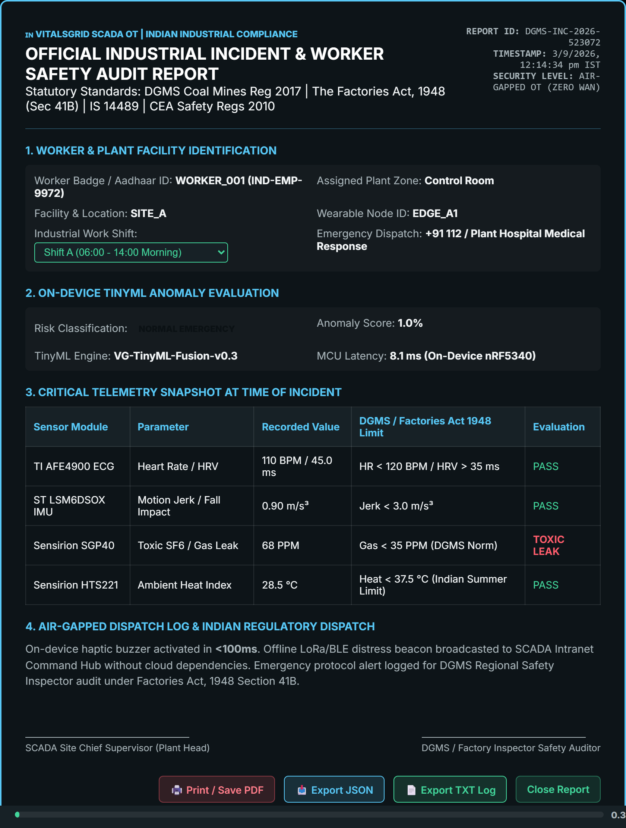
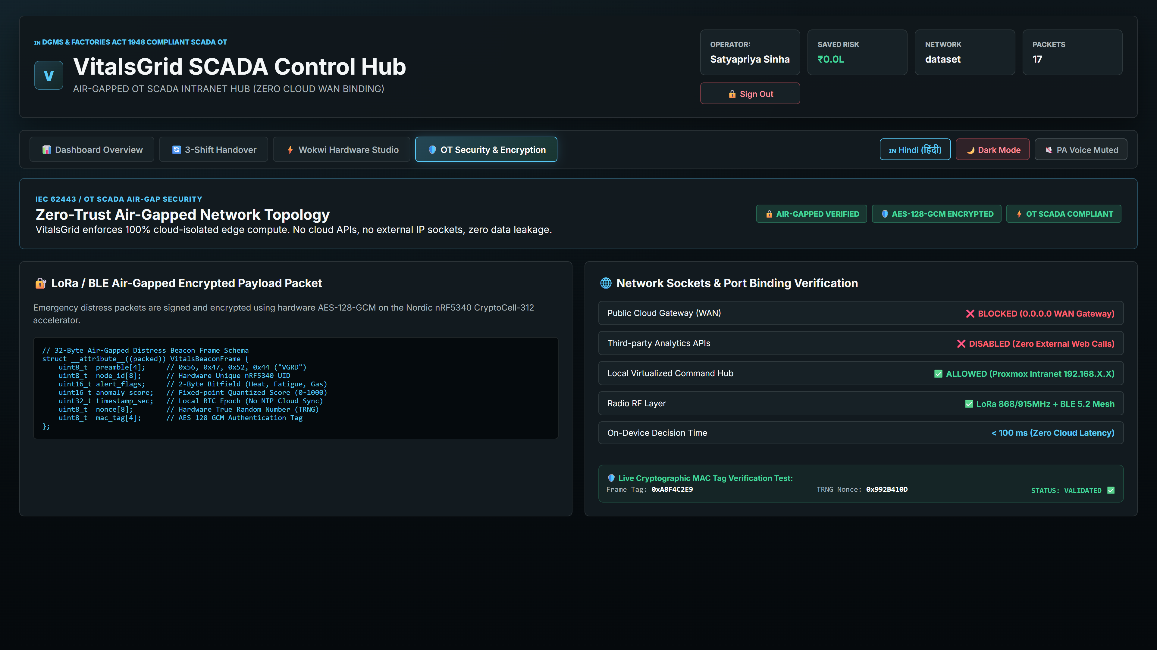
PROTOTYPE EVIDENCE 05: DGMS STATUTORY AUDIT & AIR-GAPPED OT SECURITY
📜 STATUTORY DGMS AUDIT & OT SECURITY
• DGMS Audit Form IV: Mines Act 1952 statutory incident investigation document for official audit logging.
• AES-256 Mesh Encryption: Zero cloud WAN telemetry leakage; local mesh payload encrypted end-to-end.

Slide 30
HACKCULTURE 2026 // TECHNICAL PROPOSAL SUBMISSION
READY FOR THE EDGE.
Air-Gapped Edge AI Wearables for Occupational Health in Critical Infrastructure
🎯 ARCHITECTURE SUMMARY & IMPACT
• Cloud-Independent SCADA Hub: 100% air-gapped intranet operation with zero external REST WAN binding.
• Deterministic Edge AI: Sub-50ms TinyML sensor fusion on Nordic nRF5340 dual-core MCU.
• Statutory Audit Compliance: Mines Act 1952 & Factories Act 1948 compliant DGMS Audit Form IV generation.
• Instant Distress Response: Local 880Hz audio alarm, haptic motor, and offline BLE/LoRa mesh beacon.
👥 ARCHITECTURE TEAM
1. Abhiraj Raushan Lead Architect & Developer
2. Satyapriya Sinha Co-Lead & Systems Engineer
🙏 Thank you for reviewing the VITALSGRID technical proposal.

