Slide 1
Forensic Investigation of Android
Abhishek kumar Sah
M.Sc IT (CS)
19084321014

Slide 2
Index
Title
[1] Problem Statement………………………………………………
[2] Forensics…………………………………………………………
[3] Introduction………………………………………………………
[4] Current Smartphone Platform……………………………………
[5] Data Extraction Methods…………………………………………
[6] Conclusion……………………………………………………..

Slide 3
Problem Statement
Providing forensic investigation procedure for data acquisition and analysis of Android OS based on mobile devices.

Slide 4
Forensics
The Digital forensics is a branch of forensic science, focusing on the recovery and investigation of raw data residing in electronic or digital devices.
Mobile forensics is a branch of digital forensics related to the recovery of digital evidence from mobile devices.

Slide 5
Introduction
Android is developed by Google and released on September 23, 2008.
Based on Linux Kernel and designed mainly for touchscreen mobiles such as smartphones and tablets.

Slide 6
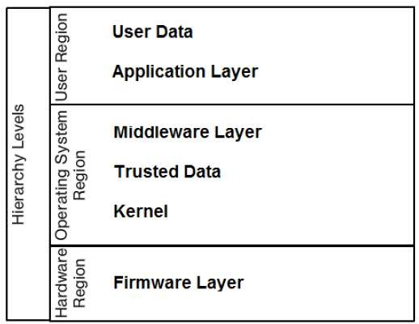
Current Smartphone Platform

Slide 7
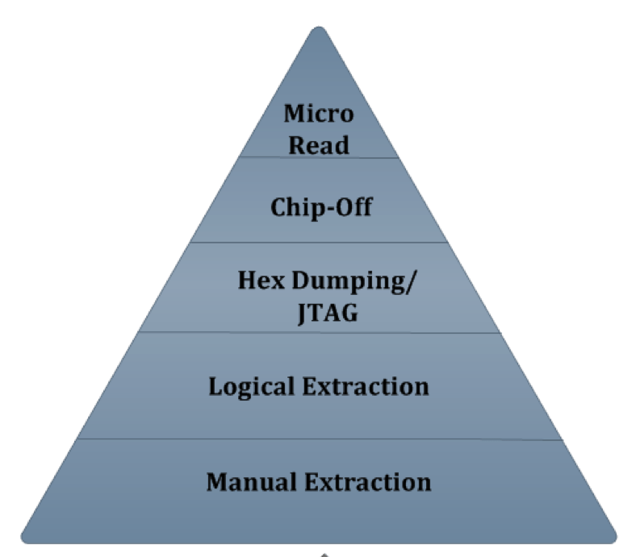
Data Extraction Methods

Slide 8
Manual Extraction
This method involves simply scrolling through the data on the device and viewing the data on the phone directly through the use of the device's keypad or touchscreen. For example, the data may be accidentally deleted or modified during the examination.
Popular tools for manual extractions include:
1.Project-A-Phone
2.Fernico ZRT
3.EDEC Eclipse

Slide 9
Logical Extraction
In this technique, the investigators connect the cellular device to a forensic workstation or hardware via Bluetooth, Infrared, RJ-45 cable, or USB cable.
The computer—using a logical extraction tool—sends a series of commands to the mobile device. As a result, the required data is collected from the phone’s memory and sent back to the forensic workstation for analysis purposes.
The tools used for logical extraction include:
1.XRY Logical
2.Oxygen Forensic Suite
3.Lantern

Slide 10
Hex Dump
A hex dump, also referred to as a physical extraction, is achieved by connecting the device to the forensic workstation and pushing unsigned code or a boot loader into the phone and instructing the phone to dump memory from the phone to the computer.
This process is cost-effective and supplies more information to the investigators, including the recovery of phone’s deleted files and unallocated space.
The common tools used for hex dump include:
1.XACT
2.Cellebrite UFED Physical Analyzer
3.Pandora’s Box

Slide 11
Chip-Off
The chip-off technique allows the examiners to extract data directly from the flash memory of the cellular device .
They remove the phone’s memory chip and create its binary image. This process is costly and requires an ample knowledge of hardware.
Improper handling may cause physical damage to the chip and renders the data impossible to retrieve.
The popular tools and equipment used for chip-off include:
1. iSeasamo Phone Opening Tool
2. Chip Epoxy Glue Remover
3. Circuit Board Holder

Slide 12
Micro Read
The process involves manually viewing and interpreting data seen on the memory chip. The investigators use a high-powered electron microscope to analyze the physical gates on the chips and then convert the gate level into 1’s and 0’s to discover the resulting ASCII code. This process is expensive and time-consuming.
NOTE:- There is no tools available for Micro Read.

Slide 13
Some tools
MOBILedit
Mobilyzer
…many more

Slide 14
MOBILedit
MOBILedit Forensics is advanced phone forensic software, it is Extract and deeply analyze phone content including, deleted data, application’s data, passwords, geolocations, and anything that might reside in the phone. Professional software for authorities as well as for enterprise and end-users. It’s also able to bypass the passcode, PIN, and phone backup encryption.

Slide 15
Mobilyzer
Mobilyzer provides standard measurement tools for users, researchers and developers, and it manages data collection by reporting to cloud-based servers.
Mobilyzer allows researchers to conduct mobile network experiments using a collection of mobile devices running apps.

Slide 16
MOBILedit
With MOBILedit Forensic you can view, search or retrieve all data from a phone with only a few clicks. This data includes call history, phonebook, text messages, multimedia messages, files, calendars, notes, reminders and raw application data.
It will also retrieve all phone information such as IMEI, operating systems, firmware including SIM details.

Slide 17
Conclusion
We are going to acquire the information from an Android phone which is generally encrypted. For this purpose we will take some data extraction tools which are available for Windows operating system.
The project will deal with the data extraction from the phone like investigate from corrupted or deleted data, acquiring IMEI, OS, Contacts, Call Logs, Browser History, etc.

Slide 18


