Slide 1
NETWORK-FORENSIC
New paradigm in Network Analysis
By: Abhishek kumar sah

Slide 2
CONTENTS
Introduction
Network Forensic Examination Steps
Network Forensic Methods
Network Forensic with Network Protocol
Network Forensic Analysis Tools

Slide 3
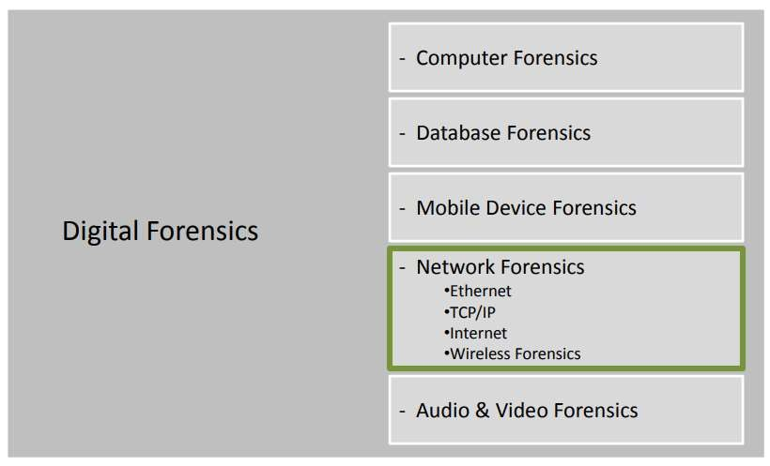
INTRODUCTION
Network forensics is categorized as a single branch of digital forensics;
it includes the areas of monitoring and analyzing computer network traffic and allows individuals to gather information, compile evidence, and/or detect intrusions.

Slide 4
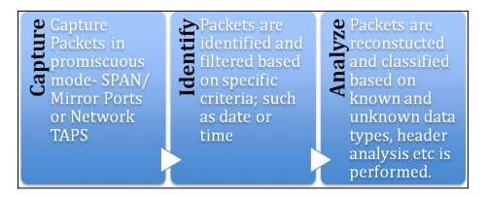
CIA Process for Network Forensic

Slide 5
Network Forensic Examination Steps
Identification: recognizing and determining an incident based on network indicators. This step is significant since it has an impact in the following steps.
Preservation: securing and isolating the state of physical and logical evidences from being altered, such as, for example, protection from electromagnetic damage or interference.
Collection: Recording the physical scene and duplicating digital evidence using standardized methods and procedures.
Examination: in-depth systematic search of evidence relating to the network attack. This focuses on identifying and discovering potential evidence and building detailed documentation for analysis.
Analysis: determine significance, reconstruct packets of network traffic data and draw conclusions based on evidence found.
Presentation: summarize and provide explanation of drawn conclusions.
Incident Response: The response to attack or intrusion detected is initiated based on the information gathered to validate and assess the incident.

Slide 6
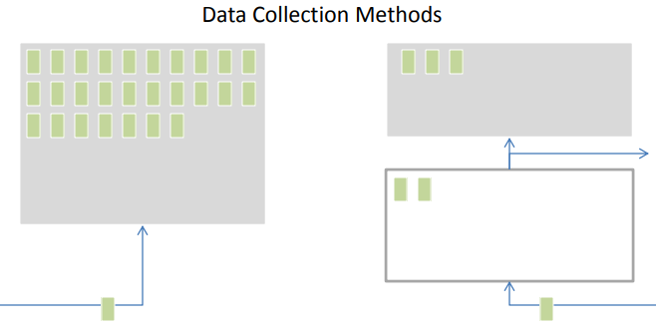
Network Forensic Methods
Catch-it –as-you-can
Stop, look and listen

Slide 7
Network Forensic with Network Protocol
Network Forensic methods can be applied within the different network protocols or layers.
ETHERNET
TCP/IP
INTERNET
WIRELESS

Slide 8
ETHERNET
 Methods are achieved with eavesdropping bit streams (on the Ethernet
layer).
 Uses monitoring tools or sniffers
(Wireshark ,Tcpdump)
Protocols can be consulted for filter traffic and reconstruct attachment transmitted, such as the Address Resolution Protocol (ARP)
Network Interface Card (NIC), but can be averted with encryption
Disadvantage is large storage Capacity.

Slide 9
TCP/IP
Methods are achieved with router information investigations (on the
Network layer).
Each router includes routing tables to pass along packets.
These are some of the best information sources for data tracking .
Follow compromised packets, reverse route, ID the source
Network layer also provides authentication log evidence

Slide 10
INTERNET
Methods are achieved by identifying server logs (on the Internet).
Includes web-browsing, email, chat, and other types of traffic &
communication
Server logs collect information
Email accounts have useful information except when email headers are faked

Slide 11
Wireless Forensic
Methods are achieved by collecting & analyzing wireless traffic (Wireless Networks). Mobile Phones
A sub-discipline of the field
To get that which is considered “valid digital evidence”
This can be normal data OR voice communications via VoIP
Analysis is similar to wired network situations, with different security issues

Slide 12
Network Forensic Analysis Tools
Functions of a Network Forensic Analysis Tool:
Evaluation of network performance
Network traffic capturing and analysis
Detection of anomalies and misuse of resources
Determination of network protocols in use
Aggregating data from multiple sources
Security investigations and incident response
Protection of intellectual property

Slide 13
Network Forensic Tools
dumpcap, pcapdump and netsniff-ng –Packet Sniffer
tcpdump, wireshark/tshark and tstat - Protocol Analyzers

Slide 14
Advantages of Network forensic
Network Performance Benchmarking
Network Troubleshooting
Transactional Analysis
Security Attack Analysis

Slide 15
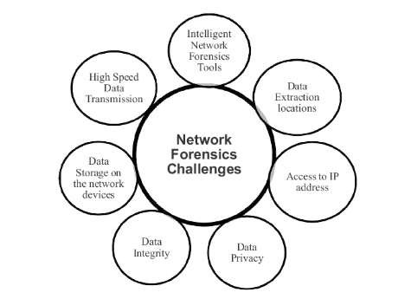
Network Forensic Challenges

Slide 16
Conclusion
The development of intelligent network forensic tools to focus on specific type of network traffic analysis is a challenge in terms of future perspective.
This will reduce time delays, less computational resources requirement; minimize attacks, providing reliable and secured evidences, and efficient investigation with minimum efforts

Slide 17


