Slide 1
PYTHON

Slide 2
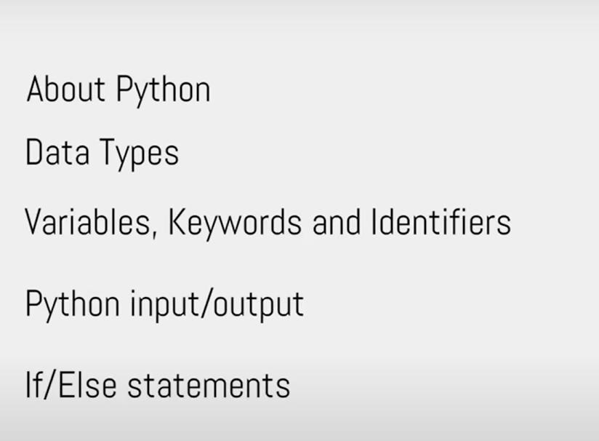
TODAY, TOPIC

Slide 3
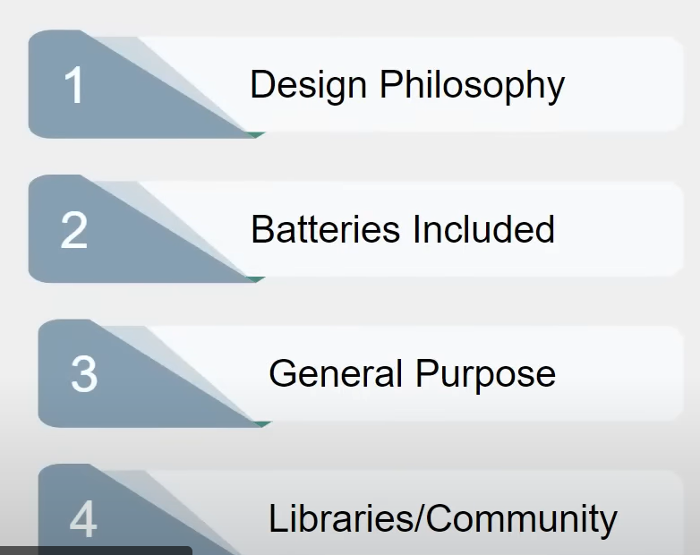
Why Python

Slide 4
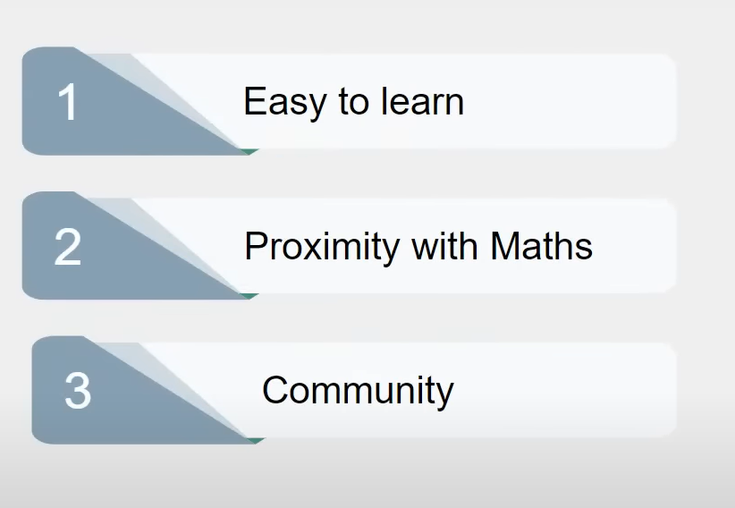
Why Python for Data Science

