Slide 1
PYTHON

Slide 2
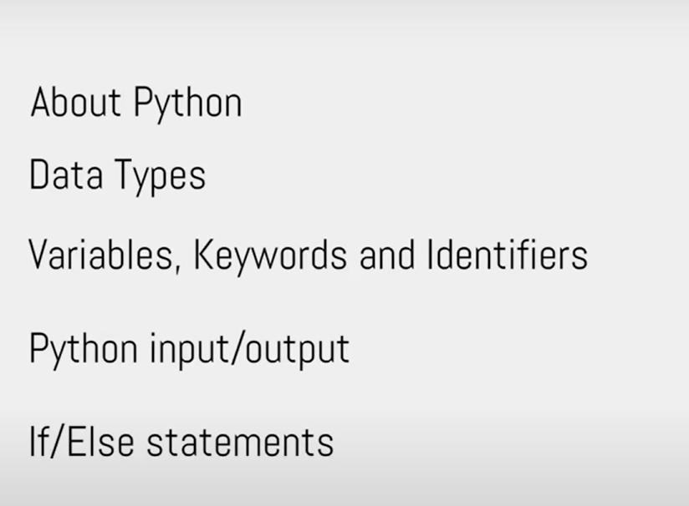
TODAY, TOPIC

Slide 3
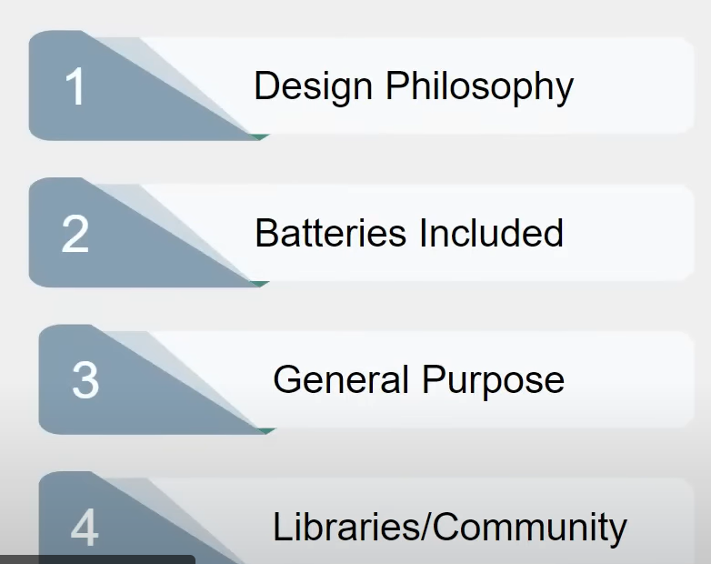
Why Python

Slide 4
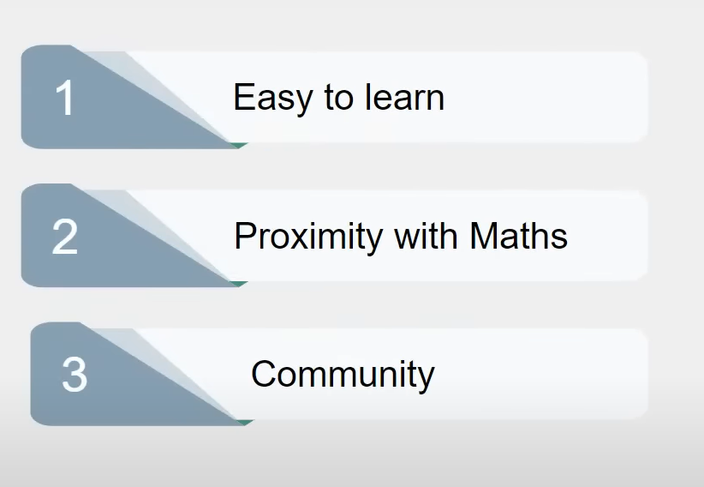
Why Python for Data Science

Slide 5
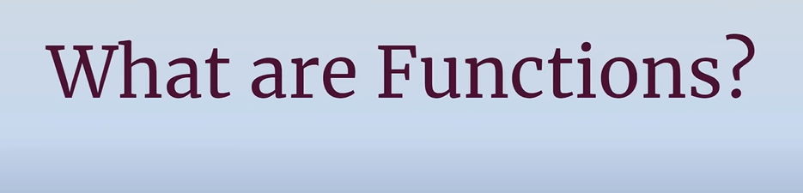

Slide 6

ABSTRACTION

Slide 7


DECOMPISITION

Slide 8





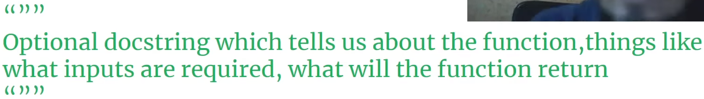


COMPONENTS OF A FUNCTIONS
is_even(7)

Slide 9

