Slide 1

A MAJOR PROJECT SEMINAR ON
FITNESS HARMONY SIMULATOR BASED ON PYTHON
BACHELOR OF TECHNOLOGY
IN
ELECTRONICS AND COMPUTER ENGINEERING (ECM)
Under the esteemed guidance of
DR. D. PAVAN DAS
PRESENTED BY
P.Abhiram- 17671A1932
D.Meghna- 17671a1915
S.Raju- 17671a1935

Slide 2
AIM OF THE PROJECT
To develop a software on fitness harmony simulator based on python.
By using this software we can avoid hiring personal trainer.
Track your training.

Slide 3
Cons of using personal trainer
One of the biggest disadvantage of having a personal trainer is cost.
Not all trainers are good, there are some great trainers and there are some bad ones.
In this pandemic situation hiring a personal trainer is a risky job.

Slide 4
procedure
We will use the pose estimation running on the CPU to find the correct points and using these points we will get the desired angles.
Then based on these angles we find many gestures including the number of biceps
curls.
We will write the code in a way that you will be able to find angles between any 3 points with just a single line of code.
The computer will monitor a person’s workout to make sure all of their postures and angles are correct.
Instead of being stuffed with hundreds of workouts, this trainer offers smart workouts to achieve fitness goals.

Slide 5
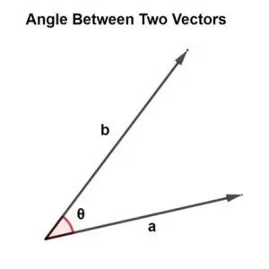
Angle between two points
angle = math.degrees(math.atan2(y3 - y2, x3 - x2) - math.atan2(y1 - y2, x1 - x2))

Slide 6
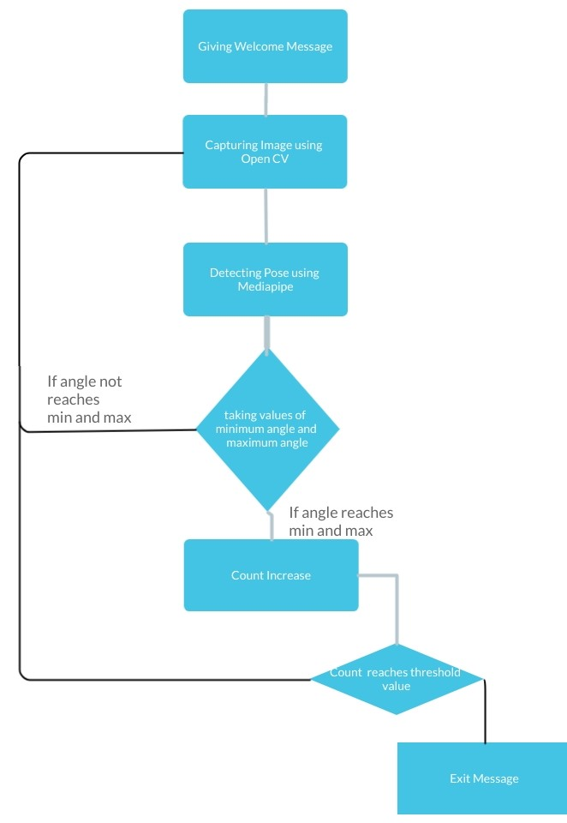
FLOW CHART

Slide 7
Libraries
Open cv
Mediapipe
Math
Pyttsx3
Numpy
Beeply

Slide 8
Libraries
Cv2:
OpenCV python is an open-source library for machine learning, image processing, and computer vision. It plays a vital role in real-time systems, which is the key in today’s world.
Mediapipe:
By using mediapipe library we can detect Face, Pose, Hands
Math:
This is the most basic math module that is available in Python. It covers basic mathematical operations like sum, exponential, modulus, etc.
Numpy :
The numpy library in Python is most widely used for carrying out mathematical operations that involve matrices.
Pyttsx3:
pyttsx3is a text-to-speech conversion library in python.
Beeply:
The beeply module in python will helps you produce musical notes using your computer’s characteristic beep sounds.

Slide 9
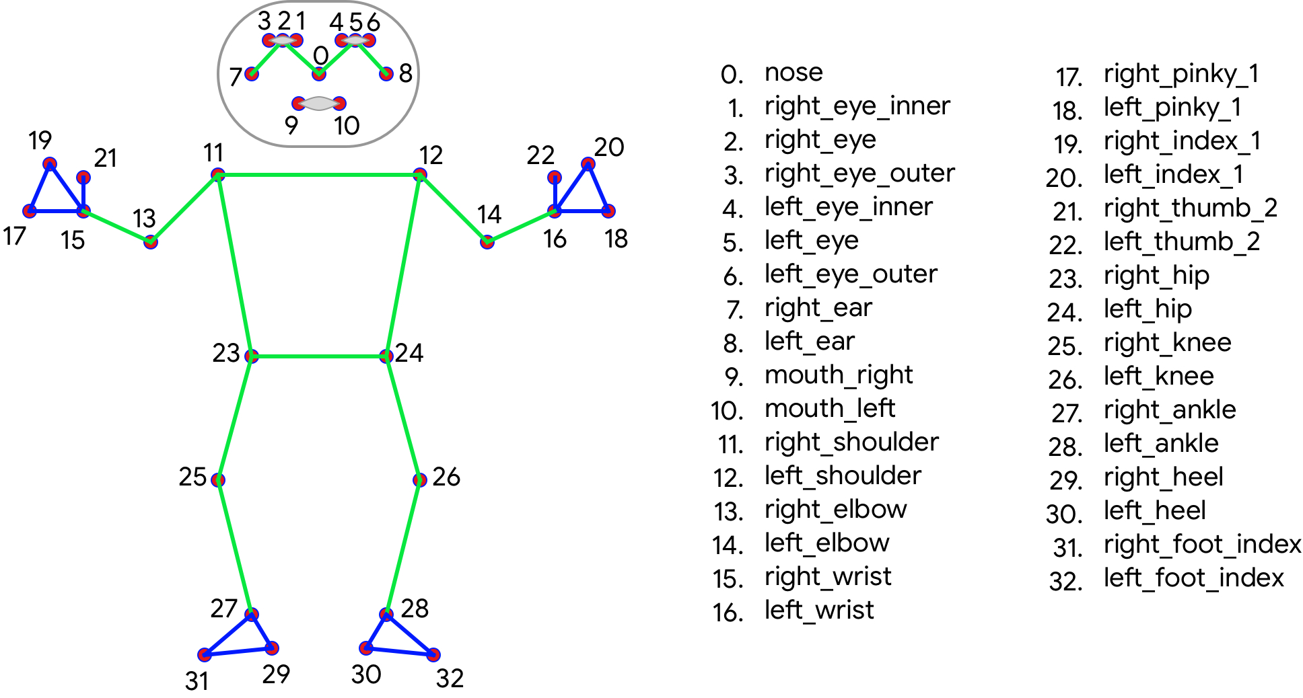
Mediapipe

Slide 10
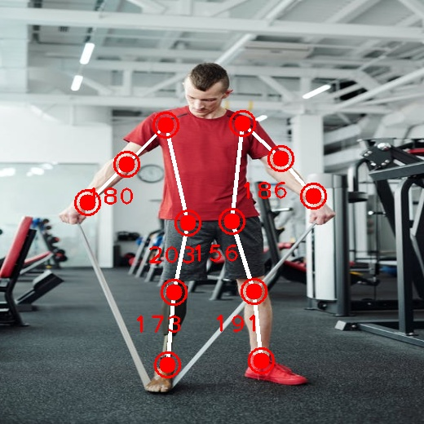
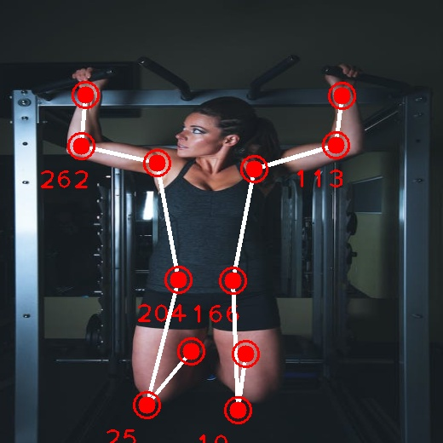
implementation

Slide 11
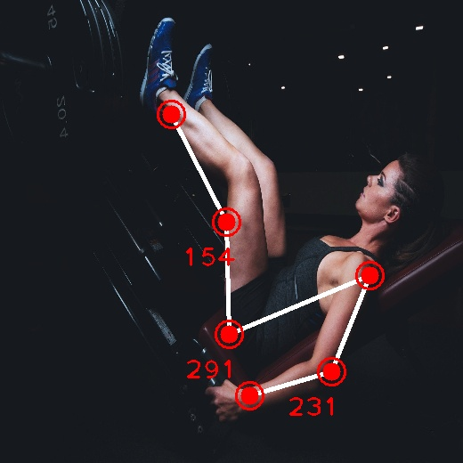
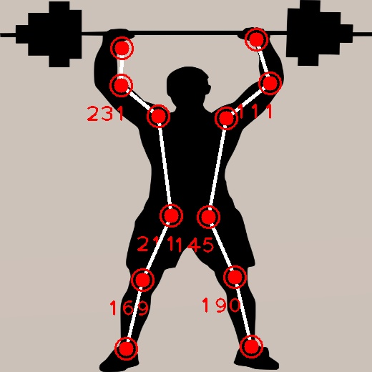

Slide 12
USED SOFTWARE
Pycharm IDE:
PyCharm’s huge collection of tools out of the box includes an integrated debugger and test runner; Python profiler; a built-in terminal; integration with major VCS and built-in database tools.

Slide 13
ADVANTAGES
Free of cost
Improvement In Coaching As Well As Performance.
Improvement In Revenue & Customer Satisfaction.

Slide 14
disadvantages
No group motivation
No in-person professional guidance

Slide 15
FUTURE SCOPE
We can store all the data of training and recommend the good workouts.
Recommending the nutrition food according to the level of workout they are doing.
Creating an application for Android and IOS.

Slide 16
Conclusion
By using this fitness harmony simulator we can do workouts at home without hiring a personal trainer and it is cost efficient.

Slide 17
Thank you

