Slide 1
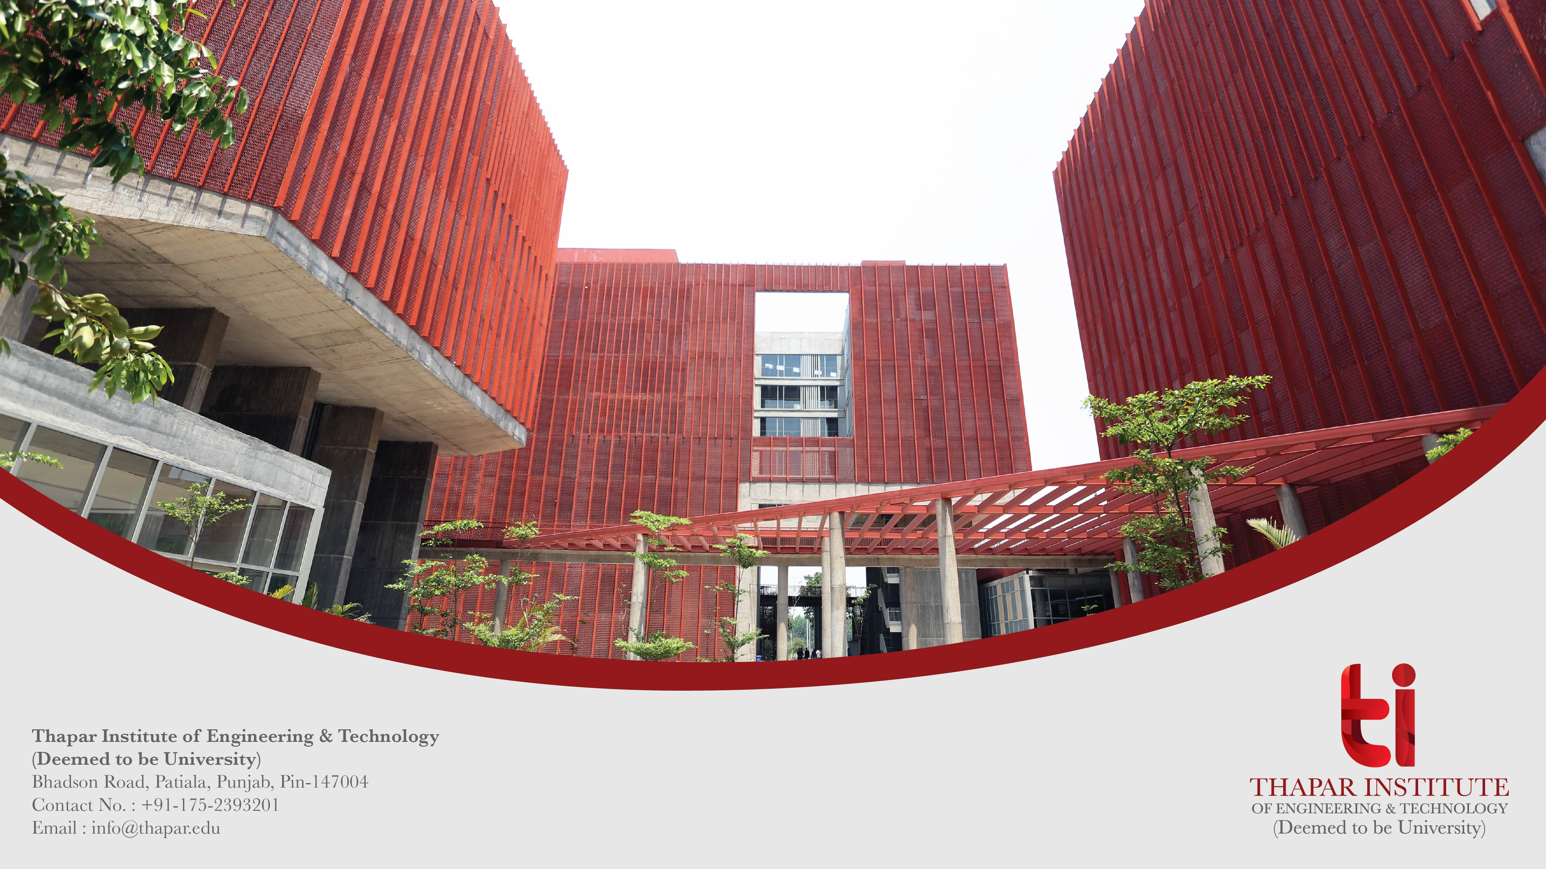
Cartoonifying an Image
Name: LOKESHWAR REDDY
Roll No: 102203156
Name: EPURU ABHIRAM
Roll No: 102203173
www.thapar.edu

Slide 2

List of Contents
Introduction (1 slide)
Key Features (1 slide)
Demonstration (1 slide)
​Conclusion (1 slide)

Slide 3
Introduction
Welcome to the Cartoonifying an Image project presentation.
This project offers an innovative and engaging way to take realistic images and transform into captivating cartoon-like representations.
We aimed to create a cartoonified Image using Python, OpenCV.
Let's explore the key features of this application.

Slide 4
Key Features
Grayscale Conversion
Converting the image to grayscale removes color information, focusing on the intensity values of each pixel.
Edge Detection
Identifying and enhancing the edges in the grayscale image creates the distinct outlines characteristic of cartoons.
Image Blending
Combining the grayscale image with the edge-detected image results in a cartoon-like representation with prominent edges and simplified details.
Color Adjustment
Optionally, adjusting the colors of the cartoonifed image can further enhance the cartoonish style.
Final Display
Enabling users to transform realistic images into captivating cartoon-like representations

Slide 5
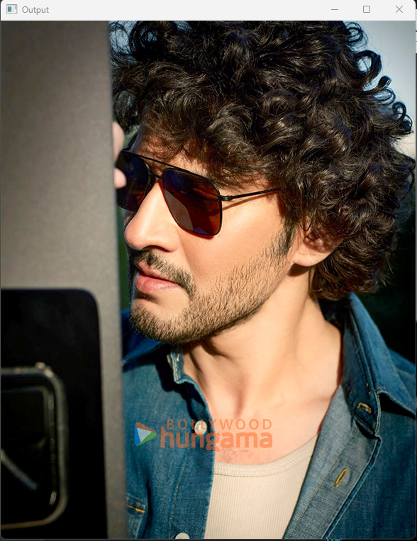
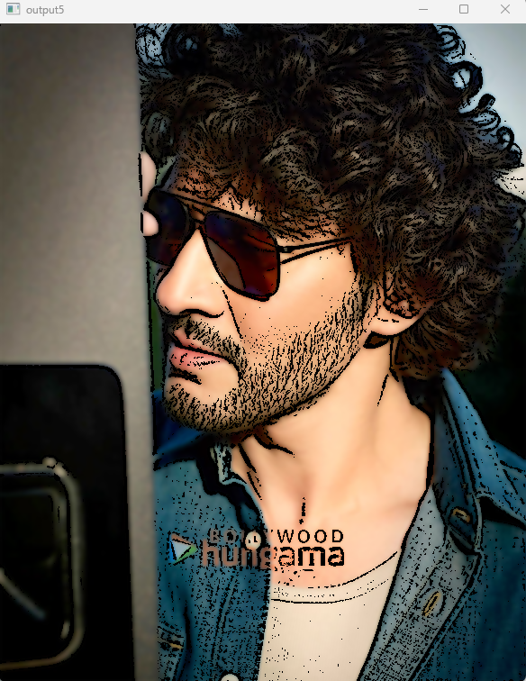
Demonstration
Now, let's see the application in action.
The following screenshots showcase the application's core functionalities.
Users can upload image and get their cartoonified Image.
The final image is presented at the end.

Slide 6
Conclusion
In conclusion, this project provides a practical tool for transforming realistic images into captivating cartoon-like representations.
It leverages computer vision technology to enhance the user experience.
We extend our gratitude to the libraries and modules that made this project possible, particularly OpenCV .
The possibilities for future applications and customizations are vast.
We welcome any questions or feedback from the audience.

Slide 7
Thank you

