Slide 1
UMLS
usecase

Slide 2
class

Slide 3
sequence

Slide 4
collaboration

Slide 5
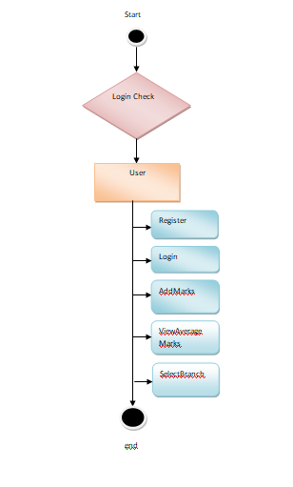
activity

