Slide 1

MindCloud AI
Cloud-Based AI Mental Health Support Platform
Presented By: G. Sai Abhiram | CSE | Pragati Engineering College

Slide 2


Introduction
Mental health issues — stress, anxiety, and depression — are rising in modern society. Many people do not seek help due to stigma, cost, or lack of availability.
MindCloud AI is a cloud-based platform offering instant mental wellness support through an AI chatbot, mood tracking, and self-care guidance.

Slide 3



Problem Statement
Current Challenges
Limited access to mental health professionals
Expensive therapy sessions
Lack of 24/7 support
Fear of social judgment
No regular emotional tracking system
The Need: An affordable, secure, and always-available support platform.

Slide 4
Proposed Solution
AI Chatbot
Mood Tracking
Wellness Guide
AI-powered emotional support chatbot available anytime
Mood and stress tracking system to monitor emotional trends
Meditation and relaxation suggestions for self-care
Emergency Alerts
Secure Cloud Storage
Emergency help alerts when users need urgent support
Secure cloud-based storage accessible anytime, anywhere

Slide 5
Objectives
01
02
24/7 Mental Health Assistance
Promote Emotional Well-Being
Provide round-the-clock support for users
Help users maintain and improve their mental wellness
03
04
Mood Trend Monitoring
Cloud Scalability
Help users track and understand their emotional patterns over time
Use cloud computing to scale the platform reliably
05
06
Privacy & Security
Affordable & Accessible
Ensure all user data remains private and secure
Make mental health support available to everyone

Slide 6
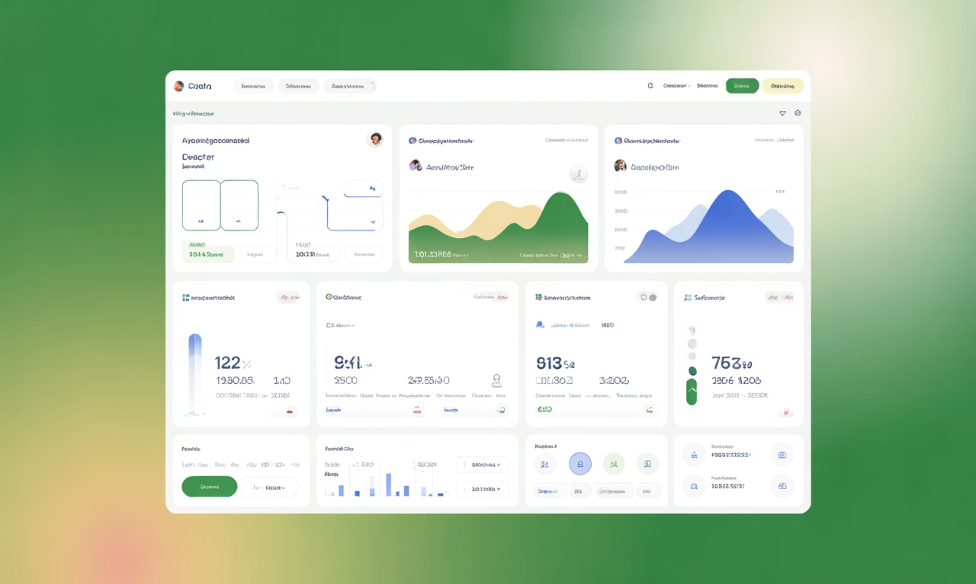
System Modules
User Modules
Registration / Login
AI Chat Assistant
Mood Tracker
Wellness Dashboard
Personal Journal
Admin Modules
User Analytics
Resource Management
Chatbot Monitoring

Slide 7
Technology Stack
Frontend
Backend
React.js / HTML / CSS
Python Flask / Node.js
Database
Authentication
Firebase Firestore
Firebase Auth
Cloud Hosting
AI Integration
Vercel / Render
OpenAI API / Hugging Face API

Slide 8
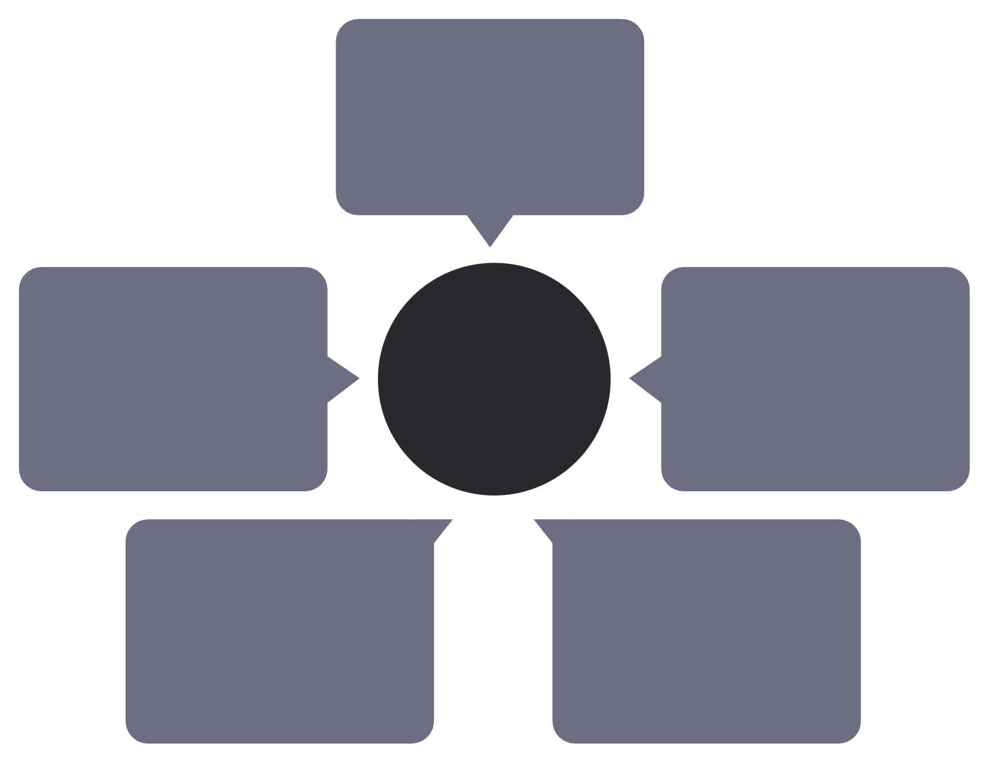
Cloud Architecture
Working Flow
User Device
Client entry point
AI Chat Service
Cloud Architecture Flow
Frontend Website
Conversational intelligence
UI and interactions
Cloud Database
Backend Server
Persistent scalable storage
Business logic layer
The platform flows from user device through frontend and backend to cloud database and AI chat service, ensuring scalable, fast, secure, and reliable delivery.
Key Benefits
Scalable
Fast
Secure
Reliable

Slide 9

Advantages & Future Scope
Advantages
Instant support anytime
Low-cost solution
Private and secure
Easy to use
Cloud backup
Future Scope
Voice chatbot
Multi-language support
Video counseling
Wearable integration

Slide 10

Conclusion
MindCloud AI combines AI + Cloud Computing to deliver a smart, secure, and accessible mental health support platform. It solves real-world problems using modern technology and has strong future potential.
🙏 Thank You
❓ Questions?

