Slide 1

Student Learning Management Portal

Slide 2

TEAM MEMBERS (Cluster-3)
Abhiram(Team Lead)-2200031304
Sai Mahendra – 2200030548
Venkat rao-2200030768
MENTOR :

Slide 3
PROBLEM STATEMENT
Developing a user-friendly student learning management system to streamline course registration, enrollment, and scheduling processes for efficient management and reporting.

Slide 4

ABSTRACT
The student learning management system revolutionizes academic navigation, offering a user-friendly interface and seamless integration with existing learning systems. It simplifies course management, providing personalized recommendations, interactive collaboration tools, and immersive learning experiences. By enhancing student engagement, efficiency, and academic performance, it transforms education into an empowering adventure where students take control of their learning journey.

Slide 5

INTRODUCTION
Simplify course and academic record management for students and faculty members. Provide a user-friendly system to streamline the process and make it more efficient. Ensure a seamless experience for all stakeholders involved in the academic process Offer a comprehensive solution for course management, registration, and scheduling. Enhance efficiency and reduce the complexity of managing courses and academic records.

Slide 6
KEY FINDINGS
Efficient Management and Streamlining
Enhanced Learning Experience
Simplified Administrative Tasks
Centralized Communication Platform
Valuable Academic Insights

Slide 7
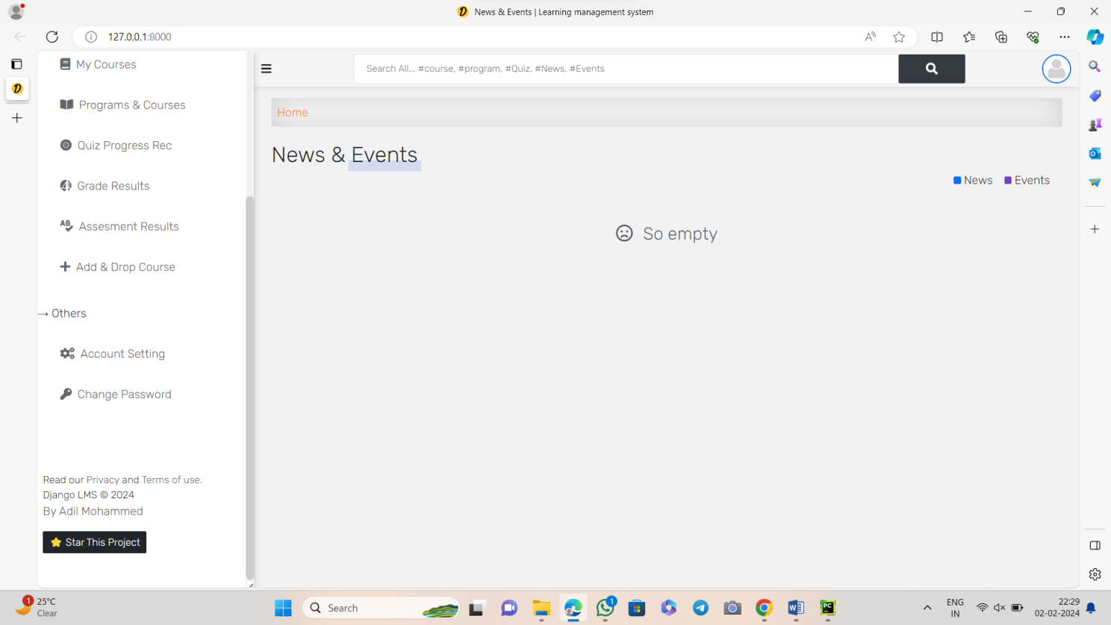
USER INTERFACE

Slide 8
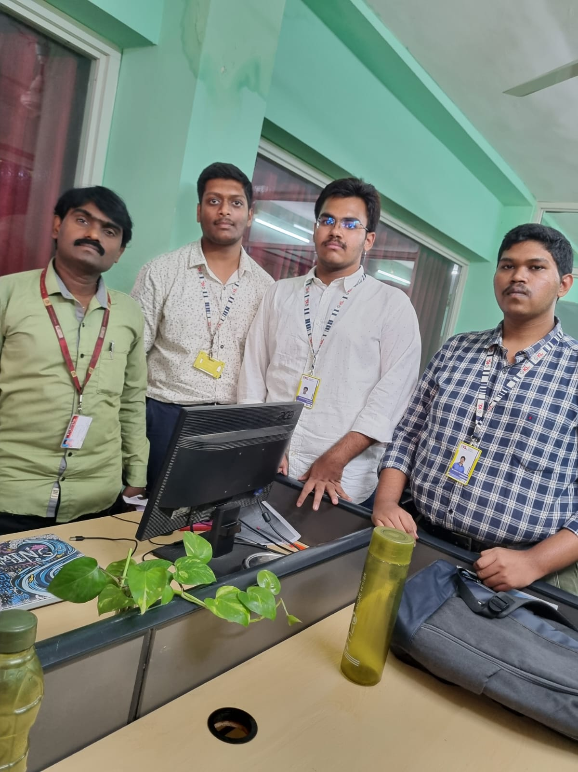
Interaction with faculty

Slide 9
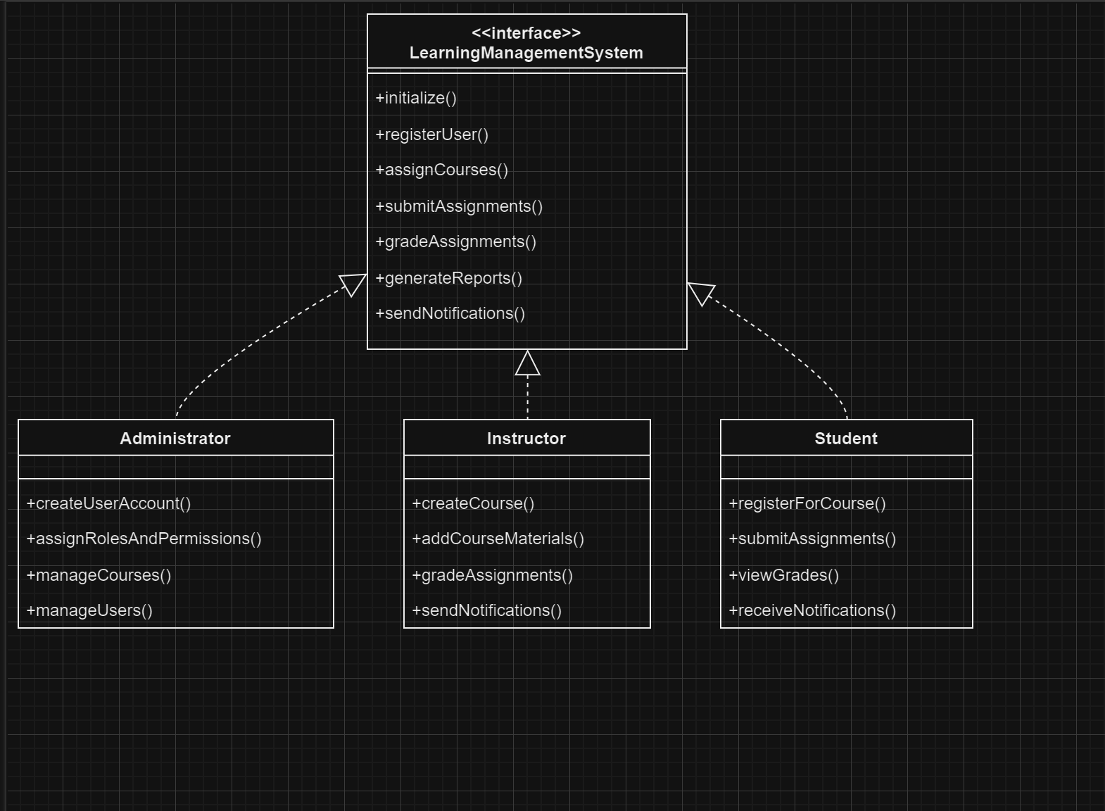
Use-Case Diagrams

Slide 10
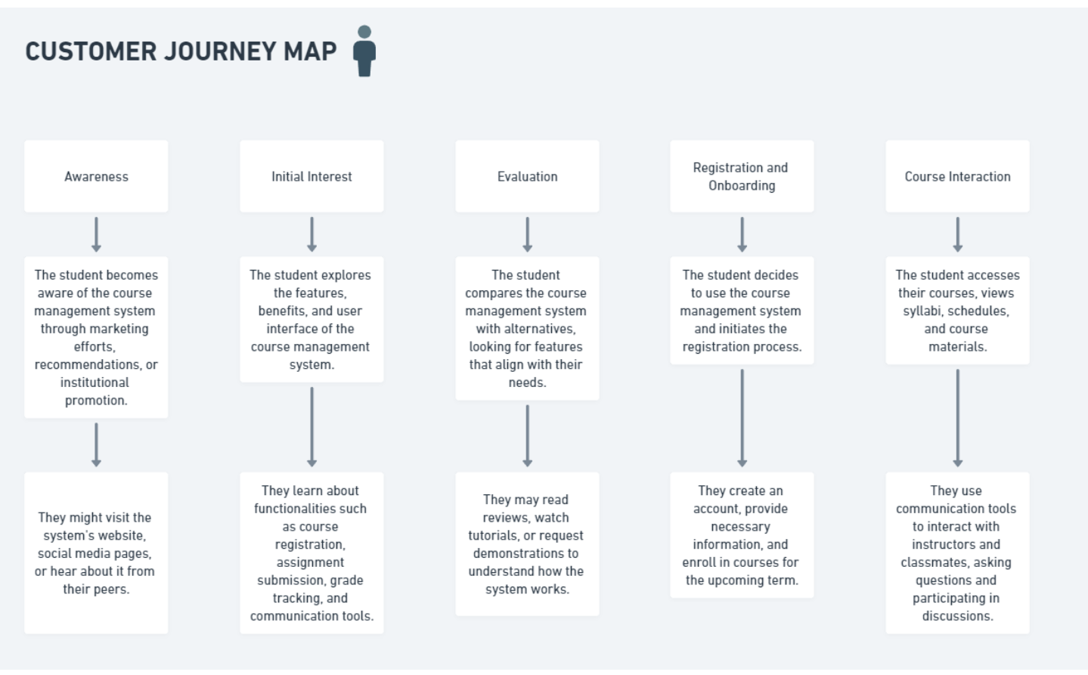
Customer Journey Map

Slide 11
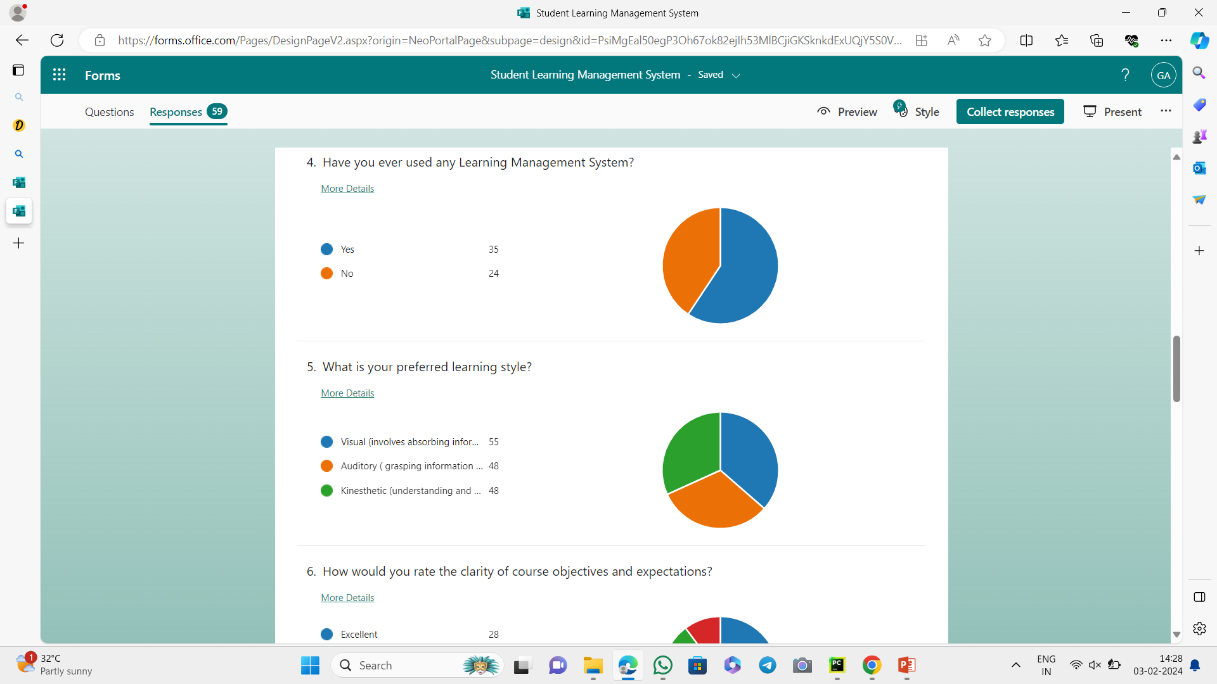
USER INSIGHTS

Slide 12
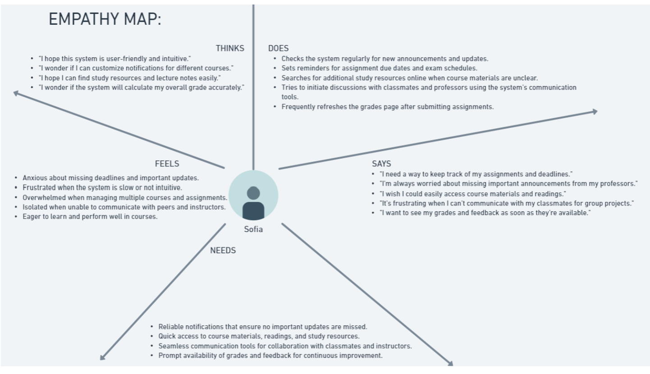
Empathy Map

Slide 13
MODULES
Admin : The admin module in a student course management system project is designed to provide administrative functionalities to manage the system. It allows the admin to add, update, and delete courses and student information. Additionally, the module enables the admin to generate reports and track the progress of students, making it an essential component for efficient management of the system.
Faculty : The faculty module in a student course management system project is designed to cater to the needs of the teaching staff. It provides functionalities for faculty members to manage their courses, upload course materials, and track student progress. Additionally, the module allows faculty members to communicate with students, assign and grade assignments, and generate reports on student performance, making it a crucial tool for effective teaching and monitoring of courses.
Student : The student module in a student course management system project is designed to empower students with tools for managing their academic journey. It allows students to view and register for courses, access course materials, submit assignments, and track their progress. Additionally, the module enables students to communicate with faculty members, view grades, and receive important announcements, making it a valuable resource for students' academic success and engagement.

Slide 14
Conclusion
In conclusion, the student course management system project provides a comprehensive and efficient solution for educational institutions to manage student and course information. It streamlines administrative tasks, enhances communication between students and faculty, and improves overall efficiency. With its user-friendly interface, secure authentication, and scalability, the system offers a reliable and effective platform for managing courses and supporting student success.

Slide 15


