Slide 1
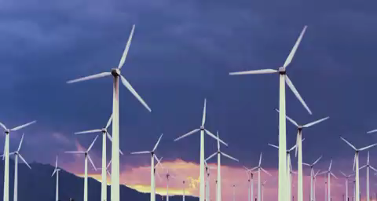
Wind energy
-narAsImha
211FA04601

Slide 2
What is wind energy ?
The terms "wind energy" and "wind power" both describe the process by which the wind is used to generate mechanical power or electricity. This mechanical power can be used for specific tasks (such as grinding grain or pumping water) or a generator can convert this mechanical power into electricity.

Slide 3
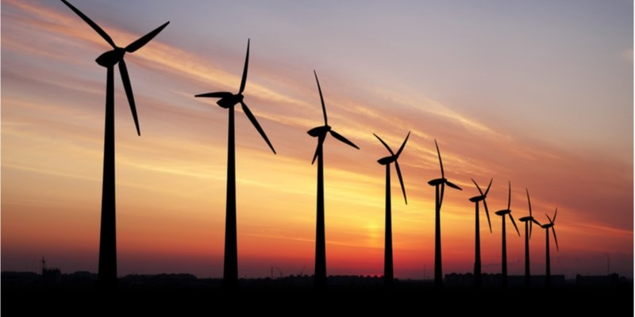
Wind energy

Slide 4
How to produce wind energy ?
Wind energy, or wind power, is created using a wind turbine, a device that channels the power of the wind to generate electricity. The wind blows the blades of the turbine, which are attached to a rotor. The rotor then spins a generator to create electricity.

Slide 5
Wind energy
Advantages
Disadvantages
Wind power creates good-paying jobs.
Wind power is a clean and renewable energy source. ...
Wind power benefits local communities. ...
Wind power occupies little land….
Unpredictable.
Threat to wildlife. Wind energy does not cause environmental problems ...
Noise. ...
Expensive to store…

Slide 6
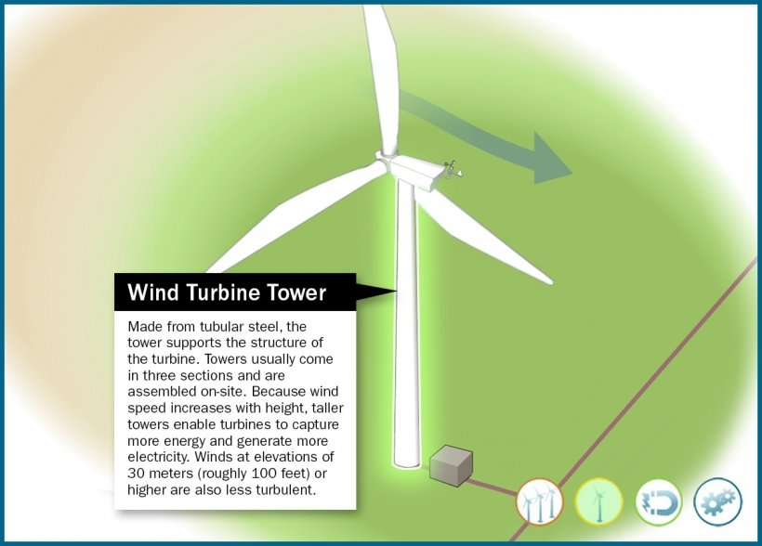
Power of wind turbine

Slide 7
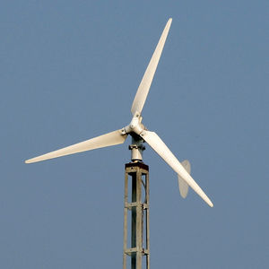
Types of wind turbines
Horizontal axis wind turbines
Horizontal axis wind turbines are the most commonly used turbines due to their strength and efficiency. The base of the towers have to be extremely strong.

Slide 8
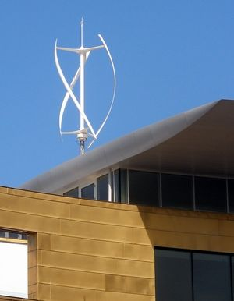
Vertical axis wind turbines
Vertical axis wind turbines are less affected by frequent wind direction changes as compared to the horizontal axis wind turbines due to the blades being rotated on the rotor shaft perpendicular to the ground.

Slide 9
Why Do We Need Wind Energy?
Our energy needs are changing, and so is the way we are meeting them. The UK has a legally binding commitment to continue dramatically reducing its greenhouse gas emissions over the coming decades; and energy production is the biggest current source of these emissions.

Slide 10


