Slide 1
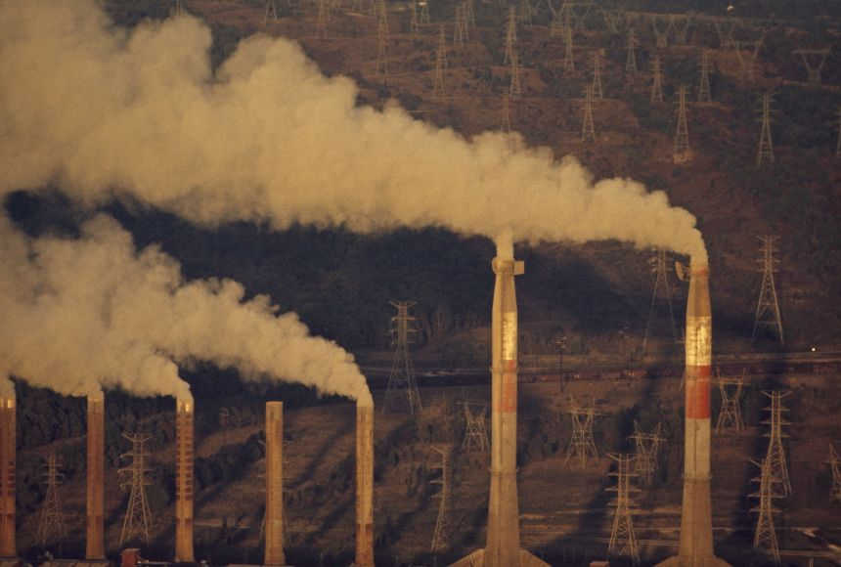
GLOBAL WARMING
Abhiram Nagam 211FA04562

Slide 2
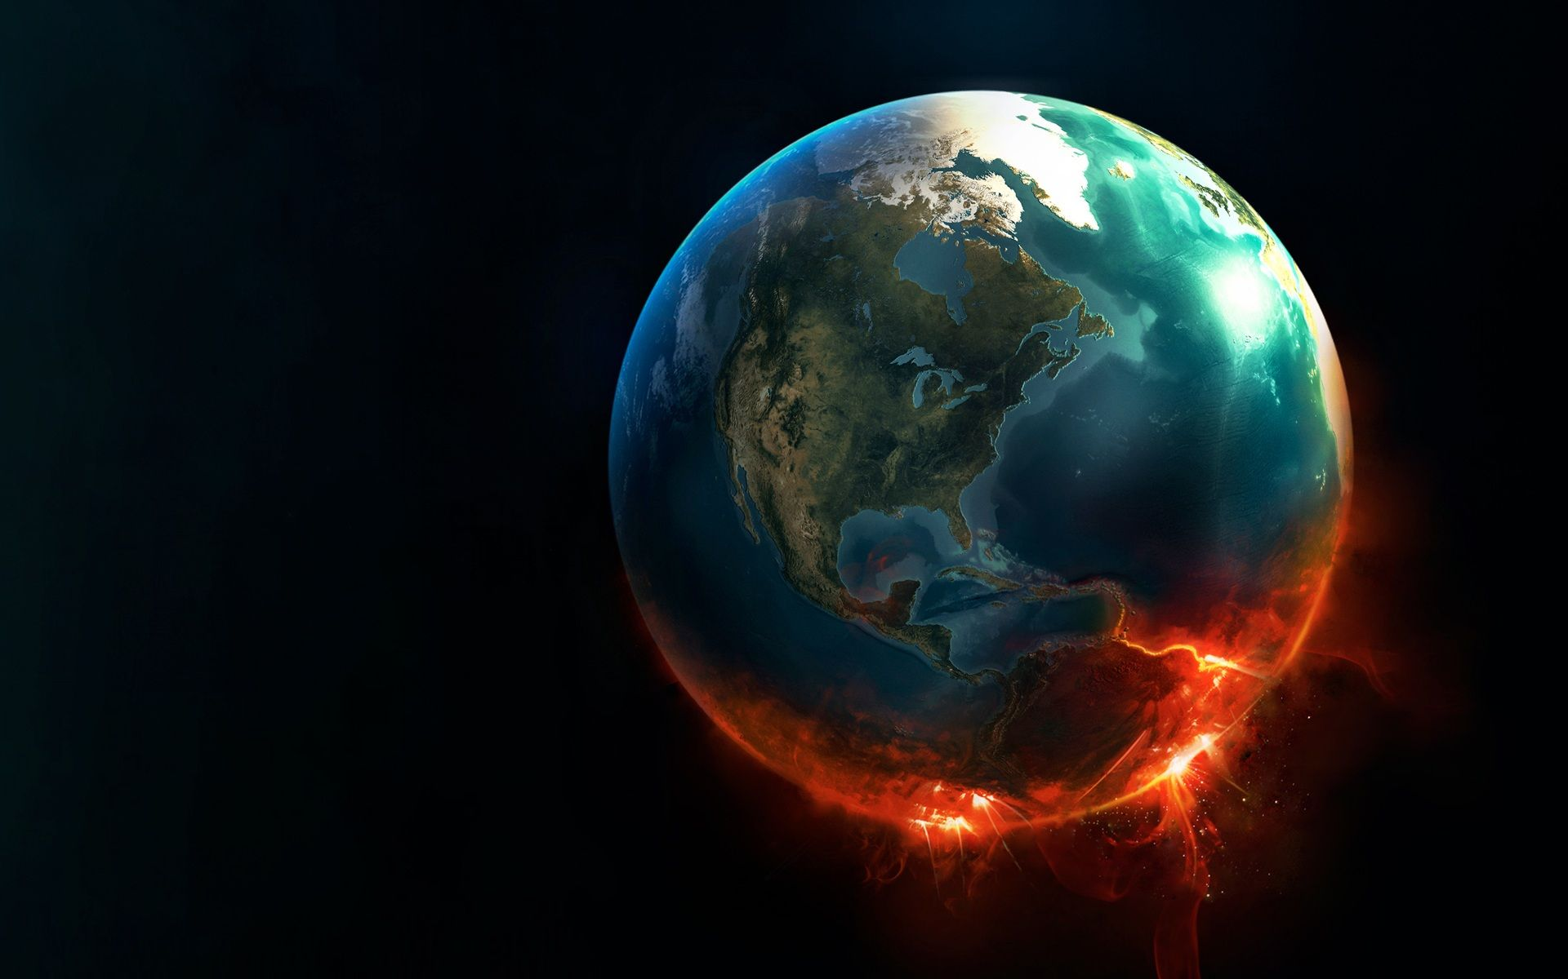
zl
INTRODUCTION
How do people feel about global warming? We are told by scientists and activists that, if we are to reduce its worst predicted consequences, we must start taking measures to prevent global warming.
The science of climate change tells us that global warming is genuinely dangerous . It is also immediate, it is happening now. It's effects have been evident for many years and will become more severe in the coming decades.

Slide 3
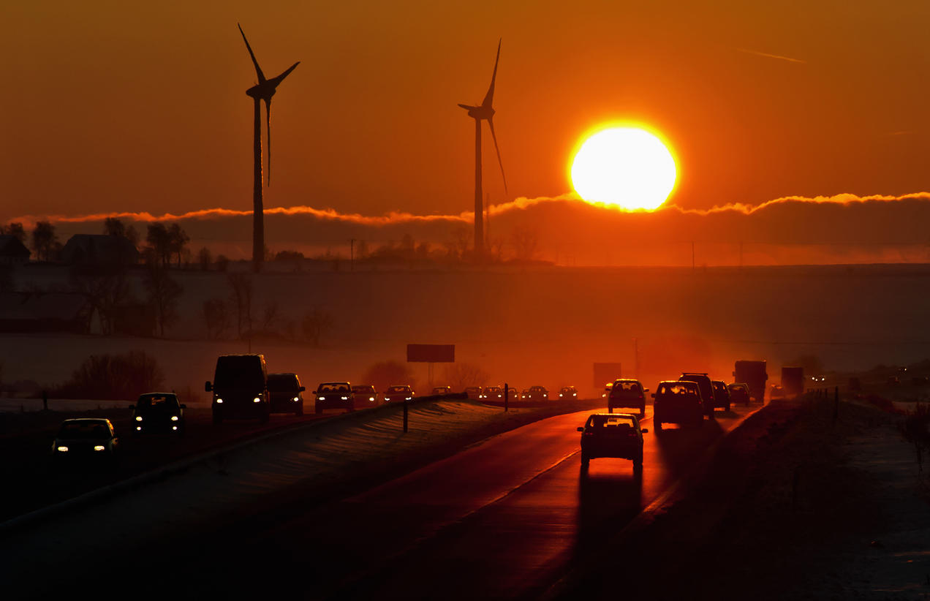
WHAT IS GLOBAL WARMING?
* Global warming as we know is an increase in the temperature of Earth's atmosphere.
* Scientists have spent decades figuring out what is causing Global Warming.
* Global warming is an aspect of climate change, referring to the long-term rise of the planet's temperature.

Slide 4
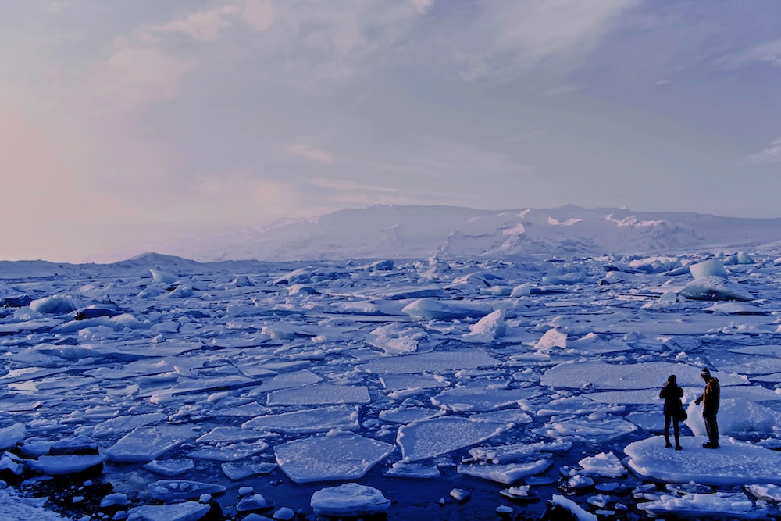
What causes global warming?
Global warming occurs when carbon dioxide (CO₂) and other air pollutants collect in the atmosphere and absorb sunlight and solar radiation that have bounced off the earth’s surface.
Normally this radiation would escape into space, but these pollutants, which can last for years to centuries in the atmosphere, trap the heat and cause the planet to get hotter.
These heat-trapping pollutants—specifically carbon dioxide, methane, nitrous oxide, water vapor, and synthetic fluorinated gases—are known as greenhouse gases, and their impact is called the greenhouse effect.
Examples of Greenhouse gases : Carbon Dioxide, Methane, Nitrous oxide(N20), etc..

Slide 5
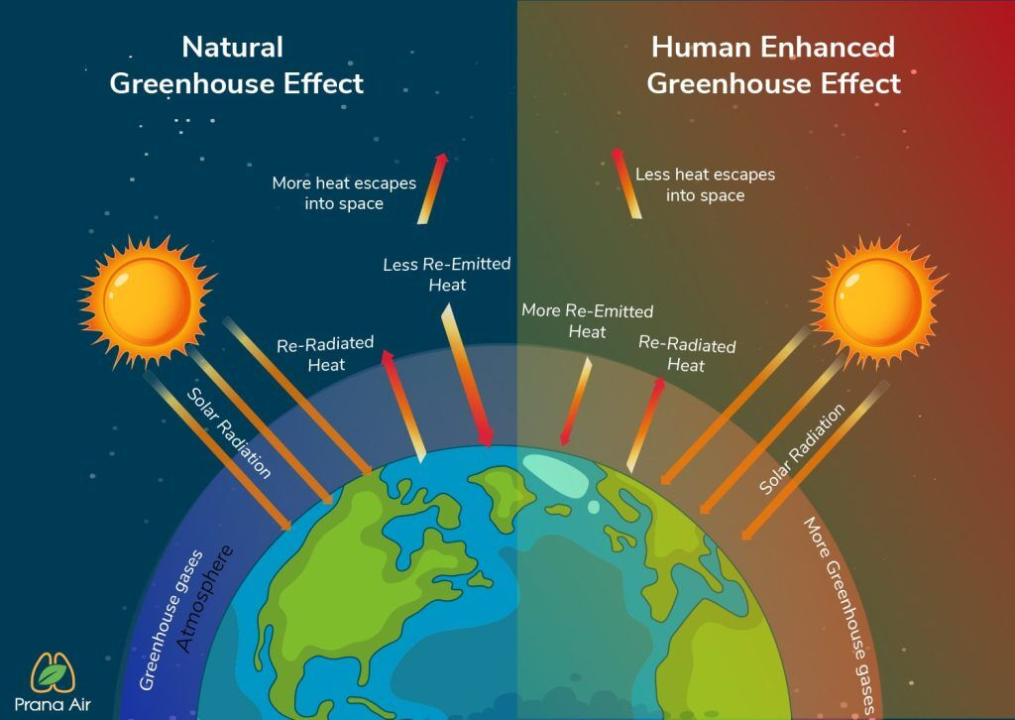

Slide 6


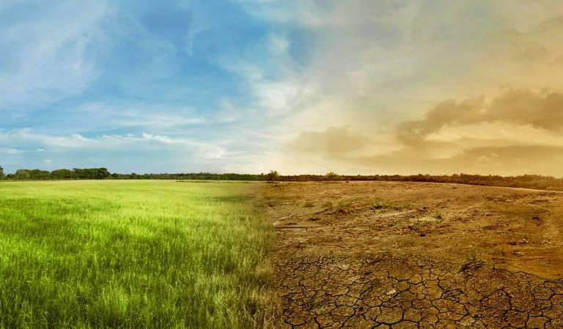
What is Climate Change?
Climate change refers to long-term shifts in temperatures and weather patterns.
Affect of Global warming on Climate Change :
As the earth's atmosphere heats up, it collects, retains, and drops more water, changing weather patterns and making wet areas wetter and dry areas drier.

Slide 7

Factors Responsible For Global Warming :
There are many factors responsible for Global Warming. Some of the factors are :
1 : Urbanization.
2 : Chloro Fluoro Carbons.
3 : Deforestation.
4 : Pollution.
5 : Over exploitation of resources.

Slide 8
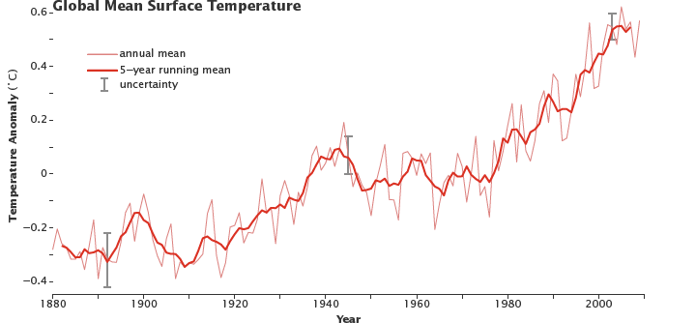
Stats overtime :

Slide 9
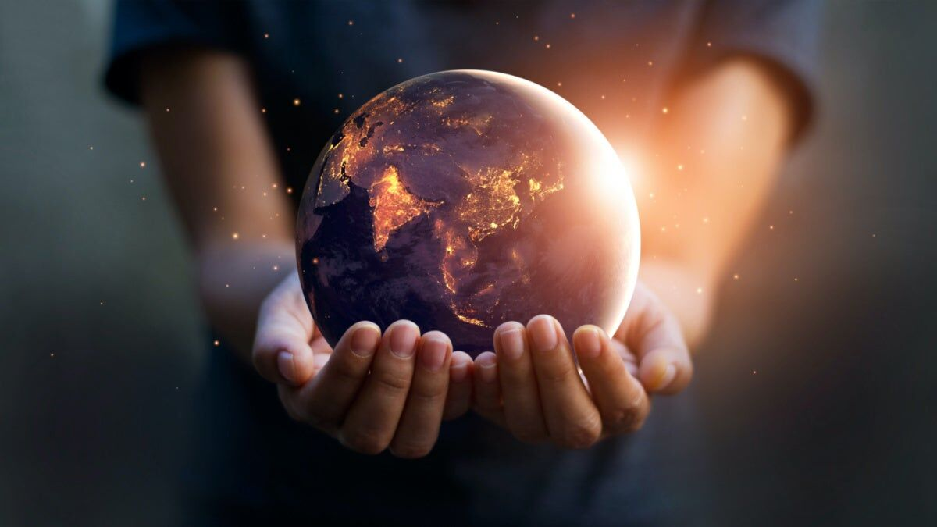
Solutions to Global Warming :
Set limits on global warming pollutants.
Invest in green jobs and energy.
* Build better communities and transportation networks.

Slide 10
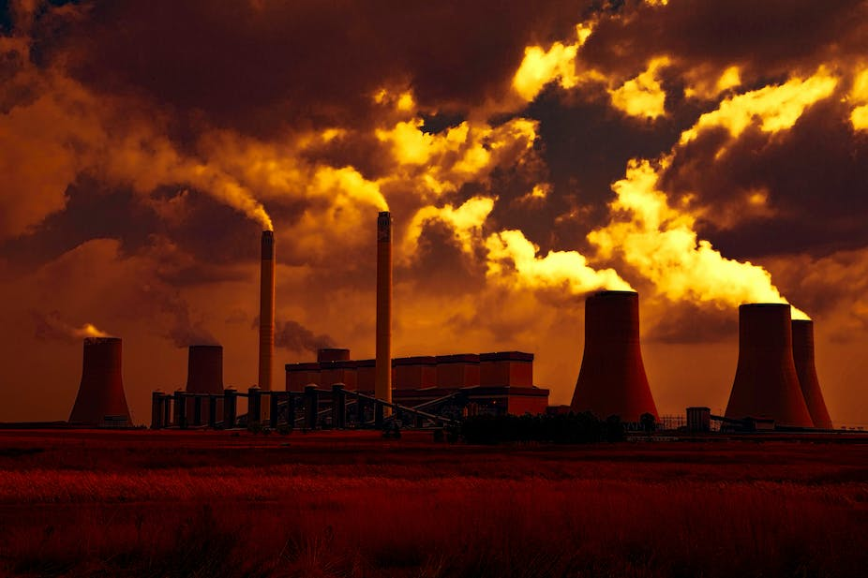
Global warming is not a prediction. It is happening.
- James Hansen

Slide 11
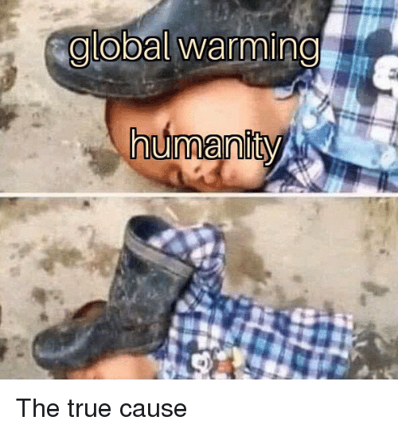

Slide 12
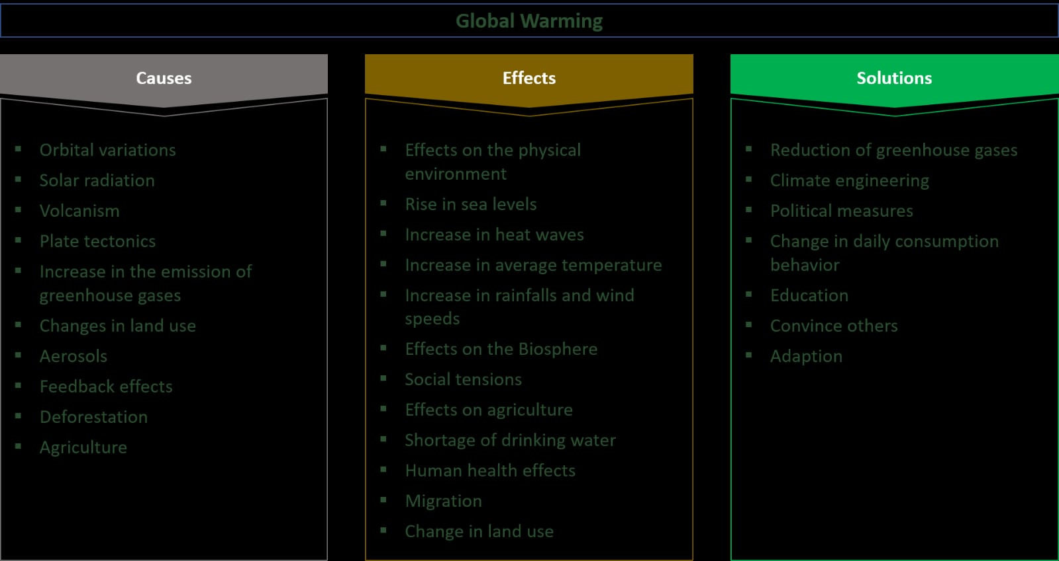

Slide 13
