Slide 1
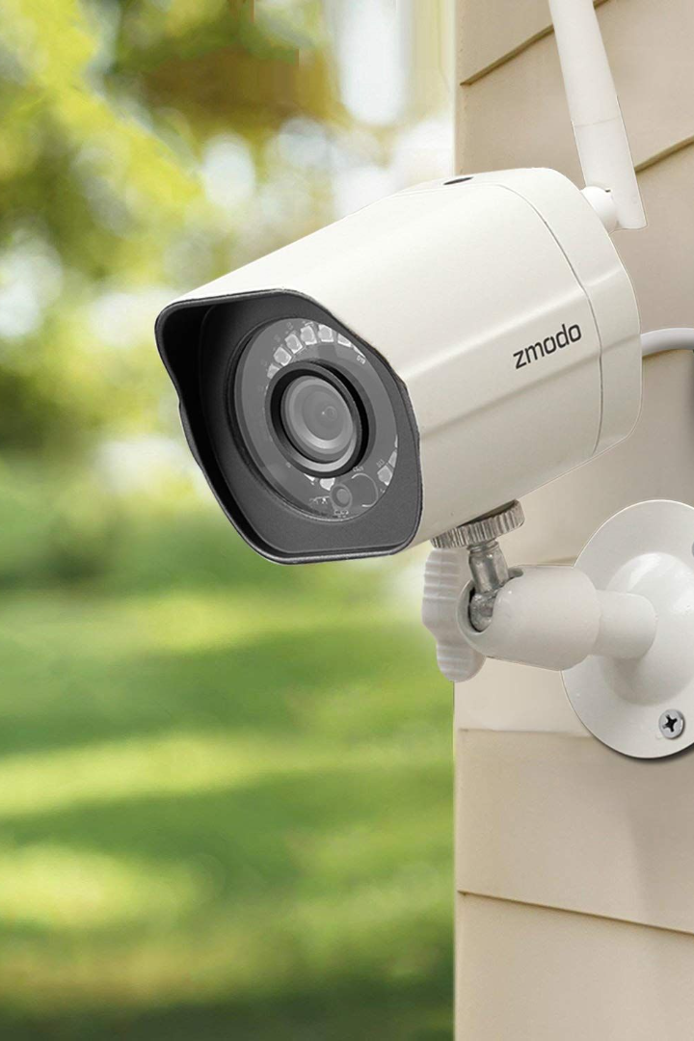
Real Time Surveillance System for Safety Purpose Using Deep Learning
Introducing a cutting-edge real-time surveillance system that leverages the power of deep learning to ensure safety and security in various settings.
sn
by sidda n

Slide 2

Background and Need for Real-Time Surveillance Systems
The rise in criminal activities and security threats necessitates the implementation of advanced surveillance systems.
Real-time surveillance allows for immediate response to incidents and proactive measures for crime prevention.

Slide 3

Utilizing Deep Learning in Surveillance Systems
Deep learning offers superior capabilities for recognizing patterns, objects, and behaviors in surveillance footage.
Its ability to analyze large volumes of data enables accurate detection of anomalies and potential threats.

Slide 4

Understanding Deep Learning
Deep learning is a subset of artificial intelligence (AI) that enables machines to learn from data and make complex decisions.
Applications of deep learning include image recognition, natural language processing, and object detection.

Slide 5

Building a Real-Time Surveillance System
1
Gathering and Preprocessing Surveillance Data
Collecting high-quality data from security cameras and preparing it for deep learning analysis.
2
Training Deep Learning Models
Developing and fine-tuning deep learning models to accurately detect and classify objects and behaviors.
3
Implementing the Surveillance System
Integrating the trained models into a real-time surveillance system with efficient data processing and alert mechanisms.

Slide 6

Benefits of Real-Time Surveillance System Using Deep Learning
1
Enhanced Safety and Security Measures
Real-time surveillance allows for immediate threat detection and timely intervention, ensuring a safer environment.
2
Improved Detection Capabilities and Response Time
Deep learning enables the system to accurately identify and respond to suspicious activities, minimizing false alarms.

Slide 7

Challenges and Considerations
Handling Large Volumes of Data in Real Time
Ensuring Privacy and Data Protection
Addressing Computational and Algorithmic Complexities
Strict data protection measures must be implemented to safeguard the privacy and confidentiality of individuals.
The system must efficiently process and analyze massive amounts of surveillance data without latency issues.
Deep learning models require significant computing power and careful optimization to ensure real-time performance.

Slide 8

Conclusion
Real-time surveillance systems using deep learning have tremendous potential for enhancing safety and security.
Continued advancements in deep learning technology will unlock even more sophisticated surveillance capabilities in the future.

