Slide 1

Computer Networks
Batch-08
211FA04210
211FA04279
211FA04452
211FA04562

Slide 2
Problem Statement:
A)
Choose One Technology (Eg 5G, WIFIGE) And Delvelop Deeper Into Its Technical Details Architecture, And Future Directions Analyse Research Papers (Science Direct/IEEE) Journals), Compare Different Vendor Implementations And Identify Potential Challenges And Opportunities Identify Potential Challenges And Opportunites

Slide 3

5G Technology Overview:
5G stands for the fifth generation of mobile networks, designed to provide higher data speeds, reduced latency, massive network capacity, increased availability, and a more consistent user experience than its predecessor, 4G LTE. It is pivotal for new applications in the Internet of Things (IoT), autonomous vehicles, smart cities, and real-time control.
5G Architecture:
In 5G, the network functions are split up by their service, and they communicate with each other via a service-based interface. That's the reason why the architecture of 5G networks is also termed as 5G core Service-Based Architecture (SBA). The topology diagram of 5G is illustrated in figure 1, demonstrating the crucial elements of a 5G core network.

Slide 4
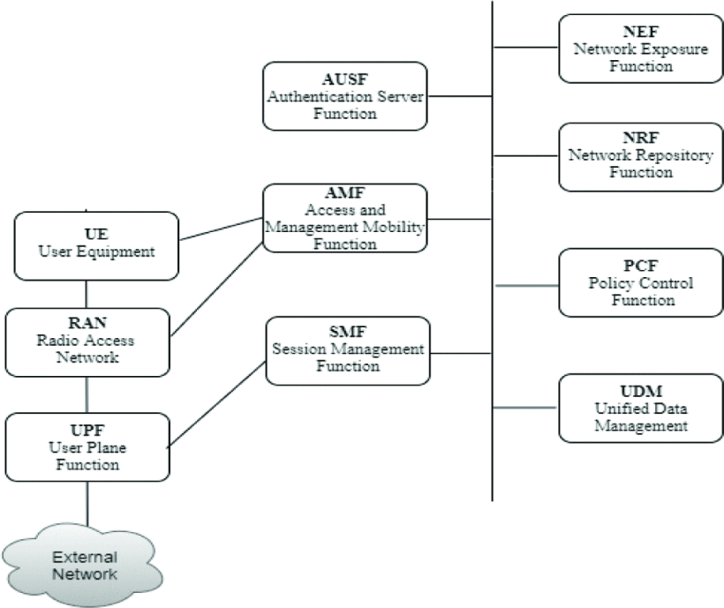
The User Equipment (UE) is the device you use to connect to the network, like a 5G smartphone. It connects to the 5G core through the Access and Mobility Management Function (AMF). The AMF chooses a Session Management Function (SMF) based on the services you need. The User Plane Function (UPF) handles the data traffic between your device and other networks. The Authentication Server Function (AUSF) network behavior and access subscription information. allows the AMF to access the 5G core services and authenticate your device. Other functions like the Policy Control Function (PCF), Application Function (AF), Session Management Function (SMF), and Unified Data Management (UDM) help control

Slide 5
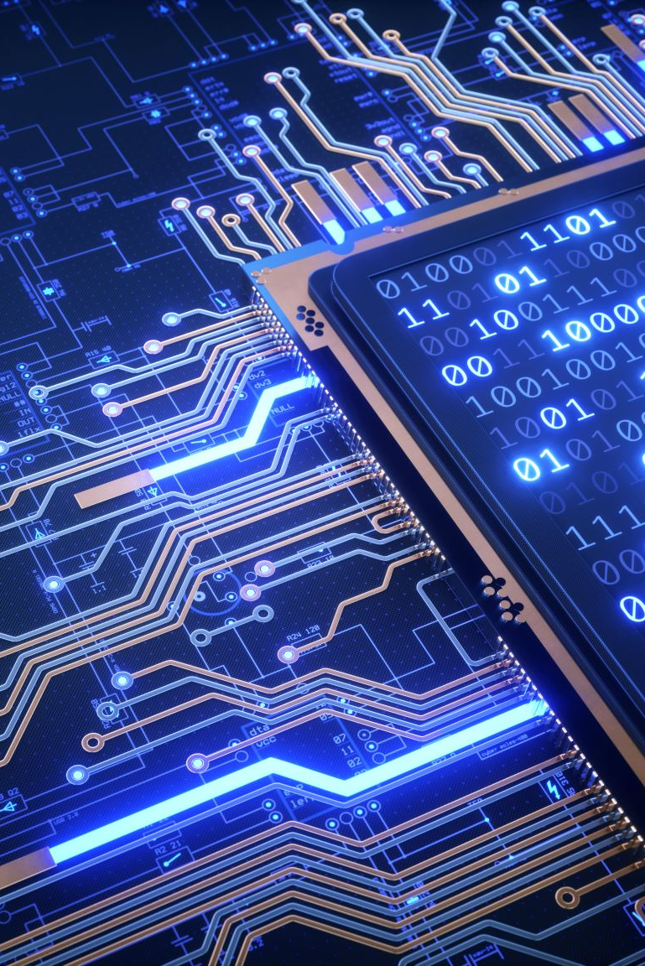
Vendor Implementations and Comparisons:
Huawei is a leader in 5G technology with strong R&D investment, but faces geopolitical challenges.
Ericsson and Nokia excel in software and network services, supporting network slicing and IoT.
Samsung focuses on high-band spectrum technologies in 5G.
ZTE offers competitive 5G solutions, especially in emerging markets.

Slide 6
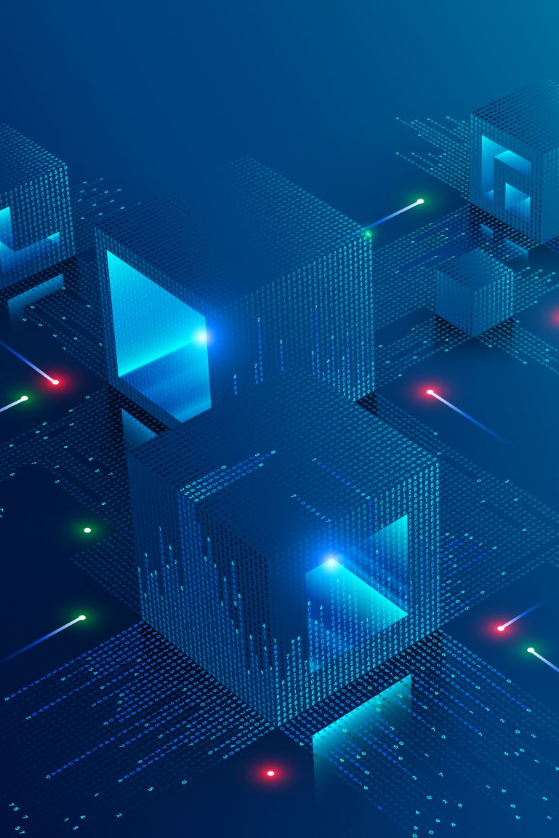
Challenges:-
Spectrum Allocation: Ensuring Enough Bandwidth For 5G Services.
Infrastructure Costs: High Initial Investment For Dense Deployments In Cities.-
Security: Ensuring The Safety And Privacy Of Communications In Complex 5g Networks.
Opportunities:-
Economic growth: 5G drives new services and industries.
Innovation in services: AR/VR, autonomous driving, and smart cities benefit from 5G's low latency and high bandwidth.
Digital inclusion: 5G can bring high-speed internet to underserved areas, bridging the digital divide.

Slide 7
B) Consider sending a packet from a source host to a destination host over a fixed route. List the delay components in the end-to-end delay. Which of these delays are constant and which are variable?
Transmission delay: It is the time consumed in pushing all the packets of data into a transmission medium like wire in wired networks. It is a delay that is caused due to the data rate of the medium or link between the source and destination. It is the function of the length of packets and is independent of the distances between the two communicating nodes
Propagation delay: It is the time consumed by a signal to reach the destination node from the source node. It is equal to the distance between nodes divided by the speed of propagation of the signal.
Processing delay: It is the time taken by a router to process the header of a signal or data packet being transmitted across the network between the source nodes and the destination node. It is the key element of network delays.
Queuing delay: It is the time for which a signal or data packet has to wait in the queue before it gets executed. It is a key element of network delays.

Slide 8
Classification:
Constant: The delay whose value is fixed and independent of the aspects or components related to the end-to-end transmission of signal or data packets..Processing delay: It is constant as the router takes an equal amount of time to process the header of a packet.
Transmission delay: It is constant for a given length of a packet.
Propagation delay: It is the ratio of the distance between nodes and the transmission speed, and it is constant for two given nodes and the transmission speed of the signal in a network.
Variable: The delay whose value is dependent on the aspects or components related to the end-to-end transmission of signal or data packets.
Queuing delay: This is not fixed as the delay depends on the number of jobs already in the queue and waiting time also depends on the size of a packet.

Slide 9

C) Implement codes to calculate Transmission Delay, Queueing delay,
Overall delay, Throughput, and Loss of data packets.

Slide 10
Server.py :
import socket
import time
import os.path
import wmi
def send_file(client_socket, file_path):
with open(file_path, 'rb') as file:
while True:
data = file.read(1024)
if not data:
break
client_socket.sendall(data)
def helper(all_interfaces,interface_name):
for i in all_interfaces:
if i.Name ==interface_name:
return i.speed
interface_name=input("Enter the interface name: ")
w = wmi.WMI()
all_interfaces=w.Win32_NetworkAdapter()
transmission_rate=helper(all_interfaces,interface_name)
transmission_rate=int(transmission_rate)
if not transmission_rate:
print("There is no such interface!")
else:
fs=input("Enter file path : ")
if os.path.exists(fs):
size=os.path.getsize(fs)
print(f"File size is {size} bytes")
size_bits=size*8
transmission_delay=size_bits/transmission_rate
server_ip='10.10.12.135'
server_port=12345
server_socket = socket.socket(socket.AF_INET, socket.SOCK_STREAM)
server_socket.bind((server_ip, server_port))
server_socket.listen(1)
print("Server listening on port", server_port)
arr=[]
i=1
vf=False

Slide 11
Server.py (Continuation):
while True:
client_socket, addr = server_socket.accept()
if not vf:
all_start_time=time.time()
vf=True
check_time=time.time()
f=False
if i>1:
var=check_time - end_time
if var>= 0 and var<=2:
f = True
print(f"Serving to client {i} : ........")
i+=1
print("Connected to client:", addr)
start_time = time.time()
send_file(client_socket, fs)
client_socket.shutdown(socket.SHUT_WR)
response = client_socket.recv(1024).decode()
end_time = time.time()
print("Received response from client:", response)
if f:
queue_local = time.time()
qdelay = queue_local - all_start_time-arr[-1]
print(f"Queueing delay for {i-1}th client : {qdelay}")
else:
print(f"No Queueing delay for {i-1}th client")
total_time = end_time - start_time
print(f"Transmission delay is {transmission_delay} seconds")
print("Total delay:", total_time, "seconds")
arr.append(total_time)
client_socket.close()
print('--------------------------------------------')
server_socket.close()
else:
print("File does not exist!")
print("--------------------------------------------------------")

Slide 12
Client.py :
import socket
import os
import time
def receive_file(server_socket, file_path):
total_data_received = 0
f=False
start_time = time.time()
with open(file_path, 'wb') as file:
while True:
data = server_socket.recv(1024)
if not data:
break
file.write(data)
total_data_received += len(data)
if time.time() - start_time >= 1:
if not f:
print(f"Throughput : {total_data_received*8} /sec")
f=True
total_data_received = 0
start_time = time.time()
server_ip = '10.10.12.135'
server_port = 12345
client_socket = socket.socket(socket.AF_INET, socket.SOCK_STREAM)
client_socket.connect((server_ip, server_port))
print("Connected to server:", server_ip)
filename = 'fm.zip'
received_file_path = os.path.join(os.getcwd(), filename)
receive_file(client_socket, received_file_path)
print("File to_serve and saved as:", received_file_path)
response = "File to_serve successfully"
client_socket.send(response.encode())
client_socket.close()

Slide 13
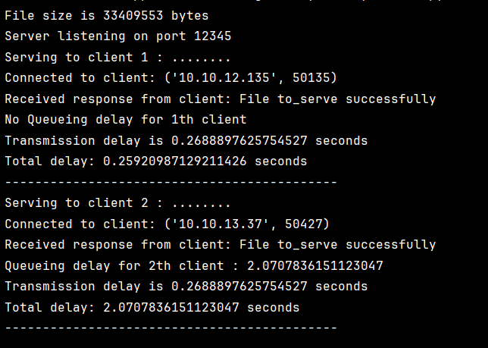
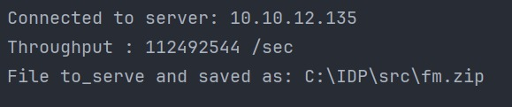
OUTPUTS:
OUTPUT (Server.py):
OUTPUT (Client.py):

Slide 14
Loss.java:
import java.net.InetAddress;
import java.util.Scanner;
public class Loss {
public static void main(String[] args) {
Scanner scanner = new Scanner(System.in);
try {
System.out.print("Enter IP address to ping: ");
String ipAddress = scanner.nextLine();
System.out.print("Enter number of requests: ");
int numRequests = Integer.parseInt(scanner.nextLine());
System.out.println("Starting.....");
InetAddress inet = InetAddress.getByName(ipAddress);
int timeout = 5000; // ms
int successfulPings = 0;
long totalDelay = 0;
int lostPackets = numRequests - successfulPings;
double lossPercentage = (double) lostPackets / numRequests * 100;
double averageDelay = successfulPings > 0 ? (double) totalDelay / successfulPings : 0;
System.out.println("Packets: Sent = " + numRequests + ", Received = " + successfulPings +
", Lost = " + lostPackets + " (" + String.format("%.2f", lossPercentage) + "% loss)");
System.out.println("Average Delay of all packets = " + String.format("%.2f", averageDelay) + "ms");
} catch (Exception e) {
e.printStackTrace();
} finally {
scanner.close();
}
}
}
for (int i = 0; i < numRequests; i++) {
long startTime = System.currentTimeMillis();
if (inet.isReachable(timeout)) {
long endTime = System.currentTimeMillis();
long delay = endTime - startTime;
totalDelay += delay;
successfulPings++;
}
}

Slide 15
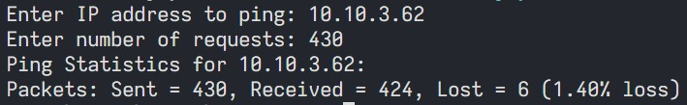
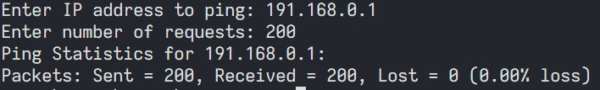
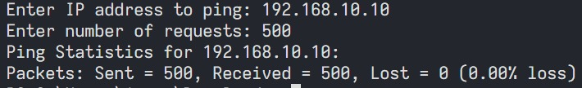
OUTPUT (Loss.java):

Slide 16


