Slide 1
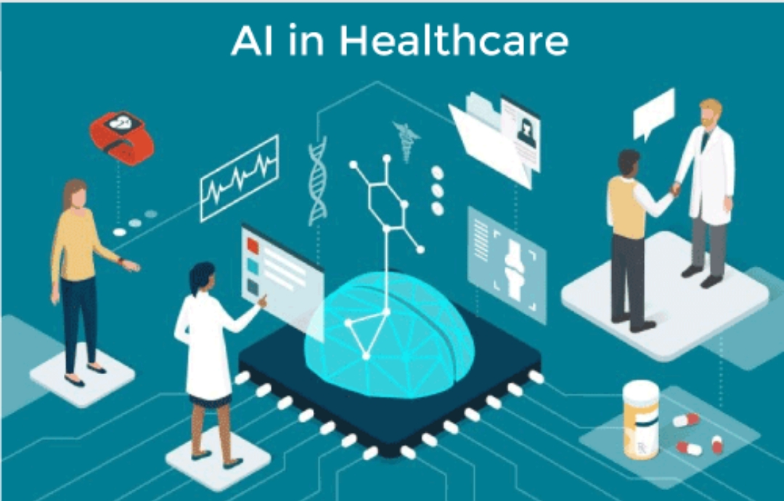
Artificial Intelligence in Healthcare
P. V. S. S. Neeraj
211FA04615
Section: H
Branch: CSE

Slide 2
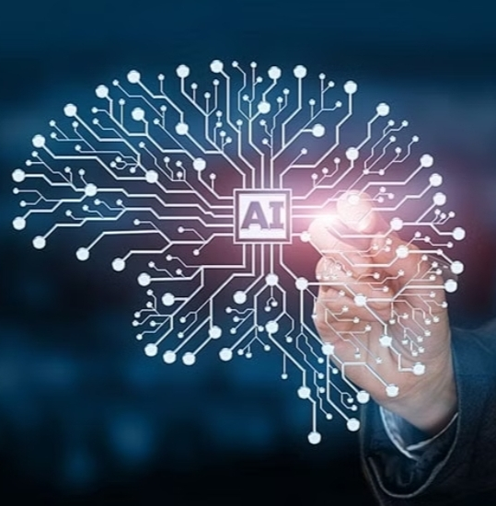
Artificial Intelligence (AI) and Its Relevance in Healthcare
Artificial intelligence (AI) is the intelligence of machines or software.
AI or artificial intelligence, refers to the development of computer systems and software that can perform tasks.
In healthcare, AI plays a crucial role in improving medical diagnosis accuracy, personalizing treatment plans and managing patient data efficiently.

Slide 3
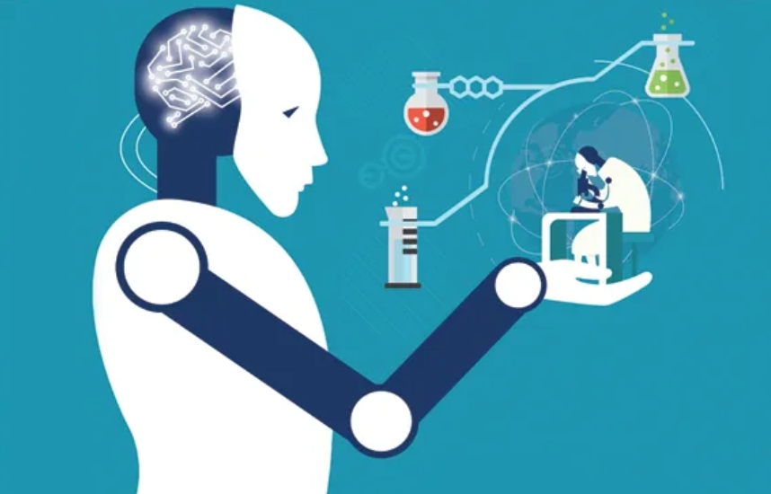
Why AI in Healthcare?
AI is used in healthcare to make things better for patients and doctors.
AI helps doctors find diseases early.
AI makes healthcare more efficient and can save money.

Slide 4
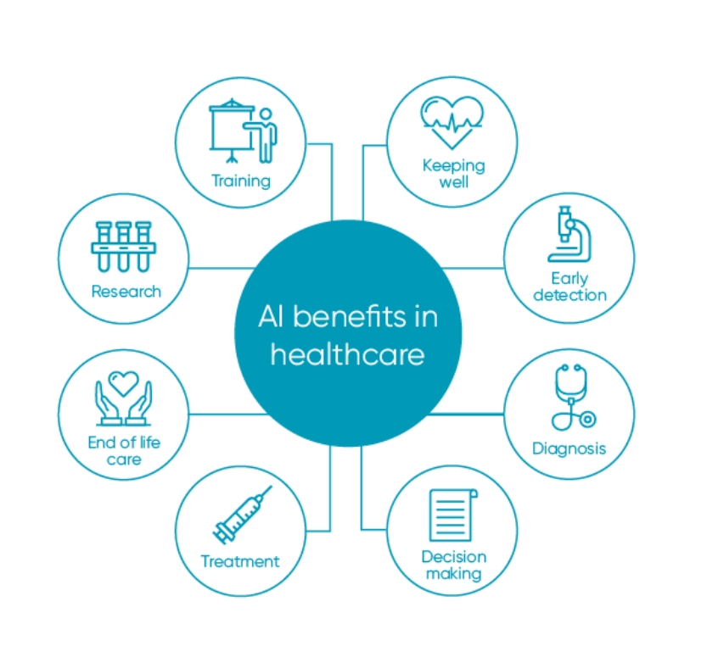
Benefits of AI in Healthcare
Improved diagnosis and treatment
Enhanced patient care
Reduction in medical errors
Efficiency in administrative tasks

Slide 5
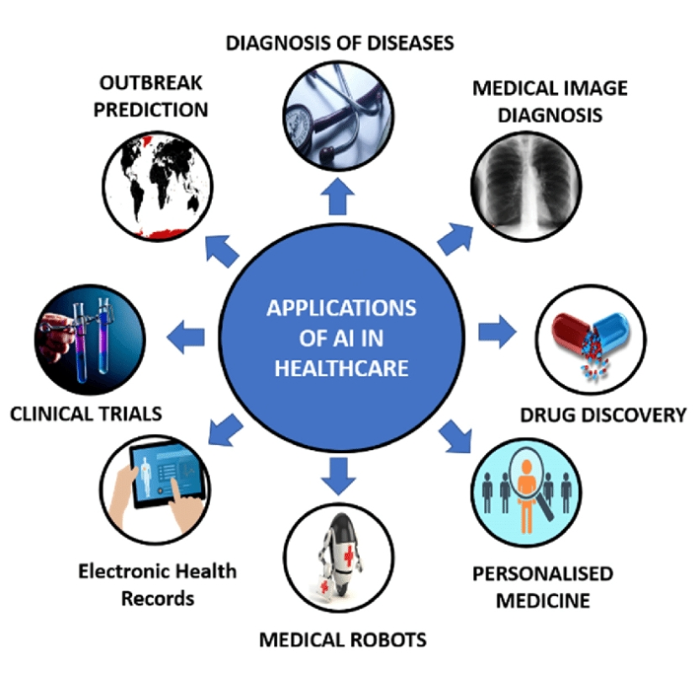
AI Applications in Healthcare
AI applications in healthcare are diverse and have a wide range of uses.
Some of the prominent applications include:
1. Medical Imaging Analysis
2. Disease Diagnosis
3. Treatment Personalization
4. Drug Discovery

Slide 6
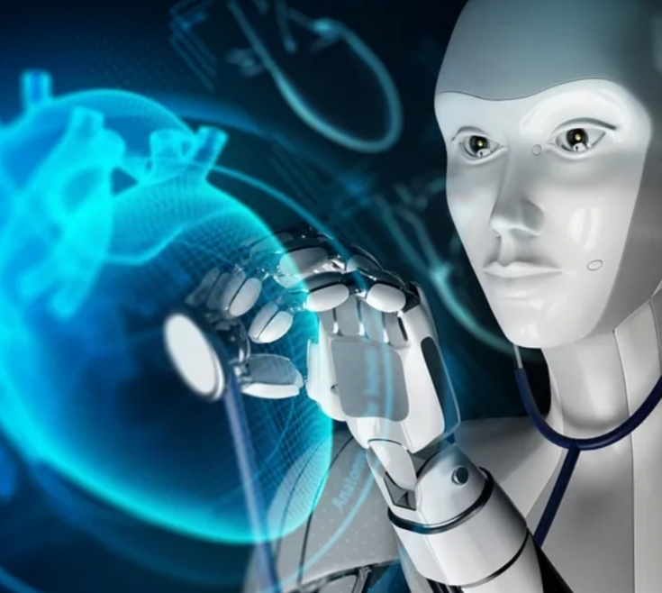
How is AI used in Disease Diagnosis and Early Detection?
AI is used for disease diagnosis and early detection by analyzing medical images, like X-rays and MRIs, to find problems in the body quickly.
AI also looks at your health information, whether you are healthy or not.

Slide 7

Potential Impact of AI on Global Healthcare Systems
AI helps in predicting and preventing diseases.
AI also helps the doctors to find and treat diseases faster and better.
AI can reduce healthcare costs.

Slide 8
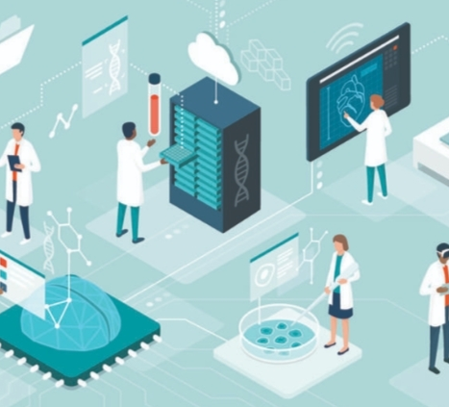
Conclusion
AI in healthcare promises a transformative impact on patient care and medical practices.
AI has the potential to improve patient outcomes and enhance healthcare quality.

Slide 9


