Slide 1
IoT Enabled Occupancy based Home/Lab Automation controller
Ch Geethika Lakshmi Ramya (200070015)
Abhiram Naidu Mullu (200070046)
K Sri Lavya (200070031)

Slide 2
Agenda
Introduction
Block Diagram
Components Datasheet
IoT middleware
Challenges and Solutions
Future Works

Slide 3
Introduction
Our project is focused on creating an IoT-enabled home automation
Aim is to make an IoT-based controller node that can independently control light and fans in the lab.
Combine these nodes using a central server to automate the whole process.

Slide 4
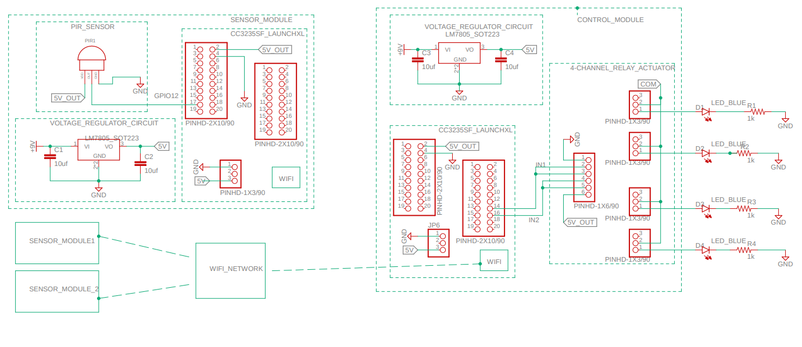
Block Diagram

Slide 5
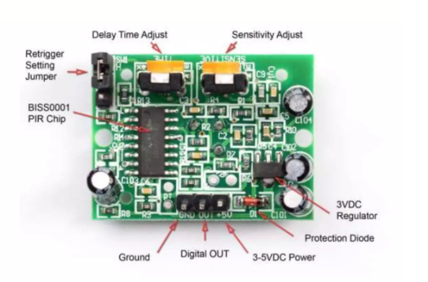
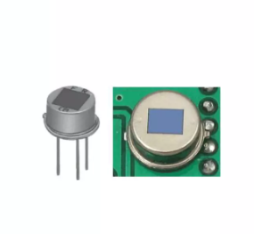
Components
PIR Sensor (Range:up to 20ft,Output:3V digital pulse, Input:5V-12V)
CC3235SF Micro-controller
Voltage Regulator (9V battery, 10uFcapacitors, LM7805)
4-channel Relay Module

Slide 6
IoT Middleware
Deployed 2 CC3235S boards for acting as main and node servers.
Established a simple HTTP connection between the board using the included wifi modules.
Implemented HTTP request handling and error handling.
Transmitted the sensor values from the node board to the main board for issuing control signal to the 4-channel relay.

Slide 7
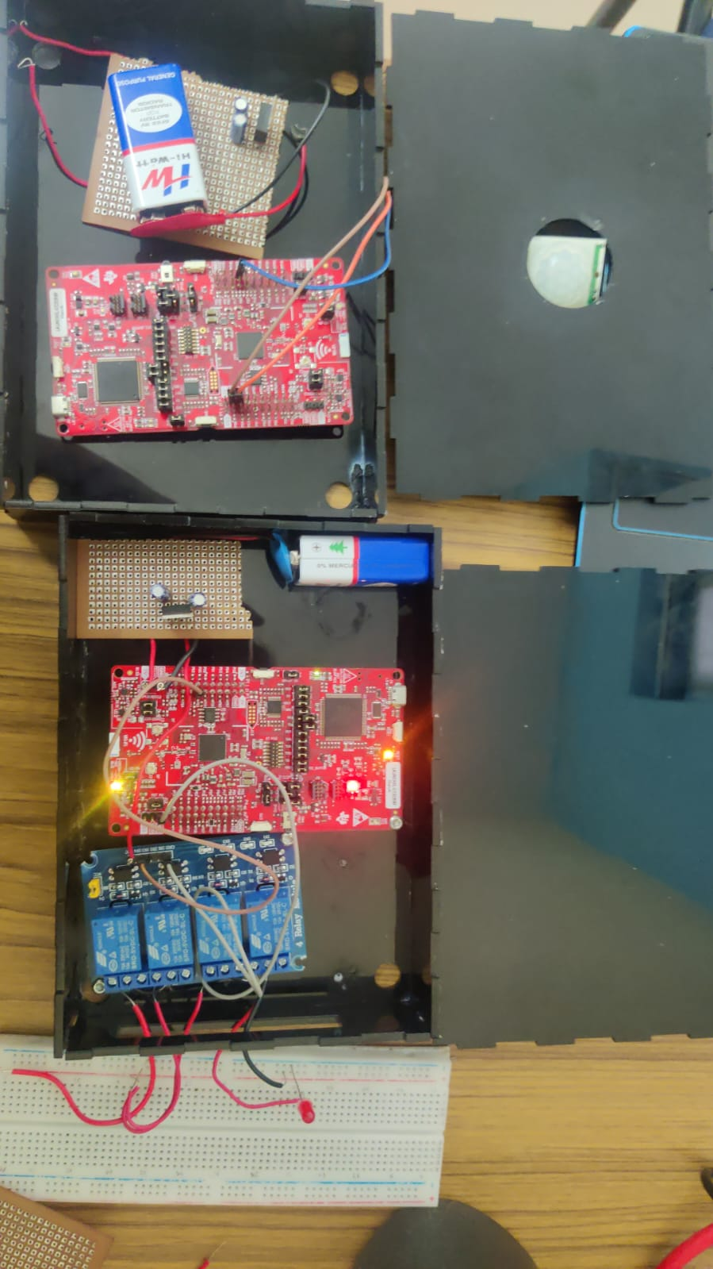
Left : Node server with PIR Right : Main server with 4 channel relay

Slide 8
Challenges and Solutions
High sensitivity sensor
The PIR sensor available in the lab has a very high sensitivity and is detecting movement from as far as 4 meter which is not at all desirable.
So we have to do multiple tests and note down the change in voltage values with distance.
We came up with a software solution for this problem.

Slide 9
Challenges and Solutions
Connectivity
We tried using a MQTT type of connection but the budget of our project doesn't make sense for us to use an extra microcontroller for acting as an MQTT broker.
So we shifted to a HTTP type of connection which is giving is connectivity issues.
We are still working on the wifi interfacing for this project

Slide 10
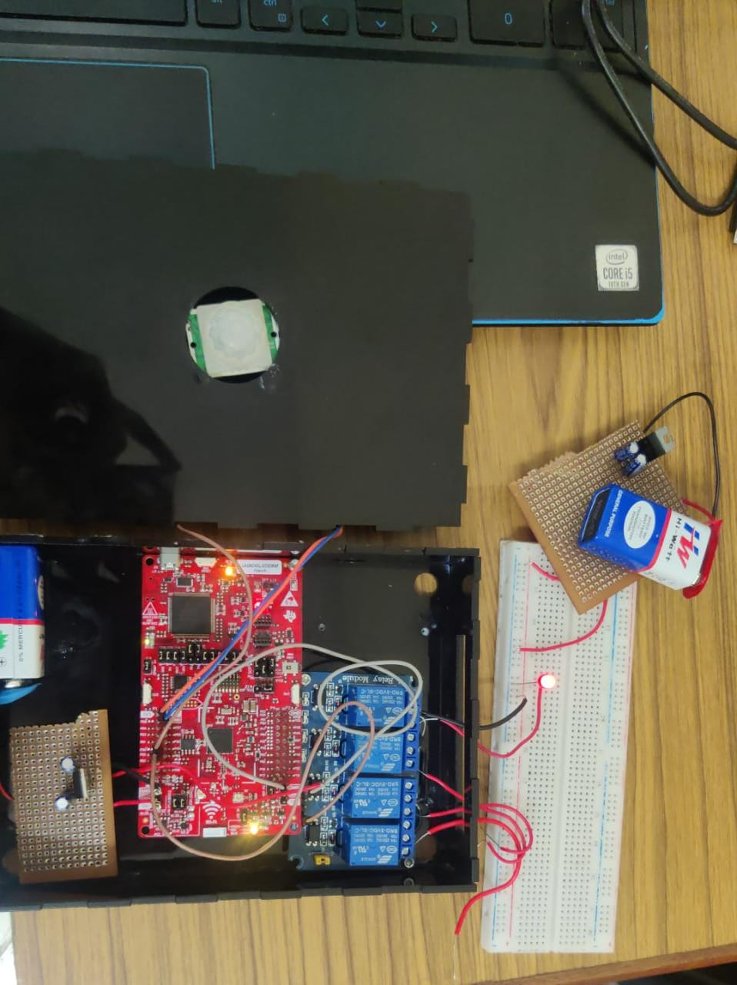
Conclusions
Successfully built a working prototype for the sensor module.
Control signal is being given to the actuator in case of detection.
Still working on the wireless connectivity part of the project.

Slide 11
Thank you !

