Slide 1
Customizing Legal Document Summarization: A Case Study in Patent Documents
Group 8
Team Members:
Madhu surusetti
Nagubudi Venugopal Bhavyanth
Anusree Putta
Grishma Tallapareddy
Abhiram Nallamothu
Anudeep Oggu
Computational Methods for Information Systems (Spring 2024 1)
Section: 22

Slide 2
Contents
Introduction
Research Questions
Methodology
Results
Discussion
Conclusion

Slide 3
Introduction:
Legal documents can be complicated and challenging to read, particularly patents.
Conventional methods of summarizing frequently fall short of capturing the most crucial details.
This paper suggests a novel approach to tailor legal document summary to specific requirements.

Slide 4
Research Questions:
How can we develop summarization techniques that effectively capture the complexities of legal language, particularly in patents?.
What strategies can be employed to tailor summaries to individual user preferences and needs?
How do our proposed methods compare to existing approaches in terms of accuracy, comprehensibility, and user satisfaction?

Slide 5
Research problems:
Beyond generic summarization, users have different preferences for the summary. For example, users want the summary output: to focus on certain topics different levels of detail
Customizable summarization for legal documents has not been explored.
Customizable summarization is ideal for users in the legal domain.
No existing ML datasets for legal document customizable summasrization.

Slide 6
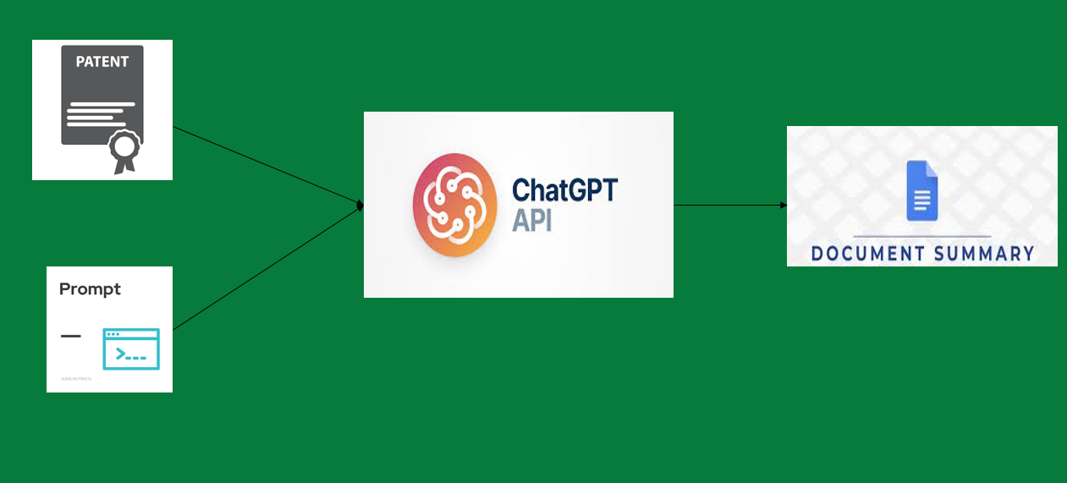
Overview of Methodology :

Slide 7
Methodology
1. Data Collection:
Various patent documents were gathered from different sources.
Data included patent title, number, abstract, claims, classifications, and description.
2. Data Preprocessing:
Steps were taken to ensure uniformity and consistency in the collected dataset.
Tasks included removing duplicates, standardizing formats, and verifying metadata accuracy.
3. Annotation with Large Language Models (LLMs):
The dataset underwent annotation using Large Language Models like GPT-3.5.
Customized summaries were generated using prompts tailored to attributes and rank values.

Slide 8
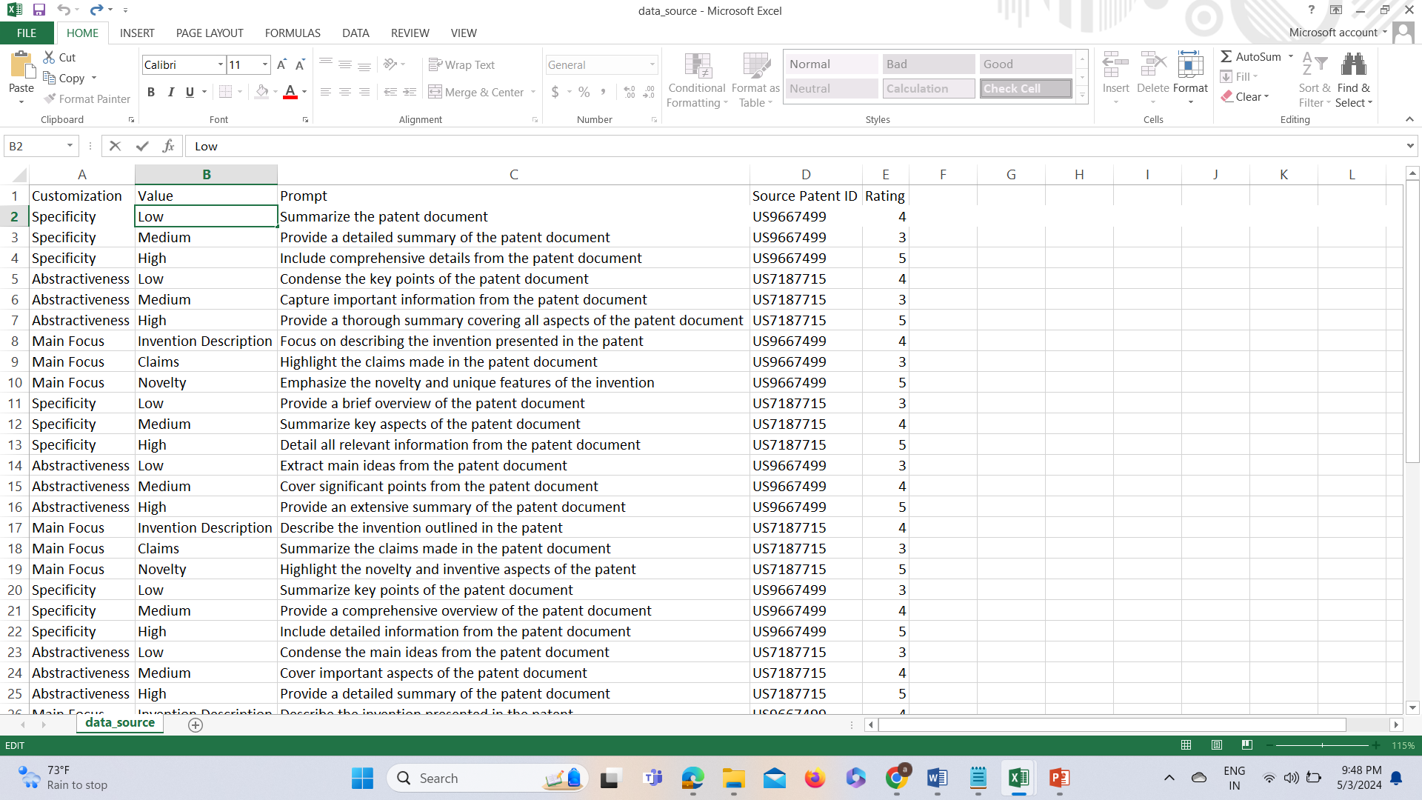
Optional prompts and Code :
Github link to prompt strategy and design:

Slide 9
Data Set overview
1.Dataset Name: INFO5731_Group8.xls
2.Dataset Description: This dataset contains a collection of patent_id’s , patent documents and their corresponding summaries.
3.Number of Records: 1100
4.Number of Columns/Fields: 3 (patent_id,patent_document, Summary)
5.Average Length of Original Documents: 15000 words
6.Average Length of Generated Summaries: 5000 words

Slide 10
4. Evaluation of Summaries:
Summaries were assessed using automated metrics (ROUGE score, BERT score, SummaC) and manual review.
Manual evaluation focused on customizability, clarity, accuracy, coverage, and
5. Customizable Summarization Dataset Creation:
A patent document summarization dataset was created using optimal prompts.
GPT-3.5 API was utilized to produce customized summaries for each document.
6. Quality Evaluation of the Dataset:
The generated dataset underwent evaluation through automated and manual methods.
Evaluation criteria encompassed accuracy, clarity, coverage, and flexibility.

Slide 11
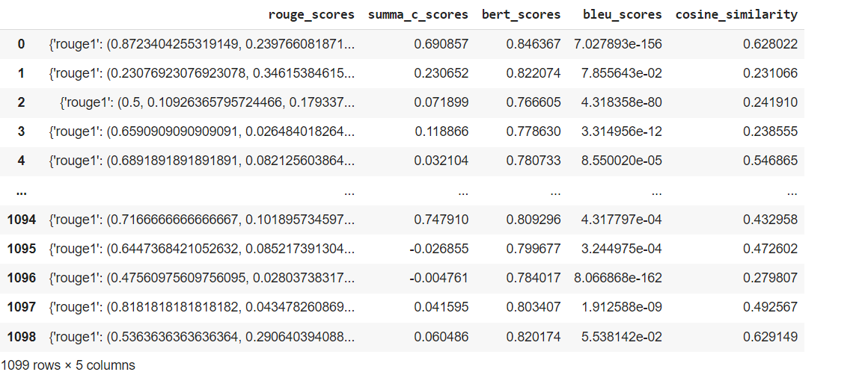
Results:

Slide 12
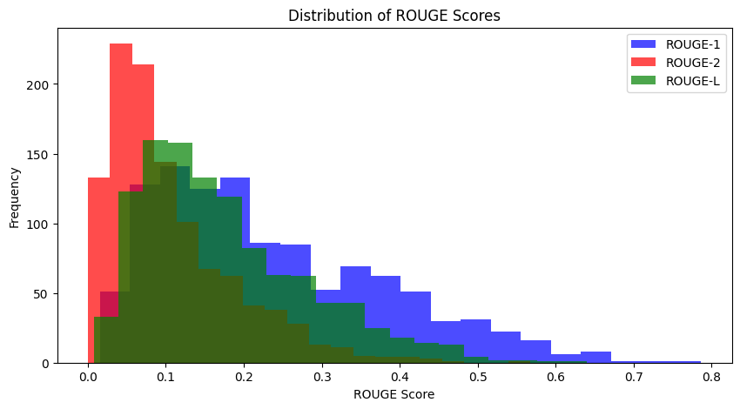
Distribution of Rouge Score:
The distribution of rouge score is shown in x-axis
The y-axis appears to indicate the frequency, presumably the number of instances that scored a particular ROUGE value.

Slide 13
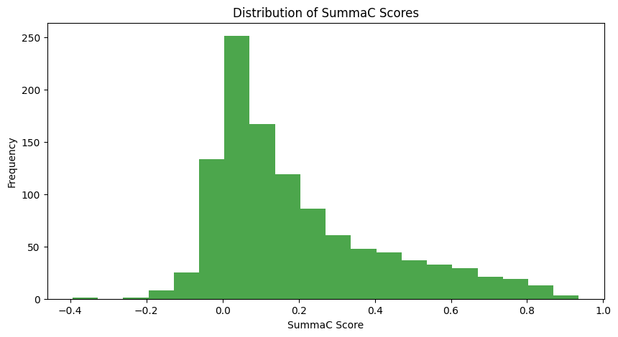
Summac Score Comparison:
X-axis: The x-axis of the graph represents the SummaC score, likely ranging from 0 to 1. A higher SummaC score indicates a better summary.
Y-axis: The y-axis appears to represent the frequency, presumably the number of summaries that received a particular SummaC score.

Slide 14
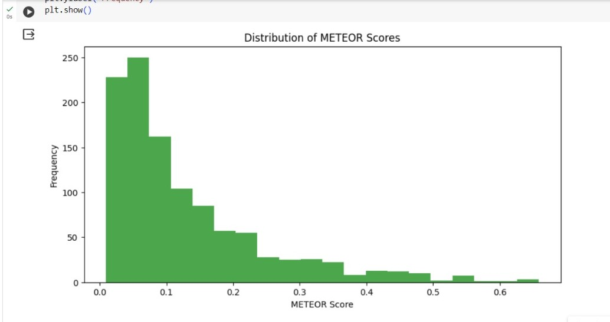
Distribution of Meteor Score
X-axis (METEOR score): Shows how similar summaries are to references (0.0 = low similarity, higher = more similar).
Y-axis (Frequency): Shows how many summaries scored within a certain range on the X-axis (higher bars = more summaries scored similarly).

Slide 15
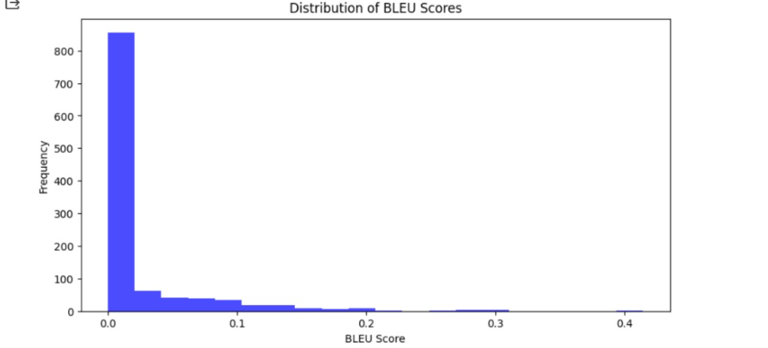
Distribution of Bleu Score
X-axis: BLEU score (higher = better translation)
Y-axis: Frequency

Slide 16
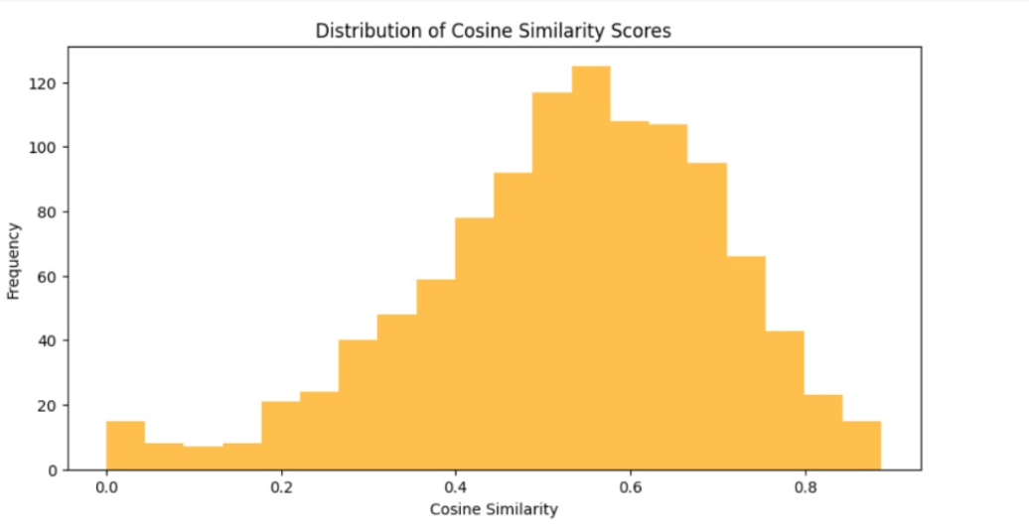
Distribution of Cosine Similarity Score
X-axis: Cosine similarity score (higher = better translation)
Y-axis: Frequency

Slide 17
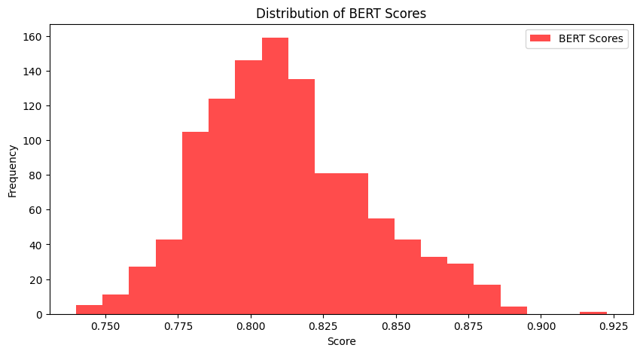
Distribution of Bert Score
X-axis: Bert score
Y-axis: Frequency

Slide 18
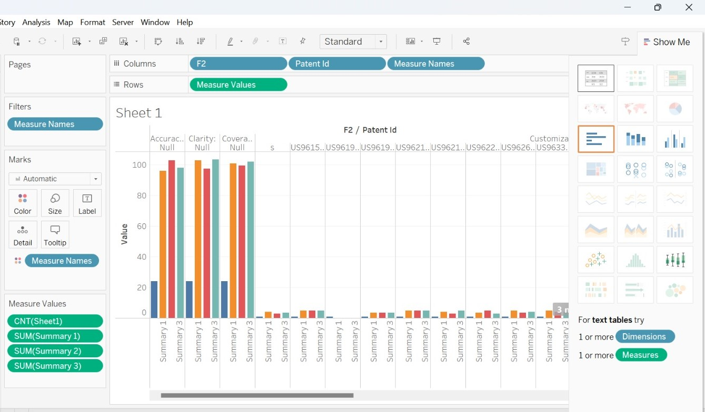
Human Evaluations:
This graph shows summaries in X-Axis for different patent documents and rating of that summaries in y-axis

Slide 19
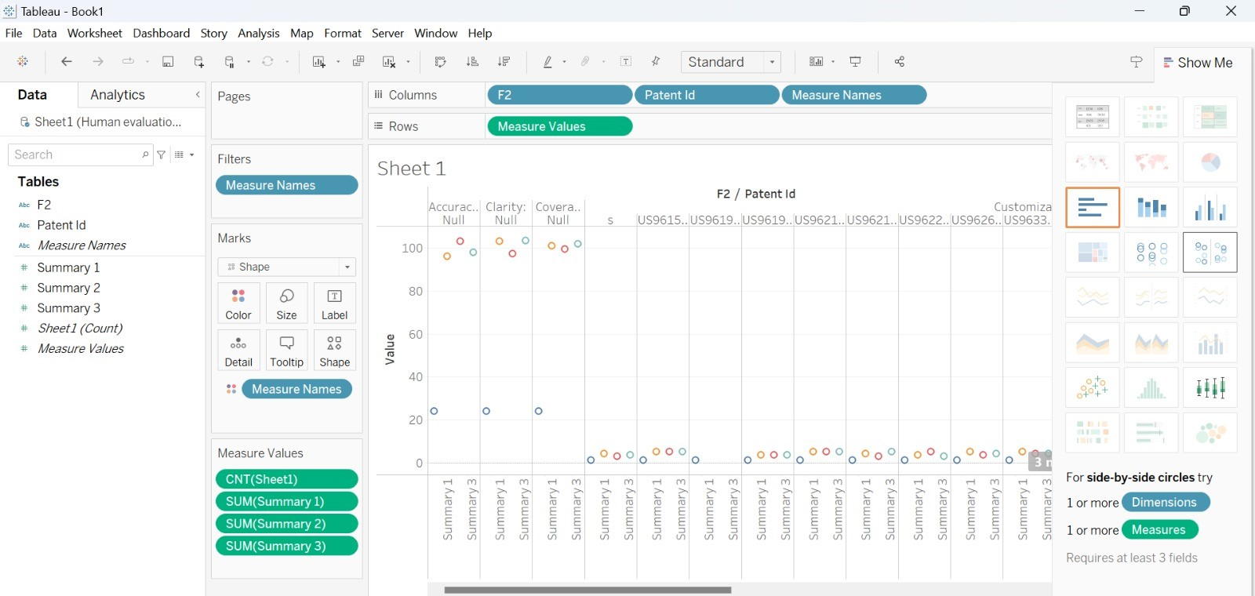
Visualization

Slide 20
Conclusion:
The study highlights the importance for researchers, practitioners, and policymakers to consider its implications.
It offers new insights into summarizing legal documents for scholars, providing practitioners with innovative methods to enhance decision-making.
Tailored legal document summaries, as per the study, can improve policymakers' access to legal information.
This study has demonstrated that accurate, understandable, and useful legal document summaries may be produced on request.
The accessibility and utilization of legal information could be completely transformed by this innovative technique.

Slide 21
Author Contributions:
Timeline | Team members
Madhu surusetti | Data preprocessing , Data annotation with LLM
Anusree Putta | Generating a customizable summarization dataset for patent documents, code for data set generation
Anudeep Oggu | Evaluating the quality of the generated summarization dataset
Abhiram Nallamothu | Experiment and data analysis plan, Code of results
Nagubudi Venugopal Bhavyanth | Code for results
Grishma Tallapareddy | Human Evaluations

Slide 22
Code
Prompt design code: https://github.com/AbhiramNallamothu/Project/blob/main/data_extraction_(1).ipynb
Github link of the repository including all input and output files:
https://github.com/AbhiramNallamothu/Project
Github link to prompt strategy and design:

Slide 23
REFERENCES:
Joan Codina-Filbà, Nadjet Bouayad-Agha, Alicia Burga, GerardCasamayor, Simon Mille, Andreas Müller, Horacio Saggion,and Leo Wanner. 2017. Using genre-specific features for patentsummaries. Information Processing & Management 53, 1 (2017),151–174.
Alberto Díaz and Pablo Gervás. 2007. User-model based person-alized summarization. Information Processing & Management43, 6 (2007), 1715–1734.
Noemie Elhadad, M-Y Kan, Judith L Klavans, and Kathleen RMcKeown. 2005. Customization in a unified frameworkfor summarizing medical literature. Artificial intelligence inmedicine 33, 2 (2005), 179–198.
Ben Hachey and Claire Grover. 2006. Extractive summarisationof legal texts. Artificial Intelligence and Law 14 (2006), 305–345.
Huan Yee Koh, Jiaxin Ju, Ming Liu, and Shirui Pan. 2022. Anempirical survey on long document summarization: Datasets,models, and metrics. ACM computing surveys 55, 8 (2022),1–35.

Slide 24
Thank You

