Slide 1
Kakinada Institute of engineering & technology department of cse – artificial intelligence and data science
CLASSROOM CHEMISTRY BOT
Domain-Specific Chemistry Question Answering System
Using FLAN-T5 & Meta Llama
PRESENTED BY
S. ABHIRAM 22B21A4566
T. SRIVALLI 22B21A4518
D. VISHNU 22B21A4569
V. MANIKANTA 22B21A45B6
S. AVINASH 22B21A45A0

Slide 2

CONTENTS
1. Abstract
2. Introduction
3. Existing System
4. Proposed System
5. System Analysis (Software & Hardware Requirements)
6. System Architecture
7. Modules of the Project
8. UML Diagrams
9. Input & Output Screens
10. Conclusion
11. Future Scope

Slide 3
Advancing Chemistry QA
Our project focuses on creating a Domain-Specific Chemistry Question Answering System designed to accurately interpret and respond to complex chemical queries.
Transformer-based AI :
Utilizing cutting-edge models like FLAN-T5 and Meta Llama for robust language understanding.
Specialized Fine-Tuning :
Leveraging diverse chemistry datasets from Hugging Face to enhance domain-specific knowledge and performance.

Slide 4

ABSTRACT
The Chemistry Bot is an AI-based system designed to answer chemistry and science-related questions with high accuracy.
It uses carefully prepared chemistry datasets and a trained AI model to understand the meaning of user questions.
The bot generates clear, relevant, and student-friendly answers instead of simple keyword matching.
This project helps students and researchers learn chemistry faster, solve problems easily, and improve understanding of complex concepts.

Slide 5
INTRODUCTION
Artificial Intelligence is increasingly used in the education field to support students by providing quick and reliable learning assistance. It helps learners get instant answers without depending only on books or teachers.
Chemistry is an important science subject but is often considered difficult because of complex formulas, reactions, and theories. Many students struggle to clear their doubts in real time.
The Chemistry Bot is an AI-based application developed to answer chemistry and scientific questions through a simple chat interface. Users can easily type their questions and receive accurate responses.
The system uses natural language processing and trained AI models to understand the meaning of user queries rather than relying on simple keyword matching.
This project aims to make chemistry learning easier, faster, and more interactive, helping students improve their understanding and confidence in the subject.

Slide 6
EXISTING SYSTEMS : The Need for Specialization
Current Question Answering (QA) solutions in chemistry face significant limitations, often resulting in inaccurate or incomplete responses to complex scientific queries.
Rule-Based & Generic
Many systems rely on predefined rules or general language models, which fall short in scientific domains.
Limited Knowledge
These systems possess inadequate knowledge of chemistry's vast and specific terminology.
High Error Rate
A high frequency of incorrect answers for scientific questions hampers their utility in academic and research settings.

Slide 7
PROPOSED SYSTEM
The proposed system is an AI-based Chemistry Bot designed to answer chemistry and scientific questions accurately.
The proposed system is an AI-based Chemistry Bot designed to answer chemistry and scientific questions accurately.
Natural Language Processing is used to understand user questions and provide meaningful, context-based responses.
The system uses an efficiently trained AI model to deliver fast and reliable answers with low computational cost.
A user-friendly chat interface with secure login allows easy interaction and better learning experience.

Slide 8
System Analysis: Technical Foundation
The development of the Classroom Chemistry Bot relies on a robust technical stack, combining powerful software tools and accessible hardware requirements.
Software Essentials
Python: Primary programming language.
Google Colab: Cloud-based environment for development.
Hugging Face: Platform for models and datasets.
PyTorch: Deep learning framework.
Hardware Minimums
A CPU/GPU with at least 8GB RAM is recommended for optimal performance during training and inference.
Key Libraries
Transformers: For pre-trained models.
Datasets: For data handling.
PEFT: For efficient fine-tuning (LoRA/QLoRA).

Slide 9
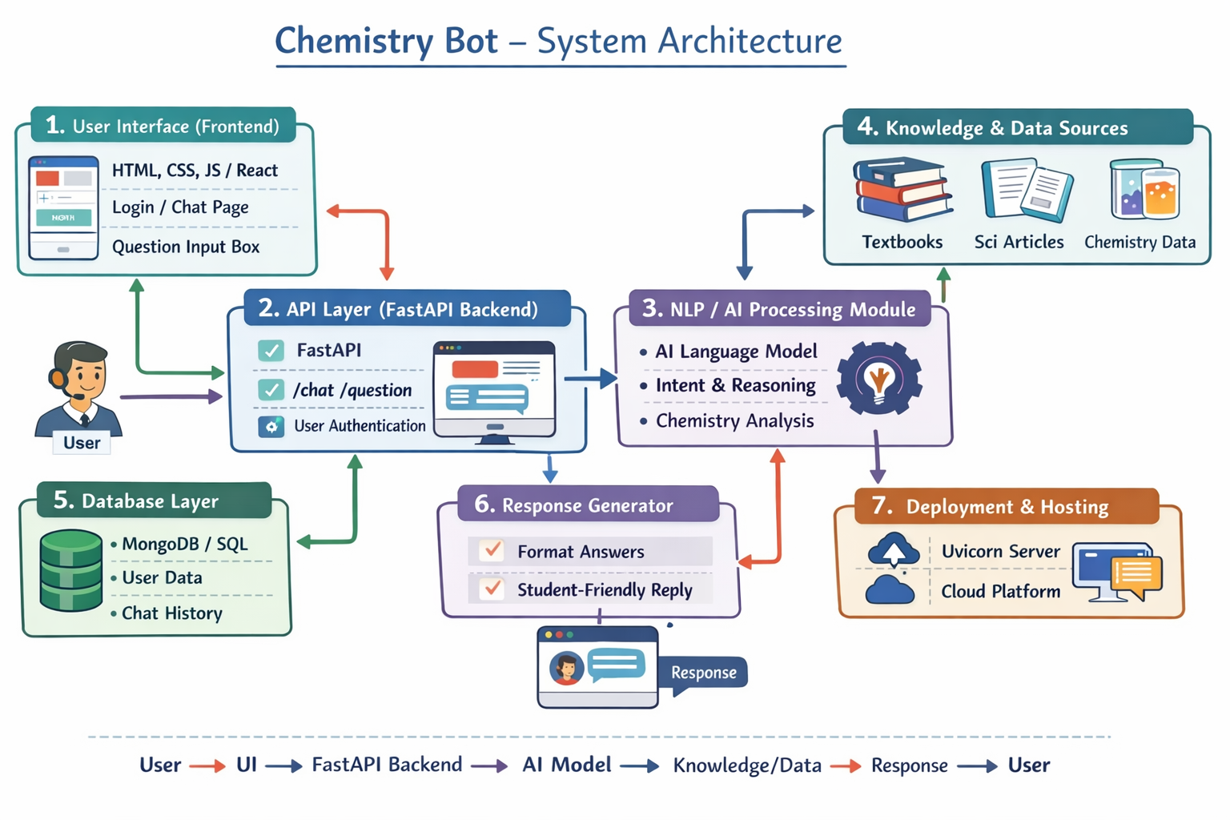

Slide 10
SYSTEM MODULES:
User Interface (UI) Module
Allows users to interact with the bot through web pages or a chat interface.
Includes login, signup, and chat sections.
Authentication Module
Handles user registration and login verification.
Ensures secure access to the system.
Question Processing Module
Receives user queries and processes them for understanding.
Converts the input into a format usable by the AI model.
AI & NLP Module
Uses Natural Language Processing to understand and analyze chemistry-related queries.
Generates accurate and relevant answers using the trained AI model.
Response Generation Module
Forms and sends a clear, user-friendly response back to the user. Can include references, explanations, or examples for better understanding.

Slide 11
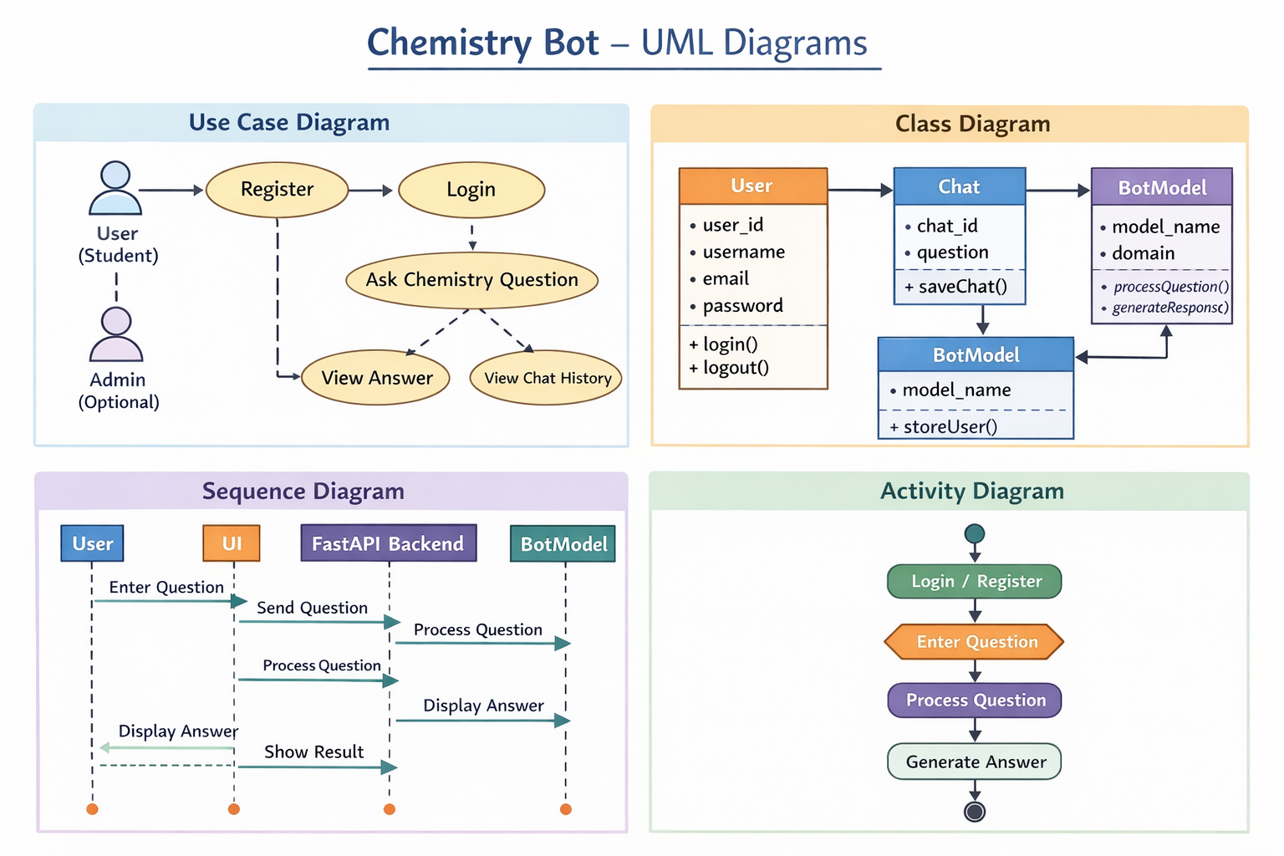

Slide 12
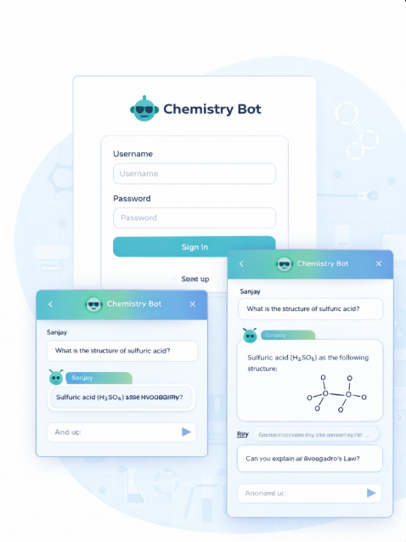
INPUT & OUTPUT SCREENS:
Input Screens :
Login / Registration Page -
Allows users to create an account or log in securely.
Chat Input Screen -
Users can type chemistry or scientific questions in a simple text box.
Output Screens
Bot Response Screen
Displays accurate and clear answers generated by the Chemistry Bot.
Chat History Screen
Shows previous questions and answers for reference.

Slide 13
CONCLUSION
The Chemistry Bot is an AI-based system developed to answer chemistry and scientific questions accurately.
It uses Natural Language Processing to understand user queries and provide meaningful, context-based responses.
The system offers a user-friendly chat interface that makes learning chemistry easy and interactive.
This project helps students save time, clear doubts instantly, and improve understanding of complex chemistry concepts.
Overall, the Chemistry Bot proves to be an effective learning support tool in the field of chemical education.

Slide 14
FUTURE SCOPE
Extend the bot to support other science subjects such as Physics and Biology.
Add voice-based input and output for better accessibility.
Develop a mobile application for wider usage.
Improve accuracy using advanced AI models and larger datasets.
Enable multi-language support to help users from different regions.

Slide 15


