Slide 1


Proof Of Work.

Slide 2
Intro…
Block header: Block size, Magic number, Version, Previous Block hash, Merkle root, Timestamp, Difficulty target, Nonce.
Transaction set:
{
A -> B,
F -> D,
E -> S,
W -> A,
X -> U.
}
Block hash:
SHA256(SHA256(Block header))
Arranged in a Merkle Tree Structure.

Slide 3
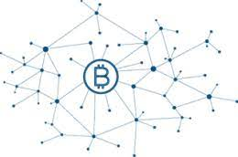

Intro…
Transaction pool:
N -> B, S -> D, I -> S, W -> S, X -> I, A -> F, T -> D, E -> S, W -> A, X -> U, A -> B, F -> D, E -> S, W -> A, X -> U.
000000gtvsu544c0003534trn

Slide 4
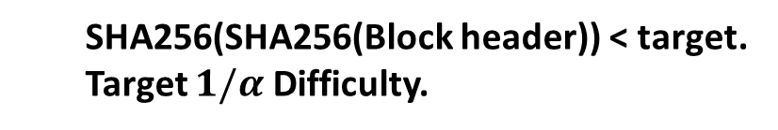
POW…
Transaction set:
{
A -> B,
F -> D,
E -> S,
W -> A,
X -> U.
(also contains a coin-base transaction for a miner to receive incentives, if valid.)
}
Nonce: __?__
SHA256(SHA256(Block header)) < target.
Target $1/α$ Difficulty.

Slide 5
Properties…
1. Longest Chain Rule:
The block that is created by a miner, must be appended to the Longest Chain present in that Network, so that the block will be considered as a valid block.
Fork: Creating a Long chain parallel to existing chain for successful 51% Attack.
To control the Block creation by miners (malicious), Creation Time was made constant.

Slide 6
Properties…
2. Block creation Time:
The block creation time, according to POW Consensus, is fixed to 10 minutes. Generally Block creation time depends on the Mining Power and Hash rate of the Network.
So to maintain a constant time, difficulty adjustments are introduced.

Slide 7
Properties…
3. Automated Difficulty Adjustments:
The Difficulty stated in Consensus of Bitcoin network is adjusted for creation of every 2016 blocks (or) in general, 2 weeks. This is made to maintain the Block creation Time.
Difficulty adjustments mean changing the Target for the miners to mine. Current difficultly is almost 64 leading zeroes.

Slide 8
Properties…
4. Uses Hash Puzzles efficiently:
POW Uses the properties of Hash in a very effective way to create a strong bond among the blocks in the Ledger. The Puzzle friendliness makes the miners to create a block, computationally expensive. The concept of Nonce is an example.

Slide 9
Properties…
5. Trivial To verify Block:
The Block creation involves a very huge computation Power, but verifying the block by other nodes is very simple and to the point. The other nodes just check the hash by the nonce and data included in that particular block.

Slide 10
Properties…
6. Involves all three consensus in one:
POW includes all three major properties in any consensus algorithms, which are:
Consensus about rules.
Consensus about history.
Consensus that coins are valuable.

Slide 11
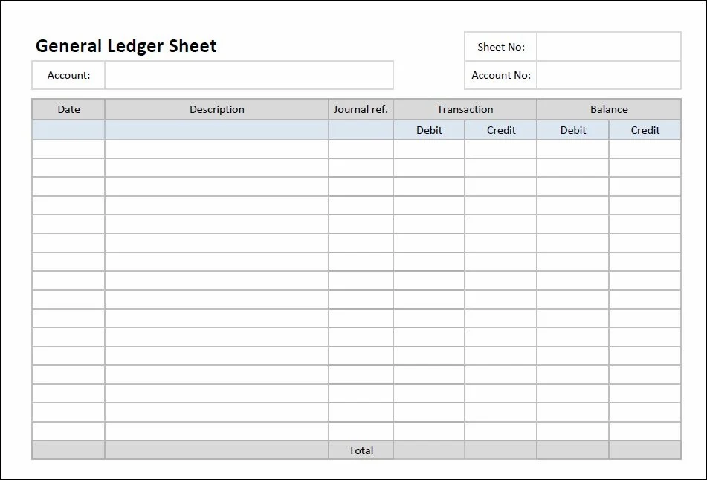

Slide 12
Checks the computation power required for both blocks (based on difficulty) and propagates the block with more computation power
Another Block coming to a node at same time..

Slide 14
POW…
000000gtvsu544c0003534trn
Longest chain.
Wait for a while…
000000rg534tvtwev4tg66700
Now valid block.!

Slide 15

POW…
000000gtvsu544c0003534trn
000000rg534tvtwev4tg66700
Wait for a while…
Longest chain.
Incentive (Block reward + Transaction fee)

Slide 16
POW…
000000gtvsu544c0003534trn
Now transactions present here are resistant to Double-spend.
000000rg534tvtwev4tg66700
Longest chain.
Wait for a while…

Slide 17
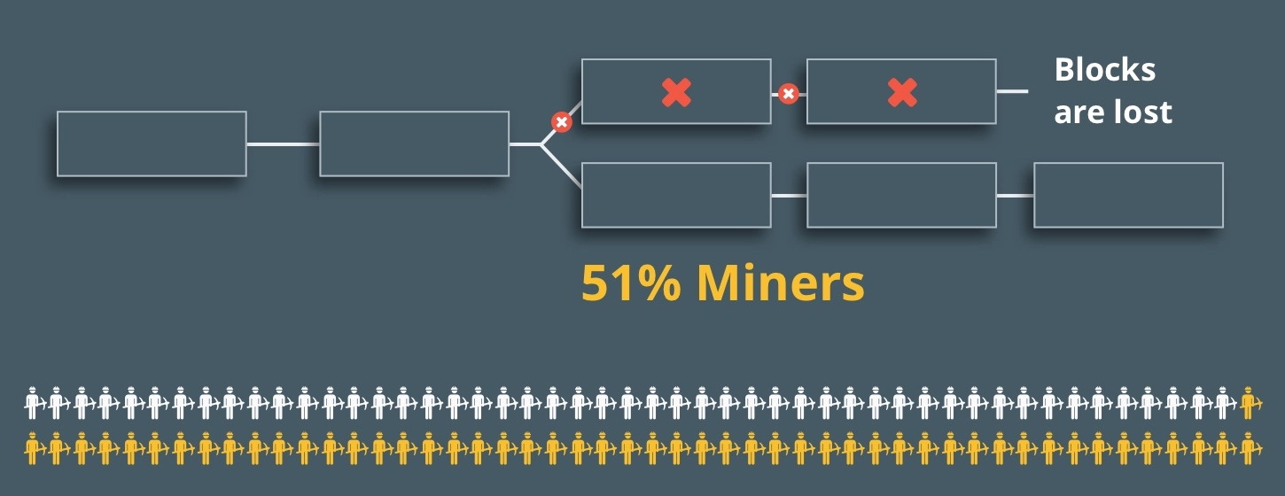
Cons…
1. 51% Attack.
Controlling over 51% of the whole mining power in the network is 51% attack. This attack is followed by Double-spend attack by forking the chain.

Slide 18

Cons…
2. Environment Impact.
Block chain network which uses this type of consensus consumes a lot of electricity and produces a heavy impact on the environment.

Slide 19
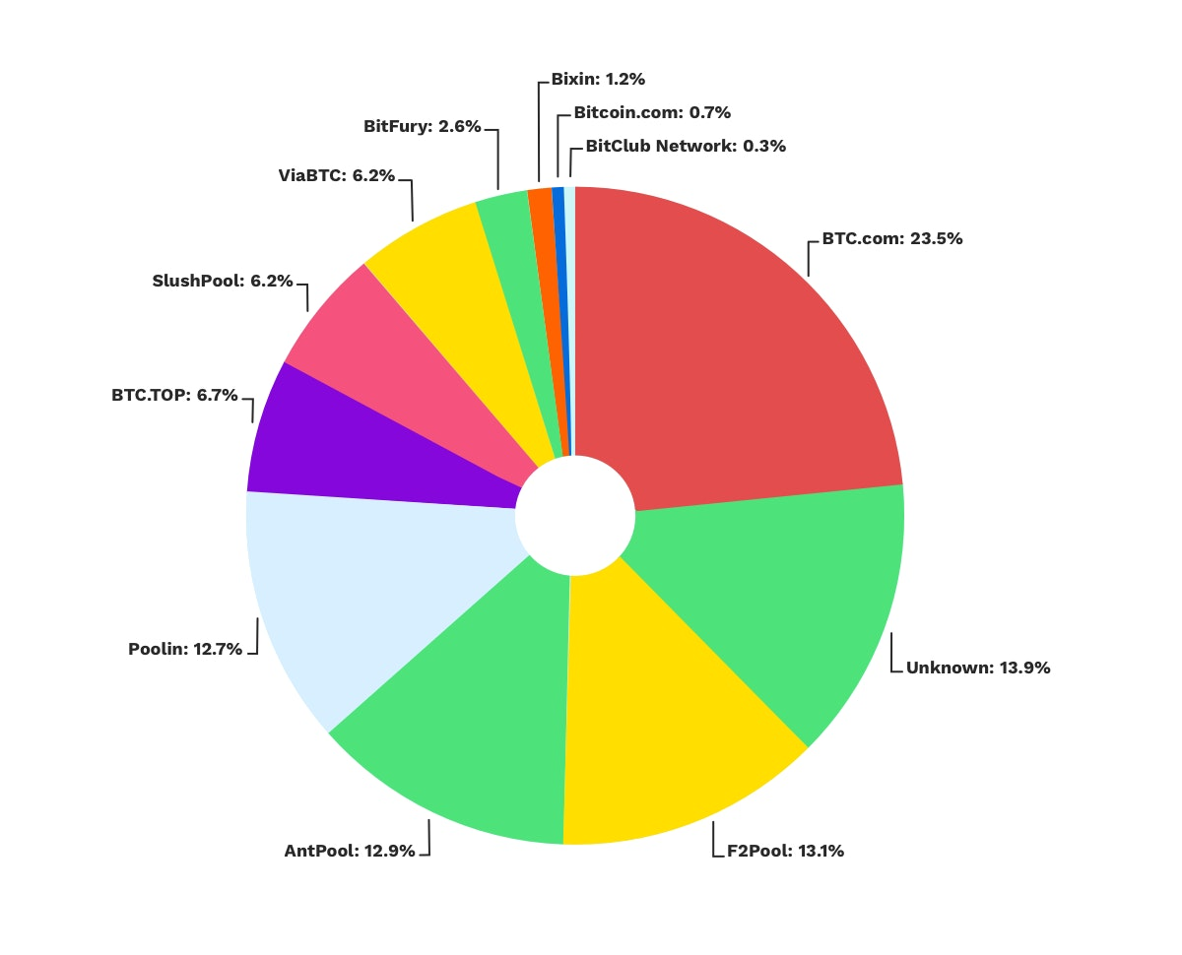
Cons…
3. Pooling and centralization.
As the mining became unprofitable for the new incoming miners in the network, and the chance of creating a block is becoming less day by day, mining pools are encouraged among the miners. This leads to centralization of the hashing power.

