Slide 1
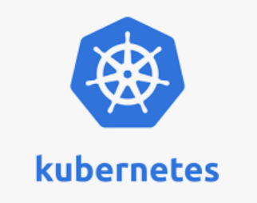


Slide 2
Kubernetes overview
Orchestration image
Notes:
https://www.pexels.com/photo/an-orchestra-performing-4028878/

Slide 3
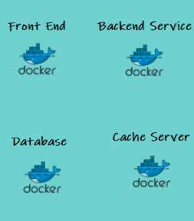
Container Orchestration – Why do we need it ?
Dev
Prod

Slide 4
Challenges in a container environment
How do I decide which container should run on which server ?
How do I know the resource utilization of the servers so that I can deploy my containers based on the resource requirement?
How do I monitor and manage all those server and schedule automate this process ?

Slide 5
Why Kubernetes (or container orchestration)
Orchestrate containers across multiple hosts
Self organizing and Automatic bin packing
Seamlessly deploy, update and Rollback
Quick and predictable/consistent
Self healing
Service discovery and Load balancing
IPAM. Binding to labels
Secret and Configuration Management
Scale out and scale in/scale up and scale down

Slide 6
Why Kubernetes contd…
Storage orchestration
Optimum hardware utilization
Batch Execution….

Slide 7
Software container world
Need to Simplify and standardize how the containers come together to make a usable software system

Slide 8
Why the market has chosen Kubernetes?
Born from a Google internal project (Google BORG)
Google donated Kubernetes to Cloud Native Computing Foundation (CNCF)
Based on an extensive experience from Google, over a long period of time
Large open source community and project

Slide 9







Kubernetes Architecture – View from 10000 ft
Kube-Controller
Kube-proxy
Containerd/CRIO (CRI)/Pods

Slide 10
API Server
Interface providing all operations to external/internal world.
Clients can readily communicate with it
Performs administrative tasks
REST based api server
Scale horizontally
Responsibility
Authenticate User
Authorizes User
Validate Request
CRUD data
Update ETCD, scheduler and kubelet

Slide 11
Pod Creation Process – Step 1
When you create a pod like below
kubectl run testpod --image=nginx
kubectl
converts my request https - REST request
send to api-server
on https://ip:6443

Slide 12
Pod Creation Process – Step 2
api server will
authenticate
authorize
validate
talk to etcd
Following would be the ETCD entry – this is indicative (not not real because it is NOSQL and not exactly table like below).
----------------------------------------------------------------------------------
SlNo Name Image Node CurrentState DesiredState
----------------------------------------------------------------------------------
1 testpod nginx - - Running ----------------------------------------------------------------------------------

Slide 13
Pod Creation Process – Step 3
Scheduler
identifies the best node
E.g. kworker2
Following would be the ETCD entry – this is indicative (not not real because it is NOSQL and not exactly table like below).
----------------------------------------------------------------------------------
SlNo Name Image Node CurrentState DesiredState
----------------------------------------------------------------------------------
1 testpod nginx kworker2 - Running ----------------------------------------------------------------------------------

Slide 14
Pod Creation Process – Step 4
Controller instructs kube-apiserver
Kube-apiserver instructs kubelet on kworker2
Kubelet on kworker2 will work with the CRI (container runtime like container/crio) to create the POD
Kubelet will update the api-server about the progress – Eventually ETCD will have the below entry
----------------------------------------------------------------------------------
SlNo Name Image Node CurrentState DesiredState
----------------------------------------------------------------------------------
1 testpod nginx kworker2 Running Running ----------------------------------------------------------------------------------

Slide 15
ETCD
NoSQL Stores configuration information
Highly available key value store
Recommended to be distributed among multiple nodes.
Accessible only by Kubernetes API server
Has sensitive information.
Back up
Only service to backup.
kubectl exec etcd-master -n kube-system etcdctl get / --prefix -keys-only

Slide 16
Controller Manager
Watches the desired state and match the current state
Logically each controller is a separate process
Compiled into a single binary
Run in a single process.
- It is a daemon which
regulates Kubernetes cluster.
- Controller also manages lifecycle functions
- namespace/resource crud operations and lifecycle,
- event garbage collection,
- terminated-pod garbage collection,
- cascading-deletion garbage collection,
- node garbage collection, etc.

Slide 17
Controller Manager
The key controllers are
- Node Controller
- Responsible for noticing and responding when nodes go down.
- Replication Controller
- Responsible for maintaining the correct number of pods for every replication controller object in the system.
- Endpoint Controller
- Populates the Endpoints object (that is, joins Services & Pods)
- and Service Account and Token Controller.
- Create default accounts and API access tokens for new namespaces.

Slide 18
Scheduler
Watches newly created pods and allocates a node.
Schedules the tasks to slave nodes
Stores resource usage information about each node
Considers
quality of the service requirements,
data locality,
affinity,
anti-affinity, etc.

Slide 19
Worker Node
- Can be VM or machine.
- Has container runtime
- Has kubelet, kube-proxy and pod(s)
kubectl get nodes
kubectl describe node <<node name>>

Slide 20
Master to Node Communication
Nodes to Master
All communication to the master on secure HTTPS port (443)
Master to Nodes communication happens between
Master (api-server) to kubelet
Master (api-server) to node/pod/service through Kube-proxy.
api-server connects to kubelet for
Fetching logs from pods
Attaching (through kubectl) to running pods.
Providing the kubelet’s port-forwarding functionality
Kubelet listens on a port – forwards the request to Pod.

Slide 21
Master to Node Communication
Master (api-server) connect to node/pod/service through Kube-proxy.
- Default to plain HTTP connections
- Neither authenticated nor encrypted.
- Can be moved to https and secured.

Slide 22
Kubelet
Not inside a container – Not a Pod.
Service runs on each node
Relay information to and from control plane service.
Communicates master component
- receive commands and work.
- assumes responsibility
- manages network rules, port forwarding, etc.

Slide 23
Kubernetes Proxy Service
Started as a proxy but Proxy++ now.
- Can do primitive load balancing
- networking is
- predictable
- accessible
- isolated as well.
- manages network for pods, volumes, secrets, health checkup, etc.
- check on host sub-netting
- Ensure that the services are available.
- Sets routes so that POD ect is reachable.

Slide 24
YAML
- What is YAML?
- How to write YAML file

Slide 25
Manifest file
1. apiVersion:
2. kind:
3. metadata:
4. spec:

Slide 26
apiVersion : Manifest file
kind | version
Pod | : v1
ReplicationController | : v1
Service | : v1
ReplicaSet | : apps/v1
Deployment | : apps/v1
DaemonSet | : apps/v1
Job | batch

Slide 27
Kind and metadata a : Manifest file
kind: <object type>
metadata:
name:
labels:

Slide 28
kind : Manifest file
spec:
defines the desired state of the object.
For replicas, define a template.
template defines an object.
template can have metadata and spec under it.

Slide 29
Namespaces
Virtual clusters backed by the same physical cluster
Names of resources : unique within a namespace
Namespaces can not be nested
Kubernetes resource can only be in one namespace.
- kubectl get namespaces
default: default namespace for objects with no other namespace
kube-system: The namespace for objects created by the Kubernetes system
kube-public: reserved for cluster usage

Slide 30
Namespaces
Create namespace
kubectl create namespace <name>
Run a container in a namespace
kubectl run nginx --image=nginx --namespace=<ns name>
Get Objects in a ns
kubectl get pod –n <ns name>
kubectl get svc -n kube-system
kubectl describe svc kube-dns -n kube-system
kubectl get pods -o wide -n kube-system
Delete namespace
kubectl delete namespaces <name>

Slide 31
How to Deploy
1. Pod
2. ReplicationControllers
3. ReplicaSet
4. Deployment
5. DaemonSet
6. StatefulSet

Slide 32
POD Creation
CLI talks to (-) APIServer.
APIServer
- authenticates user
- validate request
- Creates and entry in ETCD and returns the message "Pod created!".
- Scheduler is continuously monitoring the changes in ETCD, realizes that a POD has to be created. Scheduler identifies the node where Pod has to be created and informs (call api) API server about it.
- API server updates the ETCD about the node where Pod would be created.

Slide 33
POD Creation
API server - kubelet
kubelet - Docker
Docker - create POD container.
POD creates (say nginx pod) (nginx container + pause container)
Docker - creates nginx pod.
- Kubelet watches over the container creation.
- Kubelet intimates the API server about Pod creation status
- API server updates the ETCD.

Slide 34
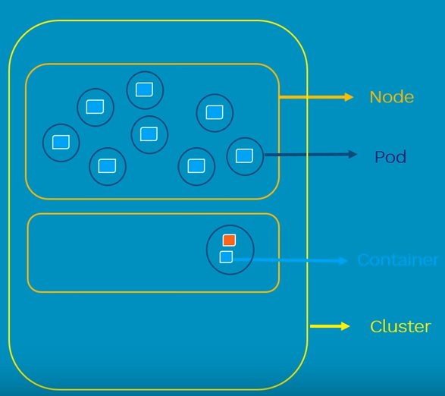
POD
A Pod (as in a pod of whales or pea pod) is a
- group of 2 or more containers
- shared storage/network,
- co-located and co-scheduled,
- run in a shared context.

Slide 35
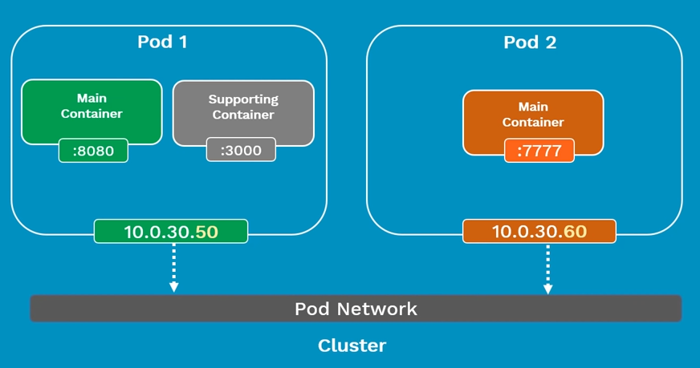
POD

Slide 36
POD
Containers in different Pods have
distinct IP addresses and
can not communicate by IPC without special configuration.
These containers usually communicate with each other via [Pod] IP.
ephemeral (rather than durable) entities.
If a Node dies,
the Pods scheduled to that node are scheduled for deletion, after a timeout period.

Slide 37
Labs of POD
kubectl apply -f ng-pod.yaml
kubectl get pod
kubectl get pod -o wide
kubectl describe pod <pod id>

Slide 38
Lifecycle of Pod
Create a manifest file (yaml or json)
Submit the manifest file to api server using kebectl
It gets scheduled on to a worker node inside the K8s cluster.
Once scheduled the POD would go into “pending state”.
During pending state, it will start downloading all container images and setting up containers appropriately.
POD will remain in pending state until all containers are up and running.
After all containers are running the state of the POD changes to "Running".

Slide 39
Lifecycle of Pod
After the main purpose of the POD is complete,
it succeeds and it's status changes to "Shutdown".
If a POD can't start properly for any reason
It remains in "Pending" state for considerable period of time,
then POD moves to "Failed" state.
If a POD dies,
it is dead.
Cannot make it alive again.
Can replace it with a new one but we cannot bring it up.

Slide 40
Multiple containers in a Pod
We can have multiple containers in a Pod.
Different containers in a Pod share
- Network namespace
- Cgroup (access)
- IP address
- Volumes
- IPC Name
- Can find each other via localhost.
- Communicate with each other using standard inter-process communications.

Slide 41
Labels and Selectors
kubectl apply -f label-selector.yaml
kubectl get pods -l env=development
#-l represents the label we passed.
kubectl delete -f label-selector.yaml

Slide 42
ReplicationController (rc)
What is ReplicationController?
Why do you need to replicate?
How it helps in a microservices world
Ensures that configured number of pods
- if excess, kill.
- if less create.
replicationCount = 1 makes sense

Slide 43
ReplicationController (rc)
Adv
- HA
- Loadbalancing
Labs
kubectl apply -f replication-controller.yaml
kubectl get rc
kubectl get rc -o wide
kubectl describe rc <object>

Slide 44
ReplicaSet (rs)
Advanced version of ReplicationController.
Replacement for ReplicationController.
Works based on sets

Slide 45
ReplicaSet (rs)
Criteria | Equality based | Set based
e.g. | environment = production | enviornment in (production, qa)
 | tier != frontend | tier notin (frontend, backend)
Command line | kubectl get pods –l environment=production | kubectl get pods –l environment in (production, qa)
manifest | selector: environment:production tier: frontend | selector: matchLabels:- {key:environment,operator:In, values:[prod, qa]}
Supports | Services, ReplicationControllers | Jobs, Deployment, ReplicaSet, DaemonSet

Slide 46
Labs for ReplicaSet (rs)
kubectl apply -f replica-set.yaml
kubectl get rs
kubectl get rs -o wide
kubectl describe rs <<rs id>>

Slide 47
Deployment
- Desired state in a Deployment
- DeploymentController : converts desired state to actual state
- Rollback deployment
- Scale out/in deployment
- Pause deployment
Steps
- Create a deployment
- That creates a ReplicaSet.
- That Creates Pods

Slide 48
Deployment
See rollout status:
- kubectl rollout status deployment.v1.apps/nginx-deployment
kubectl rollout status -w deployment/frontend
Update deployment:
- kubectl set image deployment/nginx-deployment nginx=nginx:1.16.1
kubectl rollout status deployment.v1.apps/nginx-deployment
Rollback:
- kubectl rollout undo deployment.v1.apps/nginx-deployment

Slide 49
Scale out/Scale in
kubectl scale --replicas=3 rs/foo
kubectl scale --replicas=3 -f replica-set.yaml
kubectl scale --current-replicas=2 --replicas=3 deployment/nginx-deployment
kubectl scale --replicas=3 deployment/nginx-deployment
kubectl scale deployment.v1.apps/nginx-deployment --replicas=2
kubectl scale deployment.v1.apps/nginx-deployment --replicas=1

Slide 50
Rollback to older version
1. append the --record param to deployment, as shown below
kubectl apply -f <deployment_file>.yaml --record
2. kubectl rollout history deploy <deployment-name> to check deployment history. for example,
REVISION CHANGE-CAUSE
3 kubectl set image deploy nginx-deployment mynginx=nginx:1.12.2
4 kubectl set image deploy mynginx mynginx=nginx:1.13.8
3. you can rollback to previous version using revision, say to revision 3
kubectl rollout undo deploy mynginx --to-revision=3

Slide 51
Update change log
You can use the annotate to manage the history same way.
Create the deployment
kubectl create deployment nginx --image=nginx:1.16.0 --replicas 1
check the history
kubectl rollout history deployment nginx-deployment
update the image on deployment
kubectl set image deployment nginx nginx=nginx:latest
Annotate the deployment now and create the history
kubectl annotate deployment nginx-deployment kubernetes.io/change-cause="version change from 1.9.1 to 1.16.1"
Check the history
kubectl rollout history deployment nginx
Notes:
https://stackoverflow.com/questions/73814500/record-has-been-deprecated-then-what-is-the-alternative

Slide 52
Daemonset and StatefulSet
DaemonSet:
- Only a single instance of POD should run on a node
- An instance of POD should always run on all nodes.
- Usecase : for monitoring.
StatefulSet:
- Work along with a service.
- If an instance dies, it would be created back on the same parameters

Slide 53
NodePort
Lab reference : Refer node-port.yaml - works with deploy-ng.yaml
Port should be between 31000 to 32767
How it work
Exposes the Service on each Node’s IP at a static port (the NodePort).
ClusterIP Service, to which the NodePort Service routes, is automatically created.
Contact the NodePort Service, from outside the cluster, by requesting <NodeIP>:<NodePort>.

Slide 54
Jobs
Creates one or more Pods and ensures that a specified number of them successfully terminate.
Primarily meant for short-lived and batch workloads.
Jobs run until the tasks specified in the job is completed.

Slide 55


Jobs
Vi jobs.yaml
You can get the job pod logs using kubectl

Slide 56



CronJobs

Slide 57
Storage Volume
Why Volumes?
Way more powerful than docker volumes
Volume Type

Slide 58
emptyDir
Creates empty directory
Removed when Pod dies
Multiple containers in same Pod can refer

Slide 59
HostPath
Mounts a file or directory from Host into Pod
Data remain on the HOST after Pod dies
Use cautiously

Slide 60
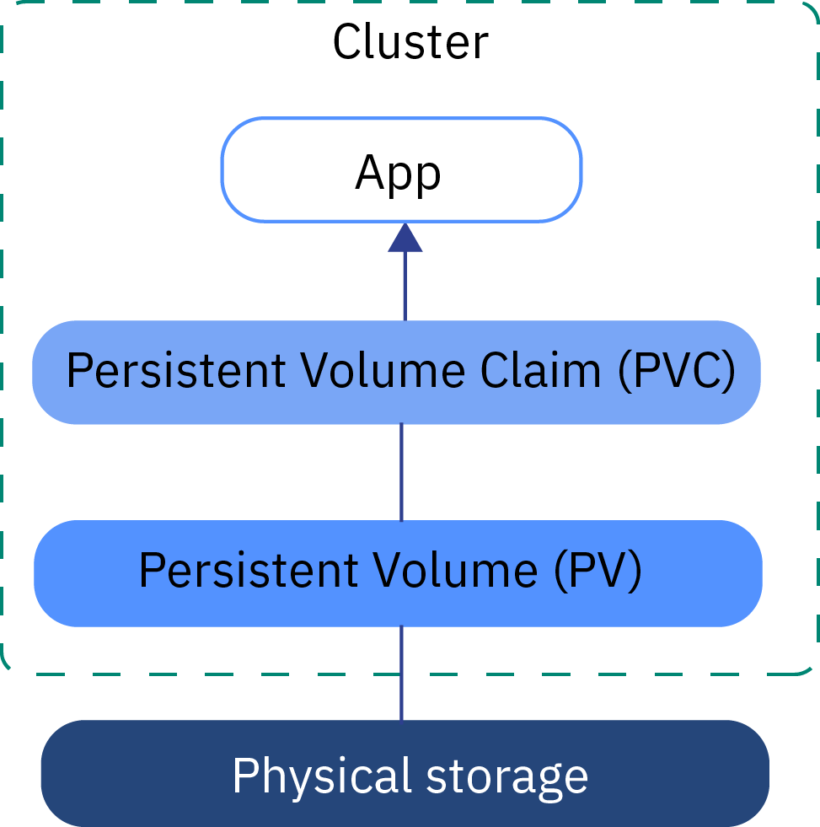
Lifecycle of Volume

Slide 61
Volumes lifecycle
Binding
Using
Storage Object in Use Protection
Reclaim – Reclaim Policy

Slide 62
Secrets
Putting sensitive information inside Docker container is not a good idea
Container can be inspected, exported and published publicly

Slide 63
Bonus: Kubernetes Networking
Container to Container
Pod to Pod
Pod to Service
External to Service

Slide 64
Container to Container Communication
Highly coupled Pod
Localhost

Slide 65
Pod to Pod Communication
Pod’s have IP address
Containers with in Pod share the network namespace including IP.
Implemented by Network drivers
Rules
pods can communicate with all pods without NAT
agents on a node (e.g. system daemons, kubelet) can communicate with all pods
For platforms that support Pod running in host network (linux)
pods in host network of node can communicate with all pods without NAT
Simple and less friction model
Containers should co-ordinate Port like how it happens on VM’s. IP-per-Pod model.

