Slide 1
KNOWSPHERE AI
Company knowledge,
with context and control.
A role-aware knowledge workspace built around permission-filtered search, cited answers, and clear administration.
PRODUCT OVERVIEW
Product walkthrough • MVP capabilities and current scope
Notes:
Opening: introduce KnowSphere AI as a company knowledge workspace. Set expectations: this deck explains the product, compares its workflow with general-purpose chat used alone, and then walks through actual admin, HR, and employee panels. This is an MVP overview, not a claim that KnowSphere is a new foundation model.

Slide 2
01 / INTRODUCTION
02
One place to ask about company knowledge
KnowSphere wraps an AI answer workflow in organization access rules and reviewable sources.
THE PRODUCT
THE MODEL
Gemini
Ask once. Get an answer grounded in the documents your role is allowed to see.
Provides semantic embeddings and drafts responses.
The application combines a role-specific workspace, a searchable knowledge base, Gemini embeddings and generation, and an audit trail.
THE PRODUCT LAYER
KnowSphere
Adds permissions, document workflow, citations, and admin views.
KNOWSPHERE AI • PRODUCT OVERVIEW
Notes:
Mention that the underlying generative model is Gemini. KnowSphere is the product layer around it: identity, access-filtered retrieval, document management and the user experience. Avoid suggesting the product trains a proprietary base model.

Slide 3
02 / PROBLEM & GAP
03
Company answers have a context gap
General chat is useful, but the organization must still connect knowledge, access, and evidence.
01
02
03
SCATTERED KNOWLEDGE
ACCESS IS CONTEXT
ANSWERS NEED PROOF
Policies and guidance live across documents and teams.
HR, employees, managers, and auditors do not share the same visibility.
A fluent response alone does not show which source supports it.
A person has to know where to look.
One broad search can expose the wrong material.
People need to check the original document.
The product gap:
connect a familiar AI assistant to scoped company knowledge and make the evidence visible.
KNOWSPHERE AI • PRODUCT OVERVIEW
Notes:
Position these as common workflow challenges, not quantified research claims. The gap KnowSphere addresses is between general chat capability and a governed organization knowledge workflow.

Slide 4
03 / DIFFERENTIATION
04
What changes when chat becomes a product workflow
A practical comparison with general-purpose chat used on its own. This is not a model benchmark.
Dimension | General-purpose chat on its own | KnowSphere workflow
AI model | The provider’s model | Gemini for embeddings + answer drafting
Company knowledge | Depends on user-provided context or connected tools | Searches published, indexed organization documents
Permission checks | Not inherently aligned to this app’s department rules | Filters eligible documents server-side before retrieval
Evidence | May provide general answers; grounding varies by setup | Shows citations from retrieved passages and page numbers
Administration | Outside the chat experience | Admin panels for people, documents, audit and overview
Difference:
the governed retrieval and workspace experience around Gemini—not a proprietary foundation model.
KNOWSPHERE AI • PRODUCT OVERVIEW
Notes:
Explain that there are many existing AI models. KnowSphere currently uses Gemini, so the differentiation is not a claim that its base model is more capable than competing LLMs. It is the way this MVP applies role and department access, retrieves organization documents, surfaces citations, and provides administrative workflows.

Slide 5
04 / HOW IT WORKS
05
From sign-in to a cited answer
The central product difference is a controlled path from identity to evidence.
01
02
03
04
05
Sign in
Filter access
Retrieve
Draft + cite
Review
Session identifies the current user and role.
Backend limits documents by role, department and publication status.
Gemini embeddings rank only eligible passages.
Gemini drafts from retrieved passages; citations are checked.
The user checks sources; admin actions create audit events.
GUARDRAIL
Previous assistant answers can help resolve follow-up context, but they are not treated as evidence.
KNOWSPHERE AI • PRODUCT OVERVIEW
Notes:
Walk the audience through the pipeline. Stress the ordering: the backend applies access rules before passages are sent to Gemini for embedding or answer drafting. The sources remain the basis for citations; prior assistant output is not evidence.

Slide 6
05 / FEATURE SET
06
The MVP is designed for everyday knowledge work
A focused set of capabilities with current availability made explicit.
Role-aware portals
Scoped knowledge search
Cited responses
Separate navigation and experiences for admin, HR, manager, employee, and auditor roles.
Published documents are filtered by role and department before semantic retrieval.
Answers include validated source references and PDF page numbers.
Document review
Audit trail
Session-based chat
Admin and knowledge manager can upload TXT/Markdown, review, and publish.
Role changes and important actions are logged; events can export as CSV.
Follow-up context is available during the page session; chat history is not persisted.
KNOWSPHERE AI • PRODUCT OVERVIEW
Notes:
Current MVP feature list. Clarify that direct upload is TXT/Markdown up to 80 KB, with uploaded files private until reviewed and published by an authorized admin or knowledge manager. Seeded sample PDFs are indexed at startup if their text is selectable.

Slide 7
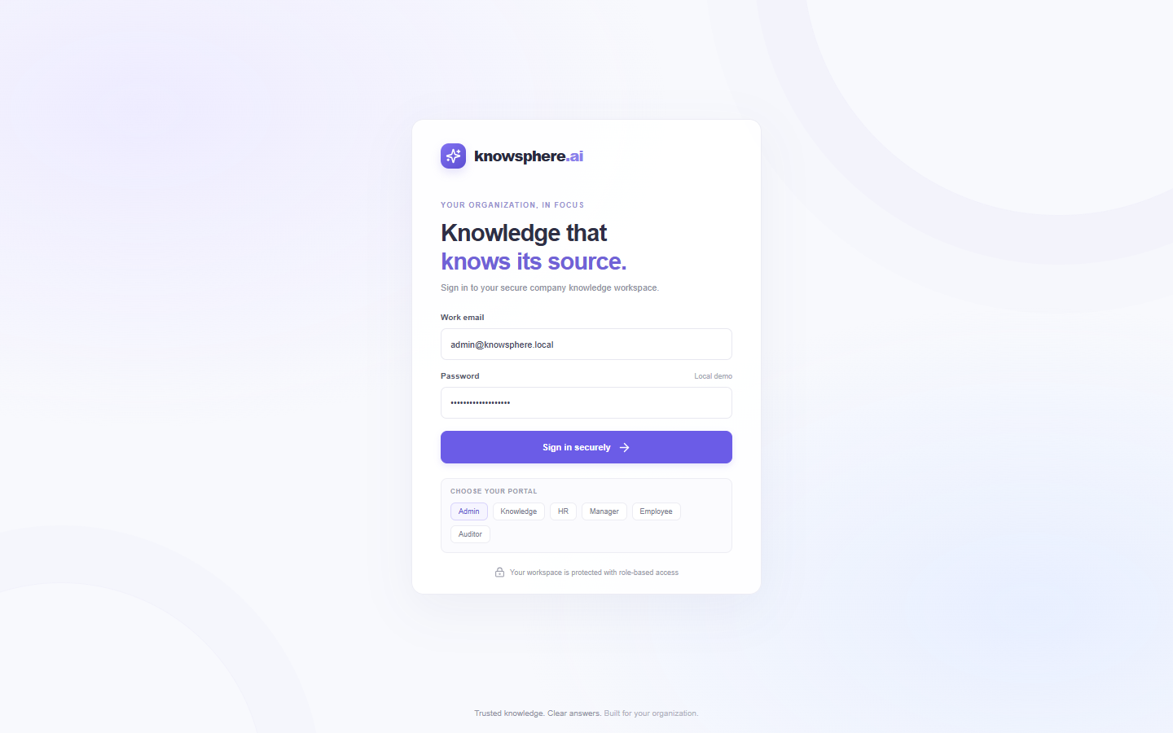
06 / LOGIN & ROLES
07
One sign-in, then a workspace shaped by role
The session establishes who is asking—and which workspace they enter.
ROLE-SPECIFIC PORTALS
Admin
Organization settings and oversight
Knowledge manager
Knowledge curation and publishing
HR
HR-specific workspace and scoped knowledge
Manager
Manager workspace and permitted material
Employee
Employee workspace and assistant
Auditor
Compliance-oriented visibility
The pictured sign-in is a local demo screen; demo credentials are for development only.
KNOWSPHERE AI • PRODUCT OVERVIEW
Notes:
Show the sign-in screen, then describe the role options shown: admin, knowledge manager, HR, manager, employee, and auditor. The local demo login fields are prefilled in this capture; credentials are for local development only and must not be reused in production. After sign-in, the application displays a role-specific workspace, while backend permission checks enforce document access.

Slide 8
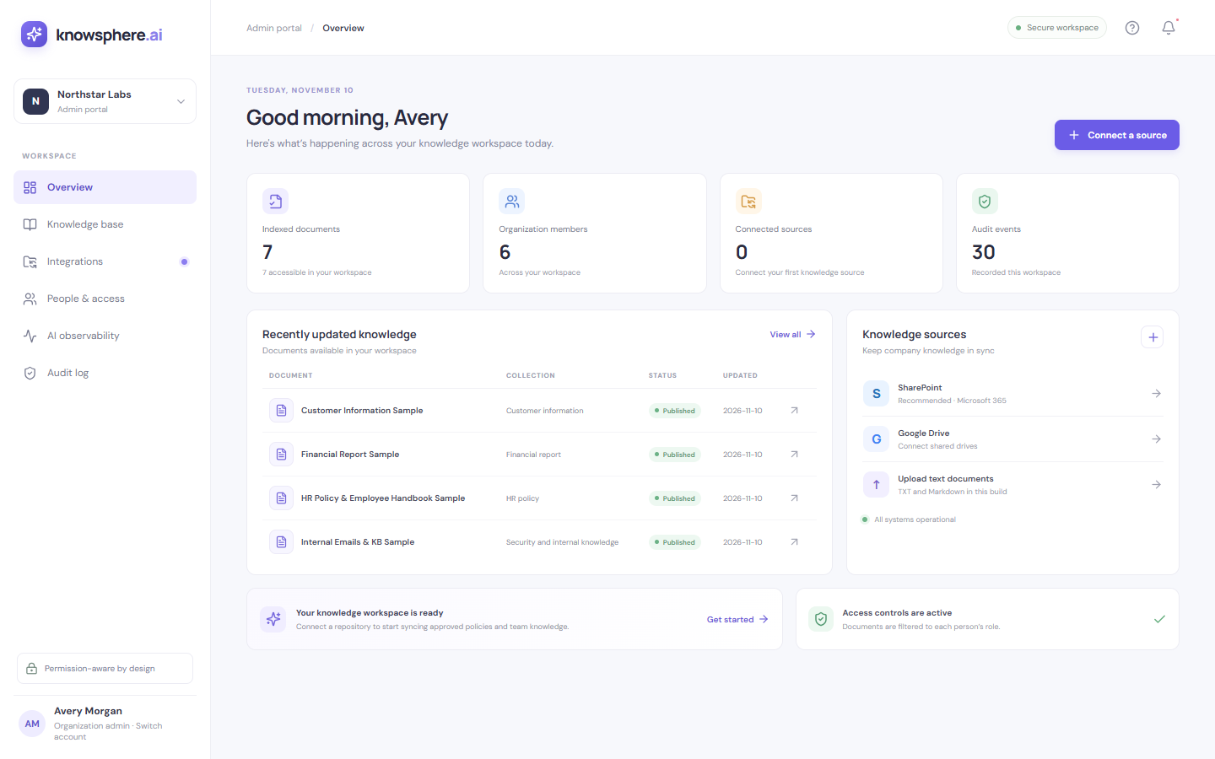
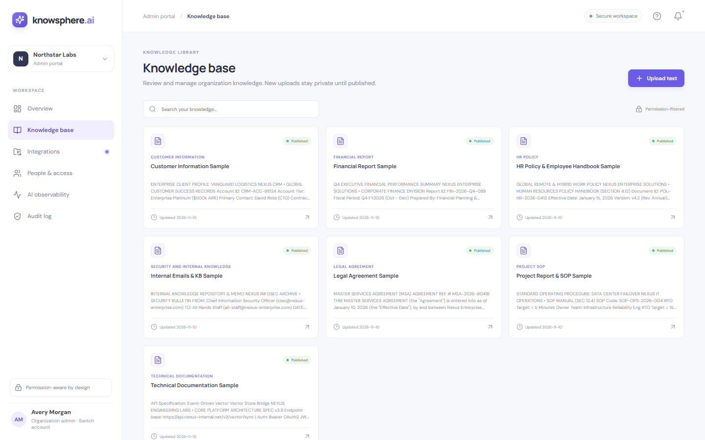
07 / ADMIN WALKTHROUGH
08
Admin: understand the workspace and manage knowledge
Overview for status; Knowledge Base for the document lifecycle.
OVERVIEW
KNOWLEDGE BASE
At-a-glance organization and knowledge status.
Inspect document scopes and manage upload, review, and publishing.
KNOWSPHERE AI • PRODUCT OVERVIEW
Notes:
Using the actual app captures: first the admin overview, then the Knowledge Base. Explain that admins can inspect document scopes across the organization. Admins and knowledge managers can upload TXT/Markdown for review and publish. The seeded PDF corpus is indexed at startup; PDF upload and OCR are not available in this MVP.

Slide 9
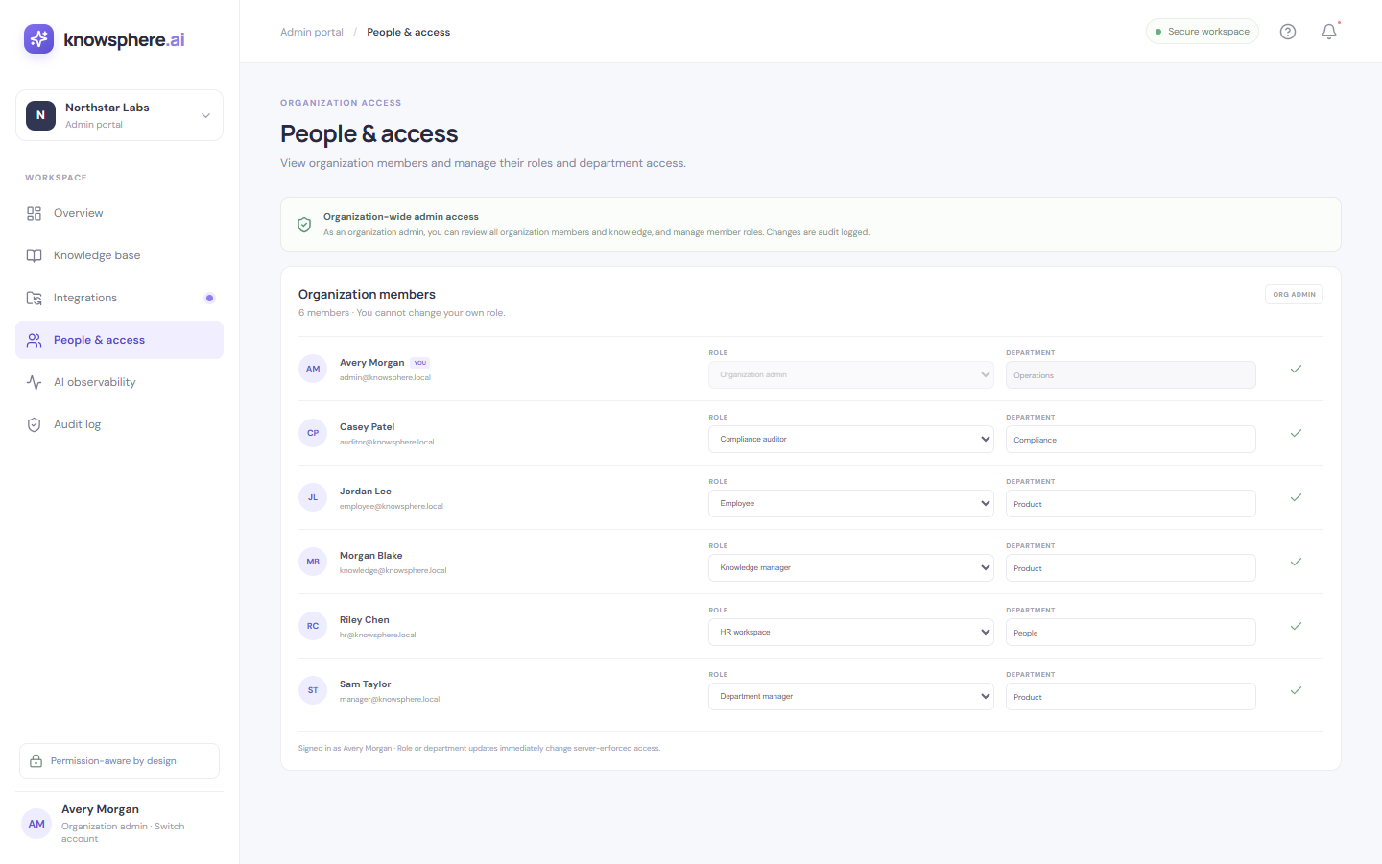
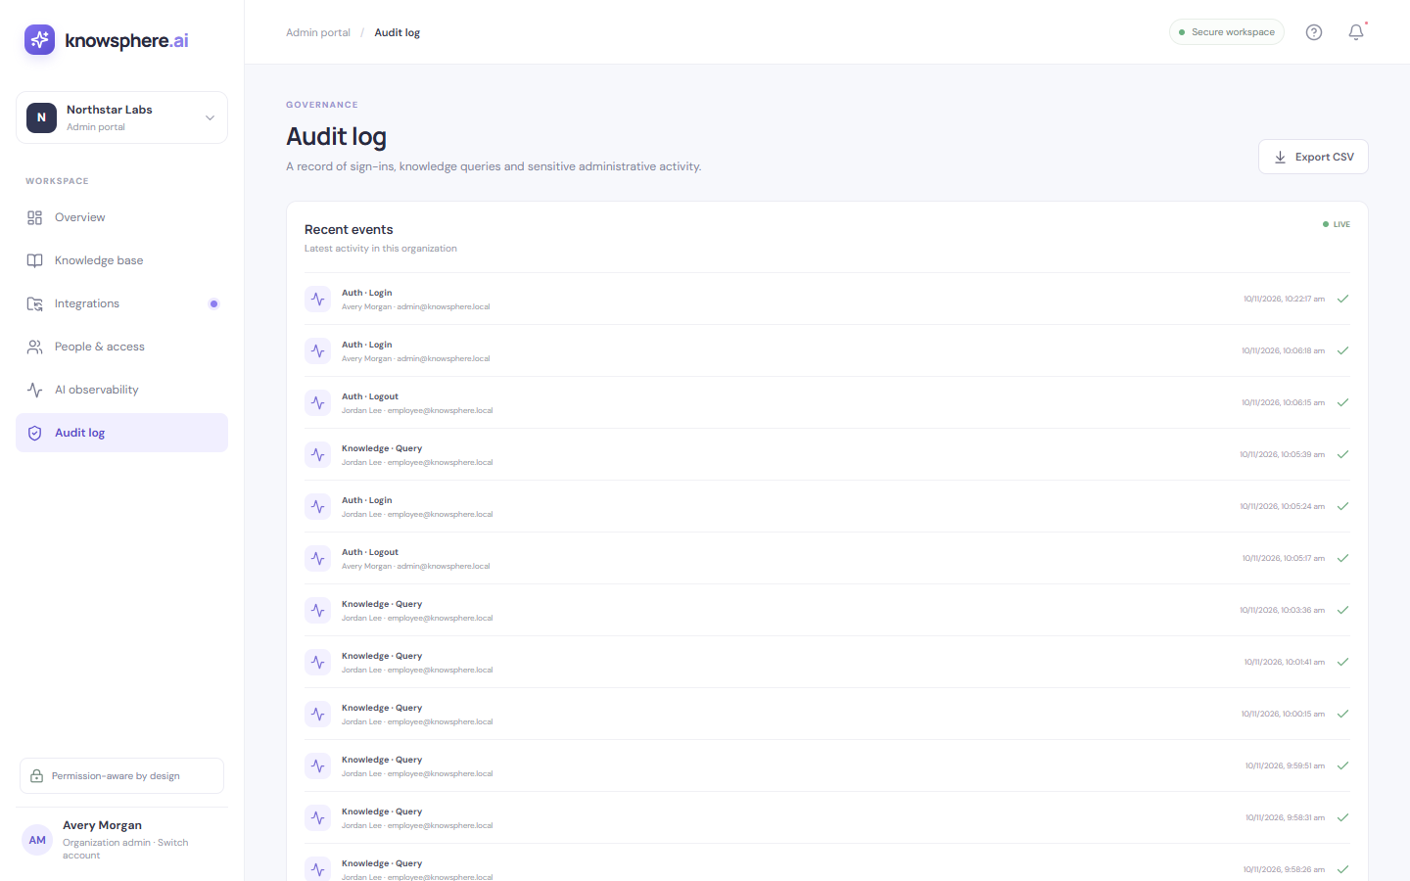
07 / ADMIN WALKTHROUGH
09
Admin: govern access and review actions
Membership, role and department changes are auditable.
PEOPLE & ACCESS
AUDIT LOG
Review members; change a member’s role or department.
Inspect organization events and export available events as CSV.
KNOWSPHERE AI • PRODUCT OVERVIEW
Notes:
Explain how the admin changes role and department for another member. Those changes create audit events. Audit events can be downloaded as CSV. The local seeded accounts are demo-only credentials and should not be used in production.

Slide 10
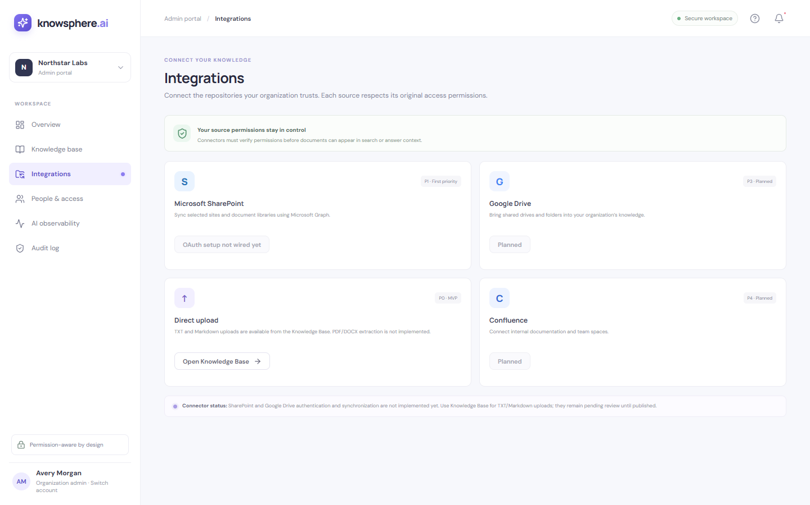
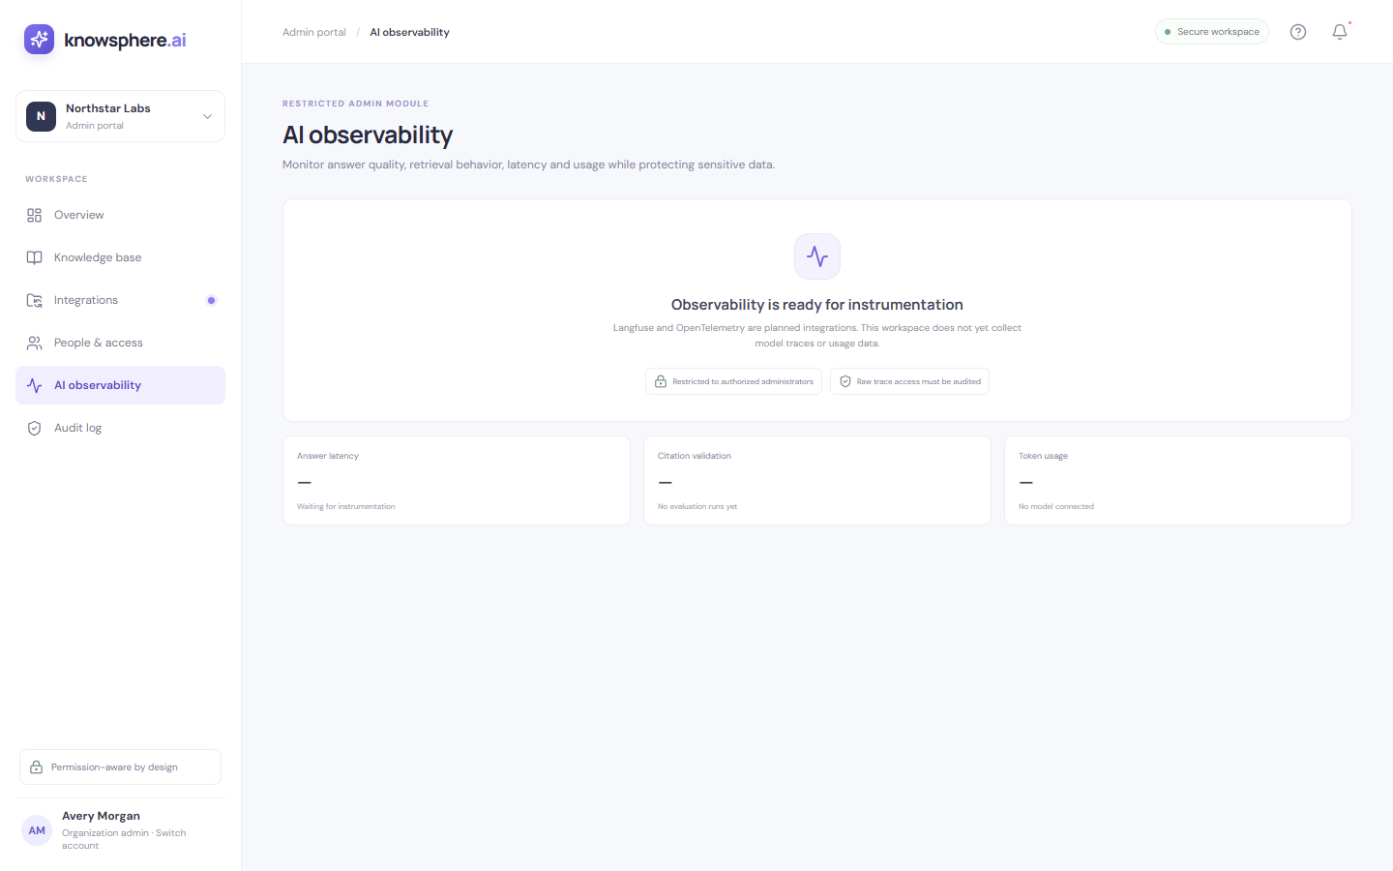
07 / ADMIN WALKTHROUGH
10
Admin: integrations and observability
These screens communicate intended direction; connected services are not wired in this MVP.
ROADMAP / PLACEHOLDER
ROADMAP / PLACEHOLDER
Integrations
AI Observability
SharePoint, Google Drive and Confluence synchronization are not implemented.
Advanced tracing/instrumentation is not connected; this panel is a placeholder.
KNOWSPHERE AI • PRODUCT OVERVIEW
Notes:
Show both panels transparently. Their presence in the UI does not mean integrations or AI observability are operational. SSO/SCIM, document versioning, and private deployment are also not implemented.

Slide 11
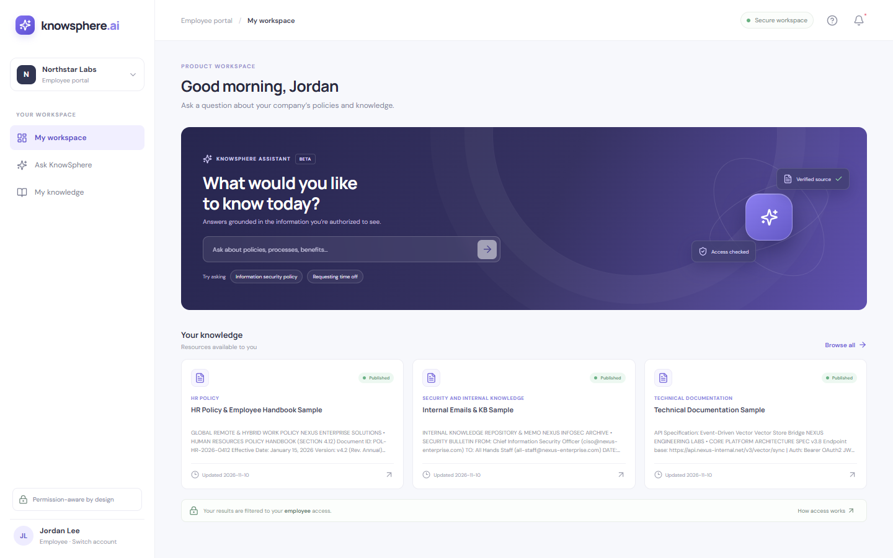
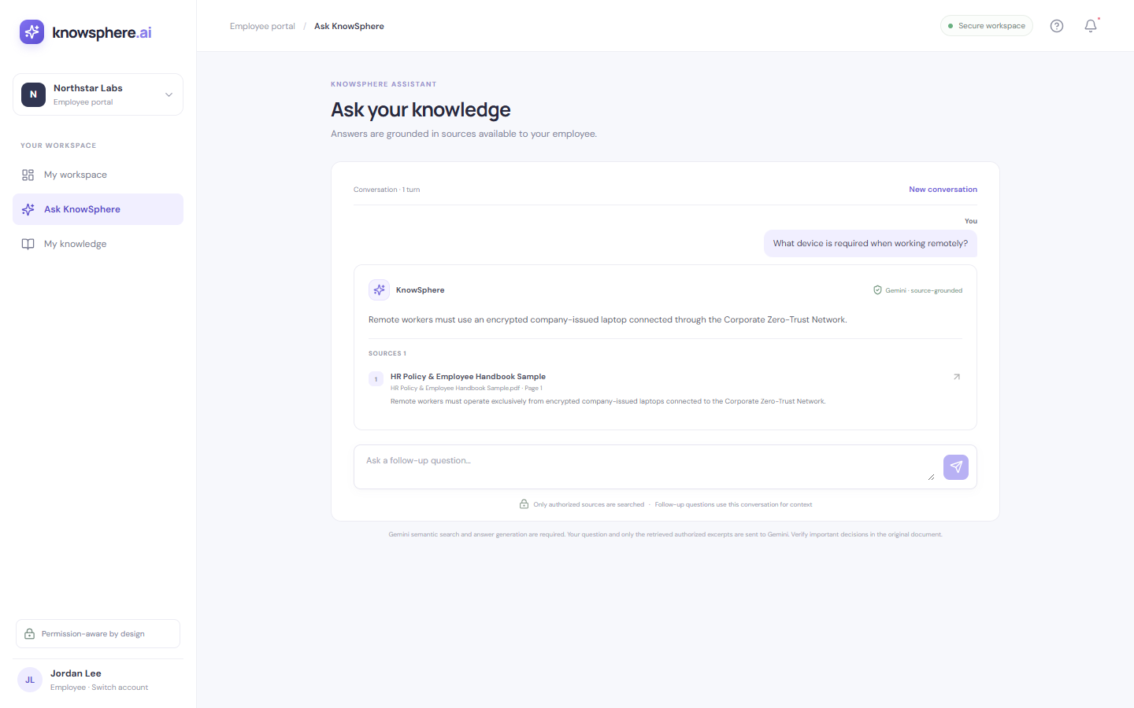
08 / EMPLOYEE WALKTHROUGH
11
Employee: ask in the context of their access
A simple path from workspace to a scoped assistant and personal knowledge view.
MY WORKSPACE
ASK KNOWSPHERE
Role-specific starting point and navigation.
Ask a policy question and inspect cited sources.
ILLUSTRATIVE CHAT EXAMPLE
This captured answer is scripted, not a live Gemini response.
KNOWSPHERE AI • PRODUCT OVERVIEW
Notes:
Employee navigation includes My Workspace, Ask KnowSphere, and My Knowledge. The screenshot answer shown here is a scripted illustrative example, not a live Gemini response. In the actual flow the assistant uses currently authorized, published passages.

Slide 12
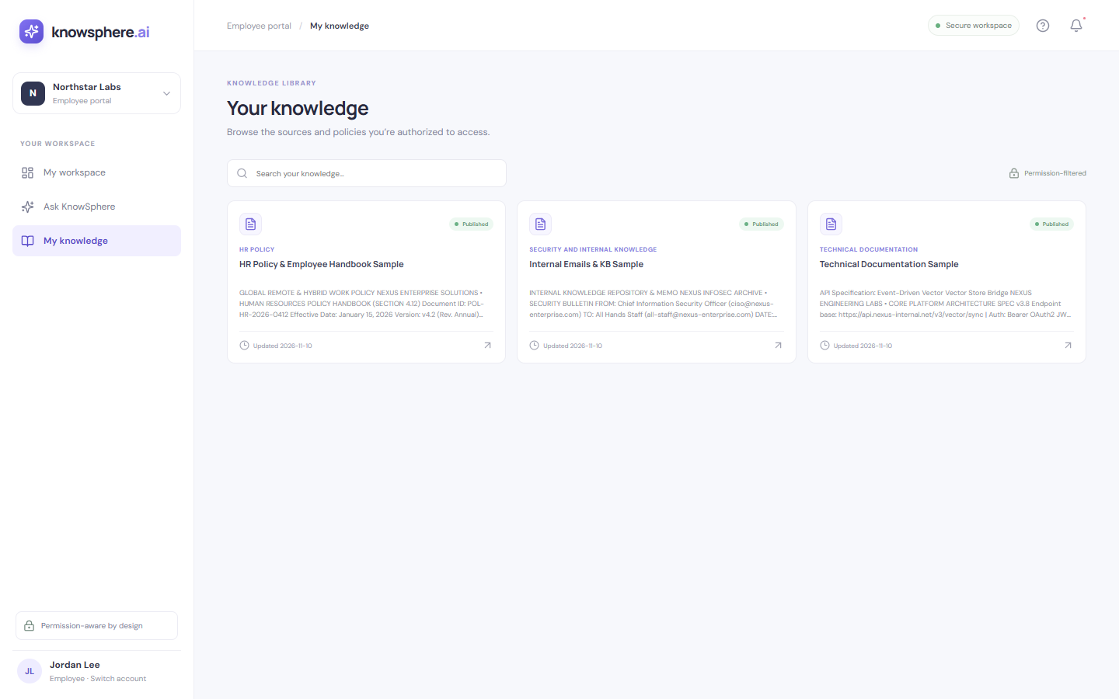

08 / ROLE WORKSPACES
12
My Knowledge and HR workspace
The same product structure can serve different roles and visibility scopes.
EMPLOYEE · MY KNOWLEDGE
HR · MY WORKSPACE
Browse knowledge available to the signed-in employee.
HR-specific entry point and panel navigation.
Role + department determine which published passages can appear in search and citations.
KNOWSPHERE AI • PRODUCT OVERVIEW
Notes:
Compare the Employee My Knowledge view with the HR home. Role-specific menus are visible in the UI. Document visibility is also enforced by the backend permission rules, so it is not merely a different screen layout.

Slide 13
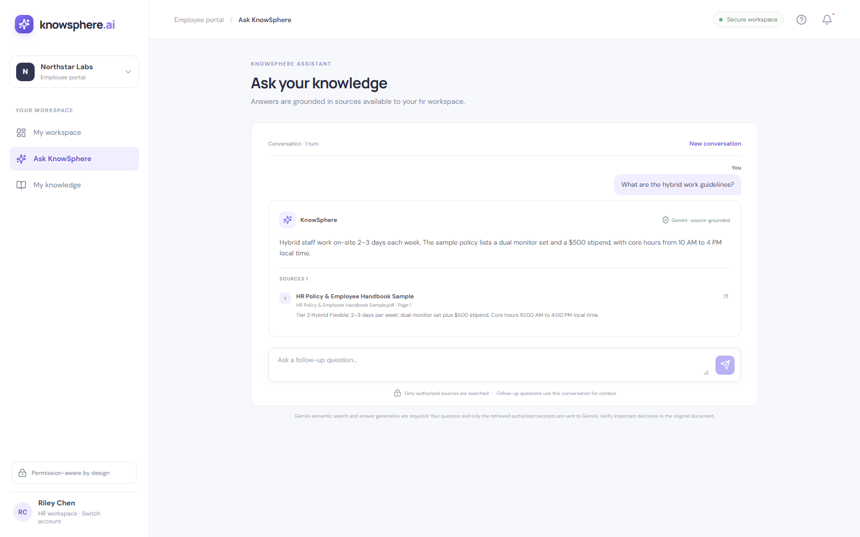
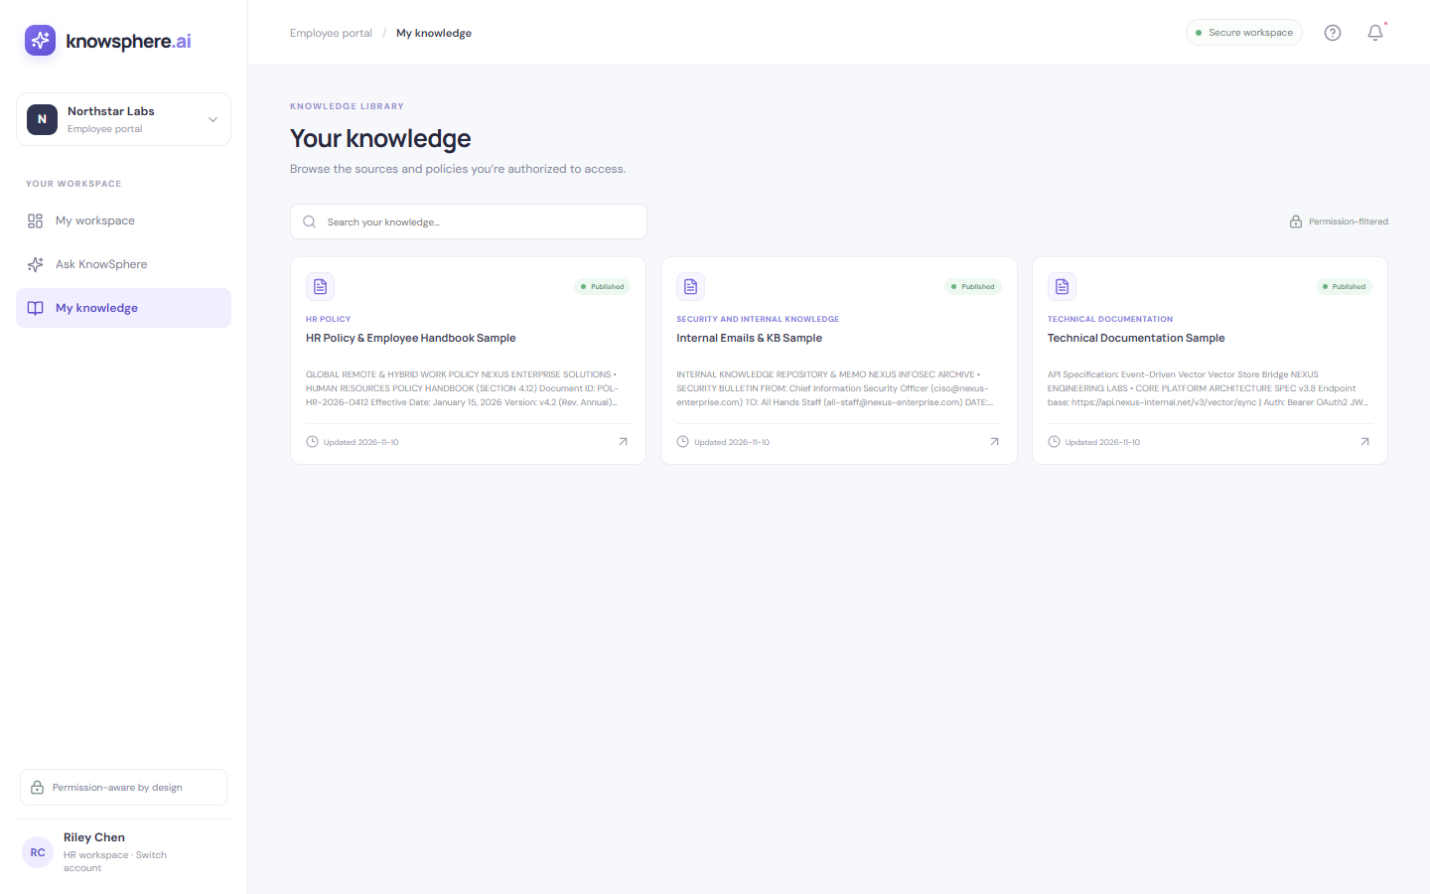
08 / ROLE WORKSPACES
13
HR: ask and browse within HR’s authorized scope
The HR workspace follows the same cited-answer pattern with role-aware retrieval.
ASK KNOWSPHERE
MY KNOWLEDGE
A sample handbook question and cited-answer layout.
Browse items visible to the HR role.
ILLUSTRATIVE CHAT EXAMPLE
The shown HR answer is scripted; confirm real responses against citations.
KNOWSPHERE AI • PRODUCT OVERVIEW
Notes:
This HR chat screenshot is an illustrative, scripted response rather than a live model exchange. The HR assistant is meant to retrieve from authorized HR-relevant material, and the user should check the displayed cited documents.

Slide 14
09 / CURRENT SCOPE
14
What is available now—and what is still ahead
A clear MVP boundary helps teams evaluate the product accurately.
AVAILABLE IN THIS MVP
NOT IMPLEMENTED YET
Role and department permission rules
Cloud drive / Confluence sync
Semantic retrieval over indexed, published documents
SSO, SCIM, invite and password recovery
Gemini-generated answers with validated citations
DOCX upload, OCR, malware scanning
TXT/Markdown upload, review, and publish
Versioning, billing, advanced observability
Audit events and CSV export
Production deployment controls and monitoring
KNOWSPHERE AI • PRODUCT OVERVIEW
Notes:
Use this slide to qualify product claims. Current ingestion supports selectable-text sample PDFs at startup and TXT/Markdown uploads up to 80 KB. The right-hand items are not implemented; some are shown as roadmap placeholders in the admin UI. This is an MVP foundation and is not yet a production deployment.

Slide 15
10 / PRICING
15
Simple reference pricing
Team and Business share the supplied rates; Enterprise is custom.
Billing period | Team | Business | Enterprise
Monthly | ₹7,999 | ₹7,999 | Custom
Quarterly | ₹14,999 | ₹14,999 | Custom
Yearly | ₹21,999 | ₹21,999 | Custom
Reference pricing is seat-based. Taxes, discounts, and contract terms are not specified.
Confirm final commercial terms with the KnowSphere team.
KNOWSPHERE AI • PRODUCT OVERVIEW
Notes:
Prices reflect the user-supplied current rates: monthly ₹7,999, quarterly ₹14,999, yearly ₹21,999 for both Team and Business, and custom Enterprise pricing. The README notes the source image is a visual reference with old TBD labels. Pricing is described as seat-based; tax, discounts, and contract terms are unspecified.

Slide 16
KNOWSPHERE AI
Company knowledge,
made easier to find—and easier to govern.
Role-aware access · Semantic retrieval · Cited answers · Admin control
See how KnowSphere can fit your organization’s knowledge workflow.
MVP overview • KnowSphere AI
Notes:
Close with the practical positioning: KnowSphere combines AI-assisted answers with permission-filtered company knowledge and source visibility. Invite the audience to evaluate it against their own documents and access needs, while keeping MVP limitations in view.

