Slide 1

SHOP FOR HOME
TEAM:
Abhishek Ghosh
Akhila A B
Mary sony Priya B
Ramya Pulishetti
Vundavalli Hemasri

Slide 2
INTRODUCTION
Nowadays most of the purchasing of the items that are needed for the daily basis, can be got through the online mode. There are many shopping websites like Amazon, Flipkart, Snap deal, Jabong, Shop Clues and many more. People without wasting much energy in going to the shops to buy the shopping items that are required can purchase it through the shopping websites. The SHOP FOR HOME is the application that allows the users to shop online without going to the shops to buy them. This will help in saving the energy, fuel, time needed to do the shopping by going to the shops.

Slide 3
PROBLEM STATEMENT
ShopForHome is a popular Store in the market for shopping the home décor stuff. Due to Covid 19 all the offline shopping stopped. So, the store wants to move to the online platforms and wants their own web application.
There are 2 users
User
Admin

Slide 4
USER
User Stories –
1. As a user I should be able to login, Logout and Register into the application.
2. As a user I should be able to see the products in different categories.
3. As a user I should be able to sort the products.
4. As a user I should be able to add the products into the shopping cart.
5. As a user I should get different discount coupons.

Slide 5
ADMIN
Admin Stories –
1. As an Admin I should be able to login, Logout and Register into the application.
2. As an Admin I should be able to perform CRUD on Users.
3. As an Admin I should be able to Perform CRUD on the products.
4. As an Admin I should be able to get bulk upload option to upload a csv for products details
5. As an Admin I should be able to set the discount coupons for the specific set of users on the application.

Slide 6



TECHNOLOGIES
Frontend:-
Angular
Backend:-
Spring boot
Database:-
MySQL

Slide 7


ENVIRONMENT/TOOLS USED
Visual studio code
Eclipse

Slide 8
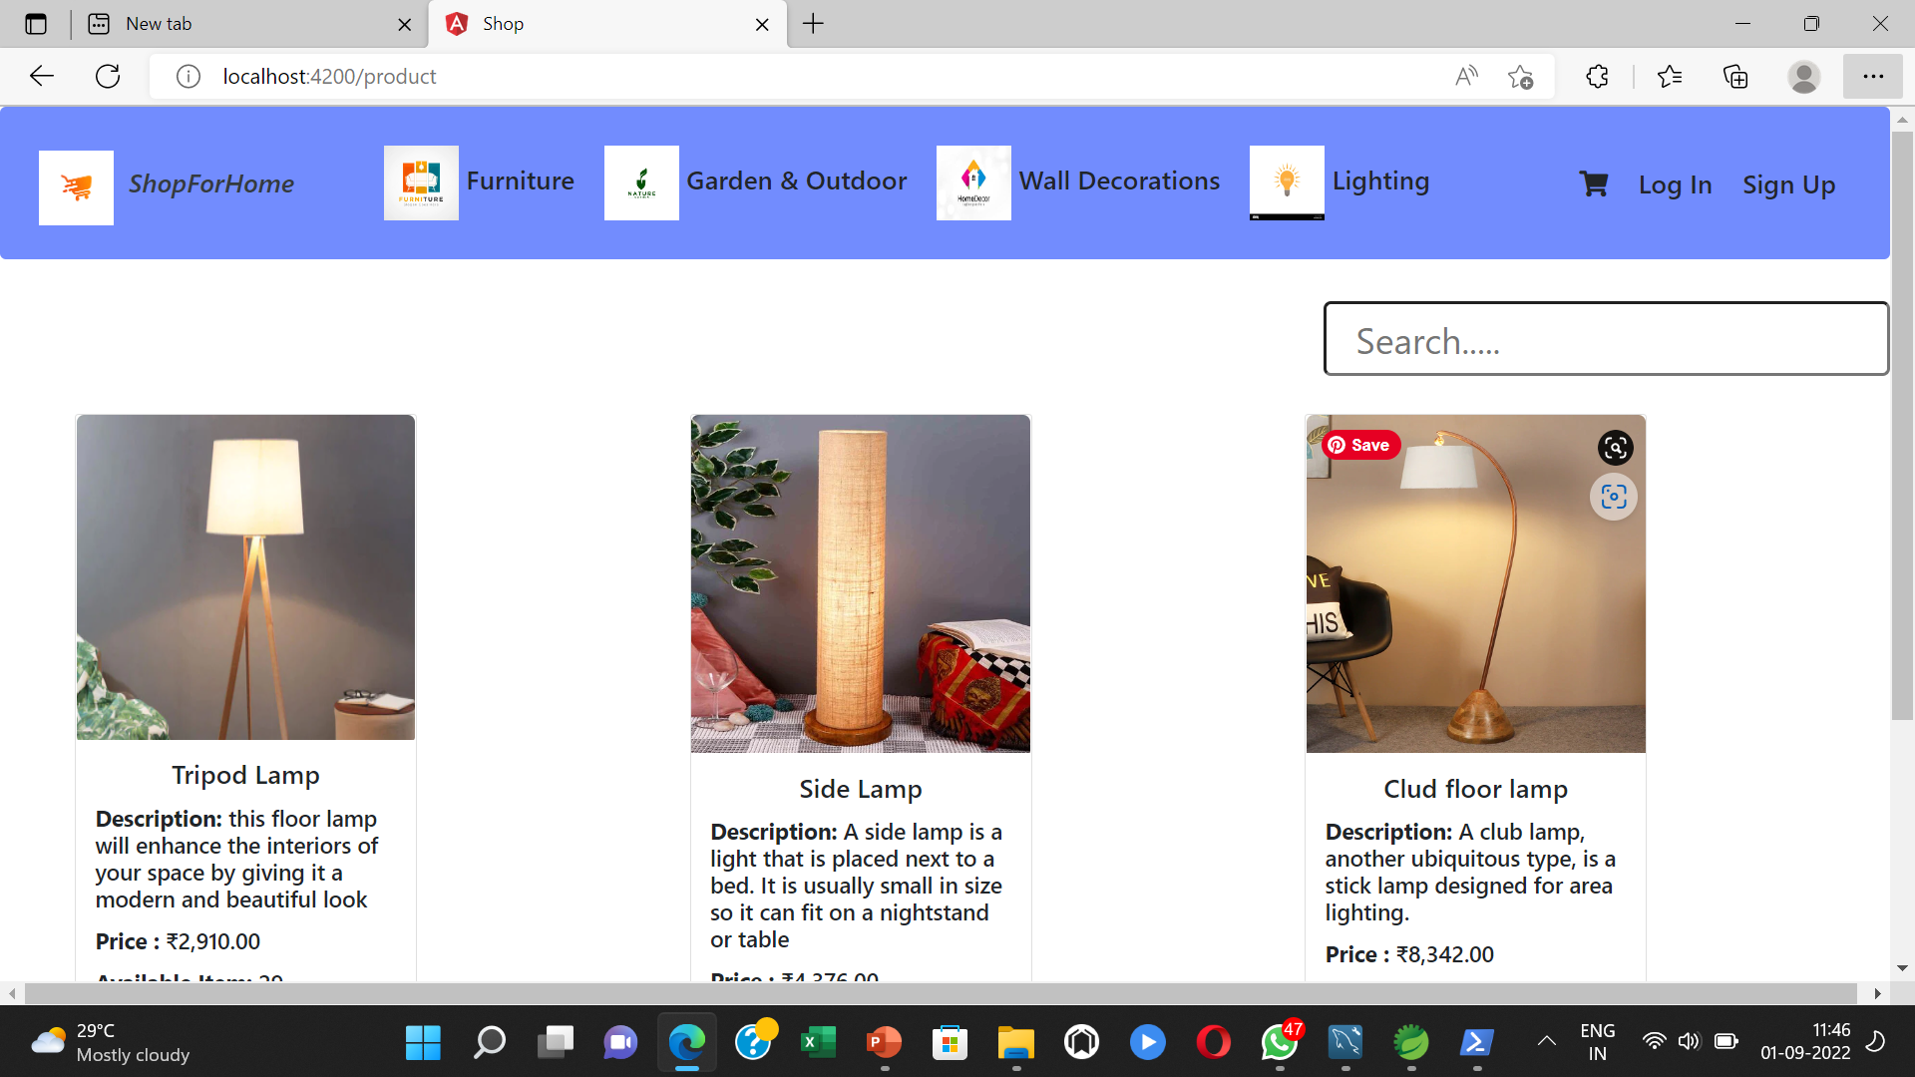
RESULT
HOME PAGE

Slide 9
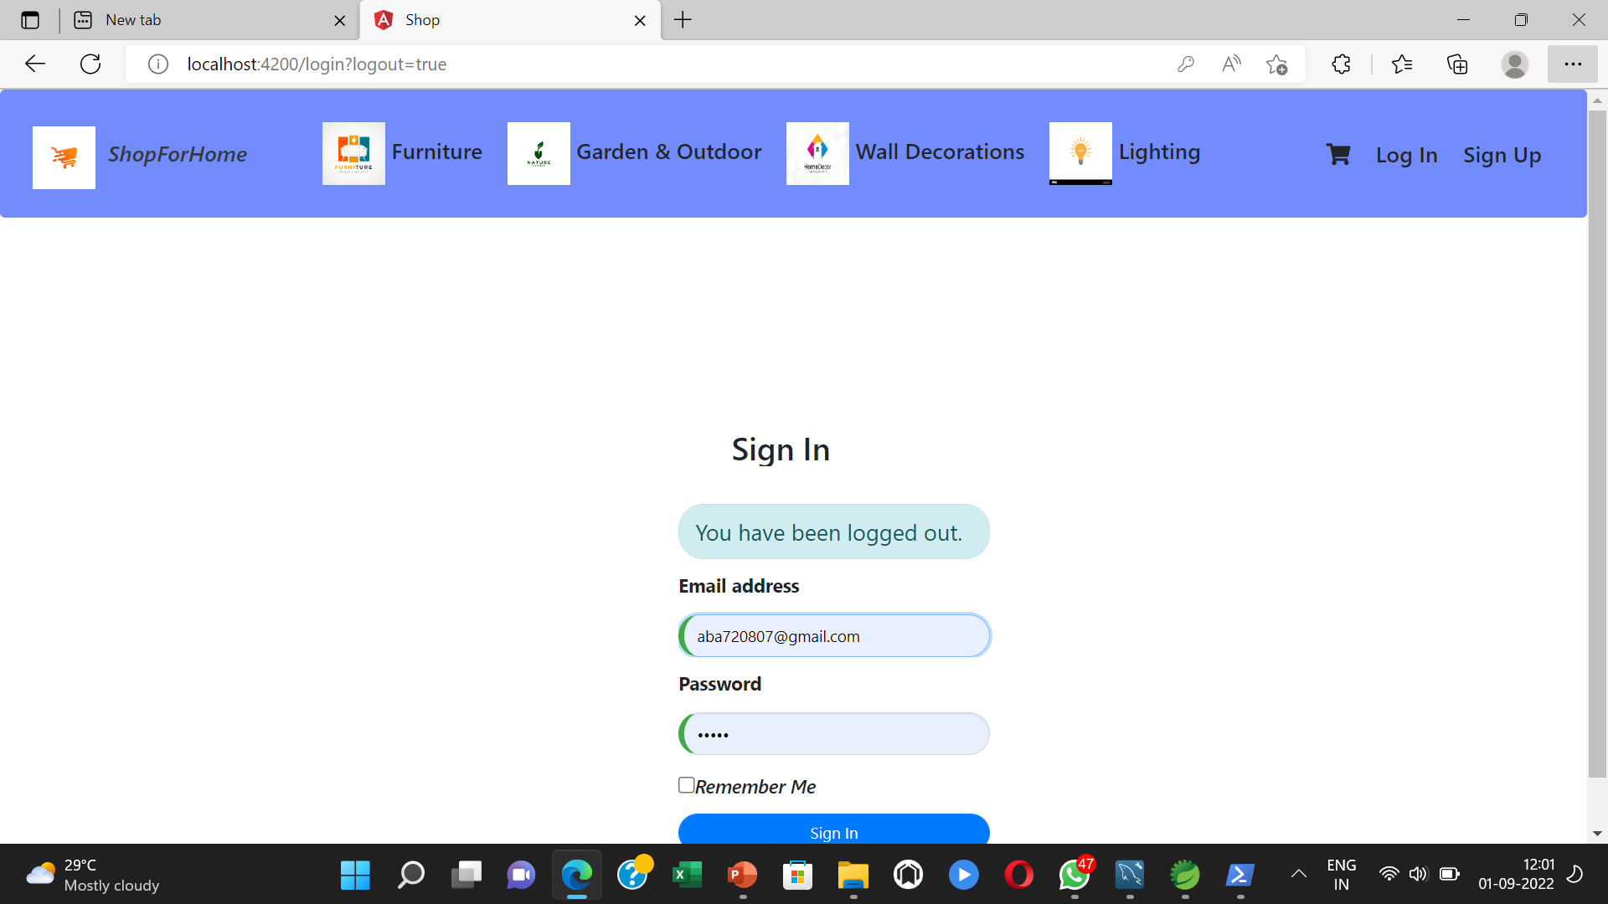
LOGIN PAGE

Slide 10
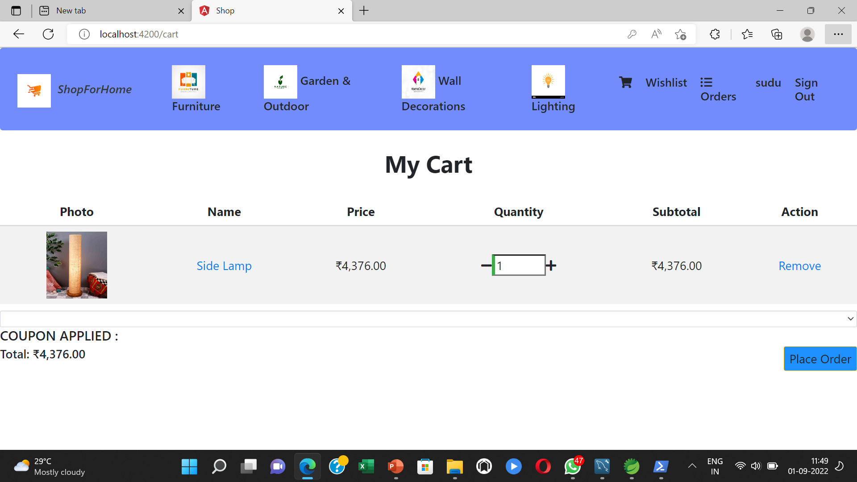
CART PAGE

Slide 11
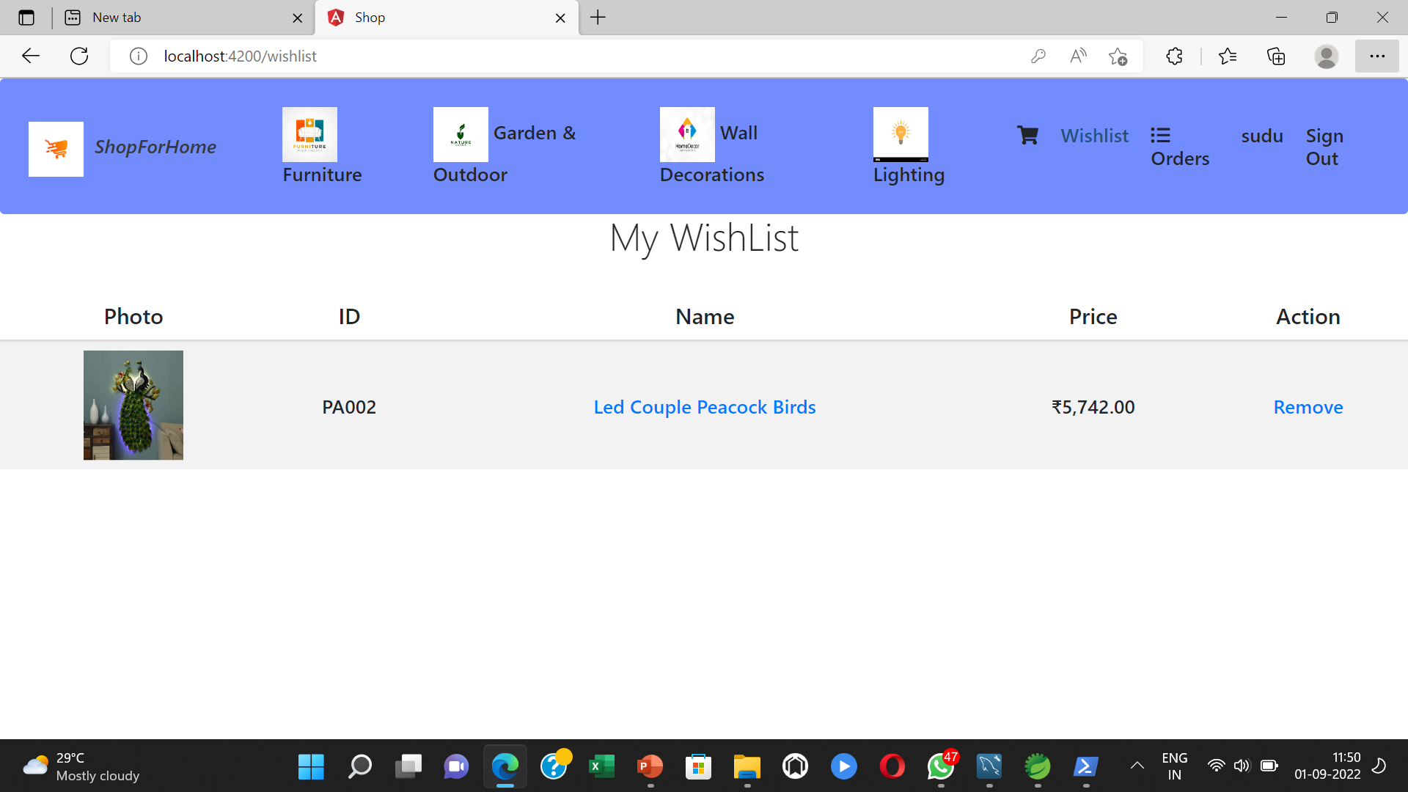
WHISLIST PAGE

Slide 12
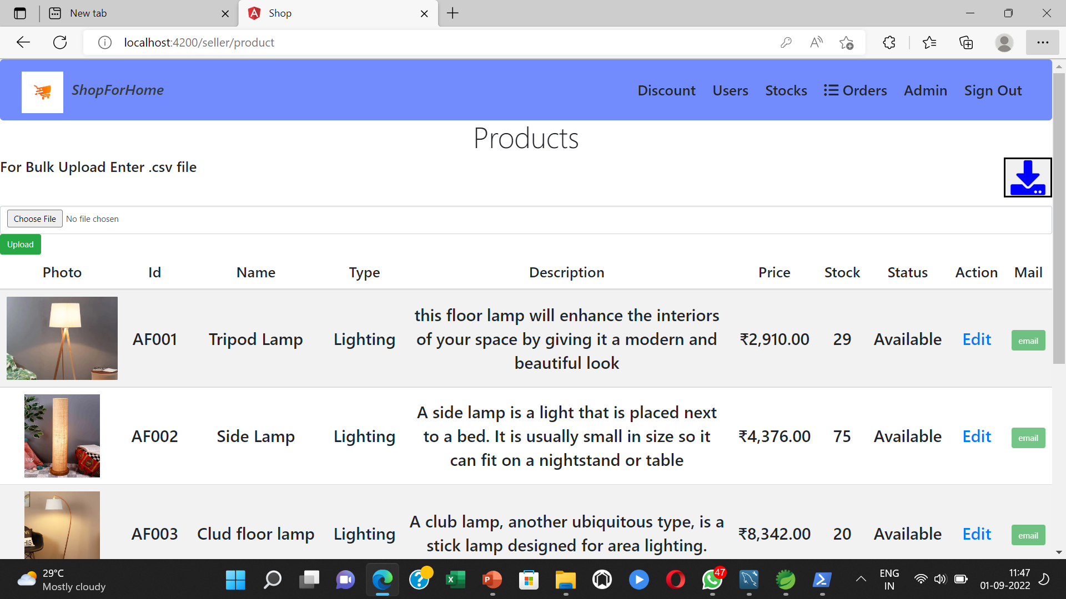
ADMIN MANAGE PAGE

Slide 13
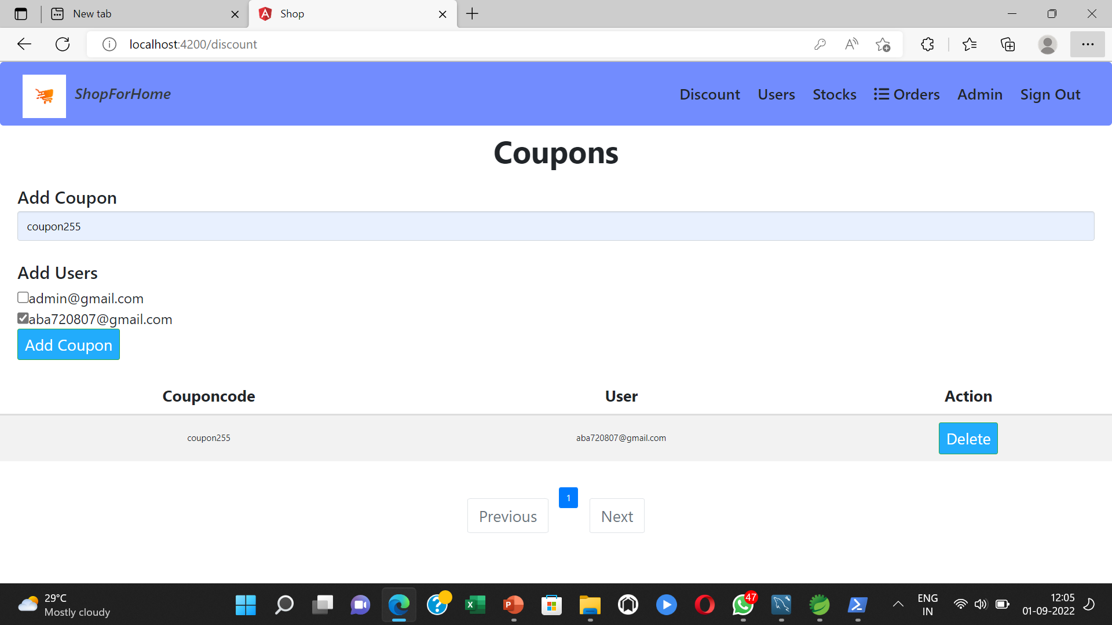
DISCOUNT COUPONS

Slide 14
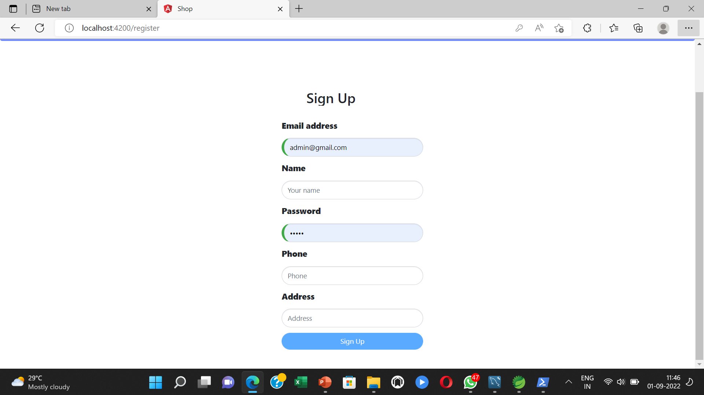
LOGOUT PAGE

Slide 15
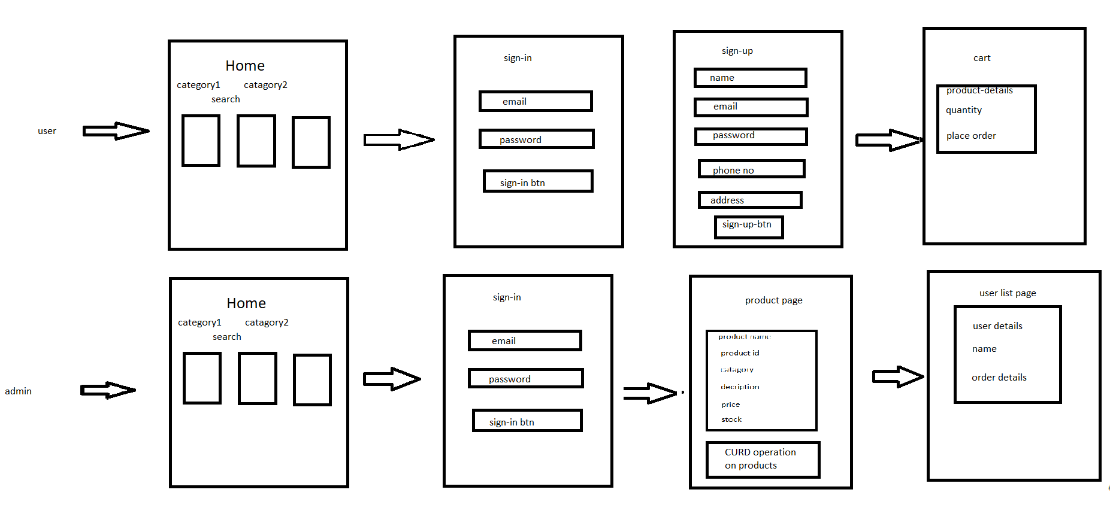
UI DIAGRAM

Slide 16
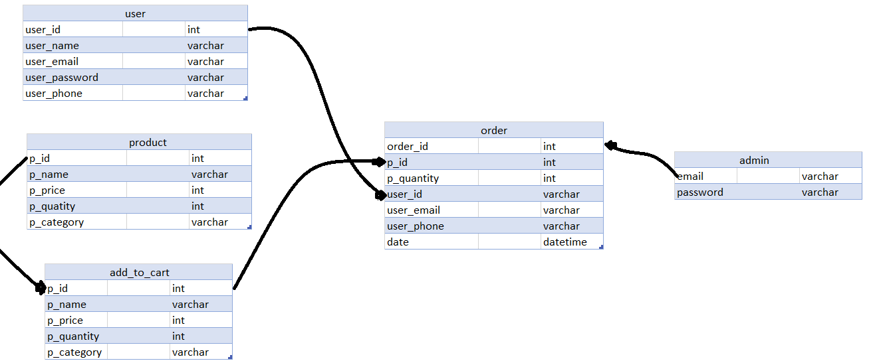
DB FLOW DIAGRAM

Slide 17
CONCLUSION
Online shopping is a different experience and you can make the shopping creative over the internet as you get used to it. There can be lot of apprehensions about online shopping when you get in to it for the first time. As you experience more and more of it those apprehensions get disappeared slowly. Remember that if you stick to the basics, online shopping become more enjoyable and easier than real-world shopping.

Slide 18
THANK YOU

