Slide 1
DEPARTMENT OF COMPUTER SCIENCE & ENGINEERING • PES UNIVERSITY
ARCHIVEMIND
AI-Powered Hybrid SQL–Vector Semantic Search Engine
Visualization of Data & User Interface (VDUI) • Mini-Project Review
ABHIROOP
PES2UG24CS024
AAYAAN
PES2UG24CS017
ML, OCR/HTR, Embeddings & Retrieval
Power BI, Analytics & Provenance
ADARSH
PES2UG24CS028
SHEIMAN
PES2UG24CS003
Frontend UX & Raspberry Pi Acquisition
SQLite, FastAPI, Data Integrity & RBAC
LOCAL-FIRST ARCHIVAL WORKFLOW / HYBRID SEARCH / VISUAL ANALYTICS

Slide 2
VDUI MINI-PROJECT REVIEW • PES UNIVERSITY
Problem Statement & Research Questions
Why digitally stored manuscripts still remain difficult to discover and interpret
THE ARCHIVAL CHALLENGE
FOUR RESEARCH QUESTIONS
Historical collections are fragmented across scans, transcripts, catalogues and institutions. Exact-term search misses conceptually related documents, while raw metadata alone rarely communicates preservation risk or topical similarity.
RQ1 Can relational keyword search and semantic embeddings complement one another?
RQ2 How can document provenance and archival relations remain inspectable?
RQ3 Can embedding/similarity results become interpretable visual analytics?
RQ4 Can the same local dataset power repeatable Power BI reports?
ARCHIVEMIND • DATA · SEARCH · VISUALIZATION
02

Slide 3
VDUI MINI-PROJECT REVIEW • PES UNIVERSITY
Proposed Solution & Differentiation
ArchiveMind is an integrated workflow—not a claim to invent OCR, embeddings or RAG
CAPTURE
UNDERSTAND
RETRIEVE
EXPLAIN
VISUALIZE
Raspberry Pi camera / image ingestion
OCR/HTR + chunking + condition metadata
SQLite FTS5 + 384-D semantic vector matching
Provenance relations + citations / RAG fallback
Native Vector Lab + Power BI reporting
OUR CONTRIBUTION
A modular, local-first archival platform combining acquisition, relational integrity, hybrid retrieval, provenance and interpretable dashboards in one workflow.
ARCHIVEMIND • DATA · SEARCH · VISUALIZATION
03

Slide 4
VDUI MINI-PROJECT REVIEW • PES UNIVERSITY
Dataset Provenance & Relational Architecture
A controlled development snapshot with transparent gaps—not a large public benchmark
10
5
4
10
45
Documents
Collections
Archives
2D vector rows
Unique similarity pairs
RELATIONAL SOURCE
POWER BI REPORT GRAINS
document → collection → archive
document ↔ document_author ↔ person
document_image → ocr_result
document → ml_prediction, document_view
document_chunk → chunk_embedding
documents: 1 row per manuscript
ai_analytics: 1 selected record per document
ingestion_analytics: 1 row per job (currently empty)
semantic_vectors: 1 row per projected document
semantic_similarity: 1 row per unique pair
Snapshot is seed/development data. Recorded OCR, predictions and ingestion jobs are absent; their absence is not hidden.
ARCHIVEMIND • DATA · SEARCH · VISUALIZATION
04

Slide 5
VDUI MINI-PROJECT REVIEW • PES UNIVERSITY
System Architecture & Data Flow
Edge capture to searchable archival intelligence and analytical reports
Raspberry Pi
FastAPI
SQLite
ML Layer
Visualization
→
→
→
→
Camera + image transfer
Ingestion + services
Archival schema / FTS5
OCR · embeddings · RAG
Web UI + Power BI
READ-ONLY POWER BI EXPORT
SQLite → deterministic CSV exports → Power Query / semantic model → three interactive report pages
The Raspberry Pi and real-model paths are hardware/network dependent; the current reviewed snapshot is offline.
ARCHIVEMIND • DATA · SEARCH · VISUALIZATION
05

Slide 6
VDUI MINI-PROJECT REVIEW • PES UNIVERSITY
VDUI Syllabus Linkage
Visualization design principles used in the ArchiveMind interface and reporting layer
UNIT 2 • NARRATIVE VISUALIZATION
UNIT 3 • INTERACTIVE DASHBOARDS
• Overview starts with manuscript KPIs and preservation conditions.
• Document Analytics builds an evidence-led preservation story.
• Semantic Search culminates in embeddings and pairwise similarity, with explicit caveats.
• Titles and annotations distinguish a 2D projection from high-dimensional cosine scores.
• Power BI slicers filter collection, era and condition.
• KPI cards show distinct document counts and at-risk proportions.
• Charts support cross-filtering and exploratory comparison.
• SQL relations and carefully chosen dataset grains avoid duplicate manuscript counts.
ARCHIVEMIND • DATA · SEARCH · VISUALIZATION
06

Slide 7
VDUI MINI-PROJECT REVIEW • PES UNIVERSITY
Data Preparation, Integrity & Validation
Reproducible snapshot exports with database immutability checks
1
READ
SQLite opened for analytics without writing archival records
2
JOIN
Document, collection, archive & authors at a single document grain
3
TRANSFORM
Typed fields; latest recorded AI output where present
4
PROJECT
Existing vector visualization service for x/y and cosine scores
5
EXPORT
Five header-stable CSVs; refreshable Power BI semantic model
REPORTED CHECKS • 17 tests passed in package generation; six targeted Power BI tests passed after local merge.
ARCHIVEMIND • DATA · SEARCH · VISUALIZATION
07

Slide 8
VDUI MINI-PROJECT REVIEW • PES UNIVERSITY
Hybrid Search: Two Complementary Retrieval Signals
SQLite lexical relevance and semantic proximity serve different failure modes
KEYWORD / LEXICAL
VECTOR / SEMANTIC
SQLite FTS5 finds matching words and BM25 ranks lexical evidence. Useful for exact historical names, titles, dates and technical terms.
Sentence Transformer design: 384-dimensional embeddings compared by cosine similarity. Useful for conceptually related passages without exact wording.
WEIGHTED HYBRID SCORE
H = α × normalized keyword score + (1 − α) × semantic score
RRF is a supplementary rank-comparison metric; the stored 2D projection is NOT the matching distance.
ARCHIVEMIND • DATA · SEARCH · VISUALIZATION
08

Slide 9
VDUI MINI-PROJECT REVIEW • PES UNIVERSITY
Provenance, RAG & User Interface
From ranked passages to inspectable archival context
PROVENANCE
CITATION-AWARE ANSWERS
INTERFACE
Document ↔ collection ↔ archive
Document ↔ author / person
Document ↔ captured image
Relational traceability supports explainable archival exploration.
Hybrid search retrieves matching text passages.
RAG/extractive answer path presents evidence from retrieved archival documents.
Local fallback is used when optional generation models are unavailable.
Nothing OS-inspired frontend.
Hybrid-score/result comparisons.
Vector Lab projection and similarity matrix.
Read-only Power BI setup/export links.
The project combines established techniques; comparative retrieval or OCR accuracy benchmarks have not yet been established.
ARCHIVEMIND • DATA · SEARCH · VISUALIZATION
09

Slide 10
VDUI MINI-PROJECT REVIEW • PES UNIVERSITY
Power BI Model & DAX Metric Architecture
A read-only complement to the ArchiveMind web interface
documents.csv
10 manuscripts
Document, condition, era, archive, collection
ai_analytics.csv
10 document rows
OCR / prediction fields blank in snapshot
ingestion_analytics.csv
0 jobs
No recorded processing jobs
semantic_vectors.csv
10 points
2D projection of stored offline vectors
semantic_similarity.csv
45 unique pairs
True vector-space cosine similarity
Key measures: DISTINCTCOUNT(document_id) · at-risk count / percentage · collection / archive counts · similarity ranking.
ARCHIVEMIND • DATA · SEARCH · VISUALIZATION
10

Slide 11
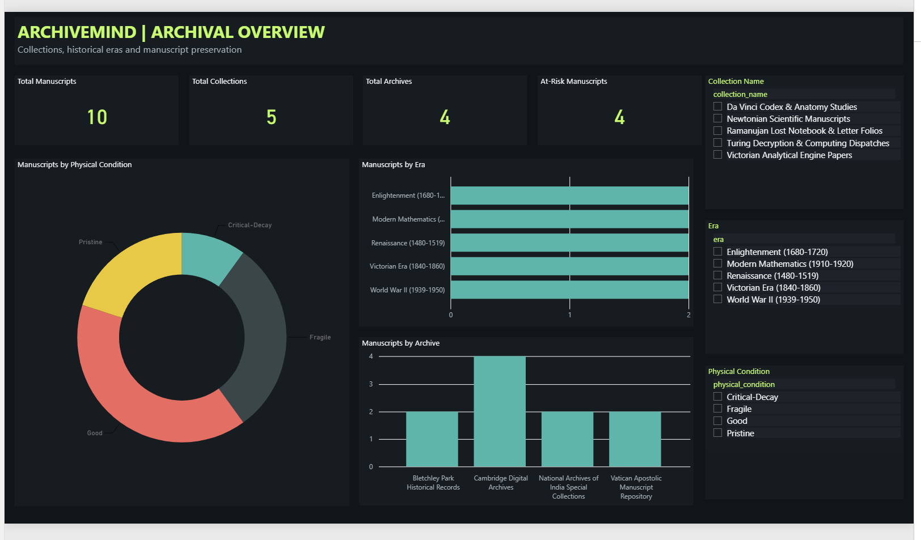
VDUI MINI-PROJECT REVIEW • PES UNIVERSITY
Power BI Demonstration — Archival Overview
Evidence: screenshots captured from the working local report
10 manuscripts • 5 collections • 4 archives • 4 at-risk manuscripts
ARCHIVEMIND • DATA · SEARCH · VISUALIZATION
11

Slide 12
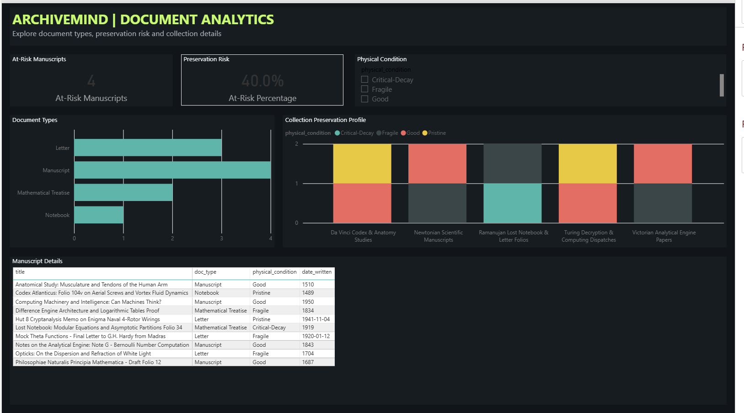
VDUI MINI-PROJECT REVIEW • PES UNIVERSITY
Power BI Demonstration — Document Analytics
Preservation insight from available records rather than fabricated OCR/ML metrics
Risk profile: 4 of 10 manuscripts are Fragile or Critical-Decay (40%).
ARCHIVEMIND • DATA · SEARCH · VISUALIZATION
12

Slide 13
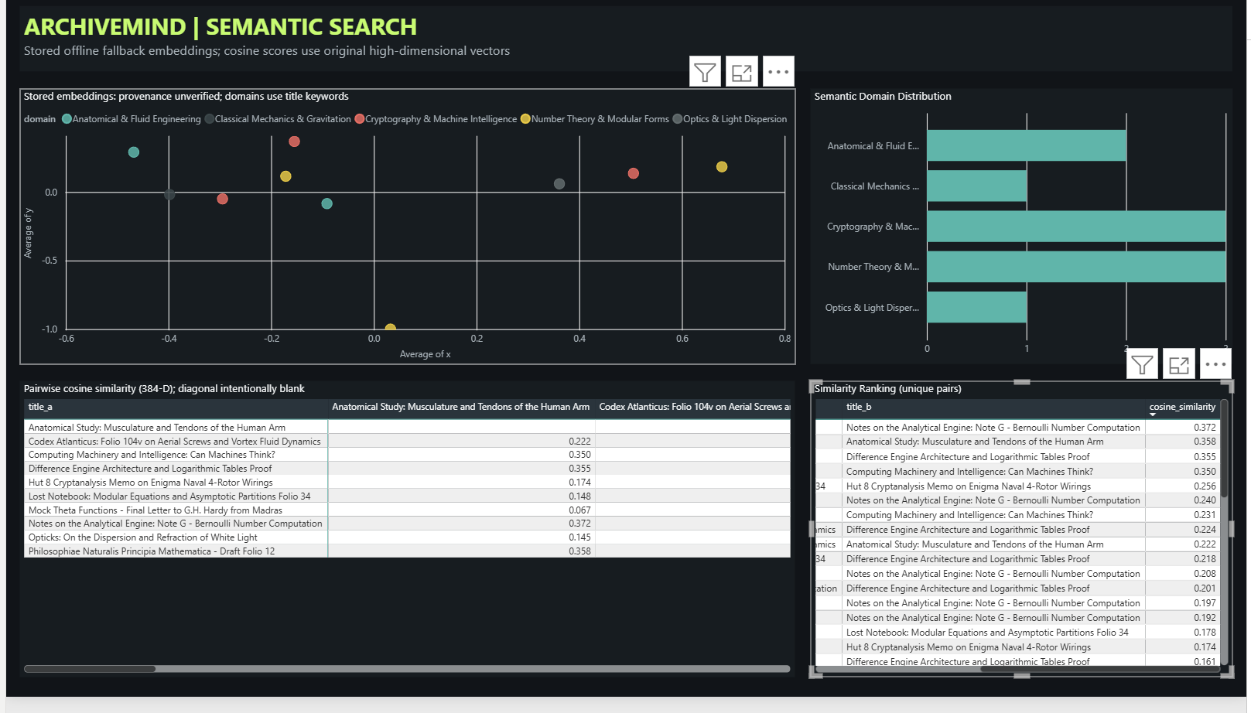
VDUI MINI-PROJECT REVIEW • PES UNIVERSITY
Power BI Demonstration — Semantic Search
The vector scatter and cosine matrix are complementary—not interchangeable
10 stored vector projections • 45 unique similarity pairs • offline-fallback embedding provenance
ARCHIVEMIND • DATA · SEARCH · VISUALIZATION
13

Slide 14
VDUI MINI-PROJECT REVIEW • PES UNIVERSITY
Key Findings & Limitations
What the current implementation actually demonstrates
VALIDATED / OBSERVED
NOT YET ESTABLISHED
• A functioning SQLite-to-Power BI export and three-page report.
• 10 manuscripts across 5 collections and 4 archives.
• 4 manuscripts are at preservation risk (40%).
• 45 unique pairwise cosine relationships visualized.
• Export tests and structural checks reported as passing.
• No recorded OCR / ML prediction outputs in this snapshot.
• No ingestion jobs in current data.
• Existing embeddings are offline fallback, not validated MiniLM.
• Pi hardware and GPU paths require separate testing.
• No controlled comparison against external search systems.
ARCHIVEMIND • DATA · SEARCH · VISUALIZATION
14

Slide 15
VDUI MINI-PROJECT REVIEW • PES UNIVERSITY
Project Roadmap & Final-Review Plan
Next steps focus on real-model evidence, data coverage and measured usability
01
DATA COVERAGE
Capture/process more licensed manuscript images; record actual OCR, model outputs and ingestion jobs.
02
MODEL VALIDATION
Load real MiniLM weights; re-embed consistently; benchmark retrieval quality and OCR confidence.
03
UX / INTERACTION
Evaluate slicers, text contrast, tooltips, scatter selection and table readability with real users.
04
SYSTEM VALIDATION
Run Raspberry Pi physical capture checks and end-to-end integration tests; document failure modes.
05
SUBMISSION
Submit screenshots, report project, reproducible exporter, source code and honest limitations.
ARCHIVEMIND • DATA · SEARCH · VISUALIZATION
15

Slide 16
VDUI MINI-PROJECT REVIEW • PES UNIVERSITY
References & Project Artifacts
Selected academic literature and reproducible implementation evidence
01
Reimers & Gurevych (2019), “Sentence-BERT,” EMNLP. https://aclanthology.org/D19-1410/
02
Cormack, Clarke & Büttcher (2009), “Reciprocal Rank Fusion,” SIGIR. doi:10.1145/1571941.1572114
03
Lewis et al. (2020), “Retrieval-Augmented Generation,” NeurIPS. arxiv:2005.11401
04
Segel & Heer (2010), “Narrative Visualization,” IEEE TVCG. doi:10.1109/TVCG.2010.179
05
Sarikaya et al. (2019), “What Do We Talk About When We Talk About Dashboards?” IEEE TVCG.
06
Codd (1970), “A Relational Model of Data for Large Shared Data Banks,” CACM.
07
ArchiveMind repository: github.com/Abhiroop-24/ArchiveMind-HybridSearch
Evidence sources: actual ArchiveMind PBIP screenshots supplied by the team; implementation and export summaries.
ARCHIVEMIND • DATA · SEARCH · VISUALIZATION
16

Slide 17
ARCHIVEMIND
SEARCH • PROVENANCE • PRESERVATION • VISUAL ANALYTICS
THANK YOU
Questions & Discussion
Abhiroop • Aayaan • Adarsh • Sheiman

