Slide 1

PHASE 2 — IDEATION & PLANNING
Satyatma
CircuitMind — AI-powered vendor & inventory management platform
TEAM MEMBERS
MENTOR
DATE
REPOSITORY
Abhiroop, Shruthi, Aravind, Sreephaneesh, Vishnu Tej
Pushkar Katti, Vishal Mahuli
05-09-2026
github.com/Udyoga-Pramoda-Hackathon-2026/team-satyatma
Notes:
Fill in your team details. Do not change the deck structure.
1

Slide 2

SECTION 01
Solution
What are we building, who is it for, and what does it solve?
WHAT WE ARE BUILDING
WHO IT IS FOR
PROBLEM IT SOLVES
AI-Powered Vendor & Inventory Management Platform
An AI-powered vendor & inventory management platform that helps businesses manage suppliers, purchase orders, inventory levels and procurement workflows with intelligent insights.
KEY CAPABILITIES
  AI-driven demand & prediction
  Vendor management & scoring
  Procurement workflow automation
  Real-time alerts and insights
Supply Chain Teams
Businesses in manufacturing, pharmaceuticals, distribution and other industries that manage vendors, procurement and inventory.
TARGET AUDIENCE
  Procurement Managers
  Supply Chain Managers
  Inventory & Operations Teams
  CFOs / Business Leaders
Fragmented Management
Disconnected systems, spreadsheets and manual processes lead to poor visibility, operational delays, excess inventory costs and reactive decision-making.
KEY PAIN POINTS
  No real-time inventory visibility
  Hard to predict shortages & demand
  Manual and error-prone procurement
  No actionable insights on vendor risk

Slide 3

SECTION 02
Value proposition
Six lines. Together they should read as one sentence.
For
Semiconductor & electronics supply-chain managers
Who
Cannot tell, when a trade notice breaks, which of their own part numbers it hits — by how much, and by when
Our product
CircuitMind — an AI decision layer that sits on top of the ERP
That
Turns a published event into a named part, a quantity and a date — then a costed plan, with compatibility verified by rules rather than similarity
Unlike
SAP IBP, Oracle SCM and Blue Yonder, which plan from internal signals — and spreadsheets, which cannot react at all
We
Resolve the outside world against your own bill of materials — and stop at a person before anything is ordered

Slide 4





SECTION 03
Core user journey
Trigger to outcome, in seven steps.
Trigger
User entry
User action
System / AI
Result
User action
Outcome
Supplier delay detected or demand suddenly increases.
Supply Chain Control Tower.
Select the affected supplier or component.
Analyses BOM, inventory, PO, demand, lead time and production data.
Shortage risk, expected shortage date, and affected products, factories and customers.
Review the AI recommendation and supporting evidence.
Approve action early and prevent production disruption.

Slide 5
SECTION 04
Core features
Every feature traces back to a problem found in Phase 1. All four are built and running.
FEATURE
PROBLEM SOLVED
STATUS
Supply Chain Dependency Graph
Traces vendor and component dependencies to show affected products and production.
BUILT
Shortage Risk Prediction
Runs a month-by-month stock ledger over demand, stock, open POs and lead times to show what runs out, and when.
BUILT
Explainable AI Recommendations
Recommends a costed plan and shows the options it rejected, with the reason for each.
BUILT
Supplier & Inventory Intelligence
Scores supplier risk and identifies usable inventory and lead-time issues.
BUILT

Slide 6
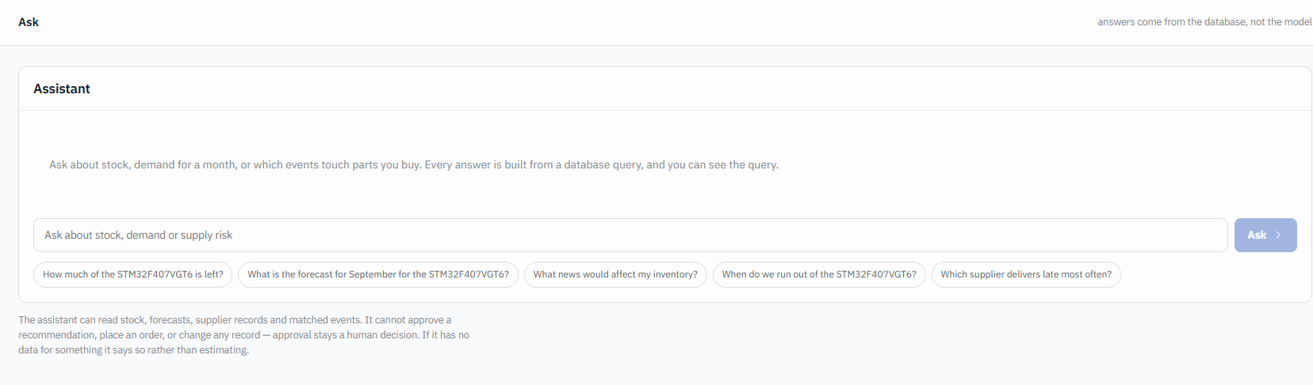
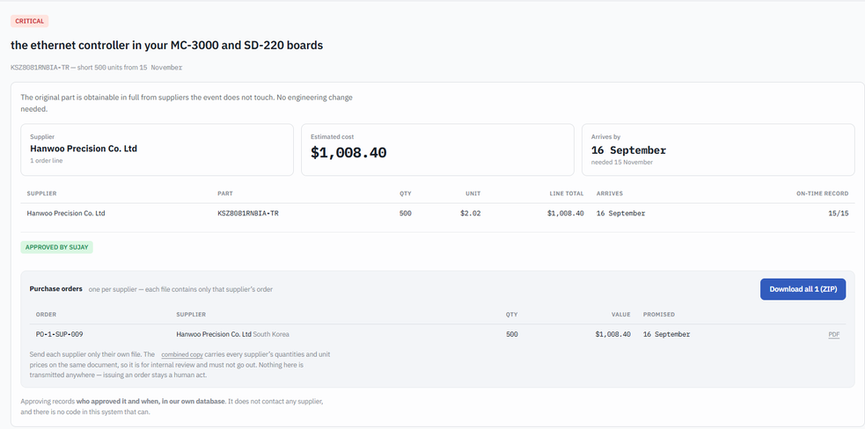
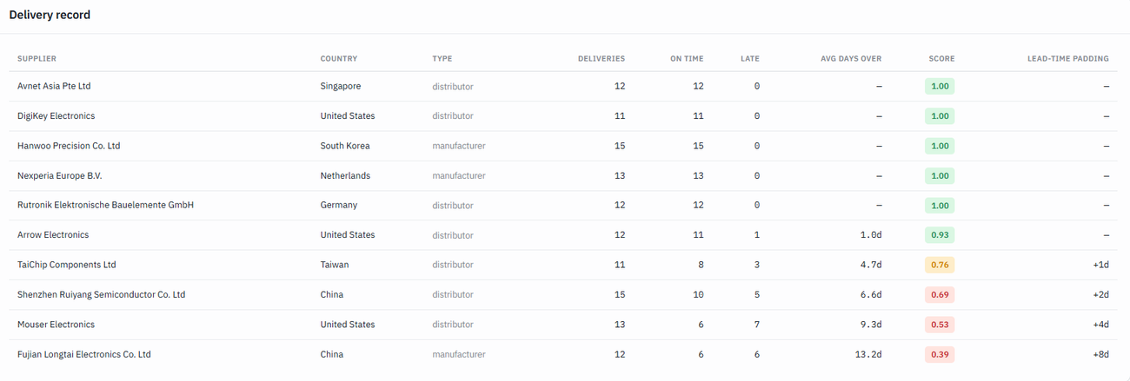
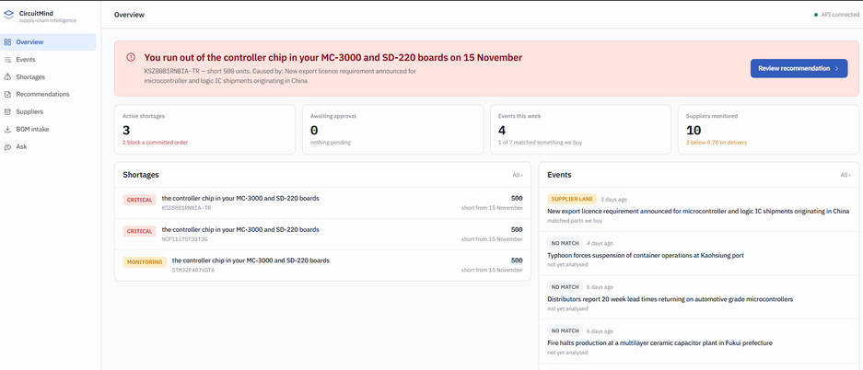
SECTION 05
Wireframes
Four key screens. Low fidelity is acceptable — show how the product works.
Screen 1
Screen 2
Notes:
Four key screens. Low fidelity is fine — the flow matters more than the polish.
6

Slide 7


SECTION 06
AI strategy
Where AI sits in the product logic — not where it decorates the interface.
AI input
What AI does
AI output
→
→
BOM documents
(PDF, Excel, CAD, etc.)
Inventory data
Current stock levels
Purchase orders
Open POs and order status
Supplier data
Lead times, capacity, availability
Demand / production plans
Forecasts and requirements
BOM Parsing Agent
Extracts components, quantities and structure from documents
Supply & Inventory Agent
Checks inventory, open POs, supplier availability and requirements
Procurement Decision Agent
Identifies shortages and determines action (reorder, expedite or wait)
LLM Reasoning Layer
Explains the analysis, justifies the recommendation and generates alerts
Shortage / inventory alerts
Components at risk
Recommended purchase orders
What to buy, how much, when
Supplier recommendations
Best available suppliers
Expected inventory impact
Projected stock levels and timelines
Explainable reasoning
Why the alert was raised and evidence used
HUMAN INVOLVEMENT
AI recommends; humans review the evidence, validate the recommendation and approve or modify the purchase order.

Slide 8

SECTION 07
Technology
Your stack. Name real tools — write “undecided” if it is still open.
FRONTEND
BACKEND
AI / MODELS
• Next.js 16 (React, App Router)
• TypeScript
• Plain CSS with design tokens
• Python
• FastAPI (server-sent events)
• psycopg 3
• statsmodels (Holt-Winters)
• Groq — openai/gpt-oss-120b
• JSON-schema constrained decoding
• Deterministic rule engine for
compatibility (no model)
DATABASE
APIs / INTEGRATIONS
DEPLOYMENT
• PostgreSQL 17
• Two schemas: erp (read-only
mirror) + platform
• Restricted read-only role
• Groq API
• pdfplumber, openpyxl, pypdf
(BOM parsing)
• News feed: seeded fixtures,
not yet live
• Render (live)
• circuit-mind.onrender.com
• team-satyatma.onrender.com

Slide 9



SECTION 08
MVP scope
What shipped, and what we deliberately left out.
SHIPPED — CORE
SHIPPED — SUPPORTING
SHIPPED — BEYOND PLAN
NOT BUILT
• BOM parsing and component extraction
• Inventory & PO visibility
• Shortage / risk alerts
• Dependency & impact analysis
• AI procurement recommendations
• Supplier risk scoring
• Lead-time analysis
• Usable inventory analysis
• Alternative supplier suggestions
• Per-supplier purchase orders
• Natural-language queries
• Autonomous purchasing
• Full ERP replacement
• Real enterprise integrations
• Production execution
• What-if simulation — not reached
The first four are out of scope by design.

Slide 10
SECTION 09
Validation
Who we showed it to, what they told us, and what we changed as a result.
WHO WE TESTED WITH
WHAT WE LEARNED
WHAT WE CHANGED
T Prabhanjan Kumar
Schneider Electric. Discussed the shortage problem and our approach to it.
Faculty & Industry Mentors
Discussed the concept and demo with academic mentors and industry advisors.
Engineering & Operations Peers
Validated the workflow with peers familiar with BOMs and inventory.
What we put in front of them
Walked through real BOM samples and end-to-end flow from parsing to PO.
Better Visibility Need
Users need clear visibility of component shortages and excess stock.
BOMs Are Complex
Often unstructured and hard to convert into actionable purchases.
Decisions Have Multi-Factors
Based on supplier dependency, lead time, stock, and alternatives.
Explanation Matters
Preferred clear explanations and reasons instead of raw data.
Unified View is Valuable
A single view connecting BOM, inventory, and POs is highly preferred.
Added BOM Parsing
Reads PDF, XLSX, CSV and TXT bills of materials into named parts.
Supplier Dependency
Traces which of your parts and boards a supplier's failure reaches.
Inventory Alerts
A month-by-month stock ledger names what runs out, and when.
Purchase Orders, Gated
Builds one PO per supplier, released only after a person approves.
LLM-based Explanations
Explains decision reasons instead of presenting flat tables.
Simplified Dashboard
Redesigned UI focusing on Action → Reason → Impact flow.
Notes:
Who you tested with, what you learned, and what actually changed.
10

Slide 11
SECTION 10
Differentiation
Why your approach, and not what already exists.
EXISTING SOLUTIONS
OUR APPROACH
WHY IT IS BETTER
SAP IBP
Plans from internal signals: orders, stock, lead times
Oracle SCM
Detects shortages from internal data; the substitute is left to a buyer
Blue Yonder
Optimises the forecast; does not read a trade notice
ERP / Spreadsheets
Records what happened; cannot react on its own
Published event → your part number → quantity → date → costed plan → a person
Five agents. The model reads the prose and picks which query to run; the database answers it. Compatibility is decided by a deterministic rule engine, with no model in the path.
It names the part, the quantity and the date
One export notice became: STM32F407VGT6, 5,130 short by 15 October, $56,960.50 across three suppliers, landing 23 days early.
Two look-alike substitutes were rejected on footprint — LQFP144 and LQFP64 against an LQFP100 land pattern. A similarity score would have recommended both.
Notes:
Why this solution, and not the existing ones.
11

Slide 12


SECTION 11
Business & impact
Who benefits, who would pay, and what this becomes.
TARGET USERS
POTENTIAL CUSTOMERS
BUSINESS MODEL / IMPACT
LONG-TERM OPPORTUNITY
Key Stakeholders
The primary day-to-day operators who manage complexity.
• Supply Chain Managers
• Procurement Managers
• Material Planners
• Inventory & Ops Teams
• Supply Chain Analysts
Target Segments
High-value industries with complex manufacturing needs.
• Semiconductor Mfrs
• Electronics Mfrs
• Automotive Electronics
• OEMs
• EMS / ODM Manufacturers
B2B SaaS Platform
Enterprise subscriptions based on facilities, users, volume, and complexity.
Impact Outcomes:
• Fewer disruptions in production
• Reduced excess & shortage stock
• Faster procurement decisions
• Improved supplier resilience
• Lower operational costs
Supply Chain Operating Layer
Building an AI-powered intelligence engine to revolutionize operations.
Evolution Path:
1. Risk Monitoring
Real-time visibility and threat mapping.
2. Scenario Simulation
Evaluate inventory and vendor alternatives.
3. Intelligent Automation
Transition to semi-autonomous operations.

Slide 13
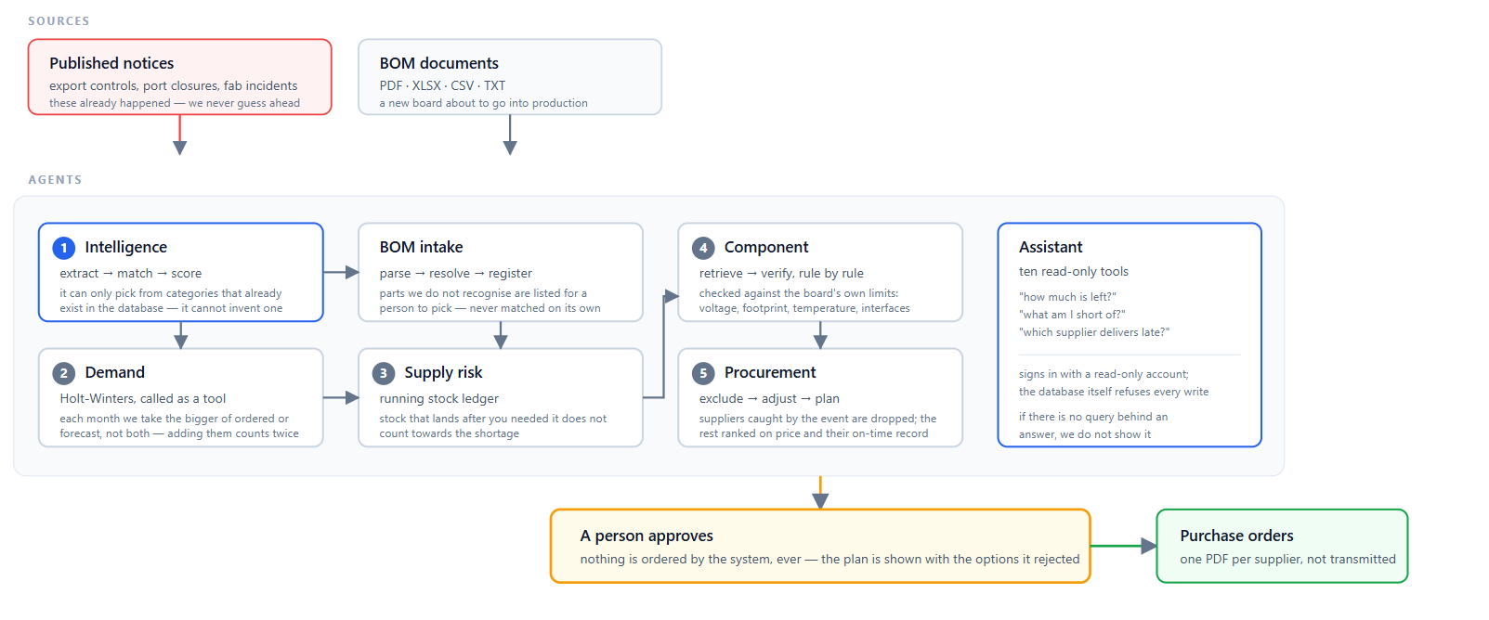
SECTION 12
Architecture
One diagram showing how the pieces connect.
ARCHITECTURE DIAGRAM
Drop your architecture diagram here.
Show client, backend, AI layer, data store and external services — with the direction of data flow between them.
Notes:
One diagram. Show data flow, not just boxes.
13

Slide 14
SECTION 13
Execution plan
One named owner per workstream, and the milestone they delivered.
WORKSTREAM
OWNER
MILESTONE
Product
Shruthi Joshi
Scope locked: five agents, one human approval gate.
Design
Vishnu Tej
Wireframes for dashboard, BOM intake and recommendation review.
Frontend
Abhiroop
Next.js dashboard: recommendations, BOM intake, constraint gate, Ask.
Backend
Phaneesh
FastAPI over PostgreSQL — 6 routers, two schemas, read-only ERP mirror.
AI
Aravind
Tool-calling agent with 10 read-only tools and an output guard.
Testing
Abhiroop
55 automated tests passing; BOM to PO exercised end to end.
Pitch
Vishnu Tej
Deck and demo video ready.
Notes:
Every workstream needs a named owner. Unowned work does not get done.
14

