Slide 1
Structuring Asynchrony
Abhiroop
Notes:
© Copyright Showeet.com – Creative & Free PowerPoint Templates

Slide 2
Asynchrony in Microcontrollers
Notes:
© Copyright Showeet.com – Creative & Free PowerPoint Templates

Slide 3
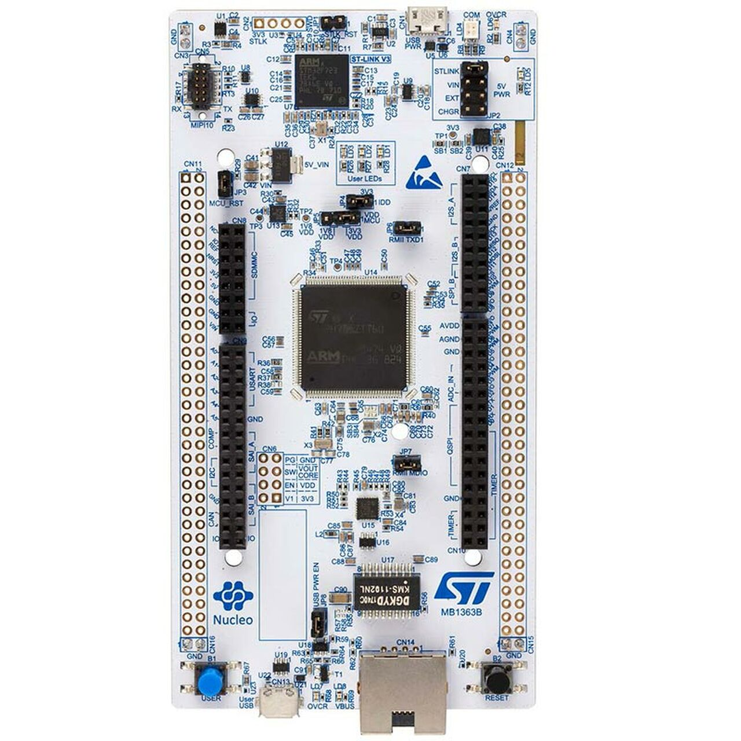
STM32F767
STM32 microcontroller
ARM Cortex-M7 216 MHz clock cycle
512KB RAM
2 MB of flash memory
1$-50$ price range
Ethernet, Board Expansion Connectors
Less sophisticated than a System-on-a-chip
Notes:
© Copyright Showeet.com – Creative & Free PowerPoint Templates

Slide 4
C
Microcontrollers are programmed in:
Notes:
© Copyright Showeet.com – Creative & Free PowerPoint Templates

Slide 5
Why not Functional Languages?
Notes:
© Copyright Showeet.com – Creative & Free PowerPoint Templates

Slide 6
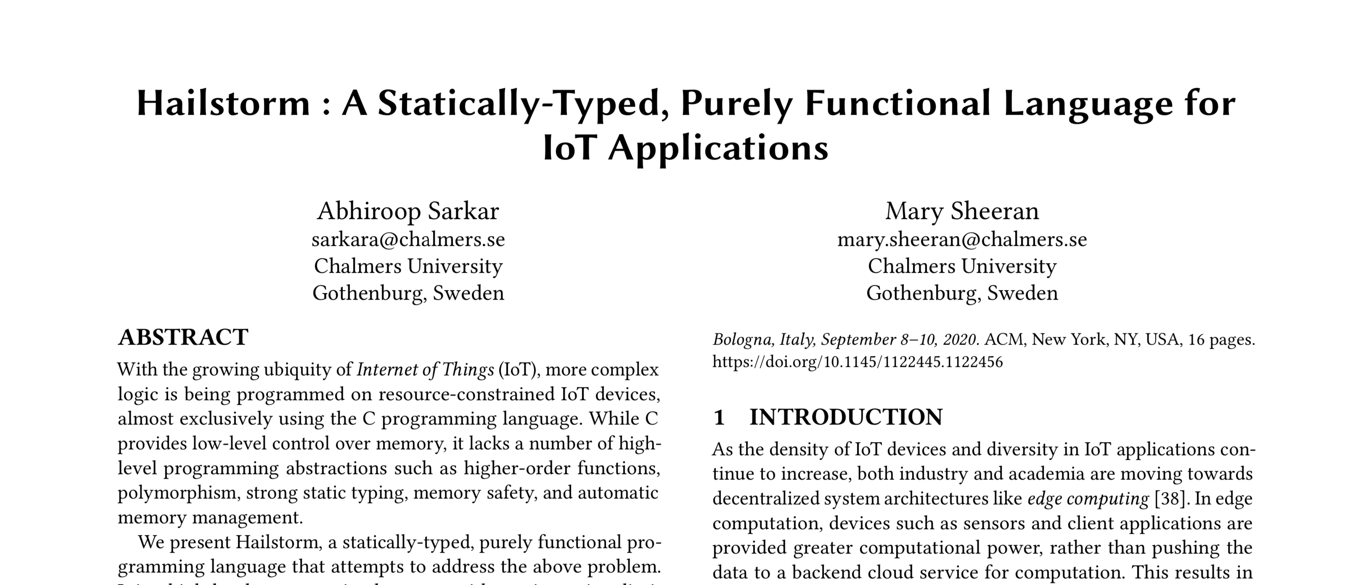
PPDP 2020
Notes:
© Copyright Showeet.com – Creative & Free PowerPoint Templates

Slide 7
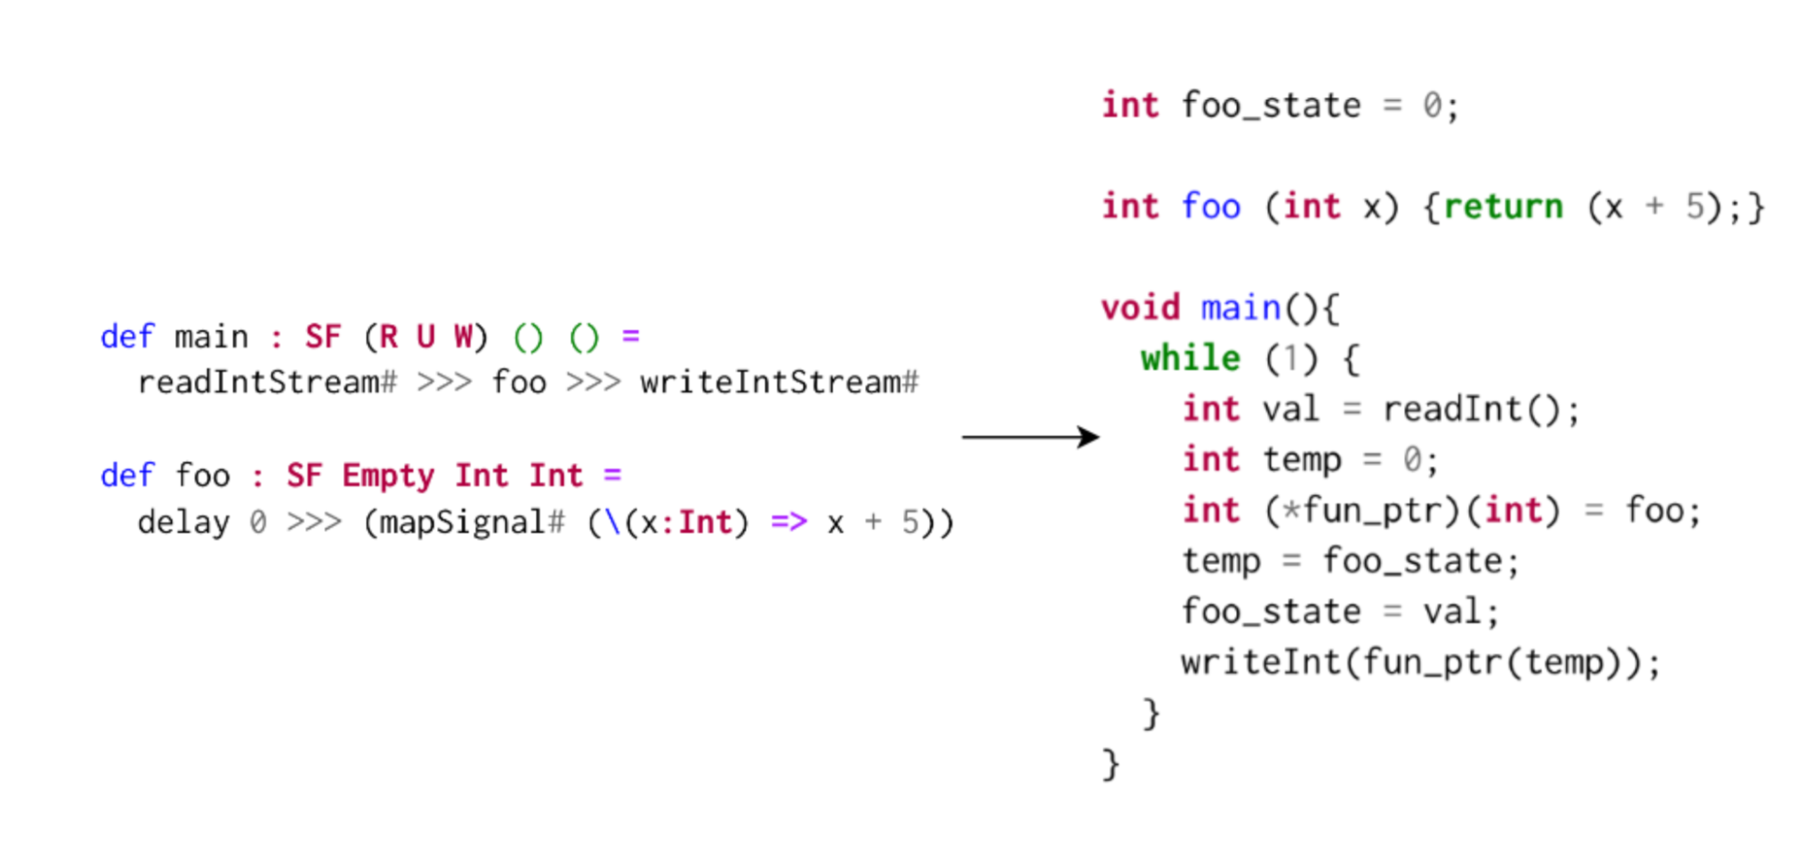
Hailstorm
Notes:
© Copyright Showeet.com – Creative & Free PowerPoint Templates

Slide 8
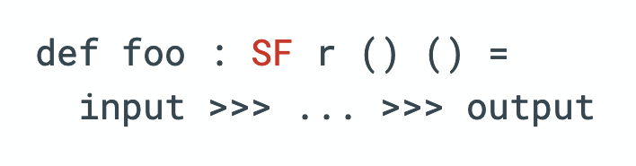
Pull based semantics
Notes:
© Copyright Showeet.com – Creative & Free PowerPoint Templates

Slide 9
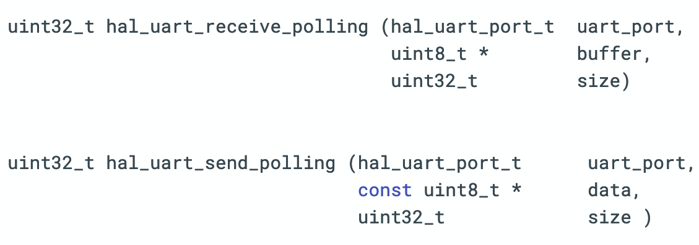
Polling based synchronous APIs
Notes:
© Copyright Showeet.com – Creative & Free PowerPoint Templates

Slide 10
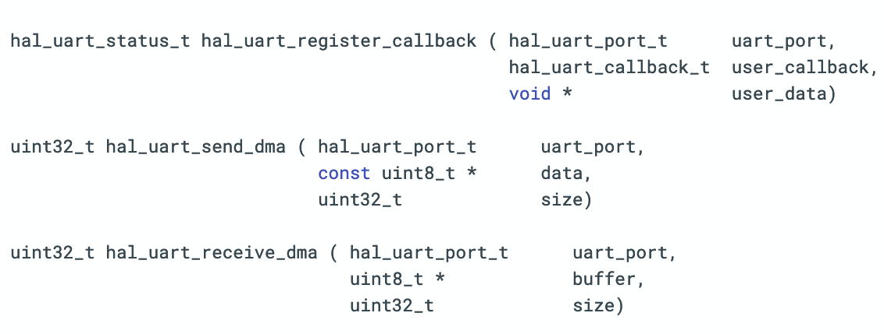
Callback based asynchronous APIs
Notes:
© Copyright Showeet.com – Creative & Free PowerPoint Templates

Slide 11
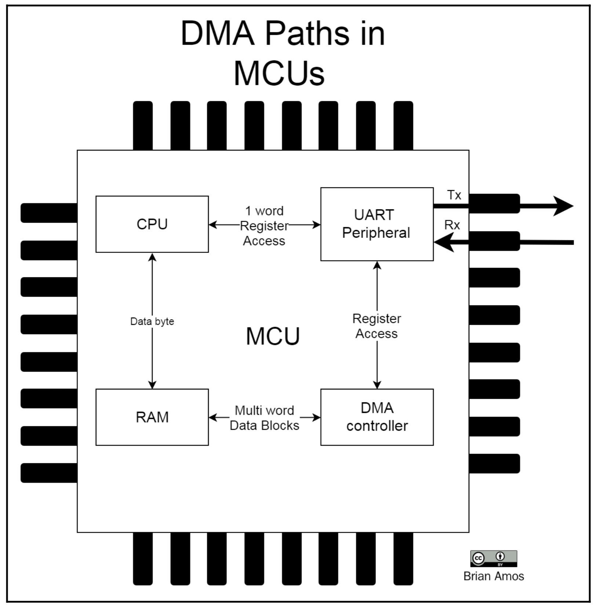
Direct Memory Access (DMA)
Notes:
© Copyright Showeet.com – Creative & Free PowerPoint Templates

Slide 12
Asynchronous APIs break the linear control flow
Notes:
© Copyright Showeet.com – Creative & Free PowerPoint Templates

Slide 13


Asynchronous layer
My synchronous program
Queues, Buffers, Backpressure..
Notes:
© Copyright Showeet.com – Creative & Free PowerPoint Templates

Slide 14

Microcontroller programs
Asynchronous layer
Queues, Buffers, Backpressure..
Notes:
© Copyright Showeet.com – Creative & Free PowerPoint Templates

Slide 15
The many solutions to tackling asynchrony…
Notes:
© Copyright Showeet.com – Creative & Free PowerPoint Templates

Slide 16
Event based
Process based
CSP
Actors
CML
Real OS Threads
Fork-join frameworks (Haskell, Java)
Synchronous languages
FRP
Event-based programming
Rx framework etc
Reagents, Li et al’s work
Control-flow based
C# async-await
Notes:
© Copyright Showeet.com – Creative & Free PowerPoint Templates

Slide 17
Shared Memory vs Message Passing
Process based
Notes:
© Copyright Showeet.com – Creative & Free PowerPoint Templates

Slide 18
Synchronous send vs Asynchronous send
Process based
Message passing
Notes:
© Copyright Showeet.com – Creative & Free PowerPoint Templates

Slide 19
CSP vs Concurrent ML
Process based
Message passing
Synchronous send
Notes:
© Copyright Showeet.com – Creative & Free PowerPoint Templates

Slide 20
Process based
Message passing
Synchronous send
Concurrent ML
Notes:
© Copyright Showeet.com – Creative & Free PowerPoint Templates

Slide 21


Microcontroller programs
Hailstorm
ML?
Concurrent ML based Virtual Machine
Notes:
© Copyright Showeet.com – Creative & Free PowerPoint Templates

Slide 22
Thank you!
Notes:
© Copyright Showeet.com – Creative & Free PowerPoint Templates

