Slide 1




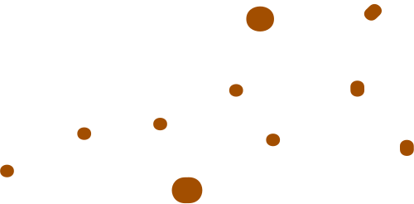



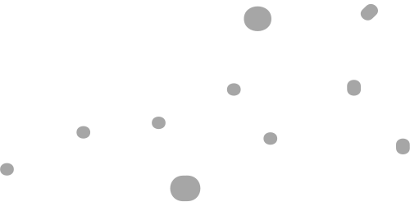
AGROGENIE
Problem Statement:
Smart Agriculture using IoT for Crop Management: Creating predictive models for precision agriculture, optimizing crop yield and resource utilization using IoT sensors.
Team Name:
TetraCuatro

Slide 2
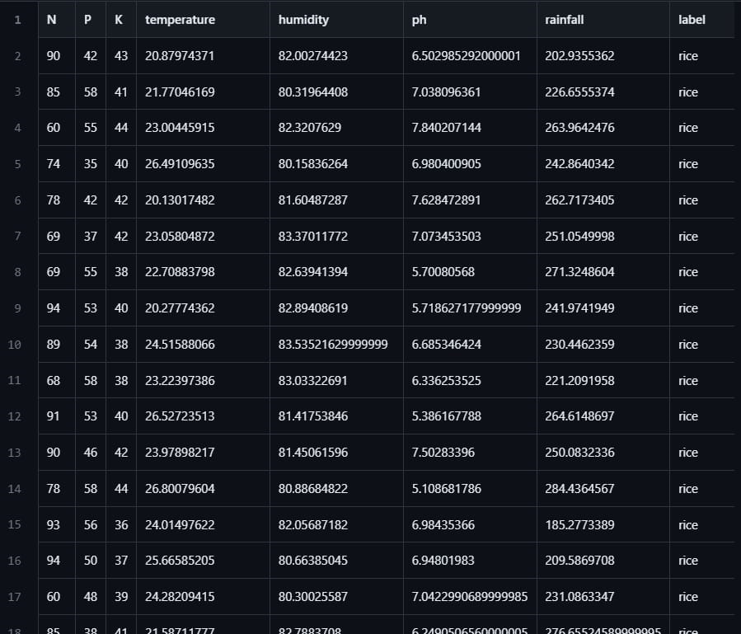
Approach Details
STEP 1: ML Model training
Data set used: Crop recommendation dataset from kaggle.
ML Algorithm used: Logistic regression based classification.
Number of instances:10000
Number of features:7
Number of iterations:1000
Learning rate:0.0001
Model was trained on Google collab platform and the model’s weights and bias values are stored for later use.
The collection of weights and bias was then transferred to the Arduino platform for real time prediction.

Slide 3
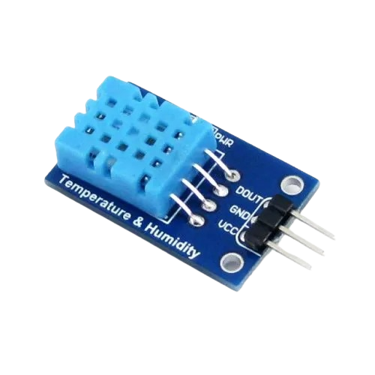
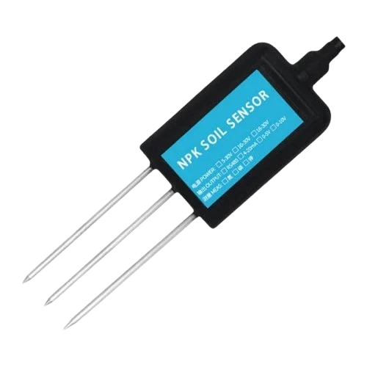
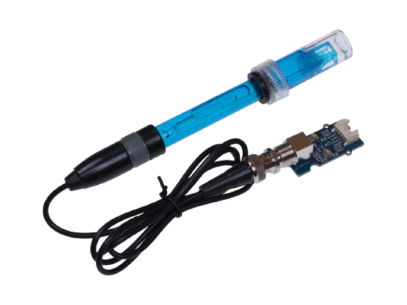
STEP 2: INTERFACING SENSORS WITH ARDUINO
Sensors to be incorporated:
NPK soil nutrient sensor
pH sensor
DHT 11 Temperature and humidity sensor
Process:
Data collected from the sensors alongside the measured rainfall data are provided to the Arduino as input.
The input array is constructed using the different data thus collected

Slide 4
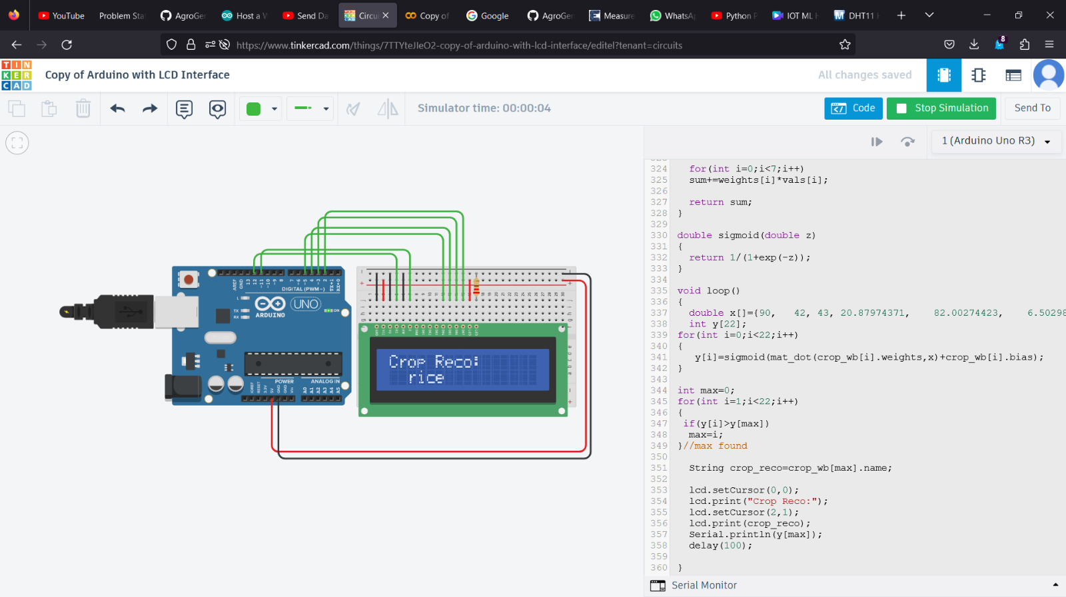
STEP 3: PREDICTION
Methodology:
For, every individual crop, the given input array is then multiplied with the array of weights and bias values are added.
The corresponding results are put into sigmoid functions and final values are stored in separate array.
The given arrays is then searched for and the index value corresponding ti the crop having maximum
probability is obtained. Accordingly, the crop is displayed on the LCD
2

Slide 5
Team Member Details
Team Leader Name: Srijeeta Sen
Branch : B. Tech Stream : CSE (AIML) Year : II
Team Member 1 Name: Debayan Ghosh
Branch : B. Tech Stream : CSE (AIML) Year : II
Team Member 2 Name: Abhiroop Sarkar
Branch : B. Tech Stream : CSE (AIML) Year : II
Team Member 3 Name: Snehal Ghosh
Branch : B. Tech Stream : CSE (AIML) Year : II

