Slide 1
IDEAS – TIH SUMMER INTERNSHIP
Power Industry Sustainability
Ranking Using AI/ML
A data-driven ESG ranking framework for Indian power sector companies
Submitted by Abhiroop Dutta
Guided by Dr. Piyali Sengupta
July 2026

Slide 2
INTRODUCTION
Why Rank Power Companies on Sustainability?
Investors, regulators, and the public increasingly judge power companies on Environmental, Social, and Governance (ESG) performance — but commercial ratings are proprietary, costly, and opaque. This project builds a transparent, reproducible AI/ML framework to rank Indian power companies on sustainability.
1
Identify Indicators — Map material Environmental, Social, and Governance indicators for the power sector.
2
Collect ESG Data — Compile three years of disclosures for six major Indian power sector companies.
3
Apply AI/ML — Cluster, model, and weight sustainability performance using appropriate techniques.
4
Benchmark Rankings — Compare AI-derived output to conventional weighting and external ratings.
5
Surface Leaders & Laggards — Deliver actionable, company-level recommendations.
Power Industry Sustainability Ranking Using AI/ML Techniques
2

Slide 3
METHODOLOGY
A Four-Phase Analytical Framework
1. Data Preparation — Clean, impute missing values, and normalize 13 ESG indicators.
2. Feature Selection — Correlation analysis and PCA to validate the E/S/G structure.
3. AI/ML Modeling — K-Means clustering and Random Forest regression applied to indicator data.
4. Ranking Framework — Weighted Sustainability Index, benchmarked against external ratings.
Sample: Adani Power · Tata Power · Power Grid Corp. of India · JSW Energy · NTPC Limited · NHPC Limited
FY 2022-23 to FY 2024-25 | 18 company-year observations
Power Industry Sustainability Ranking Using AI/ML Techniques
3

Slide 4
THE DATA
Dataset & Sustainability Indicators
6
3
18
13
Companies
Financial Years
Company-Year Records
ESG Indicators
Environmental
GHG & Energy Intensity, Water Intensity, Waste Intensity, Scope 3 Reporting
Social
Workforce Diversity, Training Hours, Worker LTIFR, CSR Expenditure
Governance
Board Diversity, Independent Directors, Governance & Ethics Mechanisms
Power Industry Sustainability Ranking Using AI/ML Techniques
4

Slide 5
METHODOLOGICAL INTEGRITY
Two Bias Corrections That Mattered
During validation, two mechanical sources of bias were identified and corrected — both material to keeping the ranking fair and defensible.
Governance Text Treated as “Zero”
Business Model Skewed Environmental Scores
Blank Ethics & Compliance disclosures for some companies were initially scored as “no governance mechanisms” — penalizing a data gap, not a real weakness.
Transmission (Power Grid) and hydro (NHPC) companies report near-zero emissions simply from not burning fuel — not necessarily superior effort.
Fix: blanks are now treated as missing data and imputed with the peer median, with a disclosure flag kept for transparency.
Fix: combustion-driven indicators are now normalized within business-model peer segments, matching how CRISIL/MSCI benchmark industry-relative.
Power Industry Sustainability Ranking Using AI/ML Techniques
5

Slide 6
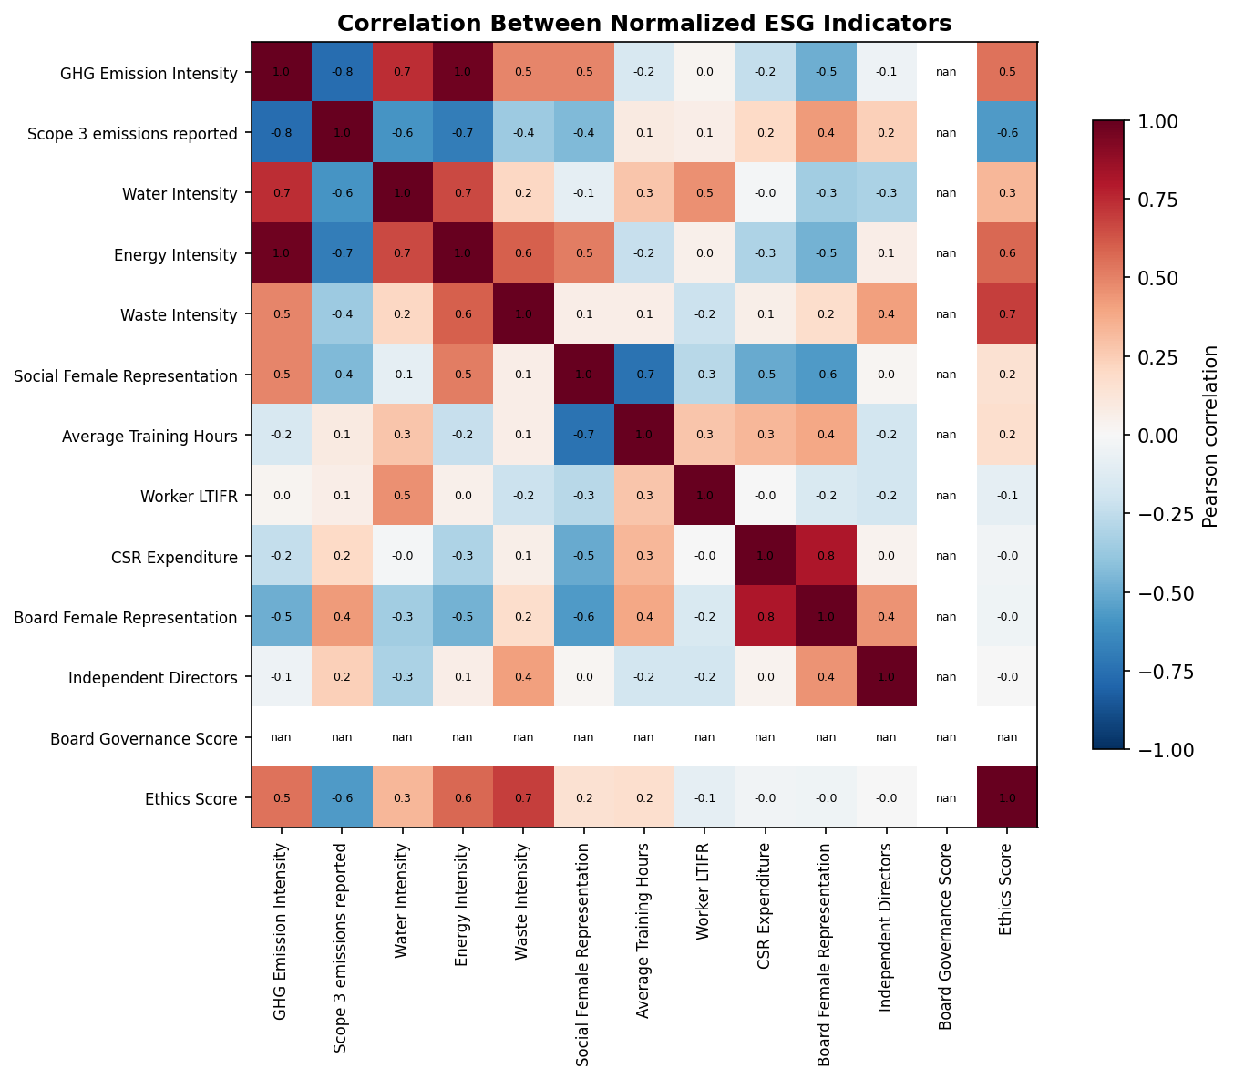
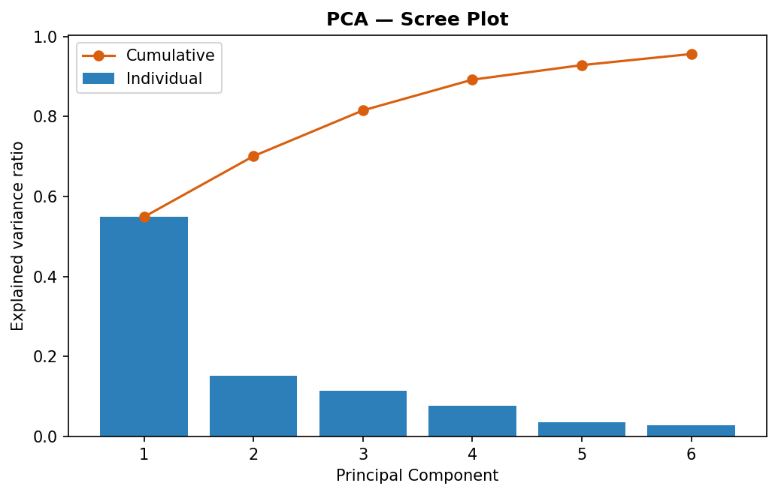
FEATURE SELECTION
Correlation Analysis & Principal Component Analysis
Key finding: GHG, Water, and Energy Intensity move together and dominate the first principal component (~57% of variance) — confirming that business-model (combustion vs. non-combustion) is the single largest axis of difference between these companies.
Power Industry Sustainability Ranking Using AI/ML Techniques
6

Slide 7
MODELING
Two Complementary AI/ML Models
K-Means Clustering
Random Forest
Groups companies into sustainability tiers without a pre-defined scoring formula.
Learns which indicators drive sustainability, producing AI-derived pillar weights.
Best k = 4 (silhouette ≈ 0.48)
5-fold CV R² = 0.58 (± 0.45)
Both models are validated appropriately for a small-sample dataset: silhouette score for cluster-count selection, and 5-fold cross-validation for Random Forest, rather than a single train/test split.
Power Industry Sustainability Ranking Using AI/ML Techniques
7

Slide 8
RANKING FRAMEWORK
From Indicators to a Sustainability Index
SI = wₑ × Environmental + wₛ × Social + wᵍ × Governance
Weighting Scheme | Environmental | Social | Governance | Basis
Equal Weights | 33% | 33% | 33% | No prior assumption
Expert Weights | 45% | 25% | 30% | GRI / SASB / WEF materiality guidance
AI-Derived Weights | 80% | 9% | 11% | Random Forest feature importance
Company scores are aggregated across FY22-23 / FY23-24 / FY24-25 with recency weighting (20% / 30% / 50%), then ranked under each scheme.
All three schemes agree almost perfectly on company order (Spearman ρ = 1.00) — the ranking is not sensitive to exactly how E/S/G are weighted, but all three do share majority weight on Environmental.
Power Industry Sustainability Ranking Using AI/ML Techniques
8

Slide 9
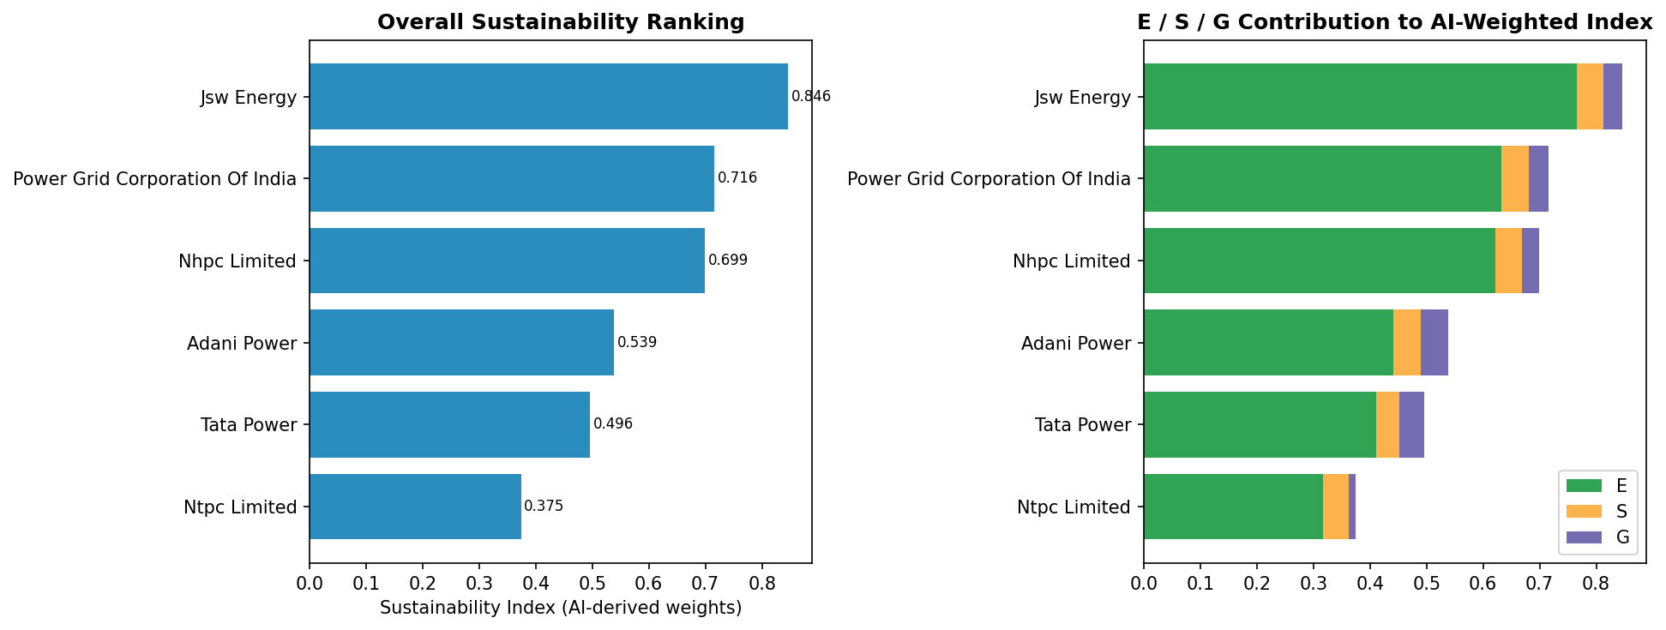
RESULTS
Final Sustainability Ranking
Leaders: JSW Energy, Power Grid, NHPC Average: Adani Power Needs improvement: Tata Power, NTPC Limited
Power Industry Sustainability Ranking Using AI/ML Techniques
9

Slide 10
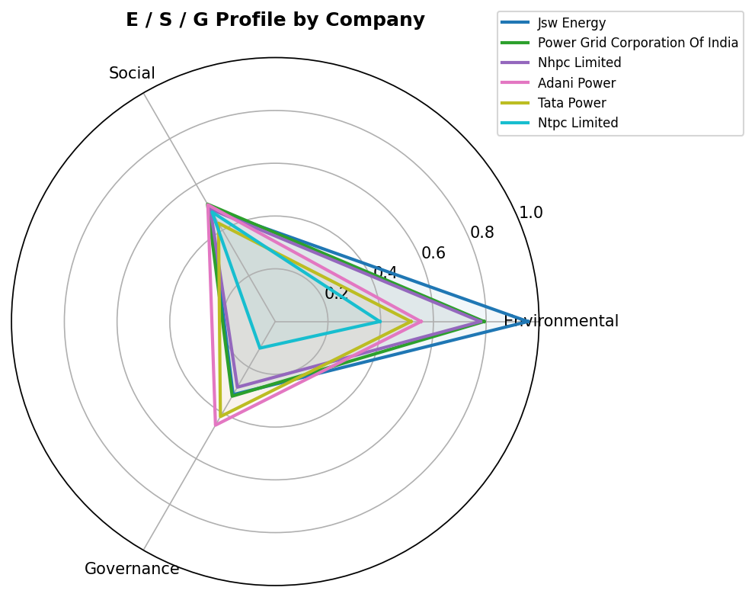
COMPANY PROFILES
Environmental / Social / Governance Fingerprints
Environmental leaders (Power Grid, NHPC, JSW) benefit from either a low-carbon business model or genuinely efficient generation.
Governance is the most consistent weak point — every company's lowest relative pillar, most acutely for NTPC (board composition dropped sharply in FY24-25).
Adani Power shows the most balanced E/S/G profile of the sample — no standout strength, but no severe weakness either.
Power Industry Sustainability Ranking Using AI/ML Techniques
10

Slide 11
VALIDATION
Benchmarking & Honest Limitations
How We Validate
Honest Limitations
Spearman rank correlation vs. real CRISIL / MSCI ESG ratings (once available).
Only 6 companies / 18 observations — correlation estimates need ρ ≈ 0.83+ just to be statistically significant.
Grid-search weight calibration: solves for the (wₑ, wₛ, wᵍ) that best matches an external benchmark ranking.
Verified external ratings (CRISIL/MSCI) are subscription-gated and not yet incorporated numerically.
Internal cross-check: all 3 methods compared pairwise (ρ = 1.00).
Weight calibration on 6 points risks overfitting without cross-validation.
Power Industry Sustainability Ranking Using AI/ML Techniques
11

Slide 12
CONCLUSION
A Transparent Starting Point for AI-Driven ESG Assessment
Reproducible pipeline: cleaning → feature selection → ML modeling → ranking, fully documented.
Two real methodological biases identified and corrected — not hidden.
JSW Energy, Power Grid & NHPC lead; Governance is the sector-wide priority area.
Next: expand company universe, add verified external ratings, cross-validate weight calibration.
Thank you
Power Industry Sustainability Ranking Using AI/ML Techniques
12

