Slide 1
DIGITAL CALCULATOR USING ARDUINO UNO R3
Submitted to : Dr. Satish Singh
Submitted by:
GROUP NO. 1
Nancy Sihmar (IIT2012202)
Abhiruchi Gupta (IIT2012208)

Slide 2
INTRODUCTION
A basic calculator performing four mathematical functions namely addition, subtraction, multiplication, division using ARDUINO UNO R3. Input is given via TSOP IR Remote Sensor which captures the key press and corresponding output is shown on 7 Segment Display
Remote keys layout
TSOP IR Sensor pins
LED
7 Segment Display (cathode)

Slide 3
PROBLEM STATEMENT
a single digit calculator that is capable of performing basic arithmetic operations .
yields result of atmost two digits.
a device is used to sense the input numbers and the operation to be performed on those numbers
a device to display the calculated answer.
the interfacing device is a microcontroller/microprocessor.

Slide 4
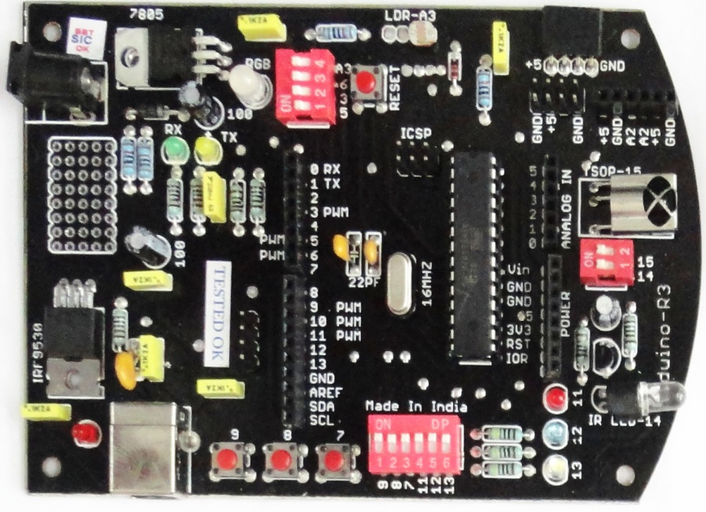
REQUIREMENT
SOFTWARE
HARDWARE
INDUINO is a single-board microcontroller. Its software consists of a standard programming language compiler and a boot loader that executes on the microcontroller i.e. Arduino 1.0.5 version IDE.
INDUINO R3
IR Remote Control
Bread Board,LEDs

Slide 5
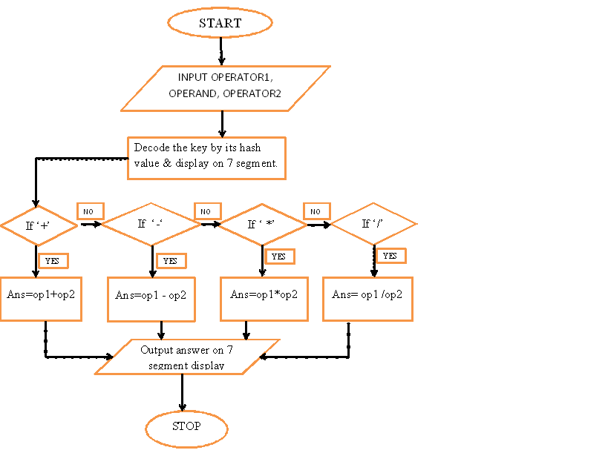
METHOD

Slide 6
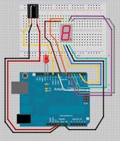
The IR receiver decodes the pulse of light and then the microcontroller carry out the corresponding command. The 7 Segment display require only 9 pins as the cathode of the segment LEDs are connected to a common pin referred to as common cathode. Fundamentals of the microcontroller is understood which facilitates programming and incorporation into other circuits.

Slide 7
RESULT
0-9, +, -, *, / are sensed from the remote feed and the operation is performed. Output from the module echoes the answer on 7 segment display to represent each number. Calculator produces result in two digit format only.

Slide 8
Refrences
www.arduino.cc
www.simplelabs.co.in
www.graylogix.com
www.youtube.com/watch?v=caMW1RRPOGE

