Slide 1

Introduction to Web Development & MERN Stack
By The Skillians
30-08-2025

Slide 2
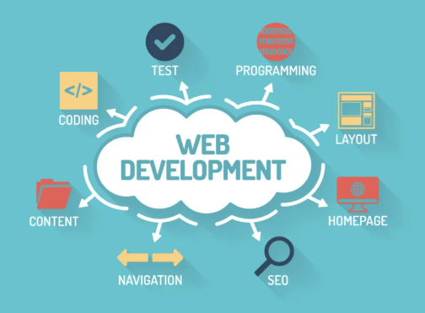
1. What is Web Development?
Definition:
Web development is the process of creating and maintaining websites and web applications that run on the internet.
Example:
A simple blog = Website.
Instagram, Facebook = Web Applications (dynamic, interactive, connected with a server & database).

Slide 3
Client vs Server
Client (Frontend):
The part users see and interact with (browser, mobile app).
Runs on the user’s device.
Sends requests to server.
Server (Backend):
The “behind-the-scenes” computer that processes requests.
Fetches data from database, applies logic, sends back response.
Analogy:

Slide 4
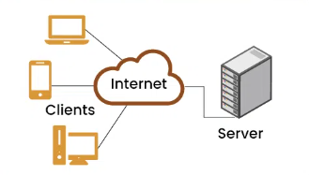

Slide 5
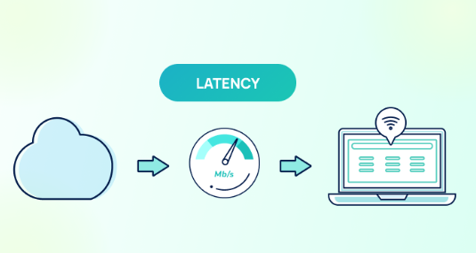
Latency
Definition: Time taken for a request to travel from client → server → back to client.
Lower latency = faster response.
Example:
Clicking a video on YouTube:
If server is near you → plays instantly (low latency).
If server is far → takes a few seconds to load (high latency).
Analogy: Like speed of a courier service delivering your parcel.

Slide 6
Bandwidth
Definition: Maximum amount of data that can be transferred over a network in a given time.
Higher bandwidth = can send more data at once.
Example:
Watching Netflix in 4K requires high bandwidth.
Browsing text-only blogs requires low bandwidth.
Analogy: Bandwidth = Width of a water pipe. Wider pipe → more water flows.

Slide 7
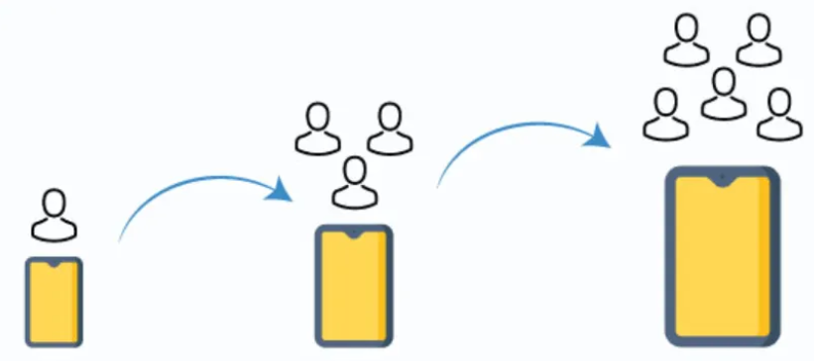
Scalability
Definition: Ability of an application to handle increased workload (more users, more data).
Example:
Facebook scaled from 1,000 users in 2004 → 3+ billion users today.
If your MERN app works fine for 10 users but crashes at 1,000, it’s not scalable.

Slide 8
Restaurant example –
Customer = Client (asks for food).
Waiter = API (takes order & brings response).
Chef & Kitchen = Server (prepares food).
Storage Room = Database (ingredients/data).

Slide 9
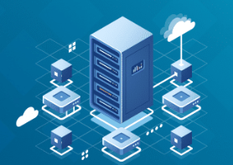
📂 Database
Definition:
A database stores, organizes, and manages data so that servers can fetch/update easily.
Example:
In Instagram → your profile info, posts, likes, comments all stored in DB.
Types:
SQL (structured, tables → MySQL, PostgreSQL).
NoSQL (flexible, JSON style → MongoDB).

Slide 10
API (Application Programming Interface)
Definition:
A set of rules that allows one software to talk to another.
API connects client ↔ server.
Example:
When you open Zomato and search “Pizza”, app calls Zomato API which fetches restaurant data from DB and shows you.
Analogy:
API = Waiter who takes your order to kitchen (server) and brings food (data).

Slide 11
HTTP & HTTPS
HTTP (HyperText Transfer Protocol):
The protocol that defines how client & server communicate.
HTTPS:
Secure version with encryption (SSL).
Example:
http:// vs https:// in your browser URL bar.
Online banking always uses HTTPS for safety.

Slide 12
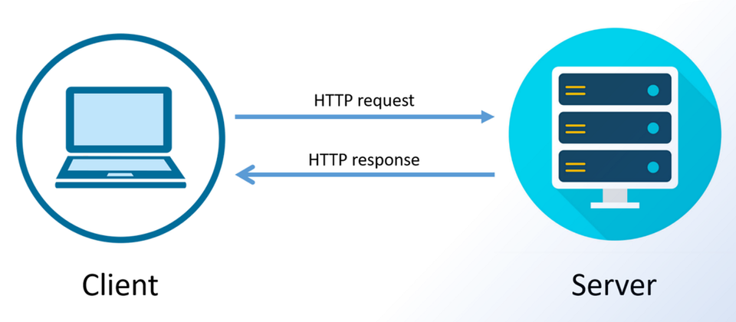
Request & Response
Request:
When client asks server for data (like clicking a button, submitting a form).
Response:
The data/info server sends back to client.
Example:
You search on YouTube → Request goes to server → Response comes back with search results.

Slide 13
Domain, Hosting, DNS & IP
Domain = Easy name for a website (google.com).
Hosting = Service that stores website files so people can access them online.
IP Address = Unique number that identifies a server (e.g., 142.250.182.206).
DNS (Domain Name System) = Converts domain names into IP addresses.
Analogy:
Domain = Your friend’s name.
IP = Your friend’s phone number.
DNS = Contact list that maps names to numbers.

Slide 14
Frontend vs Backend vs Fullstack
Frontend (Client-side) → What user sees (HTML, CSS, JS, React).
Backend (Server-side) → Logic, authentication, data (Node, Express).
Fullstack Developer → Works on both frontend & backend.
Example:
Netflix:
Frontend = Homepage, movie thumbnails, play button.
Backend = Recommendations, subscriptions, payments.
Database = All movies & user accounts.

Slide 15

MERN Stack Overview
M → MongoDB: Database (NoSQL, JSON-based).
E → Express.js: Backend framework for APIs.
R → React.js: Frontend library for UI.
N → Node.js: Runtime environment for JavaScript on server.
Flow:
React (UI) → API call → Express + Node (logic) → MongoDB (data).
Example:
Instagram:
React → UI feed.
Express/Node → Backend logic for likes/comments.
MongoDB → Stores all posts, users, chats.

Slide 16
Tools We Will Use in the Course
VS Code → Code Editor.
Node.js + npm → Backend environment & package manager.
Browser DevTools → Debug frontend code.
Postman/Thunder Client → Test APIs.
Git + GitHub → Version control & collaboration.
MongoDB Compass/Atlas → Database GUI.

Slide 17
Static vs Dynamic Websites
Static Website
Content is fixed, same for everyone.
Built with HTML, CSS only.
Example: Portfolio site, simple company landing page.
Dynamic Website
Content changes based on user/data.
Requires backend + database.
Example: Facebook news feed, Amazon product recommendations.
Analogy:
Static = Printed newspaper (same for all).
Dynamic = Personalized magazine that updates daily based on your interest.

Slide 18
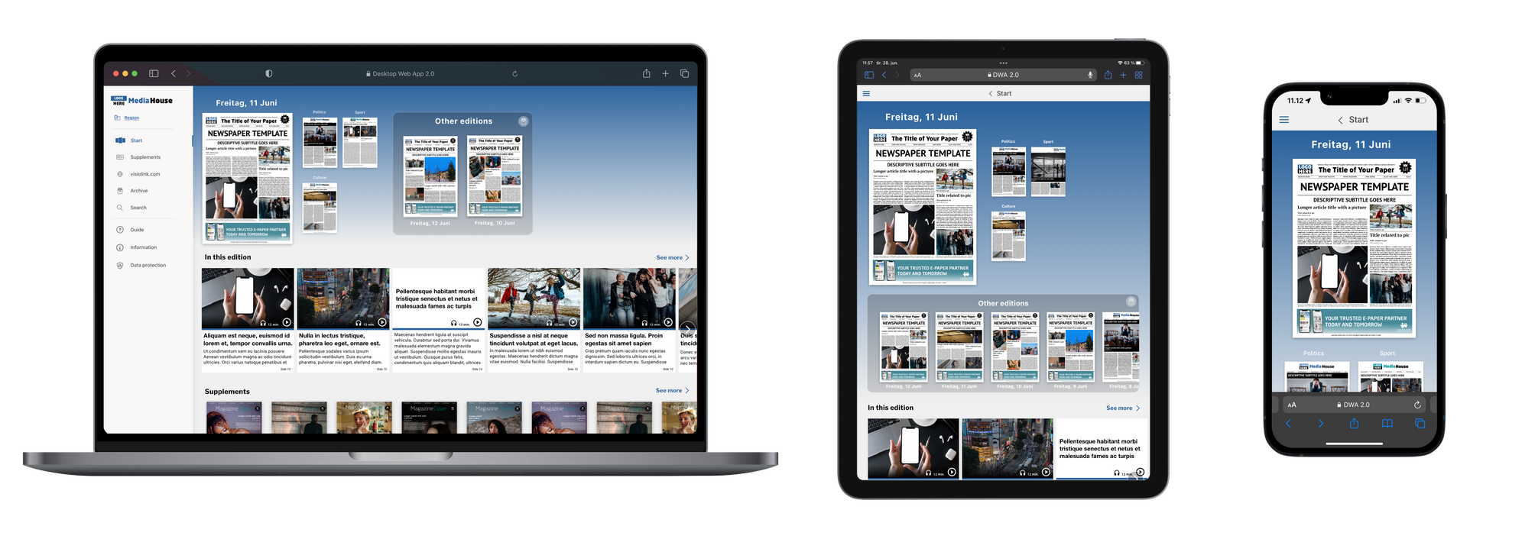
Web App vs Mobile App vs Desktop App
Web App: Runs inside a browser (Gmail, YouTube).
Mobile App: Installed on mobile device (WhatsApp, Instagram app).
Desktop App: Installed on PC (MS Word, VS Code).
Point: With MERN, we build web apps (but can integrate with mobile using React Native later).

Slide 19
Synchronous vs Asynchronous
Synchronous:
Code runs line by line, next line waits for previous.
Example: A person standing in line at ATM (one after another).
Asynchronous:
Multiple things happen at the same time.
Example: Ordering food → you wait at table while chef cooks, meanwhile you can chat with friends (non-blocking).
web apps often use asynchronous requests (AJAX, fetch, async/await).

Slide 20
Authentication vs Authorization
Authentication = Confirming “Who you are” (Login).
Authorization = Confirming “What you are allowed to do” (Admin vs User access).
Example:
Login with Gmail = Authentication.
Admin can delete users but normal users cannot = Authorization.

Slide 21
Frontend Tech Stack
HTML: Structure of page.
CSS: Design/styling.
JavaScript: Interactivity.
React.js: Modern library for building dynamic UIs.
Example:
HTML = Skeleton.
CSS = Clothes.
JavaScript = Muscles (movement).
React = Full modern body.

Slide 22
Backend Tech Stack
Node.js → Environment to run JS on server.
Express.js → Framework to handle requests, routes, APIs.
Database → Store data (MongoDB in our stack).
Example:
Node = Engine of car.
Express = Driver that controls directions.
Database = Fuel tank (data storage).

Slide 23
Packages, Libraries & Frameworks
Package → Small piece of reusable code (like lodash, axios).
Library → Collection of functions you can call (React).
Framework → Provides structure & rules to build app (Express, Angular).
Analogy:
Package = One kitchen utensil.
Library = A full drawer of utensils.
Framework = A full kitchen setup with cooking style guidelines.

Slide 24
Recap + Homework
Recap key terms (client, server, DB, API, HTTP, DNS).
Homework:
Research “Difference between Website & Web App”.
Install VS Code & Node.js.

