Slide 1

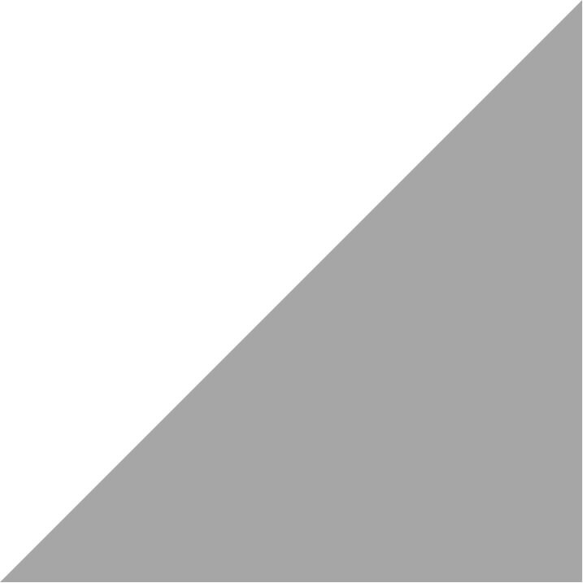
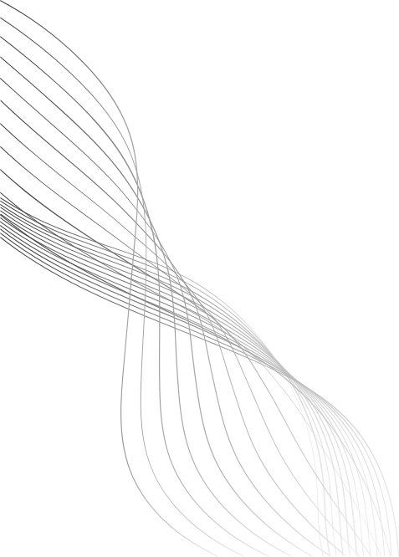
CSS
By The Skillians

Slide 2
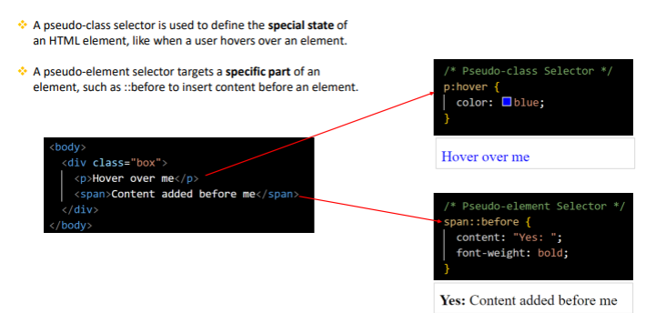

Slide 3
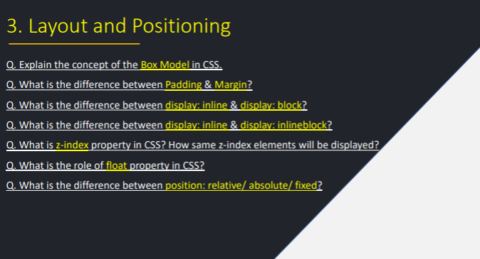

Slide 4
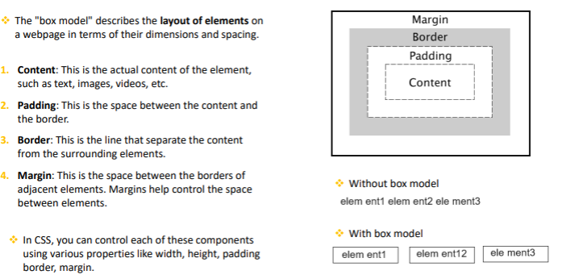

Slide 5
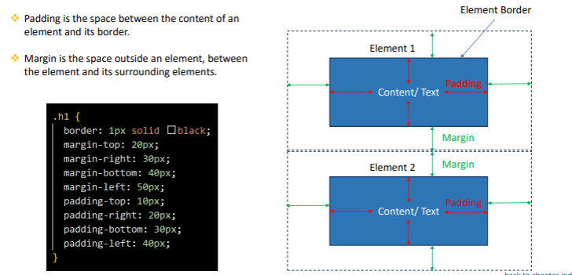

Slide 6
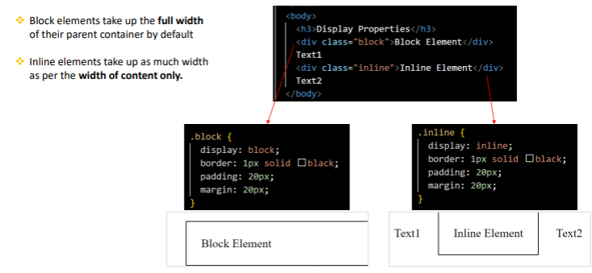

Slide 7
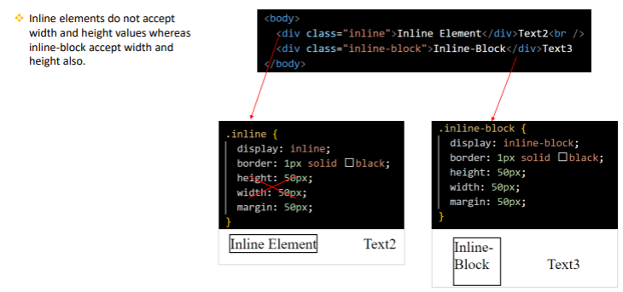

Slide 8
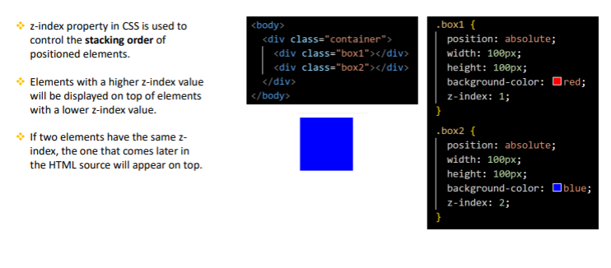

Slide 9

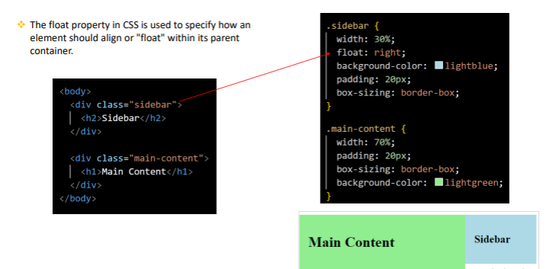

Slide 10
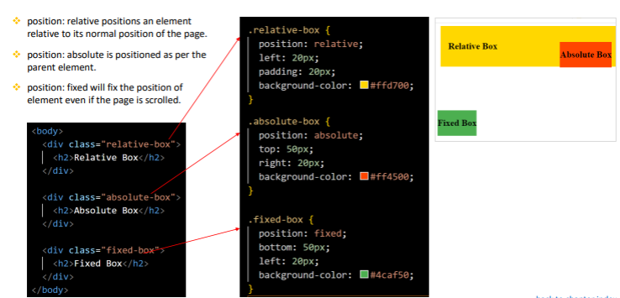

Slide 11
Q.Explain different positions in css.
Static = default, flows normally.
Relative = move relative to itself.
Absolute = placed inside nearest positioned parent.
Fixed = sticks to viewport (eg. sticky navbar).
Sticky = scroll untill a limit, then sticks.

Slide 12
Task
Create sticky footer at bottom of page and navbar at the top. using absolute.

Slide 13
Introduction to Flexbox
Title: What is Flexbox?
Description:
Flexbox (Flexible Box Layout) is a CSS layout module that makes it easy to arrange elements horizontally or vertically, align them properly, and distribute space evenly — without using floats or positioning hacks.
Flex Container
Title: Creating a Flex Container
Description:
Flexbox works when you define a parent container as a flex container.

Slide 14
Code Example
<div style="display: flex;">
<div>Item 1</div>
<div>Item 2</div>
<div>Item 3</div>
</div>

Slide 15
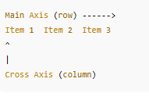
Main Axis vs Cross Axis
Title: Understanding Axes
Description:
Main Axis: The primary direction of items (row by default)
Cross Axis: Perpendicular direction (column by default)

Slide 16
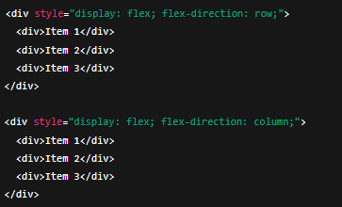
Direction of Flex Items
Title: flex-direction Property
Description:
Controls the direction of items inside the container.

Slide 17
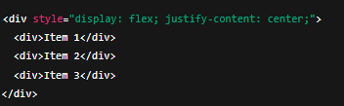
Aligning Items on Main Axis
Title: justify-content Property
Description:
Aligns items horizontally (when direction is row).

Slide 18
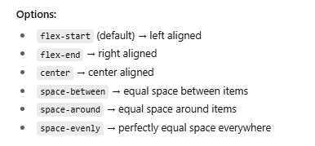

Slide 19
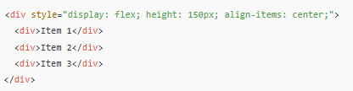
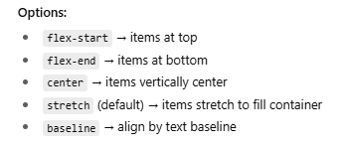
Aligning Items on Cross Axis
Title: align-items Property
Description:
Aligns items vertically (when direction is row).

Slide 20
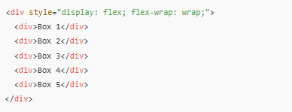
Wrapping Items
Title: flex-wrap Property
Description:
Allows items to move to a new line if there is not enough space.

