Slide 1


Transition
What is transition ?
CSS transition allows you to smoothly change a property from one value to another over a specific duration.

Slide 2
transition
transition-property
transition-duration
transition-timing-function
transition-delay

Slide 3
Syntax of transition
element {
transition: property duration timing-function delay;
}
1. property: Which CSS property to animate (e.g., color, background, transform).
2. duration: How long the animation takes (e.g., 0.5s).
3. timing-function: The speed curve of the transition (e.g., ease, linear).
4. delay (optional): Start animation after a delay (e.g., 1s).

Slide 4
Grid
CSS Grid is a layout system that allows you to design webpages in rows and columns with minimal code.
Grid container: The parent element where the grid is applied (display: grid;).
Grid items: The child elements inside the grid container.

Slide 5
Properties of Grid
gap
column-gap
fr unit
span
repeat

Slide 6
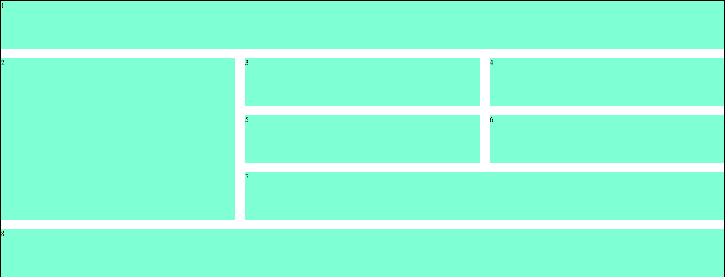
Create using grid system

Slide 7
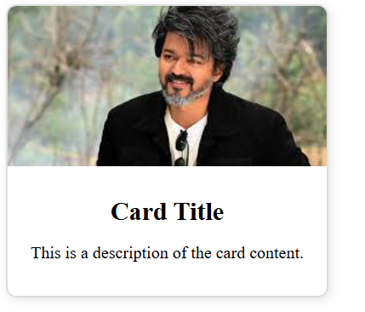
Create Card

Slide 8
Create Navbar

Slide 9
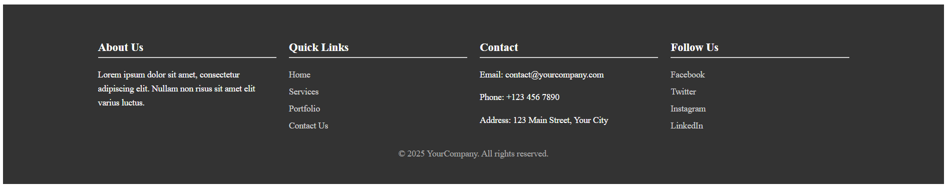
Create a footer

Slide 10
Media Queries

Slide 11
Media Queries
Definition: Media queries allow developers to apply different styles to a webpage depending on the size of the viewport (screen size), device type, orientation, or other properties.

Slide 12
@media (max-width: 768px) { /* CSS rules here */ }

Slide 13
@media (min-width: 400px) { /* CSS rules here */ }

Slide 14
Bootstrap

Slide 15
Bad Practice
<div class="header">Welcome</div>
Good Practice
<header>Welcome</header>

Slide 16
Organize and Comment Your Code
<!-- Header Section -->
<header>
<h1>Website Title</h1>
</header>
<!-- Main Content -->
<main>
<p>This is the content.</p>
</main>

Slide 17
Beest Practice
Use External CSS for Scalability
Follow Consistent Naming Conventions
Use Relative Units (e.g., %, em, rem)
Always design mobile-first, then scale up
Minimize Hardcoded Widths

