Slide 1
📊
Telecom Customer
Churn Analysis
DATA
ANALYSIS
REPORT
Identifying high-risk customer segments to inform
targeted retention strategies
EDA
Python
Pandas
Seaborn

Slide 2
Project Overview
🎯
Objective
📋
Dataset
Identify and quantify factors driving customer churn to enable targeted retention strategies.
Telecom/streaming provider data with demographics, contract details, services, and billing info.
🔧
Tools
📈
Methods
Python · Pandas · Matplotlib · Seaborn — using EDA with univariate & bivariate analysis.
Count plots, bar charts, and pie charts to compare churn vs. non-churn across all features.
Telecom Customer Churn Analysis

Slide 3
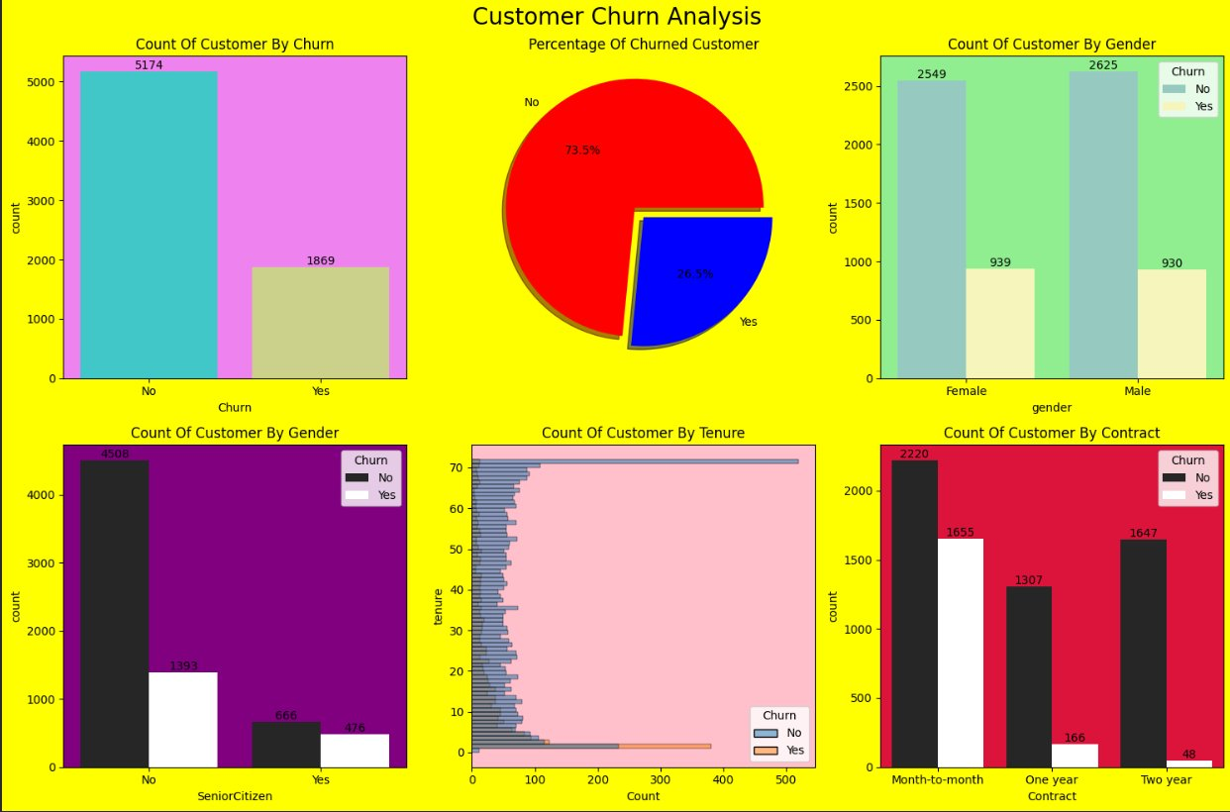
Overall Churn Rate
7,043
26.5%
5,174
1,869
Total Customers
Churn Rate
Active Customers
Churned Customers
Telecom Customer Churn Analysis

Slide 4
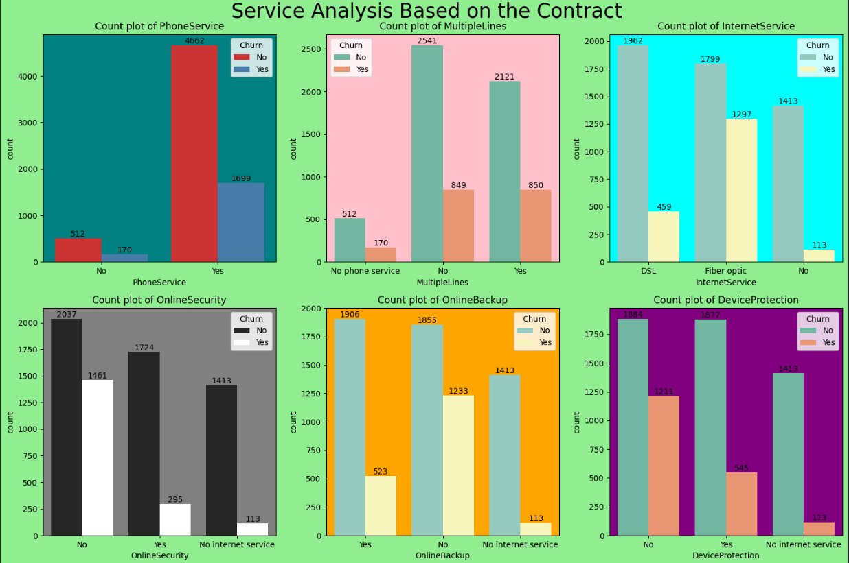
Service-Based Churn Analysis
🌐 Fiber Optic users churn most: 1,297 churned vs 1,799 active
🔒 No OnlineSecurity → 1,461 churns; with it only 295 churns
📞 Phone service users (4,662 active) show higher total churn (1,699)
Telecom Customer Churn Analysis

Slide 5
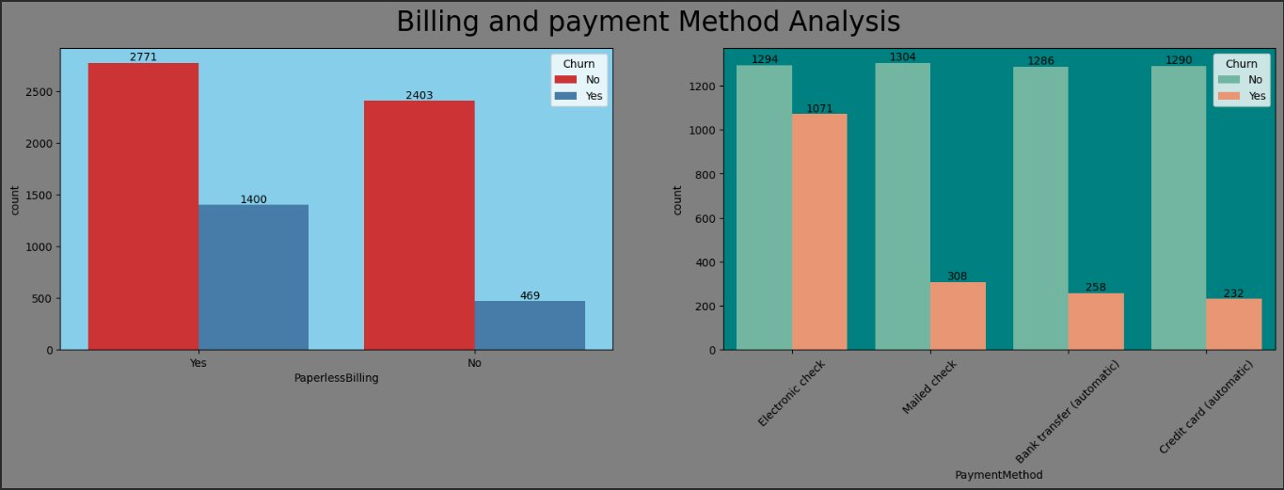
Billing & Payment Analysis
📄 Paperless Billing
💳 Electronic Check
🏦 Auto-Pay Methods
1,400 churns (Yes)
vs 469 churns (No)
Highest churn: 1,071
(vs ~258–308 for others)
Bank transfer & Credit card
have lowest churn rates
Telecom Customer Churn Analysis

Slide 6
Key Insights
01
Contract Type
02
Tenure
Month-to-month contracts drive 1,655 churns vs 48 for two-year contracts.
Low-tenure customers churn most. Long-term customers are significantly more loyal.
03
Internet Service
04
Support Services
Fiber optic users churn at nearly 42% rate, signaling quality or pricing issues.
Customers without OnlineSecurity or TechSupport churn 4–5× more than subscribers.
05
Payment Method
06
Senior Citizens
Electronic check users have 4× the churn of auto-pay users (1,071 vs ~245 avg).
Seniors churn at ~42% rate compared to ~24% for non-seniors.
Telecom Customer Churn Analysis

Slide 7
Retention Recommendations
📑 Incentivize Long-term Contracts
HIGH
🔒 Bundle Security & Support
HIGH
Offer discounts or perks for customers who switch from month-to-month to annual or biennial plans.
Proactively offer OnlineSecurity and TechSupport add-ons to new and at-risk customers.
💳 Improve Electronic Check Experience
MED
🌐 Address Fiber Optic Issues
HIGH
Investigate friction in the electronic check process. Encourage migration to auto-pay methods.
Investigate pricing, quality, or customer service for Fiber optic subscribers showing high churn.
👴 Senior Citizen Outreach
MED
🚀 Early Engagement Programs
MED
Design simplified plans or dedicated support channels for senior citizens to improve retention.
Launch onboarding programs for new customers to build habits and engagement in first 12 months.
Telecom Customer Churn Analysis

Slide 8
Conclusion
Strategic Summary
Contract type is the single strongest predictor of churn. Month-to-month customers are the primary risk group.
Customer churn is not
random — it follows
clear, actionable patterns.
Electronic check users show 4× higher churn — addressing payment friction could yield quick wins.
Promoting OnlineSecurity and TechSupport bundles can significantly reduce churn among at-risk customers.
26.5%
Overall Churn Rate
Fiber optic subscribers warrant dedicated investigation into service quality and pricing alignment.
74.5%
Month-to-month Churners
Targeted retention campaigns combining contract incentives, service bundles, and payment migration will be most effective.
~45%
Electronic Check Churn

Slide 9
Abhisek Nayak
Telecom Customer Churn Analysis
Exploratory Data Analysis Project
Aspiring Data Analyst
✔ Python
✔ SQL & PostgreSQL
✔ Power BI
14 Business Questions Answered
✔ Excel & Business Analysis
Thank you for viewing!
Portfolio Project • Open to Feedback
& Collaboration Opportunities

