Slide 1
Lecture 4 Cloud Deployment Model
CS5068NI - Cloud Computing and the Internet of Things

Slide 2
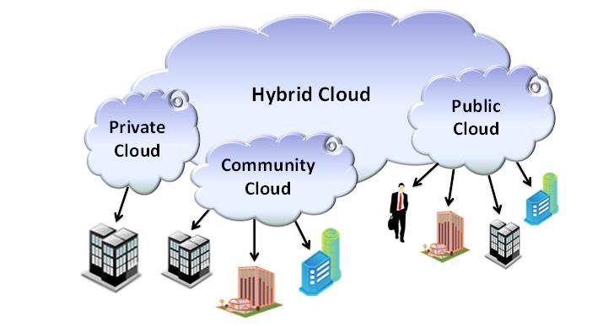
Lecture Objectives
Cloud computing revision
Key properties from Google’s & Amazon’s perspective
Cloud deployment model
On-Premise, hybrid and fully cloud
Cloud computing service types:-
Infrastructure As A Service (IaaS)
Platform As A Service (PaaS)
Software As A Service (SaaS)

Slide 3
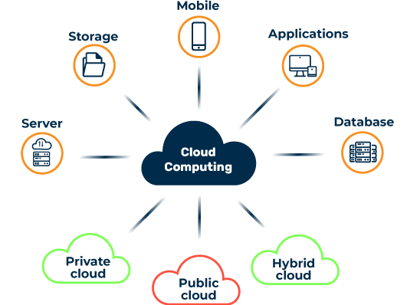
Revision
Cloud computing is on-demand delivery of compute power, storage, applications and so on via cloud services.
Mostly cloud services are pay-as-you-go pricing.

Slide 4
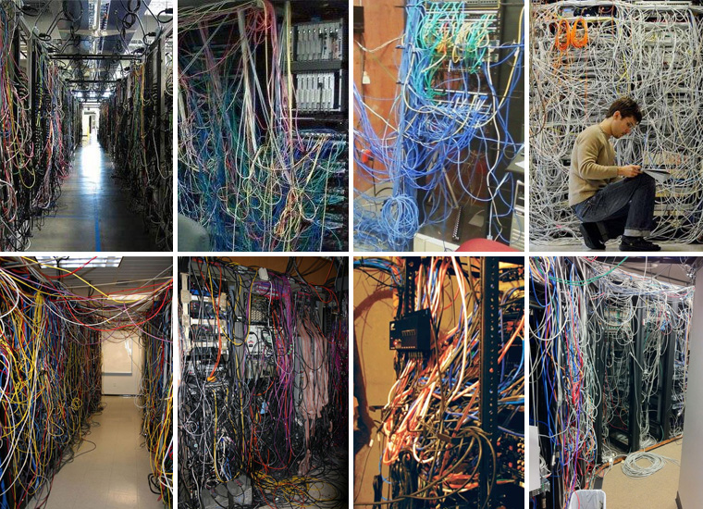
What is Cloud Computing?
Owning a Server
Racking, Stacking, Networking on your own. Add resources, maintenance, etc. costs money. And your time and money is invested more on these servers than on the applications you are hosting.

Slide 5

Cloud computing from Google’s Perspective
Google, an early pioneer of cloud computing
From Google's perspective, there are six key properties of cloud computing:
Cloud computing is user-centric
Cloud computing is task-centric
Cloud computing is powerful
Cloud computing is accessible
Cloud computing is intelligent
Cloud computing is programmable

Slide 6

Cloud computing from Amazon’s Perspective
Amazon is the most used Cloud provider today
From Amazon’s perspective, there are six key properties of cloud computing:
Trade capital expense for variable expense
Benefit from massive economies of scale
Stop guessing capacity
Increase speed and agility
Stop spending money on running
and maintaining data centers
Go global in minutes

Slide 7
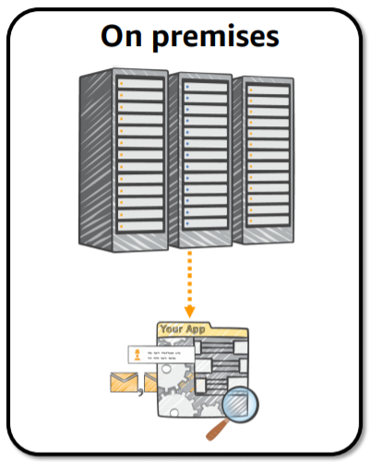
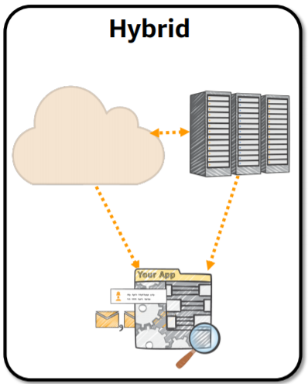
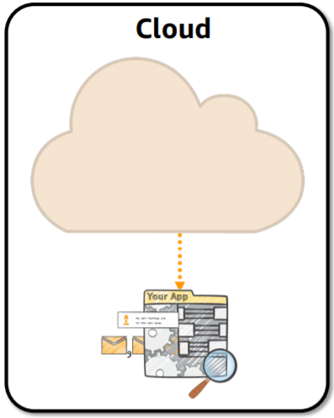
Cloud Deployment Models

Slide 8
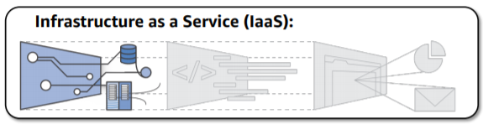
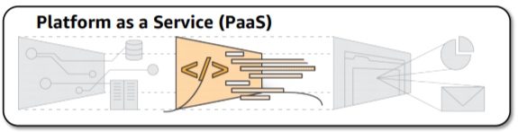
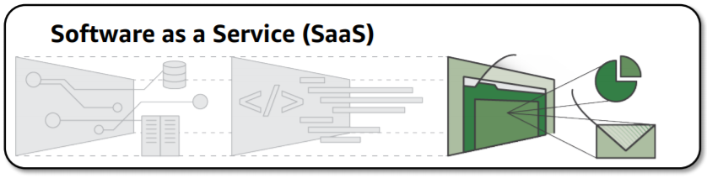
Cloud Computing Service Types

Slide 9
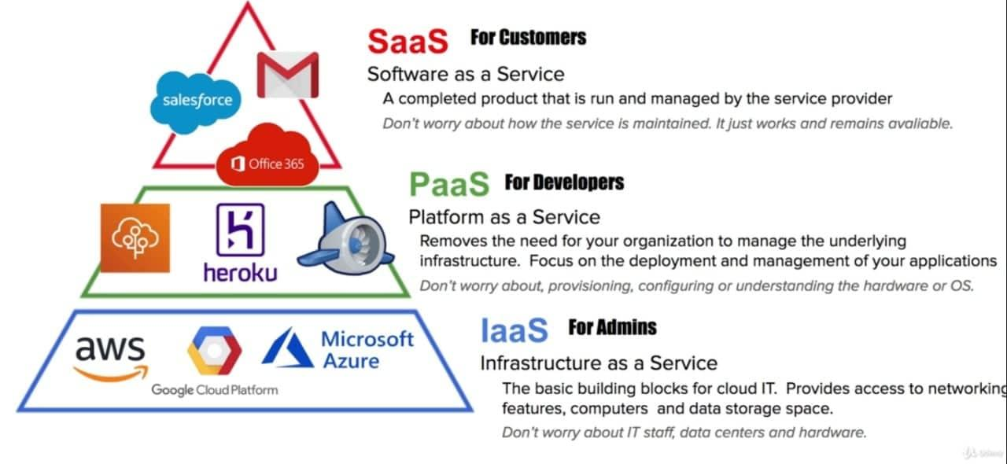
Cloud Computing Service Types

Slide 10
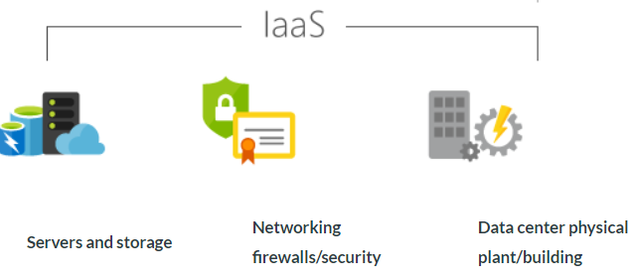
Cloud Computing Service Types (contd..)
Infrastructure As A Service (IaaS)
Also known as Hardware As A Service (HaaS)
IaaS is an instant computing infrastructure, provisioned and managed over the Internet.
Quickly scale up and down with demand, and pay only for what you use.
IaaS helps you avoid the expense and complexity of buying and managing your own physical servers and other datacenter infrastructure –the cloud provider manages the infrastructure
The cloud computing service provider manages the infrastructure, while you purchase, install, configure, and manage your own software—operating systems, middleware, and applications.

Slide 11
Cloud Computing Service Types (contd..)
Common Scenario to use IaaS
Test and development
Website hosting
Storage backup & recovery
Web applications
High performance computing
Big data analysis
Advantages of IaaS
Eliminates capital expense and reduces ongoing cost
Improves business continuity and disaster recovery.
Innovate rapidly, better security
Respond quicker to shifting business conditions.
Focus on your core business.
Increase stability, reliability, and supportability.

Slide 12
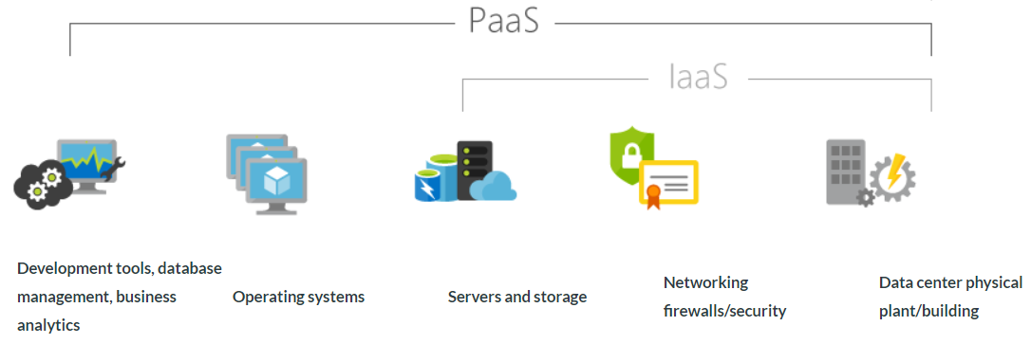
Cloud Computing Service Types (contd..)
Platform As A Service (PaaS)
PaaS is a complete development and deployment environment in the cloud
PaaS resources enables everything from simple cloud-based apps to sophisticated, cloud-enabled enterprise applications.
Like IaaS, PaaS includes infrastructure—servers, storage, and networking—but also middleware, development tools, business intelligence (BI) services, database management systems, and more.

Slide 13
Cloud Computing Service Types (contd..)
Platform As A Service (PaaS)
PaaS is designed to support the complete web application lifecycle: building, testing, deploying, managing, and updating.
PaaS allows you to avoid the expense and complexity of buying and managing software licenses, the underlying application infrastructure and middleware or the development tools and other resources.
You manage the applications and services you develop, and the cloud service provider typically manages everything else.
Common Scenarios
Development framework
Analytics or business intelligence.
Additional services such as workflow, directory, security, and scheduling.

Slide 14
Cloud Computing Service Types (contd..)
PaaS Examples:-
Google App Engine
Microsoft Azure
OpenShift from Red Hat Cloud
AWS Elastic BeanStalk
Force.com

Slide 15
Cloud Computing Service Types (contd..)
Advantages of PaaS
By delivering infrastructure as a service, PaaS offers the same advantages as IaaS. But its additional features—middleware, development tools, and other business tools—give you more advantages:
Cut coding time.
Add development capabilities without adding staff.
Develop for multiple platforms—including mobile—more easily.
Use sophisticated tools affordably.
Support geographically distributed development teams.
Efficiently manage the application lifecycle.

Slide 16
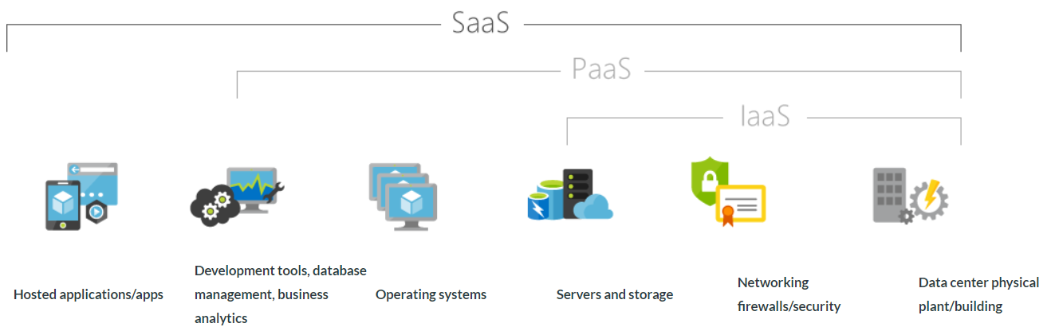
Cloud Computing Service Types (contd..)
Software as a service (SaaS) allows users to connect to and use cloud-based apps over the Internet.
Common examples are email, calendaring, and office tools (such as Microsoft Office 365).

Slide 17
Cloud Computing Service Types (contd..)
Software As A Service (SaaS)
Common Scenarios
customer relationship management (CRM)
enterprise resource planning (ERP)
and document management.
Advantages of SaaS
Obstacles of SaaS
Gain access to sophisticated applications.
Pay only for what you use.
Use free client software.
Mobilize your workforce easily.
Access app data from anywhere.
Unique Needs
Portability
Competition from open source applications

Slide 18
Cloud Computing Service Types (contd..)
Software As A Service (SaaS)—Examples
Salesforce CRM (customer management system)
Google Apps (documents, spreadsheets, presentation, etc)
Office 365
Quick books online –accounting
SurveyMonkey –online surveys
Halogen Software – HR Talent and performance management

Slide 19
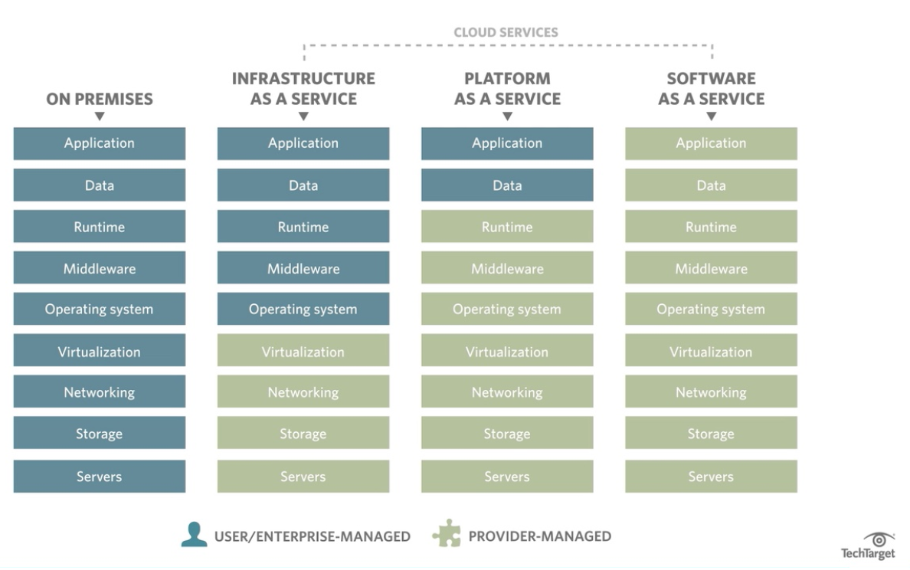
Cloud Computing Service Types (contd..)

Slide 20
Additional Links:-
Video – The AWS Platform :-
https://www.youtube.com/watch?v=mZ5H8sn_2ZI
Video - What Is Cloud Computing Webinar:- https://www.youtube.com/watch?v=kEuI5iwkft0
Video - Computing With AWS:- https://www.youtube.com/watch?v=jOhbTAU4OPI

Slide 21
Conclusion
Most of the cloud service has pay-as-you-go pricing
Three cloud service models: SaaS, PaaS, IaaS
Three cloud deployment models: On premises, Cloud, Hybrid

Slide 22
Any Questions???

