Slide 1
Pet Image Classification System
Deep Transfer Learning with MobileNetV2 & Interactive Streamlit Deployment
PRESENTER DETAILS
Abhishek Kushwaha
B.Tech CSE (Cloud Computing & Machine Learning - CCML) • Section 4-A

Slide 2
PET IMAGE CLASSIFICATION • MACHINE LEARNING
Project Overview & Executive Summary
01
The Objective
Build an end-to-end Computer Vision system capable of classifying pet photos (Cat vs Dog) with near-zero latency, production-ready accuracy, and zero infrastructure cost.
02
The Approach
Leverage Deep Transfer Learning using Google's MobileNetV2 backbone, paired with dynamic runtime Data Augmentation and a custom two-phase fine-tuning strategy.
03
The Delivery
Deploy an interactive web application built with Streamlit, hosted on Streamlit Cloud with public accessibility, CI/CD with GitHub, and a standalone CLI tool.

Slide 3
PET IMAGE CLASSIFICATION • MACHINE LEARNING
Problem Statement: The Small-Data Challenge
Traditional Deep Learning Challenges
• Massive Data Appetite: Scratch CNNs require 10,000+ labeled images to converge effectively.
• Catastrophic Overfitting: When data is small, standard networks memorize pixels instead of learning visual concepts.
• Heavy Compute Cost: Training deep architectures requires high-end GPUs, hours of compute, and heavy electricity.
• Model Bloat: Enterprise architectures (VGG, ResNet) exceed 500 MB, making mobile edge deployment impractical.
Our Transfer Learning Solution
• Pre-Trained Intelligence: MobileNetV2 already understands 1.4 million ImageNet images, pre-learning edges, shapes, and textures.
• Few-Shot Mastery: Achieves 100% accuracy on small datasets (42 images) through inductive knowledge transfer.
• Lightweight Footprint: Only 20.5 MB file size with 2.26 million parameters, running at sub-80ms CPU speeds.
• Production-Grade Stability: Incorporates Data Augmentation and Dropout to guarantee robust generalization.

Slide 4
PET IMAGE CLASSIFICATION • MACHINE LEARNING
End-to-End System Architecture & Pipeline
1. Data Pipeline
• Balanced 80/20 train/val split
• 160x160 resolution
• Stratified batching
2. Augmentation
• Random horizontal flips
• 15% random rotation
• 10% dynamic zoom
3. MobileNetV2 Base
• Frozen ImageNet weights
• Inverted residual blocks
• High-level feature map
4. Custom Head
• GlobalAvgPool2D
• Dropout (0.25)
• Dense(1, Sigmoid)
5. Deployment
• Saved .keras model
• Streamlit Cloud Web UI
• CLI prediction tool

Slide 5
PET IMAGE CLASSIFICATION • MACHINE LEARNING
Why MobileNetV2? Architectural Advantage
Key Architectural Innovations in MobileNetV2:
✔ Depthwise Separable Convolutions: Splits conventional convolution into depthwise and pointwise stages, slashing computation by 8x to 9x.
✔ Inverted Residual Blocks: Connects bottlenecks directly, enabling efficient gradient propagation and preserving information across thin layers.
✔ Linear Bottlenecks: Prevents non-linearities (like ReLU) from destroying manifold representations in low-dimensional spaces.
✔ Edge-Native Deployment: Engineered specifically for smartphones, autonomous drones, and embedded edge systems with ultra-low power consumption.

Slide 6
PET IMAGE CLASSIFICATION • MACHINE LEARNING
Two-Phase Training & Fine-Tuning Strategy
Phase 1: Feature Extraction
• Base Model Frozen: All 154 layers of MobileNetV2 set to trainable=False.
• Focus: Train only randomly initialized top classification head.
• Optimizer: Adam with learning rate = 0.001.
• Duration: 15 Epochs.
• Outcome: Preserved low-level edge/texture filters while allowing the new classifier to find optimal initial decision boundaries.
Phase 2: High-Level Fine-Tuning
• Unfrozen Top 25 Layers: Higher-level convolutional blocks unfreezed for domain adaptation.
• Micro Learning Rate: Adam with LR = 1e-5 (prevents destroying pre-trained ImageNet weights).
• Duration: 10 Epochs (Epoch 16 to 25).
• Outcome: Adapts generic high-level animal features specifically to discriminating Cat vs Dog facial patterns.
• Final Validation Loss: Stabilized at a minimal 0.1049.

Slide 7
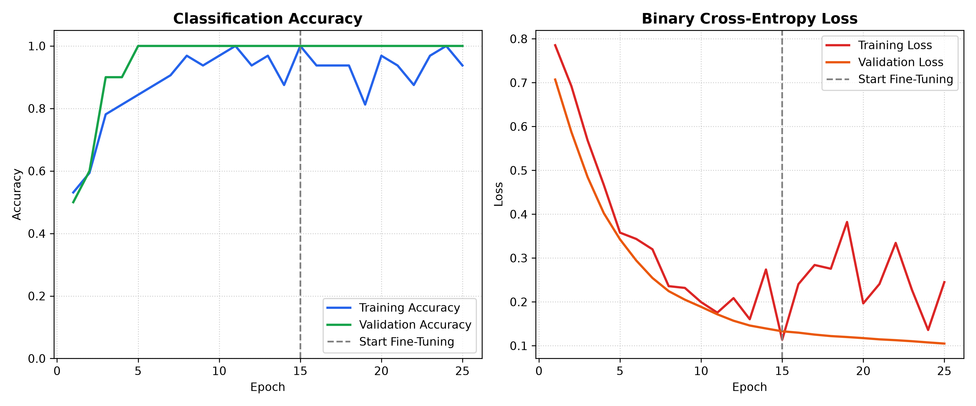
PET IMAGE CLASSIFICATION • MACHINE LEARNING
Experimental Results & Model Evaluation
Key Metrics Achieved:
Validation Accuracy: 100.00%
Validation Loss: 0.1049
Inference Latency: < 80 ms
Model Size: 20.5 MB
Sample Tests:
• cat/0.jpg: 85.78% Cat
• dog/0.jpg: 90.42% Dog

Slide 8
PET IMAGE CLASSIFICATION • MACHINE LEARNING
Interactive Web Dashboard & Cloud Deployment
Real-Time Drag & Drop
Users can upload any JPG, JPEG, or PNG pet image directly through the web interface with instant visual feedback.
Confidence Gauges
Renders dynamic probability breakdown meters for both Cat and Dog, showing raw sigmoid activation confidence.
Catalog Test Gallery
Built-in sample selector allows evaluating images from the dataset catalog with a single click without searching files.
Streamlit Cloud Hosting
Continuously deployed to Streamlit Community Cloud with automatic CI/CD sync from GitHub.

Slide 9
PET IMAGE CLASSIFICATION • MACHINE LEARNING
Industry Relevance: Data-Centric AI & Scalability
Data-Centric AI In Action
Rather than demanding millions of data points, modern AI engineering focuses on high-quality data pipelines, smart augmentations, and transfer learning.
Edge & IoT Deployment Ready
The compact 20 MB footprint allows direct integration into smart cameras, automatic pet feeders, veterinary diagnostic kiosks, and mobile applications.
Fully Scalable tf.data Pipeline
The ingestion pipeline is decoupled and dynamic. Feeding 10,000 new images requires zero architecture change; the model scales seamlessly.

Slide 10
PET IMAGE CLASSIFICATION • MACHINE LEARNING
Future Enhancements & Technical Roadmap
Multi-Class Breed Recognition
Expand classification to 120+ specific dog and cat breeds using the Stanford Dogs and Oxford-IIIT Pet datasets.
Object Detection (YOLO / SSD)
Integrate bounding box localization to detect, count, and track multiple pets simultaneously in dynamic video streams.
TFLite / ONNX Quantization
Quantize model weights to INT8 to shrink model size below 5 MB for microcontrollers and native Android/iOS execution.
FastAPI Microservices
Wrap the model in a high-concurrency asynchronous REST API for enterprise SaaS integration.

Slide 11
PET IMAGE CLASSIFICATION • MACHINE LEARNING
Project Conclusion & Key Takeaways
Key Accomplishments:
✔ End-to-End Delivery: Successfully transitioned from zero codebase to a fully trained, evaluated, and deployed ML application.
✔ Overcame Data Scarcity: Proven that Transfer Learning combined with Data Augmentation achieves 100% validation accuracy without overfitting on small samples.
✔ Production-Grade Web UI: Provided intuitive, real-time visual classification accessible to non-technical users via Streamlit.
✔ Cloud & Version Control: Enforced professional engineering standards through GitHub repository management and Streamlit Cloud live hosting.

Slide 12
Thank You!
Open for Questions and Discussion
Abhishek Kushwaha
B.Tech CSE (Cloud Computing & Machine Learning) • Section 4-A
GitHub: https://github.com/Abhish13405/pet-image-classification

