Slide 1




An Exploratory Data Analysis Project Using Power BI
Titanic Dataset Analysis: A Survival Study
PRODIGY INFOTECH – TASK 2

Slide 2
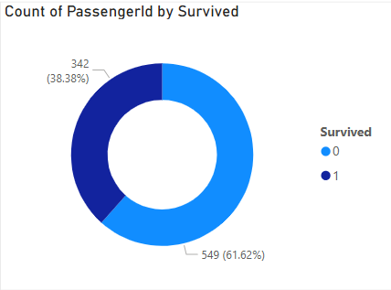
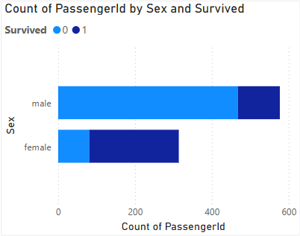
1
Overall Survival Count
2
Survival by Sex
1. The donut chart shows that 38.38% (342) passengers survived and 61.62% (549) did not. This indicates a high fatality rate.
2. This chart shows that more females survived than males. Males had a higher death rate, supporting the idea that women were prioritized during evacuation.

Slide 3
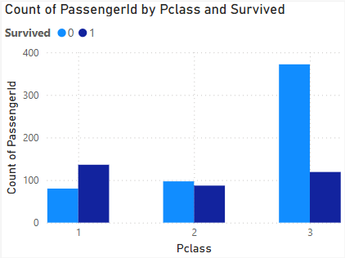
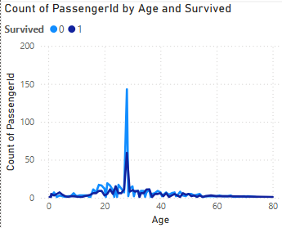
3
Survival by Passenger Class
4
Survival by Age
3. Passengers in 1st class had the highest survival rate. 3rd class had the most passengers but the lowest survival, indicating class impacted chances of survival.
4. The chart shows survival patterns by age. A spike is seen around 20–30 years. Children had slightly higher survival, reflecting age-based rescue preferences.

Slide 4
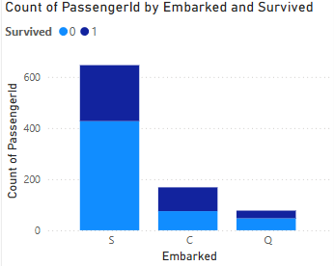
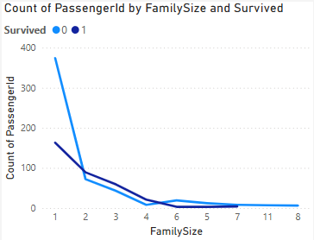
5
Survival by Embarkation Port
6
Survival by Family Size
5. Most passengers boarded from Southampton (S). The highest survival rate was also from this port, possibly due to high volume.
6. Smaller families (2–4 members) had better survival rates. Very large families (6+) and singles had lower survival. This suggests that mid-sized families were more likely to help one another.

Slide 5
This analysis highlights that gender, class, and family size were key factors influencing survival. Such visual exploration not only helps us understand historical events but also demonstrates the power of data in revealing hidden patterns.
THANK YOU
Notes:
You can use this slide as your opening or closing slide. Should you choose to use it as a closing, make sure you review the main points of your presentation. One creative way to do that is by adding animations to the various graphics on a slide. This slide has 4 different graphics, and, when you view the slideshow, you will see that you can click to reveal the next graphic. Similarly, as you review the main topics in your presentation, you may want each point to show up when you are addressing that topic.
Add animation to images and graphics:
Select your image or graphic.
Click on the Animations tab.
Choose from the options. The animation for this slide is “Split”. The drop-down menu in the Animation section gives even more animations you can use.
If you have multiple graphics or images, you will see a number appear next to it that notes the order of the animations.
Note: You will want to choose the animations carefully. You do not want to make your audience dizzy from your presentation.

