Slide 1
Histograms of Oriented Gradients for Human Detection
Another Descriptor
Navneet Dalal and Bill Triggs
CVPR 2005

Slide 2
Overview
1. Compute gradients in the region to be described
2. Put them in bins according to orientation
3. Group the cells into large blocks
4. Normalize each block
5. Train classifiers to decide if these are parts of a human

Slide 3
Details
Gradients
[-1 0 1] and [-1 0 1]^{T} were good enough.
Cell Histograms
Each pixel within the cell casts a weighted vote for an
orientation-based histogram channel based on the values
found in the gradient computation. (9 channels worked)
Blocks
Group the cells together into larger blocks, either R-HOG
blocks (rectangular) or C-HOG blocks (circular).

Slide 4
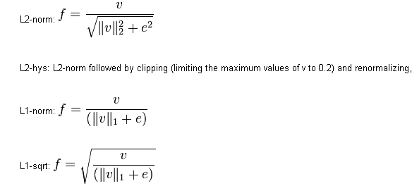
More Details
Block Normalization
They tried 4 different kinds of normalization.
Let υ be the block to be normalized and e be a small constant.

Slide 5
R-HOG compared to SIFT Descriptor
R-HOG blocks appear quite similar to the SIFT descriptors.
But, R-HOG blocks are computed in dense grids at some
single scale without orientation alignment.
SIFT descriptors are computed at sparse, scale-invariant
key image points and are rotated to align orientation.

Slide 6
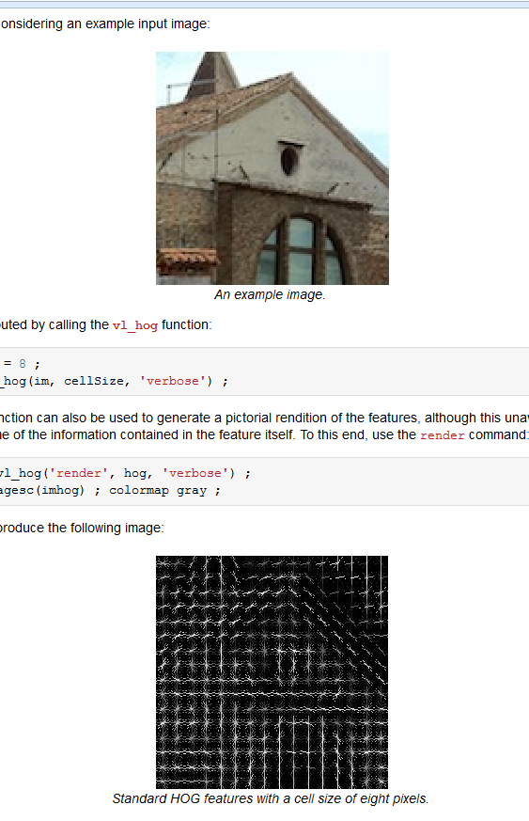
Standard HOG visualization shows orientations

Slide 7
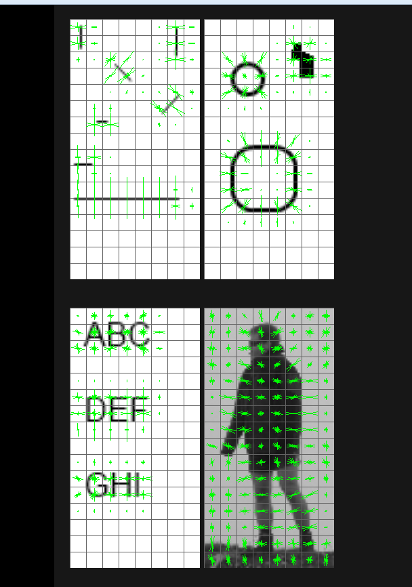
Some guy named Juergen’s visualizations
shows gradient vectors

Slide 8
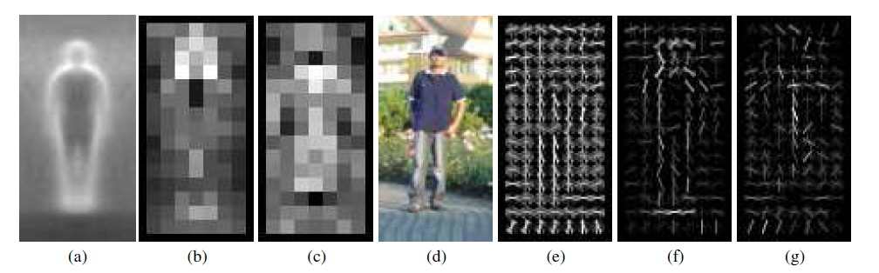
Pictorial Example of HOG for Human Detection
*
average gradient image over training examples
each “pixel” shows max positive SVM weight in the block centered on that pixel
same as (b) for negative SVM weights
test image
its R-HOG descriptor
R-HOG descriptor weighted by positive SVM weights
R-HOG descriptor weighted by negative SVM weights

Slide 9
Gory Details from More Recent Work
A cell is of 8x8 pixels. A block is of 2x2 cells.
For each cell, construct a 9-bin orientation histogram.
Contrast normalize each histogram using 4 adjacent/overlapping blocks, giving 36 numeric values for cell.
Total descriptor size depends on what template size you want.
If your template (say for a car) is 8 x 10 cells, the descriptor size would be 8x10x36 = 2880 values per window.
For whole images, they are typically resized to 100 x 100 pixels, discretized to 10 x 10 cells, so 10x10x36 = 3600 values.
Visualizations tend to plot only the first 9 dimensions of the 36 dimensions per cell.
---email from Santosh Divvala, postdoc

