Slide 1
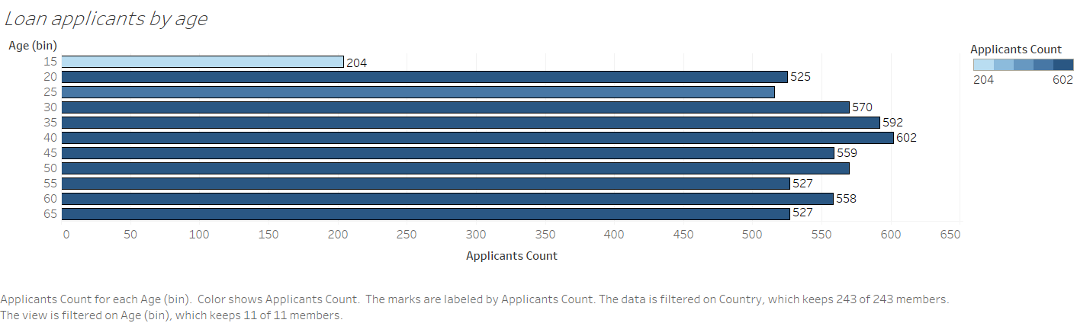
The chart reveals that the majority of loan applicants fall between the ages of 35 and 50, with a peak at age 40. The lowest number of applicants is observed in the youngest age group, 15-20 years.

Slide 2
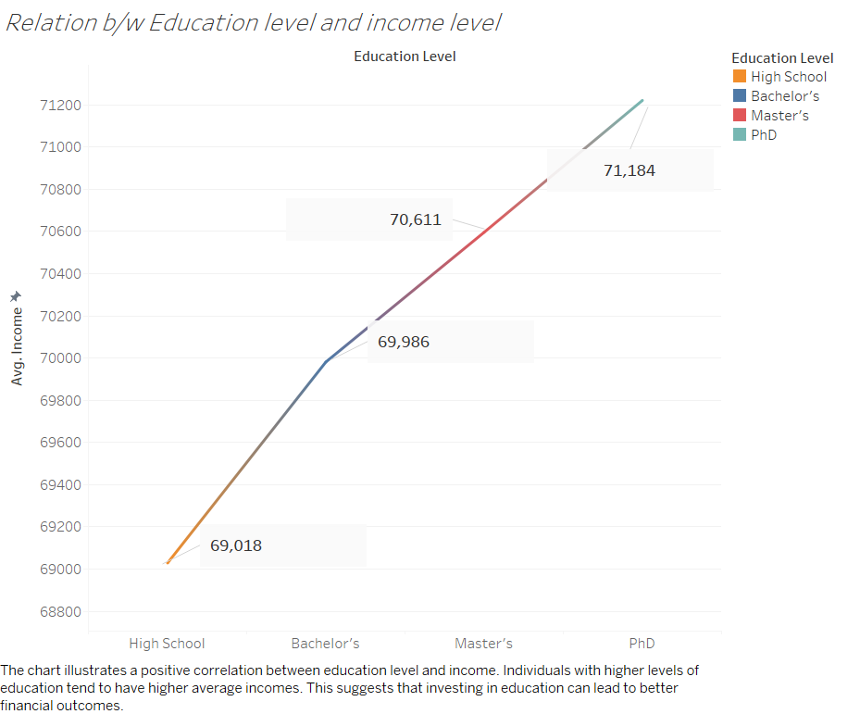

Slide 3
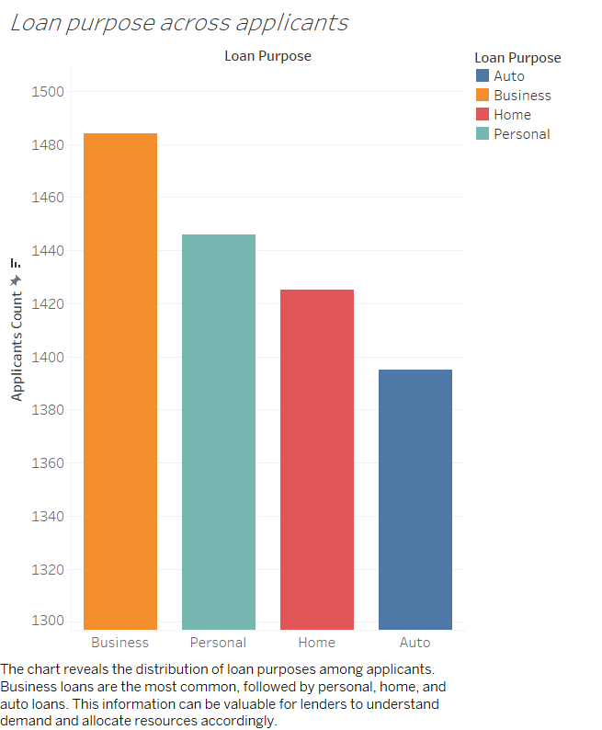

Slide 4
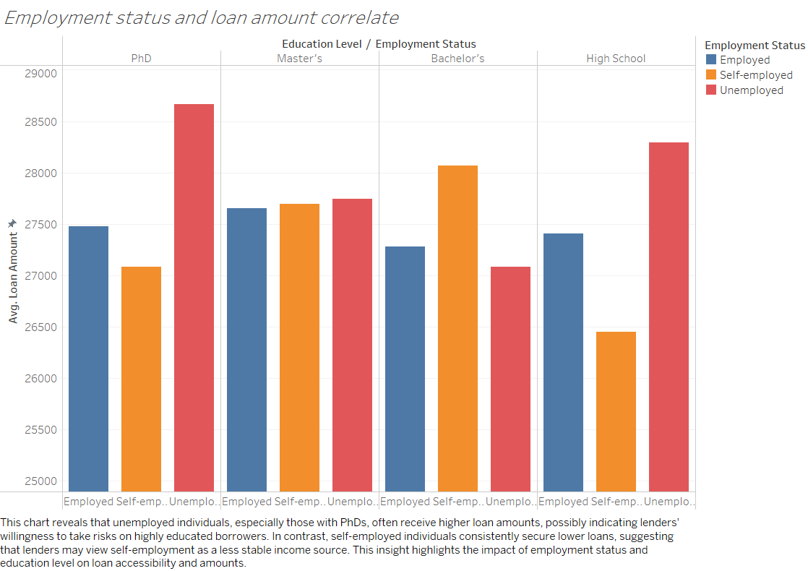

Slide 5
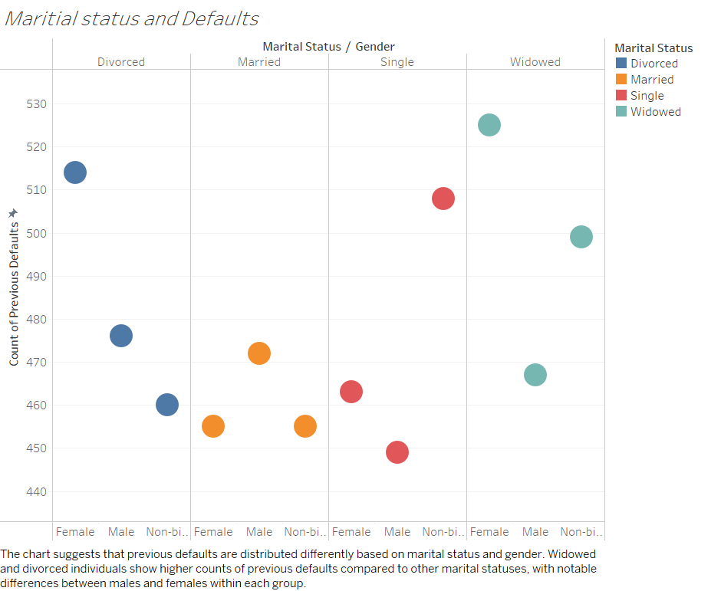

Slide 6
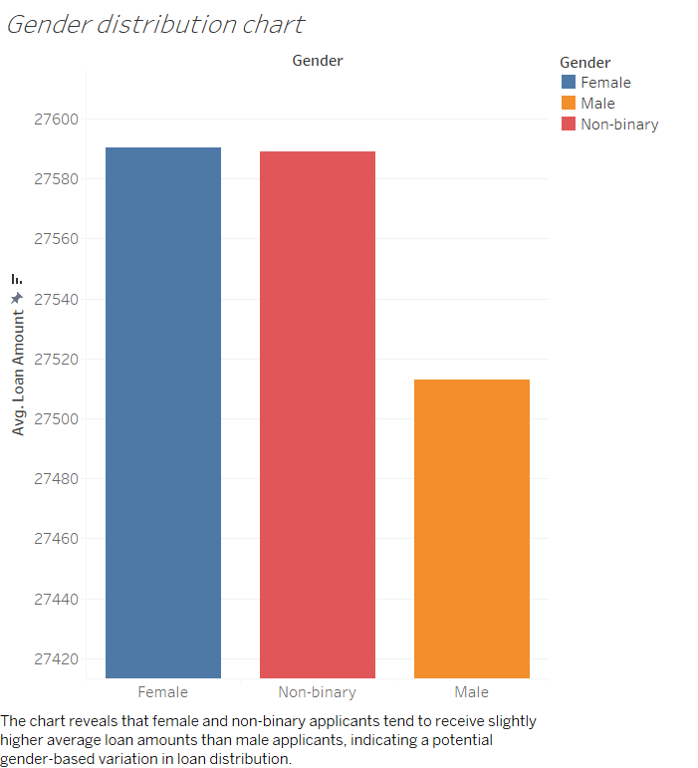

Slide 7
