Slide 1
Lumina AI Synthesizer
Intelligent Document and Media Summarization
Simple, Fast, and Powerful

Slide 2
What Lumina Can Do
1. Text Summarization: Paste entire articles or essays and get instant summaries.
2. Document Understanding: Upload massive PDFs or Word Docs for rapid insights.
3. Media Analysis: Drop in images, GIFs, or Videos, and Lumina describes and understands them.
4. Clean Export: Download your insights easily to PDF, Text, or Word formats.
5. Memory Timeline: Retrieve previous analysis from your history securely and instantly.

Slide 3
How It Works (The Workflow)
1. Upload Data
(Drop Texts, PDFs,
Images, or Videos)
2. Auto Engine
(Intelligently analyzes
the input)
3. Receive Output
(Read, Export, or
Save to History)

Slide 4
The Smart Engine Under the Hood
Lumina has two 'brains' running seamlessly without any complex settings:
Brain A – dracarys via OpenAI (The Reader): Exceptionally fast at reading words from text and multiple documents rapidly to give you the gist.
Brain B - Kimi K2.5 (The Watcher): Specially designed to 'look' at rich media (pictures and videos) and describe what's happening.
Lumina is smart enough to choose the right brain automatically based on what files you upload.

Slide 5
Aspect | Implementation
Architecture | Monolithic Flask app with Jinja2 templating
AI Strategy | Dual-model routing (text specialist + vision specialist)
Streaming | Python generators → chunked HTTP → ReadableStream in browser
File Processing | PyPDF2 (PDF), python-docx (DOCX), base64 (media)
UI Design | Warm dark claymorphism with micro-animations
State Management | localStorage for history, no database
Deployment | Single app.py entry point, flask run on port 5000

Slide 6
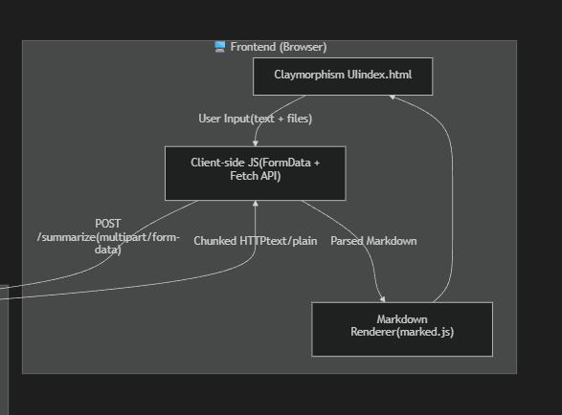

Slide 7
