Slide 1

#LifeKoKaroLift
Case Statements and Stored Procedures

Slide 2


Course: SQL
Lecture on: Case Statements and Stored Procedures
Instructor:

Slide 3
SESSION 2 : AGENDA
Demonstrating SQL CASE Statements
Creating Reusable Functions in SQL
Stored Procedures in SQL
UDFs vs. Stored Procedures
SQL Cursors

Slide 4
Case Statements in SQL
Why use SQL CASE Statements?
The CASE statement in SQL is used to apply conditional logic within queries.
It allows you to evaluate conditions and return different values based on the result.
It can be used in SELECT, UPDATE, DELETE, and other SQL commands.

Slide 5

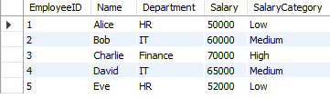
Example
QUERY
SELECT
EmployeeID,
Name,
Department,
Salary,
CASE
WHEN Salary < 55000 THEN 'Low'
WHEN Salary BETWEEN 55000 AND 65000 THEN 'Medium'
ELSE 'High'
END AS SalaryCategory
FROM Employees;
OUTPUT

Slide 6

Case Statements

Slide 7
Reusable Functions in SQL
Creating Reusable Functions in SQL
SQL allows users to create custom functions, which can be reused in multiple queries. This is helpful for operations that are not supported by built-in functions, such as custom calculations.
Steps to create a function:
Use the CREATE FUNCTION statement.
Define the input parameters, the return type, and the logic within the function.
Once created, the function can be called in any query.

Slide 8
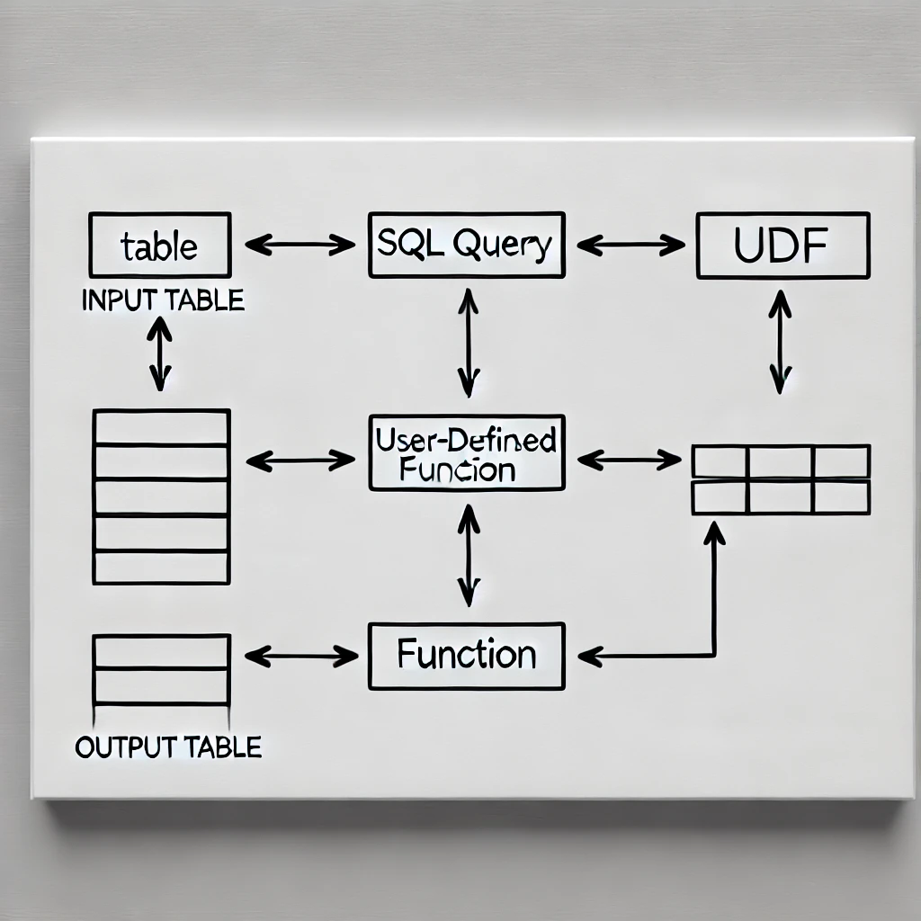
Visual

Slide 9
Example
QUERY
CREATE FUNCTION ConvertToUSD(IN price DECIMAL(10, 2), IN exchangeRate DECIMAL(10, 4))
RETURNS DECIMAL(10, 2)
BEGIN
RETURN price * exchangeRate;
END;
Now, you can use this this function.
SELECT ConvertToUSD(Price, 0.84) AS PriceInUSD FROM Products;

Slide 10
Reusable Functions

Slide 11
Stored Procedures in SQL
A stored procedure is a precompiled set of SQL statements that can be executed on demand. Stored procedures are great for executing complex operations, as they accept parameters and can include multiple SQL statements within them.
Characteristics:
They don't always return values (unlike functions), but they can return result sets.
They can perform actions such as modifying data or processing tasks on the server.

Slide 12
Example
QUERY
CREATE PROCEDURE UpdateProductPrice(IN productID INT, IN newPrice DECIMAL(10, 2))
BEGIN
UPDATE Products
SET Price = newPrice
WHERE ProductID = productID;
END;
Execute this stored procedure:
CALL UpdateProductPrice(101, 150.00);

Slide 13
UDFs vs. Stored Procedures
Aspect | User Defined Functions (UDFs) | Stored Procedures
Returns | Returns a single scalar value or table | Does not return values but can return result sets
Usage | Typically used for calculations | Used to execute complex logic and SQL statements
Called In | Can be used in SELECT, WHERE, JOIN, etc. | Can't be called within SQL queries like a SELECT statement
Side Effects | Cannot modify data or create side effects | Can modify data and perform complex operations

Slide 14
Stored Procedures

Slide 15
Cursors in SQL
SQL Cursors:
A cursor is a database object used to retrieve rows from a result set one row at a time. Cursors are ideal for handling complex row-by-row processing when set-based operations are insufficient.
Steps:
Declare the cursor to define the result set.
Open the cursor to establish the result set.
Fetch individual rows from the result set.
Close the cursor once the operation is complete.

Slide 16
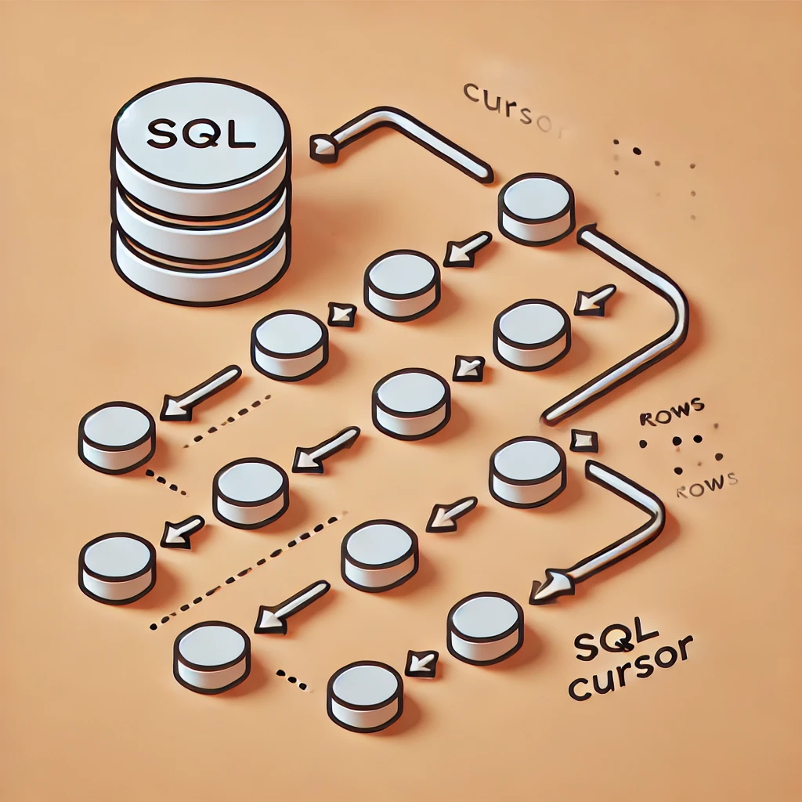
Visual

Slide 17
Cursors

Slide 18

Thank You!

