Slide 1
Convolutional Codes
COS 463: Wireless Networks
Lecture 9
Kyle Jamieson
[Parts adapted from H. Balakrishnan]

Slide 2
Today
Encoding data using convolutional codes
Encoder state
Changing code rate: Puncturing
Decoding convolutional codes: Viterbi Algorithm

Slide 3
Convolutional Encoding
Don’t send message bits, send only parity bits
Use a sliding window to select which message bits may participate in the parity calculations
Message bits:
1
0
1
1
0
1
0
0
1
0
1
Constraint length K

Slide 4
Sliding Parity Bit Calculation
K = 4
-3 -2 -1 0 1 2 3 4 5 6 7 8 …..
Message
bits:
0
0
0
0
1
1
0
1
0
0
1
0
1
+
P[0]= 0
Output: 0

Slide 5
Sliding Parity Bit Calculation
K = 4
-3 -2 -1 0 1 2 3 4 5 6 7 8 …..
Message
bits:
0
0
0
0
1
1
0
1
0
0
1
0
1
+
P[1] = 1
Output: 01

Slide 6
Sliding Parity Bit Calculation
K = 4
-3 -2 -1 0 1 2 3 4 5 6 7 8 …..
Message
bits:
0
0
0
0
1
1
0
1
0
0
1
0
1
+
P[2] = 0
Output: 010

Slide 7
Sliding Parity Bit Calculation
K = 4
-3 -2 -1 0 1 2 3 4 5 6 7 8 …..
Message
bits:
0
0
0
0
1
1
0
1
0
0
1
0
1
+
P[3] = 1
Output: 0100

Slide 8
Multiple Parity Bits
P₂[3] = 1
+
-3 -2 -1 0 1 2 3 4 5 6 7 8 …..
Message
bits:
0
0
0
0
1
1
0
1
0
0
1
0
1
+
Output: ….11
P₁[3] = 1

Slide 9
Multiple Parity Bits
P₂[4] = 0
+
-3 -2 -1 0 1 2 3 4 5 6 7 8 …..
Message
bits:
0
0
0
0
1
1
0
1
0
0
1
0
1
+
Output: ….1100
P₁[4] = 0

Slide 10
Multiple Parity Bits
P₂[5] = 1
+
-3 -2 -1 0 1 2 3 4 5 6 7 8 …..
Message
bits:
0
0
0
0
1
1
0
1
0
0
1
0
1
+
Output: ….110001
P₁[5] = 0

Slide 11
Encoder State
Input bit and K-1 bits of current state determine state on next clock cycle
Number of states: 2^{K-1}
Input bit
State
Message
bits:
0
0
0
0
1
1
0
1
0
0
1
0
1
Constraint length K

Slide 12
Constraint Length
K is the constraint length of the code
Larger K:
Greater redundancy
Better error correction possibilities (usually, not always)

Slide 13
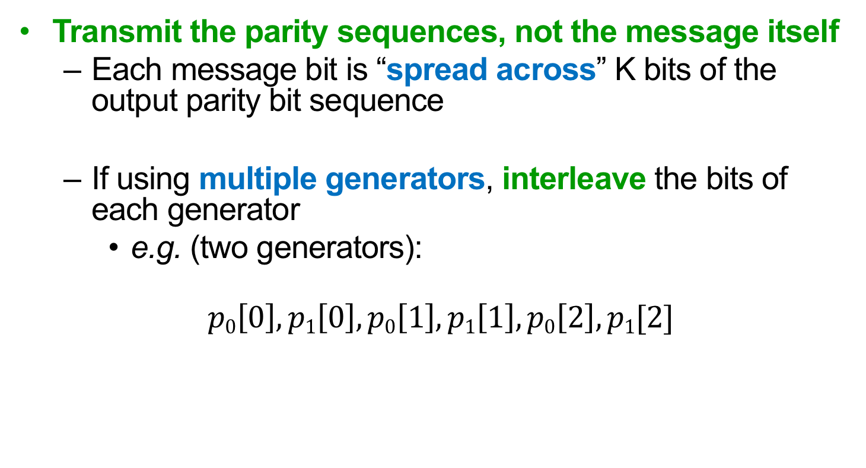
Transmitting Parity Bits
Transmit the parity sequences, not the message itself
Each message bit is “spread across” K bits of the output parity bit sequence
If using multiple generators, interleave the bits of each generator
e.g. (two generators):
$$p0\left[0\right],p1\left[0\right],p0\left[1\right],p1\left[1\right],p0\left[2\right],p1[2]$$

Slide 14
Transmitting Parity Bits
Code rate is 1 / #_of_generators
e.g., 2 generators → rate = ½
Engineering tradeoff:
More generators improves bit-error correction
But decreases rate of the code (the number of message bits/s that can be transmitted)

Slide 15
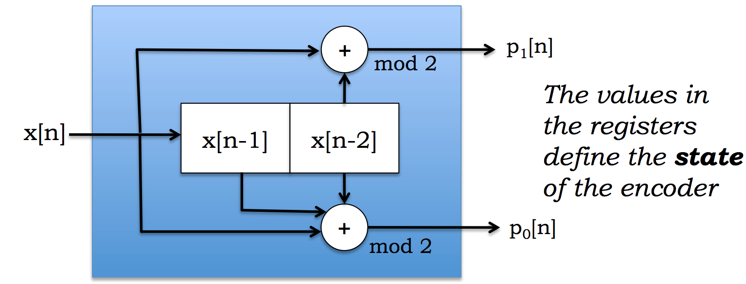
Shift Register View
One message bit x[n] in, two parity bits out
Each timestep: message bits shifted right by one, the incoming bit moves into the left-most register

Slide 16
Today
Encoding data using convolutional codes
Encoder state machine
Changing code rate: Puncturing
Decoding convolutional codes: Viterbi Algorithm

Slide 17
State-Machine View
Example: K = 3, code rate = ½, convolutional code
There are 2^{K-1} state
States labeled with (x[n-1], x[n-2])
Arcs labeled with x[n]/p₀[n]p₁[n]
Generator: g₀ = 111, g₁ = 101
msg = 101100
Starting state
0/00
00
1/11
10
0/11
0/10
1/01
1/00
01
11
0/01
1/10

Slide 18
State-Machine View
Starting state
P₀[n] = (1*x[n] + 1*x[n-1] + 1*x[n-2]) mod 2
P₁[n] = (1*x[n] + 0*x[n-1] + 1*x[n-2]) mod 2
Generators: g₀ = 111, g₁ = 101
0/00
00
1/11
10
0/11
0/10
1/01
1/00
01
11
0/01
1/10
msg = 101100
Transmit:

Slide 19
State-Machine View
Starting state
P₀[n] = 1*1 + 1*0 + 1*0 mod 2
P₁[n] = 1*1 + 0*0 + 1*0 mod 2
Generators: g₀ = 111, g₁ = 101
0/00
00
1/11
10
0/11
0/10
1/01
1/00
01
11
0/01
1/10
msg = 101100
Transmit: 11

Slide 20
State-Machine View
Starting state
P₀[n] = 1*0 + 1*1 + 1*0 mod 2
P₁[n] = 1*0 + 0*1 + 1*0 mod 2
Generators: g₀ = 111, g₁ = 101
0/00
00
1/11
10
0/10
0/11
1/01
1/00
01
11
0/01
1/10
msg = 101100
Transmit: 11 10

Slide 21
State-Machine View
Starting state
P₀[n] = 1*1 + 1*0 + 1*1 mod 2
P₁[n] = 1*1 + 0*0 + 1*1 mod 2
Generators: g₀ = 111, g₁ = 101
0/00
00
1/11
10
0/10
0/11
1/01
1/00
01
11
0/01
1/10
msg = 101100
Transmit: 11 10 00

Slide 22
State-Machine View
Starting state
P₀[n] = 1*1 + 1*1 + 1*0
P₁[n] = 1*1 + 0*1 + 1*0
Generators: g₀ = 111, g₁ = 101
0/00
00
1/11
10
0/10
0/11
1/01
1/00
01
11
0/01
1/10
msg = 101100
Transmit: 11 10 00 01

Slide 23
State-Machine View
Starting state
P₀[n] = 1*0 + 1*1 + 1*1
P₁[n] = 1*0 + 0*1 + 1*1
Generators: g₀ = 111, g₁ = 101
0/00
00
1/11
10
0/10
0/11
1/01
1/00
01
11
0/01
1/10
msg = 101100
Transmit: 11 10 00 01 01

Slide 24
State-Machine View
Starting state
P₀[n] = 1*0 + 1*0 + 1*1
P₁[n] = 1*0 + 0*0 + 1*1
Generators: g₀ = 111, g₁ = 101
0/00
00
1/11
10
0/10
0/11
1/01
1/00
01
11
0/01
1/10
msg = 101100
Transmit: 11 10 00 01 01 11

Slide 25
Today
Encoding data using convolutional codes
Encoder state machine
Changing code rate: Puncturing
Decoding convolutional codes: Viterbi Algorithm

Slide 26
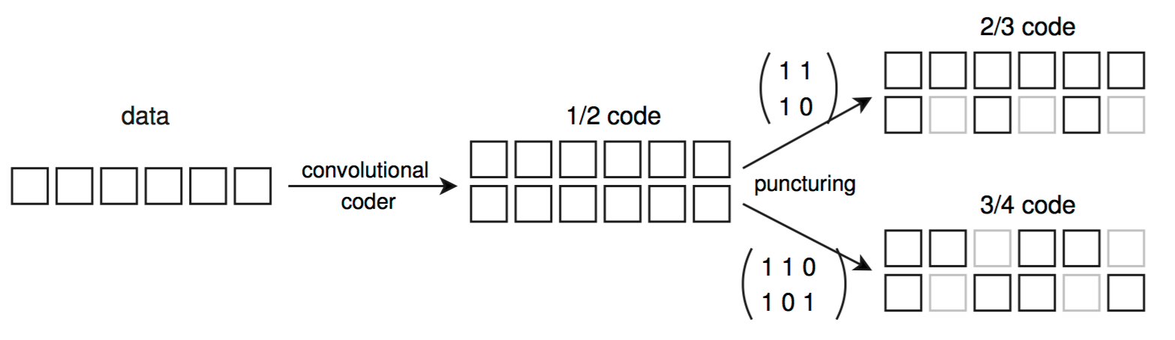
Varying the Code Rate
How to increase/decrease rate?
Transmitter and receiver agree on coded bits to omit
Puncturing table indicates which bits to include (1)
Contains p columns, N rows
p
N
N
Coded bits
Puncture, coded bits

Slide 27
Punctured convolutional codes: example
Coded bits =
With Puncturing:
0
0
1
0
1
0
0
1
1
1
P₁=$\left({1 \atop 1}{1 \atop 0}{1 \atop 0}{0 \atop 1}\right)$
Puncturing table

Slide 28
Punctured convolutional codes: example
Coded bits =
With Puncturing:
0
0
1
0
1
0
0
1
1
1
3 out of 4 bits are used
P₁=$\left({1 \atop 1}{1 \atop 0}{1 \atop 0}{0 \atop 1}\right)$
2 out of 4 bits are used

Slide 29
Punctured convolutional codes: example
Coded bits =
With Puncturing:
Punctured, coded bits:
0
0
1
0
1
0
0
1
1
1
P₁=$\left({1 \atop 1}{1 \atop 0}{1 \atop 0}{0 \atop 1}\right)$
0
0

Slide 30
Punctured convolutional codes: example
Coded bits =
With Puncturing:
Punctured, coded bits:
0
0
1
0
1
0
0
1
1
1
P₁=$\left({1 \atop 1}{1 \atop 0}{1 \atop 0}{0 \atop 1}\right)$
0
0
0

Slide 31
Punctured convolutional codes: example
Coded bits =
With Puncturing:
Punctured, coded bits:
0
0
1
0
1
0
0
1
1
1
P₁=$\left({1 \atop 1}{1 \atop 0}{1 \atop 0}{0 \atop 1}\right)$
0
0
1
0

Slide 32
Punctured convolutional codes: example
Coded bits =
With Puncturing:
Punctured, coded bits:
0
0
1
0
1
0
0
1
1
1
P₁=$\left({1 \atop 1}{1 \atop 0}{1 \atop 0}{0 \atop 1}\right)$
0
0
1
0
1

Slide 33
Punctured convolutional codes: example
Coded bits =
With Puncturing:
Punctured, coded bits:
0
0
1
0
1
0
0
1
1
1
P₁=$\left({1 \atop 1}{1 \atop 0}{1 \atop 0}{0 \atop 1}\right)$
0
0
1
1
0
1
1

Slide 34
Punctured convolutional codes: example
Coded bits =
Punctured, coded bits:
Punctured rate is: R = (1/2) / (5/8) = 4/5
0
0
1
0
1
0
0
1
1
1
0
0
1
1
0
1
1

Slide 35
Today
Encoding data using convolutional codes
Changing code rate: Puncturing
Decoding convolutional codes: Viterbi Algorithm
Hard decision decoding
Soft decision decoding

Slide 36
Motivation: The Decoding Problem
Received bits:
000101100110
Some errors have occurred
What’s the 4-bit message?
Most likely: 0111
Message whose codeword is closest to received bits in Hamming distance
Message | Coded bits | Hamming distance
0000 | 000000000000 | 5
0001 | 000000111011 | --
0010 | 000011101100 | --
0011 | 000011010111 | --
0100 | 001110110000 | --
0101 | 001110001011 | --
0110 | 001101011100 | --
0111 | 001101100111 | 2
1000 | 111011000000 | --
1001 | 111011111011 | --
1010 | 111000101100 | --
1011 | 111000010111 | --
1100 | 110101110000 | --
1101 | 110101001011 | --
1110 | 110110011100 | --
1111 | 110110100111 | --

Slide 37
The Trellis
0/00
Starting state
Vertically, lists encoder states
Horizontally, tracks time steps
Branches connect states in successive time steps
00
1/11
10
0/11
0/10
1/01
1/00
01
11
1/10
0/01
Trellis:
0 0
0/00
0/00
0/00
0/00
1/11
1/11
1/11
0/11
1/11
0/11
0 1
1/00
1/00
States
0/10
0/10
0/10
1 0
Branch
1/01
0/01
1/01
0/01
1/01
1 1
Time →
1/10
1/10
x[n-1] x[n-2]

Slide 38
The Trellis: Sender’s View
At the sender, transmitted bits trace a unique, single path of branches through the trellis
e.g. transmitted data bits 1 0 1 1
Recover transmitted bits ⟺ Recover path
x[n-1] x[n-2]
0 0
1/11
0 1
1/00
States
0/10
1 0
1/01
1 1
Time →

Slide 39
Viterbi algorithm
Andrew Viterbi (USC)
Want: Most likely sent bit sequence
Calculates most likely path through trellis
Hard Decision Viterbi algorithm: Have possibly-corrupted encoded bits, after reception
Soft Decision Viterbi algorithm: Have possibly-corrupted likelihoods of each bit, after reception
e.g.: “this bit is 90% likely to be a 1.”

Slide 40
Viterbi algorithm: Summary
Branch metrics score likelihood of each trellis branch
At any given time there are 2^{K-1} most likely messages we’re tracking (one for each state)
One message ⟷ one trellis path
Path metrics score likelihood of each trellis path
Most likely message is the one that produces the smallest path metric

Slide 41
Today
Encoding data using convolutional codes
Changing code rate: Puncturing
Decoding convolutional codes: Viterbi Algorithm
Hard decision decoding
Soft decision decoding

Slide 42
Hard-decision branch metric
Hard decisions → input is bits
Label every branch of trellis with branch metrics
Hard Decision Branch metric: Hamming Distance between received and transmitted bits
Received: 00
0 0
0/00 → 0
1/11 → 2
0/11 → 2
0 1
1/00 → 0
States
0/01 → 1
1 0
0/10 → 1
1/01 → 1
1 1
1/10 → 1

Slide 43
Hard-decision branch metric
Suppose we know encoder is in state 00, receive bits: 00
Received: 00
0 0
0/00
1/11
0
0 1
States
2
1 0
1 1
Time →

Slide 44
Hard-decision path metric
Hard-decision path metric: Sum Hamming distance between sent and received bits along path
Encoder is initially in state 00, receive bits: 00
Received: 00
0 0
0/00 → 0
0
0
0 1
1/11 → 2
1 0
2
1 1

Slide 45
Hard-decision path metric
Right now, each state has a unique predecessor state
Path metric: Total bit errors along path ending at state
Path metric of predecessor + branch metric
Received: 00 11
0 0
0/00 → 0
0/00 → 2
0
0
2
1/11 → 0
0 1
1/11 → 2
3
0/10 → 1
1 0
2
0
1/01 → 1
1 1
3

Slide 46
Hard-decision path metric
Each state has two predecessor states, two predecessor paths (which to use?)
Winning branch has lower path metric (fewer bit errors): Prune losing branch
Received: 00 11 01
0/00 → 0
0/00 → 2
0/00 → 1
0 0
0
0
2
3
1/11 → 0
0 1
1/11 → 2
0/11 → 1
3
0/10 → 1
1 0
2
0
1/01 → 1
1 1
3

Slide 47
Hard-decision path metric
Prune losing branch for each state in trellis
Received: 00 11 01
0 0
0/00 → 0
0/00 → 2
0/00 → 1
0
0
2
3
1/11 → 0
0 1
1/11 → 2
3
2
0/10 → 1
0/10 → 2
1 0
2
0
0/01 → 0
1/01 → 1
1 1
3

Slide 48
Pruning non-surviving branches
Survivor path begins at each state, traces unique path back to beginning of trellis
Correct path is one of four survivor paths
Some branches are not part of any survivor: prune them
Received: 00 11 01
0 0
0/00 → 0
0/00 → 2
0/00 → 1
0
0
2
3
1/11 → 0
1/11 → 1
0 1
1/11 → 2
3
2
0/10 → 1
0/10 → 2
1 0
2
0
3
1/01 → 1
1/01 → 0
1 1
3
0

Slide 49
Making bit decisions
When only one branch remains at a stage, the Viterbi algorithm decides that branch’s input bits:
Received: 00 11 01
Decide: 0
0 0
0/00 → 0
0/00 → 2
0/00 → 1
0
0
2
3
1/11 → 0
1/11 → 1
0 1
2
0/10 → 2
1 0
0
3
1/01 → 0
1 1
0

Slide 50
End of received data
Trace back the survivor with minimal path metric
Later stages don’t get benefit of future error correction, had data not ended
Received: 00 11 01 10
Decide: 0 1 1 1
0 0
0/00 → 2
0/00 → 1
0
2
3
0/11 →1
3
1/11 → 0
1/11 → 1
0 1
2
1/00 → 1
2
0/10 → 2
1 0
0
3
3
0/01 → 2
1/01 → 0
1 1
0
0
1/10 → 0

Slide 51
Terminating the code
Sender transmits two 0 data bits at end of data
Receiver uses the following trellis at end:
After termination only one trellis survivor path remains
Can make better bit decisions at end of data based on this sole survivor
0/00
0/00
0 0
0/11
0/11
0 1
0/01
1 0
0/10
1 1

Slide 52
Viterbi with a Punctured Code
Punctured bits are never transmitted
Branch metric measures dissimilarity only between received and transmitted unpunctured bits
Same path metric, same Viterbi algorithm
Lose some error correction capability
Received: 0-
0 0
0/00 → 0
1/11 → 1
0/11 → 1
0 1
1/00 → 0
States
0/01 → 0
1 0
0/10 → 1
1/01 → 0
1 1
1/10 → 1

Slide 53
Today
Encoding data using convolutional codes
Changing code rate: Puncturing
Decoding convolutional codes: Viterbi Algorithm
Hard decision decoding
Error correcting capability
Soft decision decoding

Slide 54
How many bit errors can we correct?
Think back to the encoder; linearity property:
Message m₁ → Coded bits c₁
Message m₂ → Coded bits c₂
Message m₁ ⨁ m₂ → Coded bits c₁ ⨁ c₂
So, d_{min} = minimum distance between 000...000 codeword and codeword with fewest 1s
+
0
0
0
0
1
1
0
1
0
0
1
0
1
+

Slide 55
Calculating d_{min} for the convolutional code
Find path with smallest non-zero path metric going from first 00 state to a future 00 state
Here, d_{min} = 4, so can correct 1 error in 8 bits:

Slide 56
Today
Encoding data using convolutional codes
Changing code rate: Puncturing
Decoding convolutional codes: Viterbi Algorithm
Hard decision decoding
Soft decision decoding

Slide 57
Model for Today
Coded bits are actually continuously-valued “voltages” between 0.0 V and 1.0 V:
1.0 V
Strong “1”
Weak “1”
Weak “0”
0.0 V
Strong “0”

Slide 58
On Hard Decisions
Hard decisions digitize each voltage to “0” or “1” by comparison against threshold voltage 0.5 V
Lose information about how “good” the bit is
Strong “1” (0.99 V) treated equally to weak “1” (0.51 V)
Hamming distance for branch metric computation
But throwing away information is almost never a good idea when making decisions
Find a better branch metric that retains information about the received voltages?

Slide 59
Soft-decision decoding
Idea: Pass received voltages to decoder before digitizing
Problem: Hard branch metric was Hamming distance
“Soft” branch metric
Euclidian distance between received voltages and voltages of expected bits:
0.0, 1.0
1.0, 1.0
“Soft” metric
Expected parity bits: (0, 1)
(V_{p0}, V_{p1})
0.0, 0.0
1.0, 0.0

Slide 60
Soft-decision decoding
Different branch metric, hence different path metric
Same path metric computation
Same Viterbi algorithm
Result: Choose path that minimizes sum of squares of Euclidean distances between received, expected voltages

Slide 61
Putting it together: Convolutional coding in Wi-Fi
Data bits
Data bits
Viterbi Decoder
Convolutional encoder
Coded bits (hard-decision decoding) or
Voltage Levels (soft-decision decoding)
Coded bits
Modulation (BPSK, QPSK, …)
Demodulation

Slide 62
Thursday Topic:
Rateless Codes
Friday Precept:
Midterm Review

