Slide 1

ACN PRESENTATION
Multimedia File Sharing Using Socket Programming
Submitted By:
Abhishek Singh Adhikari(20535002)
Ayush Kasara(20535009)
Anunay Katare(20535005)
Ankit Daswani(20535004)
Devyanshu Sengal(20535012)
Gaurav Thapliyal(20535036)
Kartik Sharma(20535035)

Slide 2
Socket Programming
What is a socket?
Socket: An interface between an application process and transport layer – The application process can send/receive messages to/from another application process (local or remote)via a socket
In Unix jargon, a socket is a file descriptor – an integer associated with an open file
Types of Sockets:
Internet Sockets, unix sockets, X.25 sockets etc
– Internet sockets characterized by IP Address (4 bytes), port number (2 bytes) Socket

Slide 3
Major Built-in Classes of JAVA used:
Socket
ServerSocket
InputStream
OutputStream
Thread

Slide 4
TYPES OF SOCKET
SOCK_DGRAM
Provides datagrams, which are connectionless messages of a fixed maximum length.
SOCK_STREAM
A stream socket provides for the bidirectional, reliable, sequenced, and unduplicated flow of data without record boundaries.
SOCK_RAW
Raw sockets are normally datagram-oriented, though their exact characteristics are dependent on the interface provided by the protocol.
SOCK_CONN_DGRAM
Provides connection-oriented datagram service. This type of socket supports the bidirectional flow of data, which is sequenced and unduplicated, but is not reliable.Currently, only the Asynchronous Transfer Mode (ATM) protocol in the Network Device Driver (NDD) domain supports this socket type.

Slide 5
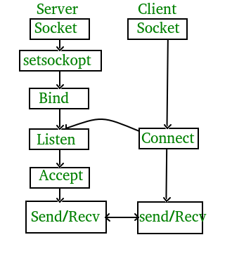
Socket Programming
Network Socket
Client
Server

Slide 6
How to Make Client
The system calls for establishing a connection are somewhat different for the client and the server, but both involve the basic construct of a socket. Both the processes establish their own sockets.
The steps involved in establishing a socket on the client side are as follows −
Create a socket with the socket() system call.
Connect the socket to the address of the server using the connect() system call.
Send and receive data. There are a number of ways to do this, but the simplest way is to use the read() and write() system calls.
How to make a Server
The steps involved in establishing a socket on the server side are as follows −
Create a socket with the socket() system call.
Bind the socket to an address using the bind() system call. For a server socket on the Internet, an address consists of a port number on the host machine.
Listen for connections with the listen() system call.
Accept a connection with the accept() system call. This call typically blocks the connection until a client connects with the server.
Send and receive data using the read() and write() system calls.

Slide 7
Files
Binary in nature
Text files
Encoding
Decoding
Multimedia files

Slide 8


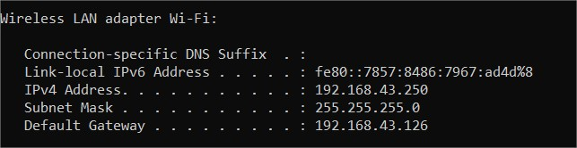
Connecting Two Nodes
Device creating Hotspot/Receiver
Connecting through wi-fi/Sender

Slide 9
File Sharing
Single-Threaded model
Multithreaded model
How multithread model may provide better throughput?

Slide 10
Single Threaded File Sharing Here only one thread is being used to transfer the data. i.e. there is only one channel of communication between sender and receiver.
The sender tries to connect to the same port which the receiver is listening to.
if the receiver is not already receiving any file it accepts the connection.
following is a simple flow of messages and functions involved:-

Slide 11
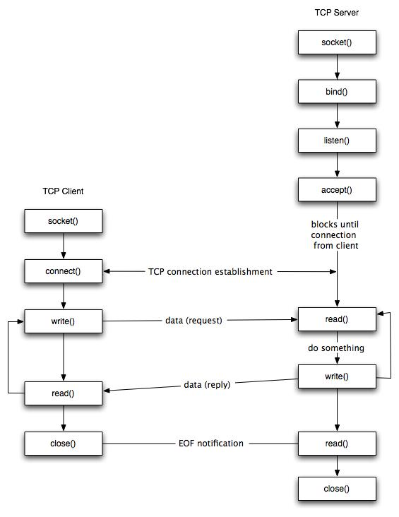

Slide 12
Single Threaded File Sharing
As we saw that the two major modules here are:
Sender
Receiver
The application implements the sender and receiver together.
This means that the same application will run on different computers and can send or receive files.

Slide 13
Single threaded sharing
To implement the sender and receiver in the same file, The main thread calls
two sub Threads, one for each operation send and receive.
This is done by creating a class that implements Runnable and overriding the
run function.
Objects of the two classes are made and called. The rest is done by respective threads.
This allows any interleaving of send and receive functions as compared to alternatively sending or receiving or repeated prompting to user for operation to be performed. Also as the main passes the processing part to other threads , using multiple ports can allow multiple clients to connect .
so single threaded also uses multithreading but only for handling operations.

Slide 14
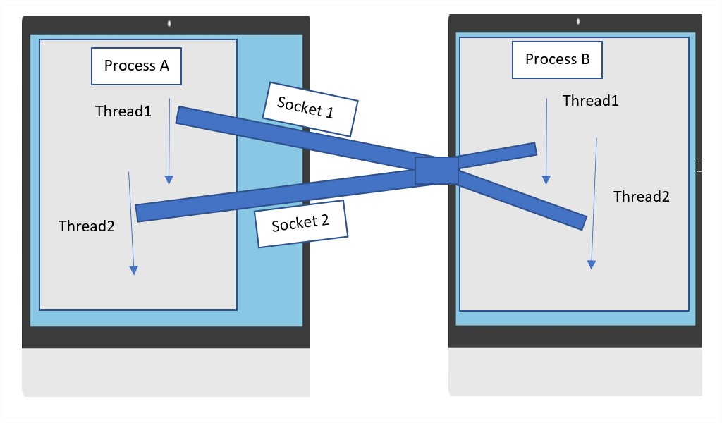
Multithreaded File Sharing Main Thread works along with other thread in each process
Sender
Receiver
Socket 1: (x, IP of sender, 5000, IP of receiver)
Socket 2: (y, IP of sender, 5000, IP of receiver)

Slide 15
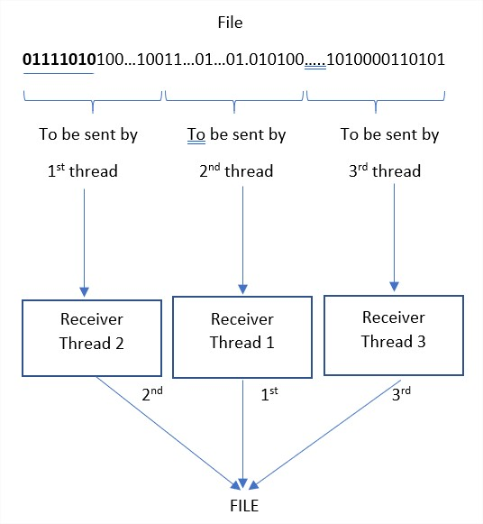
Logic Used At Sender side

Slide 16
How this provide some optimization?
Utilizing full potential of underlying Hardware.
Possible Pipelining action in Hardware.
OS scheduling.

Slide 17
Classes Used
Sender
SenderThread

Slide 18
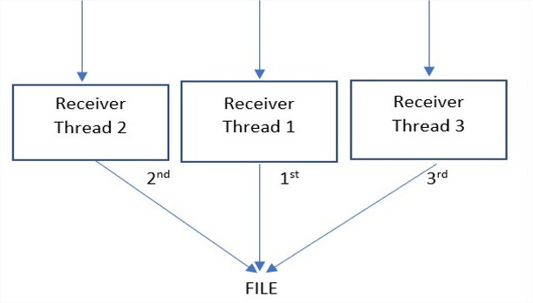
Logic Used at Receiver Side
Even though receiver port is common in all SOCKETS, still there will be multiple receiver threads to handle the data being sent by corresponding sender thread.
Several temporary files are created for each thread, every time some bytes are receive from the socket input stream they are added to corresponding file
after all the threads complete there transfer, a local operation of assembling temporary files in receiver side will occur.

Slide 19
Classes Used
Receiver
ReceiverThread

Slide 20
Result table
File Size | Single -Thread | N | Multi -Thread | Performance gain (%)
 | Send Time(in msec) |  | Send Time(in msec)
13.5GB | 2193794 | 4 | 2000237 | 9.677
3.34GB | 606191 | 4 | 563688 | 7.540
749MB | 199445 | 4 | 205153 | -2.78
File Size | No. of Threads | Transfer time (msec)
3.82GB | 2 | 703066 ≈ 11.71 min
3.82GB | 4 | 695917 ≈ 11.59 min
3.82GB | 8 | 685183 ≈ 11.41 min
3.82GB | 64 | 753862 ≈ 12.56 min
3.82GB | 128 | 964423 ≈ 16.07 min
Performance gain over Single Thread
Variable behavior of Multiple Threads model

Slide 21
Conclusion
Multithreaded Sharing may give performance gain over Single-threaded sharing, but underlying hardware plays an important role.

Slide 22
References
https://docs.oracle.com/javase/
https://www.geeksforgeeks.org/
https://en.wikipedia.org/wiki/Internet_Download_Manager

