Slide 1
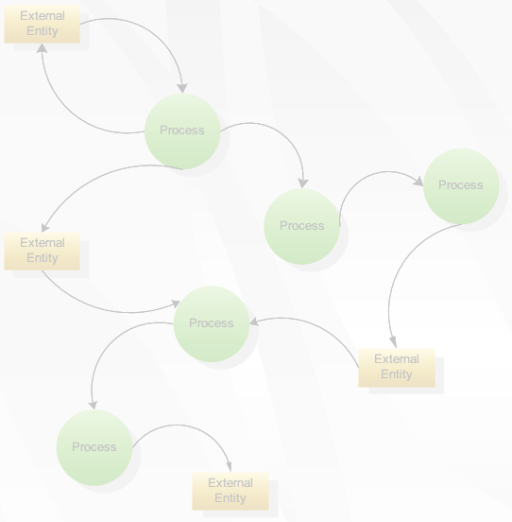
Data Flow Diagrams (DFD)
& Context diagrams
Data Flow Diagrams (DFD)
& Context diagrams

Slide 2
Data Flow Diagrams
A graphical tool, useful for communicating with users, managers, and other personnel.
Used to perform structured analysis to determine logical requirements.
Useful for analyzing existing as well as proposed systems.
Focus on the movement of data between external entities and processes, and between processes and data stores.
A relatively simple technique to learn and use.

Slide 3
Why DFD ?
Provides an overview of-
  What data a system processes
  What transformations are performed
  What data are stored
  What results are produced and where they flow
Graphical nature makes it a good communication tool between-
  User and analyst
  Analyst and System designer

Slide 4
DFD elements
Source/Sinks (External entity)
Processes
Data Stores
Data flows

Slide 5
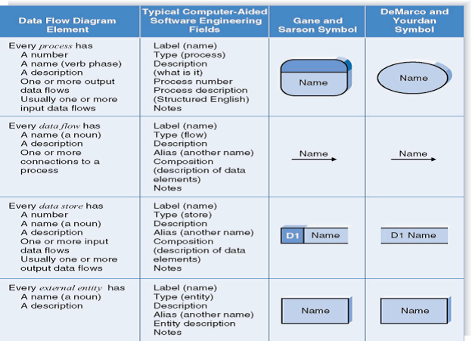
Symbols Used:
Symbol | Gane & Sarson Symbol | DeMarco & Yourdan Symbol
External Entity
Process
Data store
Data flow

Slide 6
Descriptions :
External Entity - people or organisations that send data into the system or receive data from the system.
Process - models what happens to the data
i.e. transforms incoming data into outgoing data.
Data Store - represents permanent data that is used by the system.
Data Flow - models the actual flow of the data between the other elements.

Slide 7
Symbol naming
External Entity → Noun
Data Flow → Names of data
Process → verb phrase
Data Store → Noun

Slide 8
External Entities
They either supply or receive data
Source – Entity that supplies data to the system.
Sink – Entity that receives data from the system.
They do not process data

Slide 9
Processes
Delivery Slip
Stores demand note
1. STORES
Issue Slip
Work or actions performed on data (inside the system)
Straight line with incoming arrows are input data flows
Straight lines with outgoing arrows are output data flows
Labels are assigned to Data flow. These aid documentation

Slide 10
Processes
Can have more than one outgoing data flow or more than one incoming data flow

Slide 11
Processes
Can connect to any other symbol (including another process symbol)
Contain the business logic, also called business rules
Referred to as a black box
Notes:
In DFDs, a process symbol can be referred to as a black box, because the inputs, outputs, and general functions of the process are known, but the underlying details and logic of the process are hidden.
By showing processes as black boxes, an analyst can create DFDs that show how the system functions, but avoid unnecessary detail and clutter.
When the analyst wishes to show additional levels of detail, he or she can zoom in on a process symbol and create a more in-depth DFD that shows the process’s internal workings — which might reveal even more processes, data flows, and data stores.
In this manner, the information system can be modeled as a series of increasingly detailed pictures.

Slide 12
Data Flow Diagrams
An alternate notation is often used:
A Process
A Data Store
3
Store Issue
Label
Name
D1
Data Stores
Name
Label

Slide 13
Data Stores
Data store
D1
Data Stores
D1
Data Stores
D1
Data Stores
Writing
Reading
Data store
A Data Store is a repository of data
Data can be written into the data store. This is depicted by an incoming arrow
Data can be read from a data store. This is depicted by an outgoing arrow

Slide 14
Data Flows
Data Flow
Data in motion
Marks movement of data through the system - a pipeline to carry data.
Connects the processes, external entities and data stores.

Slide 15
Data Flow
  Generally unidirectional, If same data flows in both directions, double-headed arrow can be used.
Can represent flow between process and data store by two separate arrows

Slide 16
Decomposition Of DFD
Levels | Description | Explanation
Level 0 | Context diagram | Contains only one process
Level 1 | Overview diagram | Utilizes all four elements
Level 2 | Detailed diagram | A breakdown of a level 2 process
There is no rule as to how many levels of DFD that can be used.
Notes:
If a DFD is too detailed it will have too many data flows and will be large and difficult to understand
Start from a broad overview. Expand to details – Idea similar to using procedures and linking these with a main program
Each DFD must deal with one aspect of a big system

Slide 17
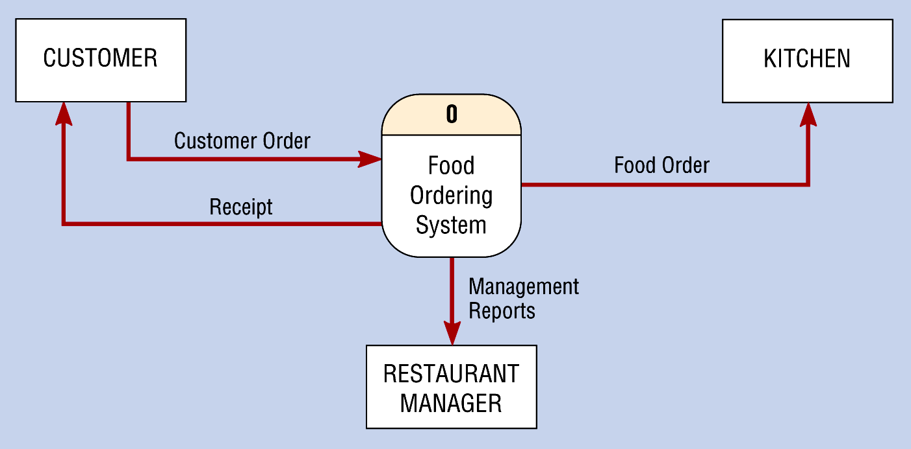
Rules for Level 0 Diagram :
1 process represents the entire system.
Data arrows show input and output.
Data Stores NOT shown. They are within the system.

Slide 18
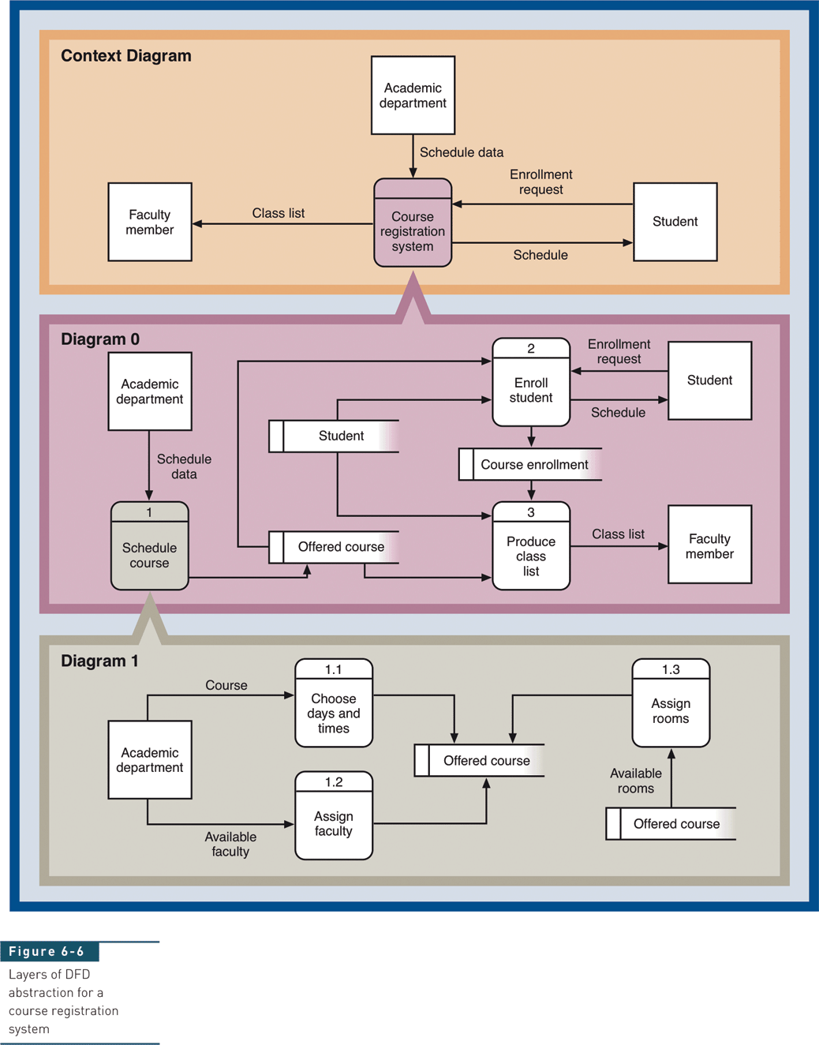
Layers of DFD Abstraction for Course Registration System

Slide 19
A Context Diagram (Level 0)
The major information flows between the entities and the system.
A Context Diagram addresses only one process.

Slide 20
Rules for Level 1 Diagram :
Level 1 DFD, must balance with the context diagram it describes.
Input going into a process are different from outputs leaving the process.
Data stores are first shown at this level.

Slide 21
Rules for Level 2 Diagram :
Level 2 DFD must balance with the Level 1 it describes.
Input going into a process are different from outputs leaving the process.
Continue to show data stores.

Slide 22
Numbering
On level 1 processes are numbered 1,2,3…
On level 2 processes are numbered x.1, x.2, x.3… where x is the number of the parent level 1 process.
Number is used to uniquely identify process not to represent any order of processing
Data store numbers usually D1, D2, D3...

Slide 23
Rules of Data Flow
Data can flow from
  External entity to process
  Process to external entity
  Process to store and back
  Process to process
Data cannot flow from
  External entity to external entity
  External entity to store
  Store to external entity
  Store to store

Slide 24
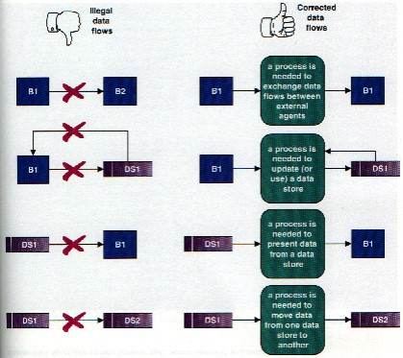
Common errors in DFD

Slide 25
Three INCORRECT Data Flow
Miracle (Spontaneous generation)
Black Hole
Gray Hole
Student name
Notes:
Three data flow and process combinations that you must avoid:
• Spontaneous generation. The APPLY INSURANCE PREMIUM process, for instance, produces output, but has no input data flow. Because it has no input, the process is called a spontaneous generation process.
• Black hole. The CALCULATE GROSS PAY is called a black hole process, which is a process that has input, but produces no output.
• Gray hole. A gray hole is a process that has at least one input and one output, but the input obviously is insufficient to generate the output shown. For example, a date of birth input is not sufficient to produce a final grade output in the CALCULATE GRADE process.
Spontaneous generation, black holes, and gray holes are impossible logically in a DFD because a process must act on input, shown by an incoming data flow, and produce output, represented by an outgoing data flow.

Slide 26
Good Style in Drawing DFD
Use meaningful names for data flows, processes and data stores.
Use top down development starting from context diagram and successively levelling DFD
Only previously stored data can be read
A process can only transfer input to output. It cannot create new data
Data stores cannot create new data

Slide 27
Creating DFDs
Create a preliminary Context Diagram.
Identify Use Cases, i.e. the ways in which users most commonly use the system.
Create DFD fragments for each use case.
Create a Level 0 diagram from fragments.
Decompose to Level 1,2,…
Validate DFDs with users.

Slide 28
Creating the Context Diagram
Draw one process representing the entire system (process 0)
Find all inputs and outputs that come from or go to external entities; draw as data flows.
Draw in external entities as the source or destination of the data flows.

Slide 29
Creating Level 0 Diagram
Combine the set of DFD fragments into one diagram.
Generally move from top to bottom, left to right.
Minimize crossed lines.

Slide 30
Creating Level 1 Diagram
Each use case is turned into its own DFD.
Take the steps listed on the use case and depict each as a process on the level 1 DFD.
Inputs and outputs listed on use case become data flows on DFD.
Include sources and destinations of data flows to processes and stores within the DFD.
May also include external entities for clarity.

Slide 31
When to stop decomposing
DFDs?
  Ideally, a DFD has at least three levels.
  When the system becomes primitive i.e. lowest level is reached and further decomposition is useless.

Slide 32
Validating DFD
Check for syntax errors to assure correct DFD structure.
  Check for semantics errors to assure accuracy of DFD relative to actual/desired system.

Slide 33
DFD for University Admission System
Context Diagram
Student Information
Report Request
University
Admission
System
Student
0
Staff
Admission Approval
or Rejection
Report

Slide 34
Level 0
Student
Information
Report Request
Student
Name & ID
Student
Perform Intake Procedure
1
Generate Reports
3
Data Item Prompt
Staff
Admission Approval
or Rejection
Data Items
Data
Query
Approved
Application
Prior Application Data
Report
Data
D1
Student Data
Verified
Approved
Application
Maintain Student Information
2
Other Student Data
Request for Student Information Maintenance

Slide 35
Level 1 Process 1, Perform Intake Procedure
Student
Information
Student
Receive Admission Application
Admission Application
1.1
Verify Admission Application
1.2
Student Name and ID
Verified
Admission
Application
Prior Application Data
D1
Student Data
Application Data
Application
Request
Review Admission Application
Application Approval
or Rejection
1.3
Approved Application

Slide 36
Level 1 Process 2, Maintain Student Information
Add New Student
Approved Application to Add
2.2
Verified Approved Application
Verified Changed Student Data
Edit Existing Student
2.3
Approved Application
Determine Operation
Approved Application to Edit
2.1
Request for Student Information Maintenance
ID of Student to Delete
D1
Student Data
Delete Existing Student
2.4
Verified ID of Student to Delete
Cancel Operation
2.5
Determination to Cancel Operation

Slide 37
DFD for Lemonade Stand
Context Diagram
CUSTOMER
0.0
Lemonade System
Sales Forecast
EMPLOYEE
Order
Production Schedule
Product Served
Pay
Payment
Time Worked
Received Goods
Payment
Purchase Order
VENDOR

Slide 38
Level 0
1.0
Sale
Customer Order
Sales Forecast
Product Ordered
CUSTOMER
Payment
2.0
Production
EMPLOYEE
Production
Schedule
Product Served
Received Goods
Inventory
VENDOR
3.0
Procure-ment
Purchase Order
Order
Decisions
Payment
Pay
Time Worked
4.0
Payroll

Slide 39

Level 1, Process 1
CUSTOMER
Customer Order
ORDER
Request for Forecast
1.1
Record Order
1.3
Produce Sales Forecast
Severed Order
Payment
Sales Forecast
1.2
Receive Payment
PAYMENT

Slide 40


Level 1, Process 2 and Process 3
Order Decision
Product Order
3.1
Produce Purchase Order
PURCHASE ORDER
ORDER
2.1
Serve Product
Quantity On-Hand
Quantity Severed
RAW MATERIALS
Quantity
Received
RAW MATERIALS
Received Goods
Production
Schedule
3.2
Receive Items
2.2
Produce Product
Quantity Used
RECEIVED ITEMS
INVENTORTY
Payment Approval
Production Data
3.3
Pay Vendor
VENDOR
2.3
Store
Product
Quantity Produced & Location Stored
Payment

Slide 41
Level 1, Process 4
Time Worked
4.1
Record Time Worked
TIME CARDS
Employee ID
EMPLOYEE
Payroll Request
4.2
Calculate Payroll
Unpaid time cards
PAYROLL
Payment Approval
4.3
Pay Employee
PAYMENTS
Payment

Slide 42
1.0
Sale
1.1
Record Order
1.2
Receive Payment
2.0
Production
2.1
Serve Product
2.2
Produce Product
2.3
Store
Product
0.0
Lemonade System
Process Decomposition
3.0
Procure-ment
3.1
Produce Purchase Order
3.2
Receive Items
3.3
Pay Vendor
4.0
Payroll
4.1
Record Time Worked
4.2
Calculate Payroll
4.3
Pay Employee
Context Level
Level 0
Level 1

Slide 43
Logical and Physical DFD
DFDs considered so far are called logical DFDs
A physical DFD is similar to a document flow diagram
It specifies who does the operations specified by the logical DFD
Physical DFD may depict physical movements of the goods
Physical DFDs can be drawn during fact gathering phase of a life cycle

Slide 44

Physical DFD for Cheque Encashment
Cash
Token
Clerk
Verify A/C Signature Update Balance
Cashier
Verify Token
Take Signature
CUSTOMER
Cheque
Cheque with Token number
Token
Bad Cheque
Customer Accounts
Store cheques
Entry in Day Book

Slide 45



Logical DFD for Cheque Encashment
Retrieve Customer Record
Check Balance, Issue token
Cheque with Token
Store Token no & cheques
Cheque
Customer Accounts
Token Slip or Cheque
Store cheques
Cheque
CUSTOMER
Search & match token
Update Daily cash book
Token Slip
Cheque with token
Entry in Day Book
Cash

Slide 46
Questions
? ? ?

Slide 47
In a DFD external entities are represented by a
  Rectangle
  Ellipse
  Diamond shaped box
  Circle
External Entities may be a
  Source of input data only
  Source of input data or destination of results
  Destination of results only
  Repository of data
A data store in a DFD represents
  A sequential file
  A disk store
  A repository of data
  A random access memory

Slide 48
By an external entity we mean a
  Unit outside the system being designed which can be controlled by an analyst
  Unit outside the system whose behaviour is independent of the system being designed
  A unit external to the system being designed
  A unit which is not part of DFD
A data flow can
  Only enter a data store
  Only leave a data store
  Enter or leave a data store
  Either enter or leave a data store but not both
A circle in a DFD represents
  A data store
  A an external entity
  A process
  An input unit

Slide 49

Thanks for your Cooperation

