Slide 1


PRESTIGE INSTITUTE OF MANAGEMENT
GWALIOR

Slide 2

PRESENTATION ON
DFD(Data Flow Diagram)
PRESENTED BY:
NEHA KAURAV
CLASS:
BCA 3rd SEM.

Slide 3

Data Flow Diagrams
A graphical tool, useful for communicating with users, managers, and other personnel.
Used to perform structured analysis to determine logical requirements.
Useful for analyzing existing as well as proposed systems.
Focus on the movement of data between external entities and processes, and between processes and data stores.
A relatively simple technique to learn and use.

Slide 4

Why DFD ?
Provides an overview of-
  What data a system processes
  What transformations are performed
  What data are stored
  What results are produced and where they flow
Graphical nature makes it a good communication tool between-
  User and analyst
  Analyst and System designer

Slide 5

DFD elements
Source/Sinks (External entities)
Data flows
Processes
Data Stores

Slide 6

External Entities
External
Entities
A Rectangle represents an external entity
They either supply or receive data
They do not process data
Source – Entity that supplies data to the system.
Sink – Entity that receives data from the system.

Slide 7

Data Flows
Data in motion
Marks movement of data through the system - a pipeline to carry data.
Connects the processes, external entities and data stores.
  Generally unidirectional, If same data flows in both directions, double-headed arrow can be used.
Data Flow

Slide 8

Processes
Delivery Slip
Stores demand note
1. STORES
Issue Slip
A circle represents a process
Straight line with incoming arrows are input data flows
Straight lines with outgoing arrows are output data flows
Labels are assigned to Data flow. These aid documentation

Slide 9

Data Stores
D1
Data Stores
D1
Data Stores
D1
Data Stores
Writing
Reading
A Data Store is a repository of data
Data can be written into the data store. This is depicted by an incoming arrow
Data can be read from a data store. This is depicted by an outgoing arrow
External entity cannot read or write to the data store
Two data stores cannot be connected by a data flow

Slide 10

Rules of Data Flow
Data can flow from
  External entity to process
  Process to external entity
  Process to store and back
  Process to process
Data cannot flow from
  External entity to external entity
  External entity to store
  Store to external entity
  Store to store

Slide 11

Good Style in Drawing DFD
Use meaningful names for data flows, processes and data stores.
Use top down development starting from context diagram and successively levelling DFD
Only previously stored data can be read
A process can only transfer input to output. It cannot create new data
Data stores cannot create new data

Slide 12
Levels of DFD
Context diagram
Level-0 diagram (System diagram)
Level-n diagram
- Detail of one process from next
highest level
Primitive diagram (Lowest level DFD)

Slide 13

Levelling Rules
If a process p is expanded, the process at the next level are labelled as p.1, p.2 etc.
All data flow entering or leaving p must also enter or leave it’s expanded version
Expanded DFD may have data stores
No external entity can appear in expanded DFD
Keep the number of processes at each level less than 7

Slide 14

Creating the Context Diagram
Draw one process representing the entire system (process 0)
Find all inputs and outputs that come from or go to external entities; draw as data flows.
Draw in external entities as the source or destination of the data flows.

Slide 15

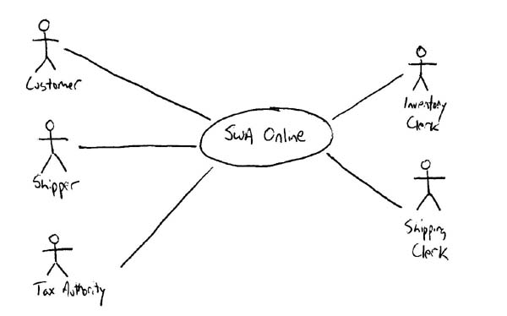
Context Diagram
External entity
Data flow
The entire system

Slide 16

IT’S A BAD DFD
Do not use direct data flows from one data store to another. There must be a process between the store.s
Do not use direct data flows from an external entity to a data store flows. Again, a process is needed between them.
Do not show direct data flows between external entities.

Slide 17
Bad! Flow between external entities
Fire brigade
Weather forecast
Weather bureau
Weather forecast
Call for help
Assess fire risk

Slide 18
Bad! Flow direct to data store
Fire brigade
Weather bureau
Weather forecast
Call for help
Forecast history
Assess fire risk
Weather forecast

Slide 19
Bad! Flow direct between data stores
Customer
Order
Process
order
Invoice
Inventory
Order
Stock check
Stock numbers
Orders

Slide 20

THANK YOU

