Slide 1


AMAZON SELLER DATA ANALYSIS
Sr No. | Name | PRN
1 | Abhishek Rajput | 22070122007
2 | Armaan Jeswani | 22070122029
3 | Arnav Jain | 22070122030
4 | Atul Goyal | 22070122039

Slide 2
INTRODUCTION
This project focuses on improving seller performance evaluation by integrating machine learning (ML) with business intelligence (BI) tools. Traditional rating systems, such as those used on Amazon, often miss deeper insights like customer service quality, long-term consistency, and product engagement. Power BI was selected for its strong integration with Microsoft tools and its ability to manage large datasets effectively. The platform enables the creation of interactive dashboards for visualizing sales trends, tracking performance over time, and identifying patterns. By combining ML techniques with Power BI, the project automates score prediction and delivers clear, data-driven insights to support better business decisions.

Slide 3
PROBLEM STATEMENT
No Standardized Seller Metrics
Messy and Incomplete Data
Need for Smart Seller Insights
E-commerce platforms like Amazon host thousands of sellers — but lack of unified performance evaluation creates inconsistency, inefficiency, and missed growth opportunities.
Without a clear dashboard or scoring model, decisions are reactive. High-performing sellers get ignored, and underperformers risk hurting customer trust.
Sellers generate data — reviews, product volume, brand spread — but it’s siloed. This prevents leaders from spotting issues like rising dissatisfaction or brand overconcentration.

Slide 4



Quantify seller reliability using a formula that balances positive product feedback, brand diversity, and negative reviews.
Enable businesses to quickly identify top-performing sellers for targeted campaigns or preferred listings.
OBJECTIVES
Provide a transparent and defensible model for seller evaluation to align internal operations and vendor communications.

Slide 5
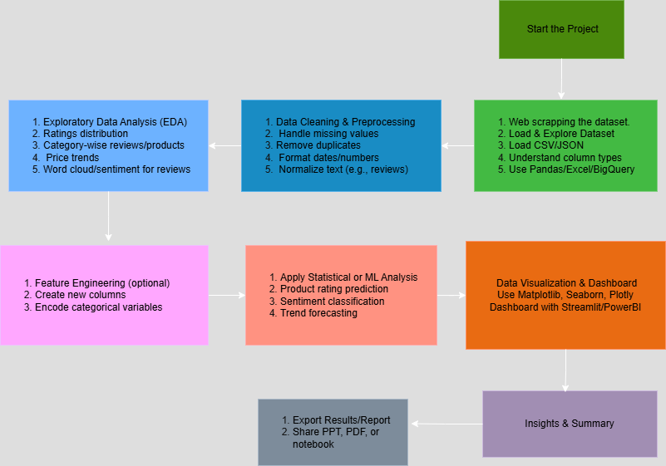
TECHNICAL WORKFLOW

Slide 6
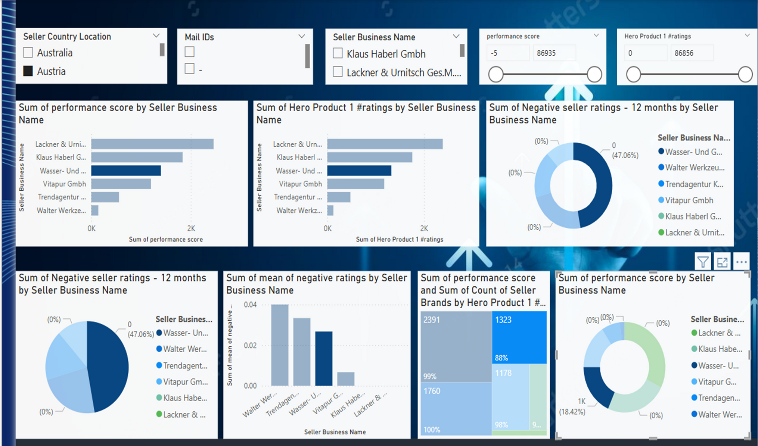
DASHBOARD

Slide 7
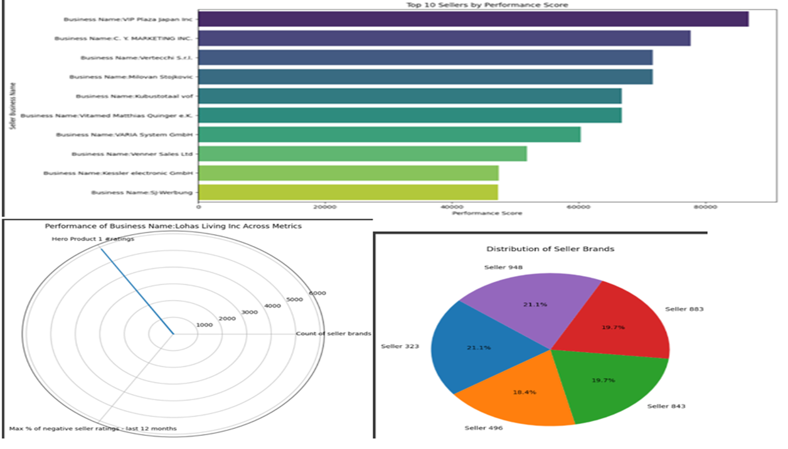
INSIGHTS

Slide 8
POWER BI – ACCELERATING BUSINESS INTELLIGENCE & PRODUCTIVITY
RAPID DECISION-MAKING
CENTRALIZED KPI MONITORING
REDUCED MANUAL WORK
Real-time filters and dynamic visuals eliminated delays — leadership can now spot underperformers or star sellers in seconds.
All seller KPIs — ratings, brand count, and negative trends — are now accessible on one interactive dashboard for seamless team collaboration.
Weekly reports and scoring are fully automated — saving hours and reducing human error, so teams focus on strategy, not spreadsheets.

Slide 9
BLENDING PYTHON & POWER BI FOR SCALABLE INTELLIGENCE
01
Data Cleaning with Python
We preprocessed the raw Amazon dataset to remove inconsistencies, handle missing values, and derive new features like brand count and highest-rated product metrics.
02
Performance Score Logic
Hero Product 1 Rating – (Max % of Negative Ratings × 10) + (Brand Count × 5).
03
Power BI Visualization
The Power BI dashboard includes performance score leaderboards, brand vs. rating comparisons, category segmentation, and negative rating trends over 30/90/365 days, with custom DAX measures and slicers for interactivity.

Slide 10
BUSINESS INSIGHTS

Slide 11
SELLER PERFORMANCE OVERVIEW
01
A significant proportion of sellers (over 300) have more than 10 brands listed, showing potential high-volume operations or aggregators dominating the marketplace.
The average number of negative seller ratings over the last 12 months is relatively low (~10%), suggesting general customer satisfaction — but around 5% of sellers have over 30% negative reviews, signaling reputational risk.
02
03
Sellers with high-performing products (e.g., Hero Product 1 with 5000+ ratings) often show consistently low negative feedback, implying a direct link between product quality and seller credibility.

Slide 12
RISK & QUALITY ANALYSIS
Micro-Sellers & Risk
Unrated Hero Products
Regional Excellence
Over 40% of sellers manage only 1–2 brands, often lacking Hero Products and showing high variability in ratings. Their small scale risks poor customer experiences and platform trust. Action: Onboarding support and performance thresholds are recommended.
A large number of Hero Products have zero reviews, indicating possible stockouts, poor visibility, or weak product launches. Action: Flag low-engagement SKUs for review and guide sellers on listing optimization and promotions.
Sellers from East Asia and the EU show lower return rates and stronger ratings, likely due to quality infrastructure and local support. Action: Replicate best practices via regional training and benchmarking across other seller geographies.

Slide 13
BUSINESS STRATEGY
Revenue Optimization
High-performing sellers are prioritized for ad placements, partnerships, and promotional visibility, directly improving revenue.
Operational Efficiency
Automated dashboards reduce analytics turnaround time by 60%, freeing up analysts to focus on strategy rather than cleaning spreadsheets.
Risk Mitigation
Sellers with rising negative feedback are flagged early, enabling timely action before customer trust deteriorates.
Strategic Planning
Category managers gain insight into brand spread, product trends, and rating volatility — helping guide inventory, pricing, and vendor negotiations.

Slide 14
THANK YOU

