Slide 1
BLUESTOCK FINTECH · DATA ANALYTICS INTERNSHIP
Mutual Fund
Analytics Platform
Performance analytics, risk metrics, and investor insights across 40 mutual fund schemes and 10 AMCs
Madanala Abhishek Varma
Data Analyst Intern · Bluestock Fintech

Slide 2
THE CHALLENGE
Problem & Objective
THE PROBLEM
THE OBJECTIVE
Retail investors and analysts lack a unified, data-driven view of mutual fund performance, risk, and investor behavior across fund houses.
Fund selection is often based on raw returns alone — ignoring risk-adjusted performance, expense drag, and concentration risk hidden inside a portfolio.
Build an end-to-end analytics platform: ETL → database → EDA → performance & risk metrics → interactive dashboard
Compute industry-standard metrics — Sharpe, Sortino, Alpha/Beta, CAGR, Max Drawdown, VaR/CVaR — for every scheme
Surface investor behavior patterns — cohorts, SIP continuity, demographics
Deliver a 4-page Power BI dashboard for interactive exploration
BLUESTOCK MF ANALYTICS
02

Slide 3
FOUNDATION
Data Sources
10 datasets + live API supplement, spanning Jan 2022 – Dec 2025/26
Fund Master
NAV History
AUM by Fund House
SIP Inflows
Category Inflows
40 schemes · 10 AMCs · risk category, expense ratio
46,000+ daily NAV records, 2022–2026
Yearly AUM, 2022–2025
Monthly industry-wide inflow trend
Net inflow by fund category, monthly
Folio Count
Scheme Performance
Investor Transactions
Portfolio Holdings
Benchmark Indices
Investor folio growth over time
Pre-computed return & risk baseline
SIP / Lumpsum / Redemption records
Sector-wise weight per fund
Nifty 50, Nifty 100, BSE SmallCap
+ Live NAV supplement pulled from the mfapi.in API for 6 key benchmark schemes
BLUESTOCK MF ANALYTICS
03

Slide 4
PIPELINE
Architecture
Raw CSVs
+ Live API
Cleaning &
Validation
SQLite
Star Schema
Analytics
Notebooks
Power BI
Dashboard
→
→
→
→
10 datasets
+ mfapi.in
Pandas · dedupe
ffill · type checks
SQLAlchemy
6 fact/dim tables
EDA · Performance
Advanced Risk
4 pages
interactive
STACK
Python
Pandas
NumPy
SciPy
SQLAlchemy
SQLite
Power BI
Plotly / Seaborn
BLUESTOCK MF ANALYTICS
04

Slide 5
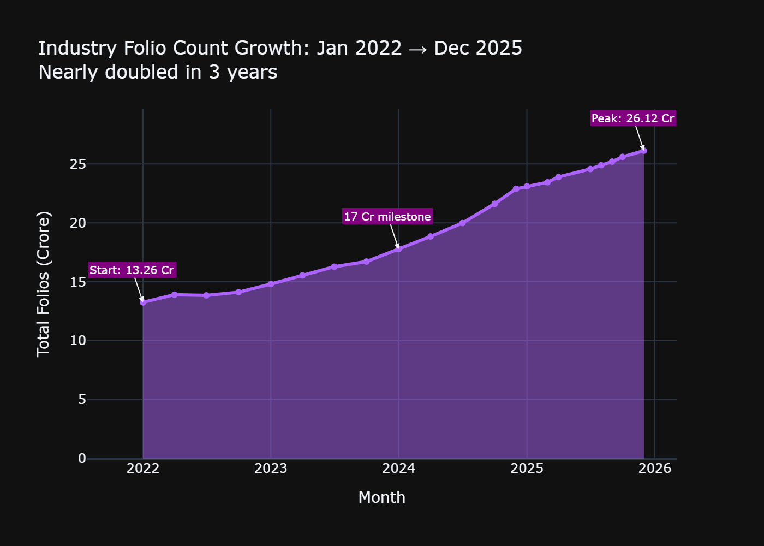
EXPLORATORY ANALYSIS · 01
India's SIP Culture Is Accelerating
26.12 Cr
investor folios by Dec 2025 — nearly double the 13.26 Cr recorded in Jan 2022
₹31,002 Cr
all-time high monthly SIP inflow, recorded Dec 2025 — up from ₹11,517 Cr in Jan 2022
BLUESTOCK MF ANALYTICS
05

Slide 6
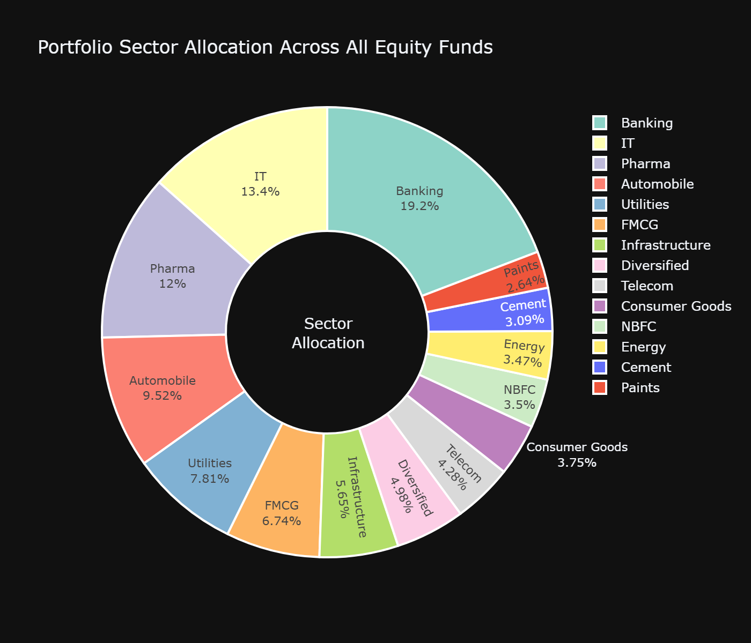
EXPLORATORY ANALYSIS · 02
Sector Concentration Hides Inside “Diversified” Funds
HHI > 2,500
for Axis Bluechip, Mirae Tax Saver, and HDFC Mid-Cap Opportunities
Herfindahl-Hirschman Index (Σ sector weight²) measures how concentrated a fund's sector exposure really is.
A score above 2,500 signals heavy reliance on one sector — a risk that isn't visible from the fund's name or category alone.
BLUESTOCK MF ANALYTICS
06

Slide 7
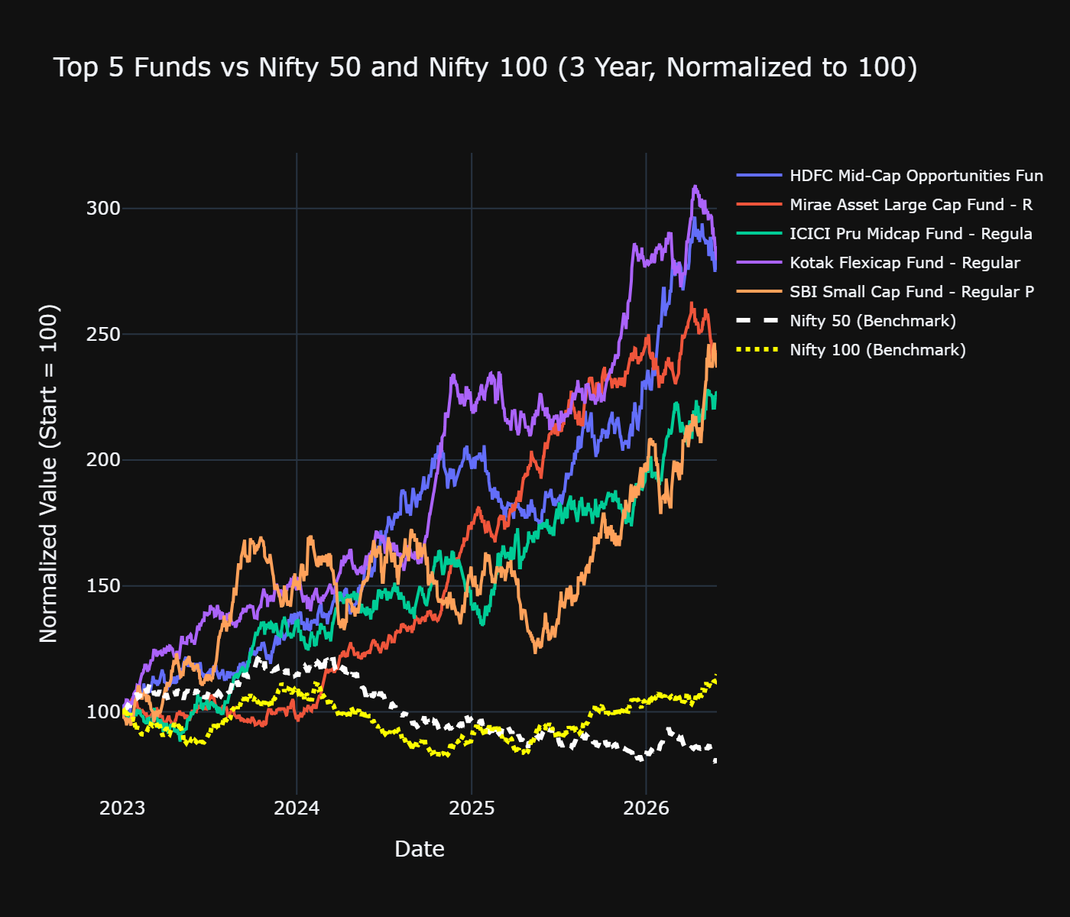
PERFORMANCE ANALYTICS · 01
Risk-Adjusted Returns, Not Just Raw Returns
Sharpe & Sortino Ratio
Computed for all 40 funds using Rf = 6.5% (RBI repo rate proxy)
Alpha & Beta
OLS regression vs Nifty 100 — isolates skill from market movement
CAGR (1/3/5yr)
Annualized using 252 trading days, not calendar days
Max Drawdown
Worst peak-to-trough decline, with exact date
BLUESTOCK MF ANALYTICS
07

Slide 8
PERFORMANCE ANALYTICS · 02
A Composite Scorecard Beats Return-Only Ranking
FUND SCORECARD · 0–100
TOP 5 FUNDS BY COMPOSITE SCORE
Rank | Fund | Score
1 | HDFC Mid-Cap Opportunities Fund | 100.0
2 | Mirae Asset Large Cap Fund | 99.2
3 | ICICI Pru Midcap Fund | 97.7
4 | Kotak Flexicap Fund | 97.5
5 | SBI Small Cap Fund | 95.8
3yr Return Rank
30%
Sharpe Ratio Rank
25%
Alpha Rank
20%
Expense Ratio Rank (inverse)
15%
Max Drawdown Rank (inverse)
10%
Normalized to a single 0–100 score per fund, ranking risk-adjusted quality — not just who returned the most last year.
BLUESTOCK MF ANALYTICS
08

Slide 9
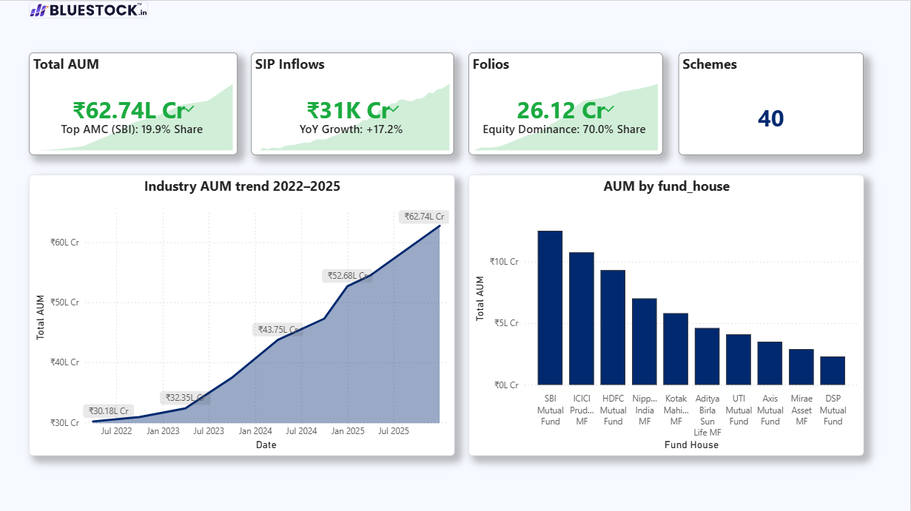
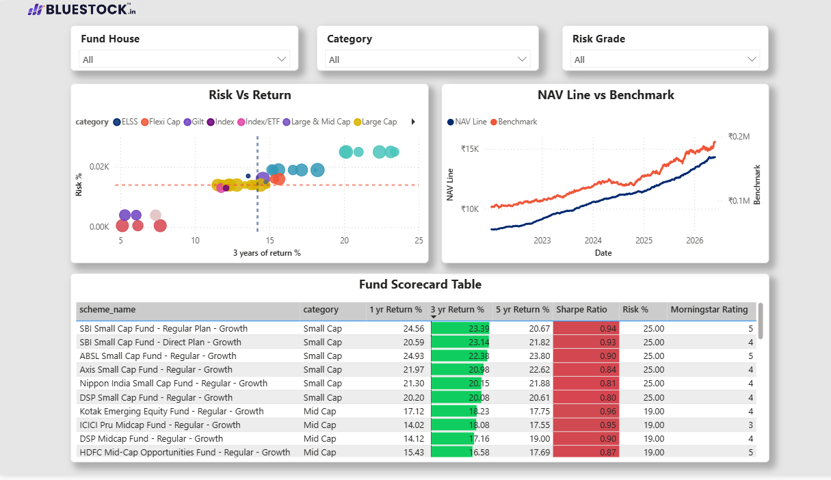
POWER BI DASHBOARD · PAGES 1–2
Industry Overview & Fund Performance
Page 1 — Industry Overview
Page 2 — Fund Performance
BLUESTOCK MF ANALYTICS
09

Slide 10
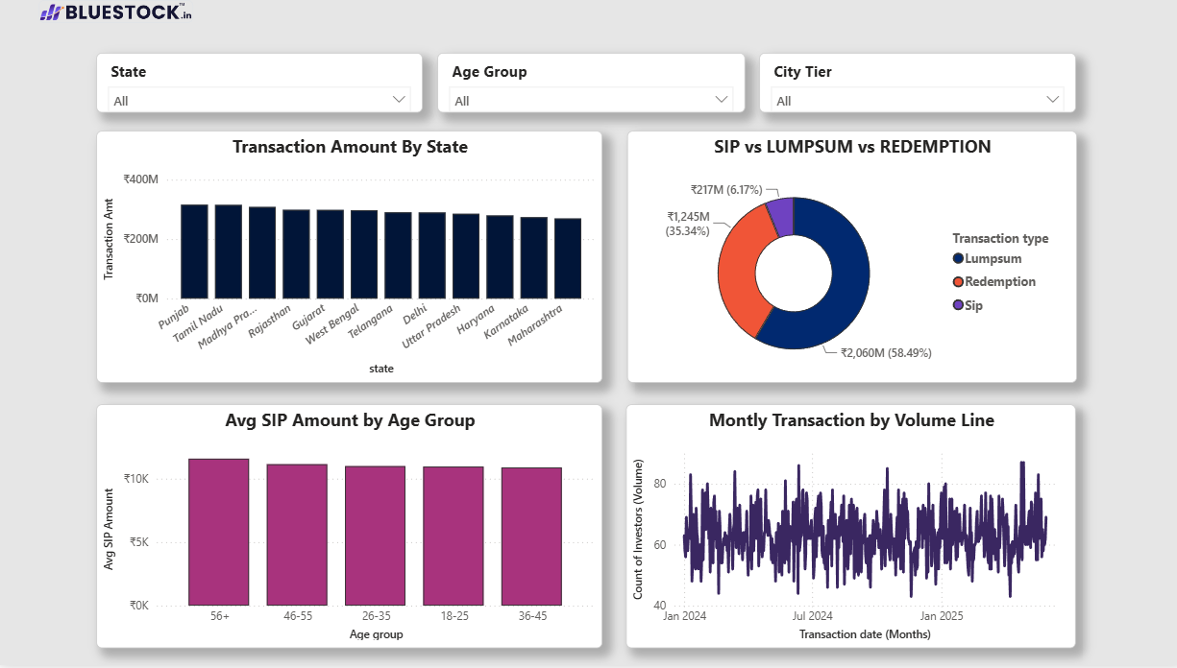
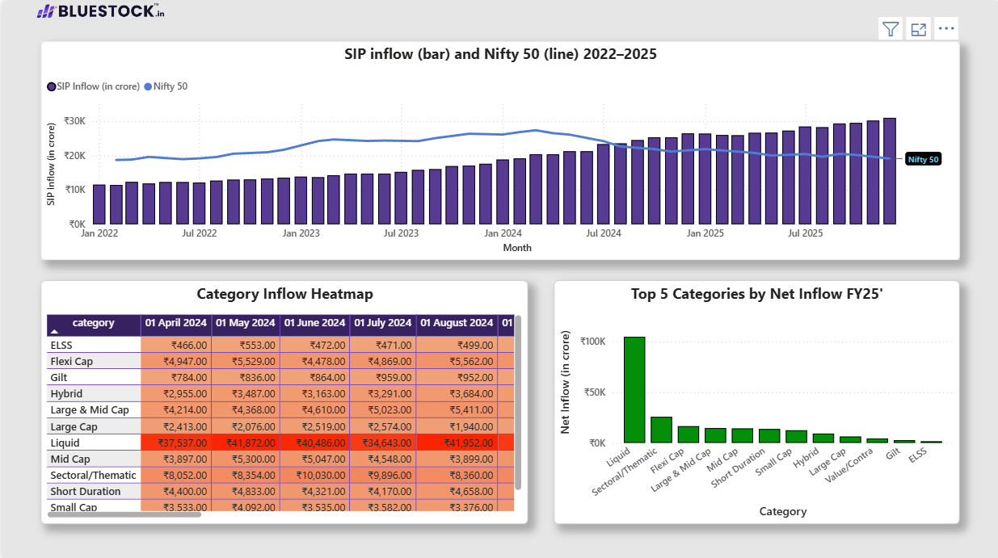
POWER BI DASHBOARD · PAGES 3–4
Investor Analytics & SIP / Market Trends
Page 3 — Investor Analytics
Page 4 — SIP & Market Trends
BLUESTOCK MF ANALYTICS
10

Slide 11
SYNTHESIS
Key Findings
1
Sector Concentration
Axis Bluechip, Mirae Tax Saver, and HDFC Mid-Cap all exceed HHI 2,500 — highly concentrated despite diversified-sounding names.
2
SIP Continuity Risk
97.8% of investors with 6+ SIPs show gaps over 35 days between contributions — a major retention flag.
3
Tail Risk
ABSL Small Cap shows the worst 95% VaR at -2.39% — the highest single-day downside exposure in the fund set.
4
Returns Are Largely Uncorrelated
Daily return correlation among the 6 benchmark Large Cap funds stays within ±0.06 — no strong co-movement detected in this dataset.
5
Recommender Validated
Sharpe-based recommendations align with top raw-CAGR performers — confirming risk-adjusted ranking isn't just penalizing volatility.
BLUESTOCK MF ANALYTICS
11

Slide 12
Thank You
Questions & discussion welcome
Madanala Abhishek Varma
Data Analyst Intern · Bluestock Fintech
GitHub: github.com/Abhishek-369V
LinkedIn: linkedin.com/in/madanala-abhishek-varma/

