Slide 1
Data Analysis
AtliQ Hospitality
Presented by Abhishek Kumar

Slide 2
AtliQ Grands
AtliQ Grands owns multiple five-star hotels across India. They have been in the hospitality industry for the past 20 years

Slide 3
Problem
Due to strategic moves from other competitors and ineffective decision-making in management, AtliQ Grands are losing its market share and revenue in the luxury/business hotels category.

Slide 4

Strategic Move
The managing director of AtliQ Grands wanted to incorporate “Business and Data Intelligence” to regain their market share and revenue. However, they do not have an in-house data analytics team to provide them with these insights.
Their revenue management team had decided to hire a 3rd party service provider to provide them with insights from their historical data.

Slide 5
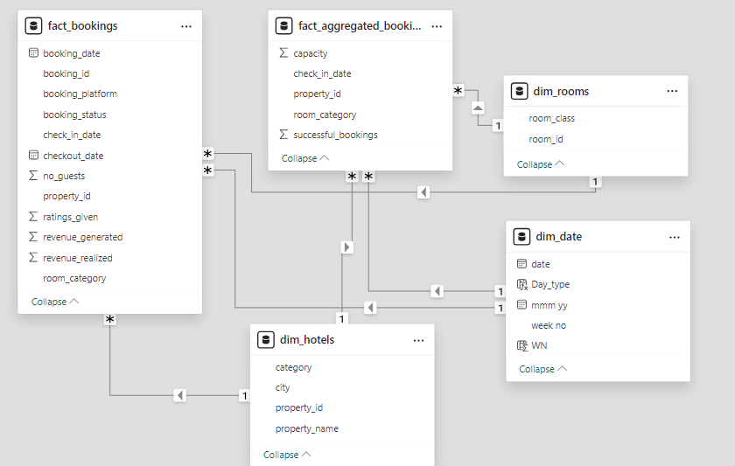
Data Modeling

Slide 6
Main KPIs
1.69b Revenue – Total of Revenue
7.34k RevPAR – Room per available room
57.79% Occupancy % – Total booking/total capacity
12.70k ADR – Average Daily rate (Revenue/total bookings)
70.14% Realisation% – Total revenue collected excluding cancellations and no-shows.

Slide 7
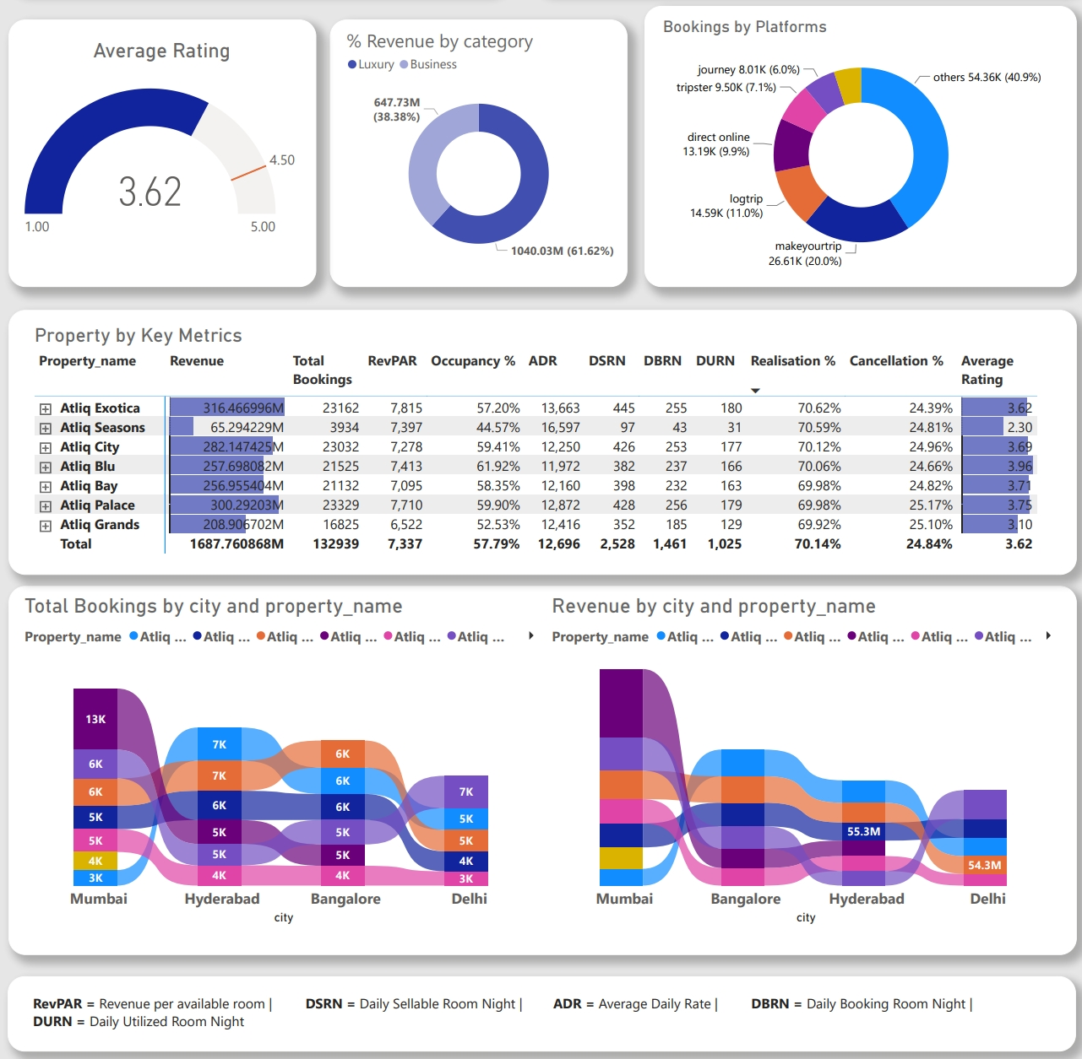
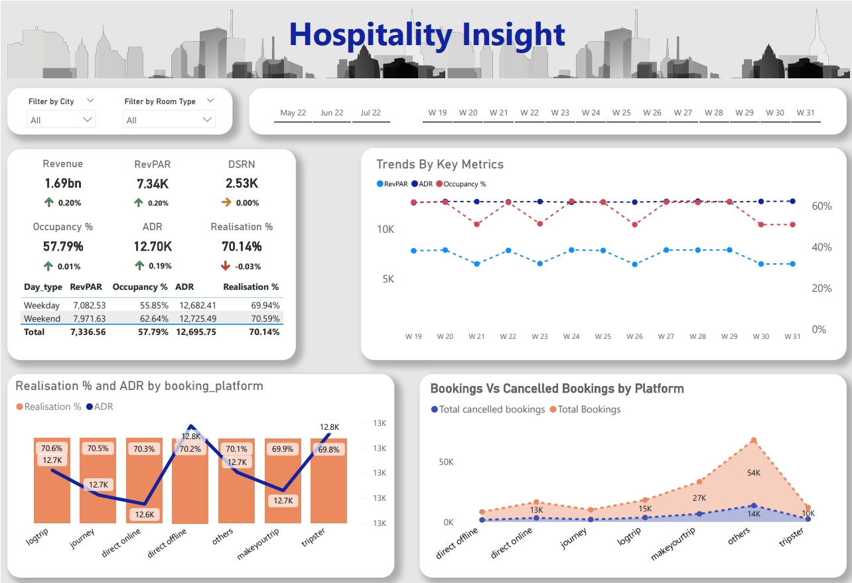
Dashboard

Slide 8
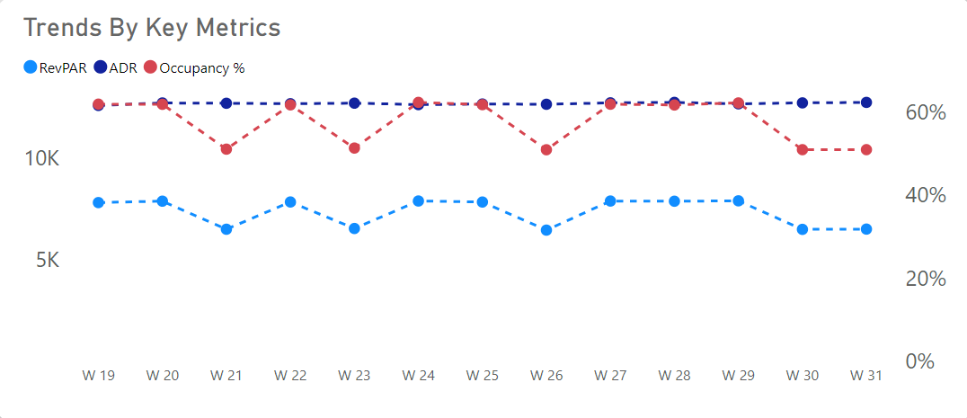
Trends By Key Metrics
Insight:
In all 14 weeks, ADR was almost always more than 12.5k.
The highest RevPAR in week 32 was 8.31k.
The highest Occupancy% in week 32 was 65.31%.

Slide 9
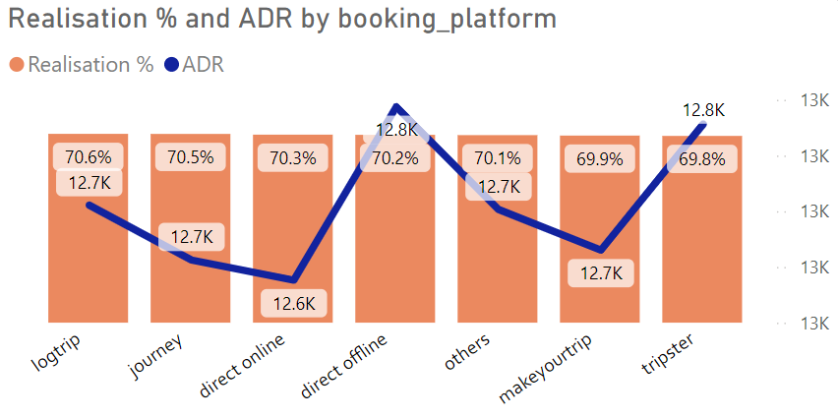
Realisation% and ADR by Booking Platform
Insight:
﻿At 70.59%, Logtrip had the highest Realisation%, and Tripster had the lowest Realisation % at 69.83%.
The average Realisation % from all booking platforms is 70.6%.
Direct offline has the highest ADR at 12.8k, and direct online has the lowest ADR at 12.6k.
The average ADR from all booking platforms is 12.5k.

Slide 10
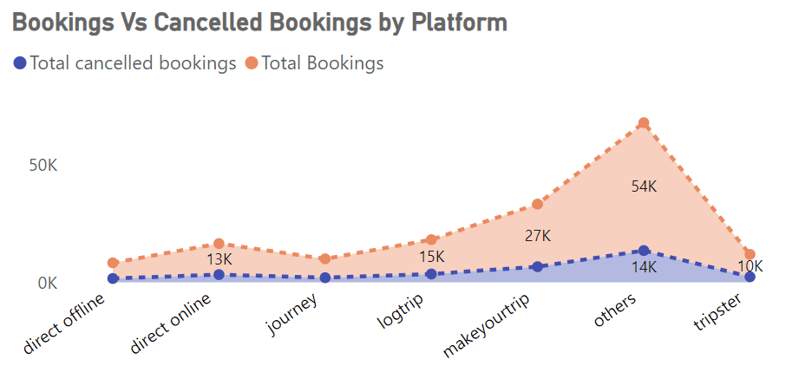
Booking Vs Cancelled Booking By Platform
Insight:
Most bookings come from MakeYourTrip at 27k, and the lowest bookings come from Direct Offline at 6.7k.
The average cancellation % from all booking platforms is 24%.
The platform with more bookings also has more cancellations, and the platform with the least bookings has the least cancellations accordingly.
Most cancellations come from MakeYourTrip at 6.7k, and the least cancellations come from Direct Offline at 1.6k.

Slide 11
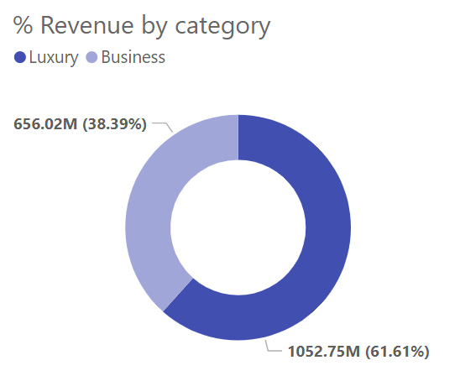
Revenue% by Category
Insight:
Revenue for Luxury (1052.75M) was higher than Business (656.01M).﻿﻿ ﻿﻿
﻿﻿Luxury accounted for 61.61% of Revenue.﻿

Slide 12
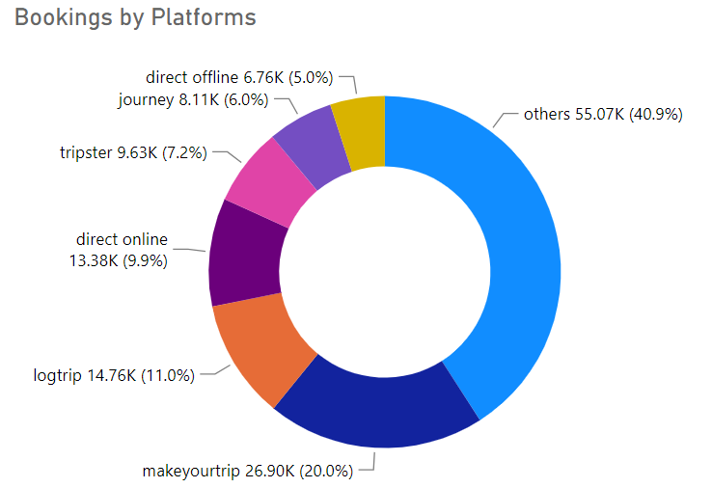
Booking by Platforms
Insight:
Most bookings come from the MakeYourTrip platform at 26.90k, which is 20% of the total bookings.
The least bookings come from Direct Offline at 6.76k, which is 5% of the total bookings.

Slide 13
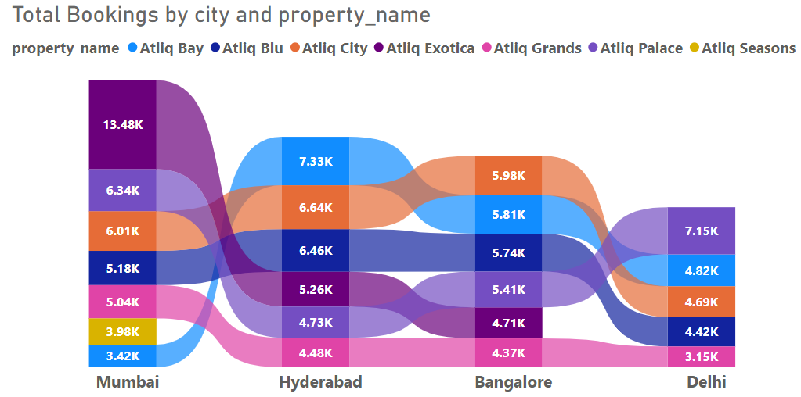
Total Bookings by City and Property Name
Insight:
Mumbai city received the highest bookings at 43.45k, and Atliq Exotica in Mumbai received the highest bookings within the city at 13.48k.
Delhi city received the lowest bookings at 24.2k, and Atliq Grands in Delhi received the lowest bookings within the city at 3.15k.

Slide 14
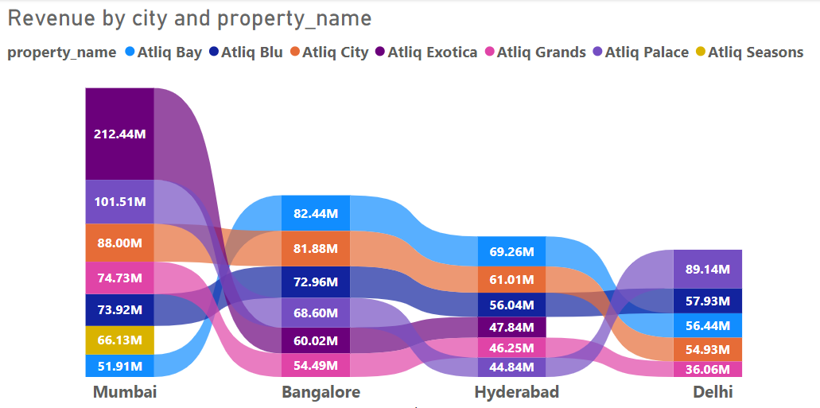
Revenue by City and Property Name
Insight:
The highest revenue collected from Mumbai city business is 420.4M, and Atliq Exotica in Mumbai received the highest revenue at 212.44M.
Delhi city received the lowest revenue at 294.5M, and Atliq Grands in Delhi received the minimum revenue at 36M.

Slide 15
Thank You
Your thoughts & suggestions are highly appreciated!

