Slide 1

Case Study: Jenson USA

Slide 2
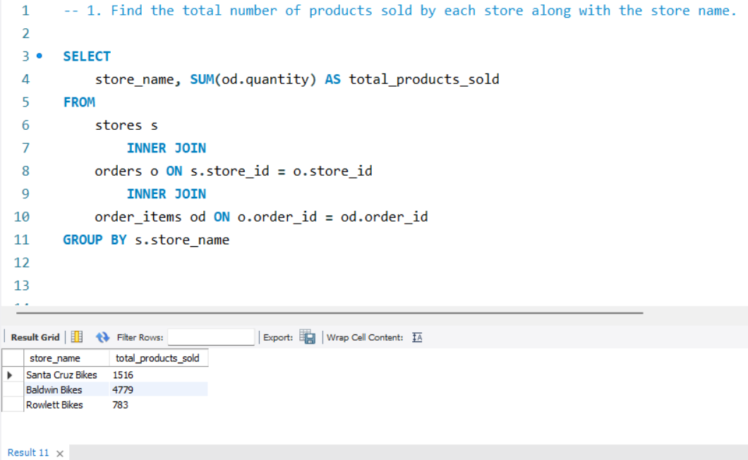
1. Find the total number of products sold by each store along with the store name

Slide 3
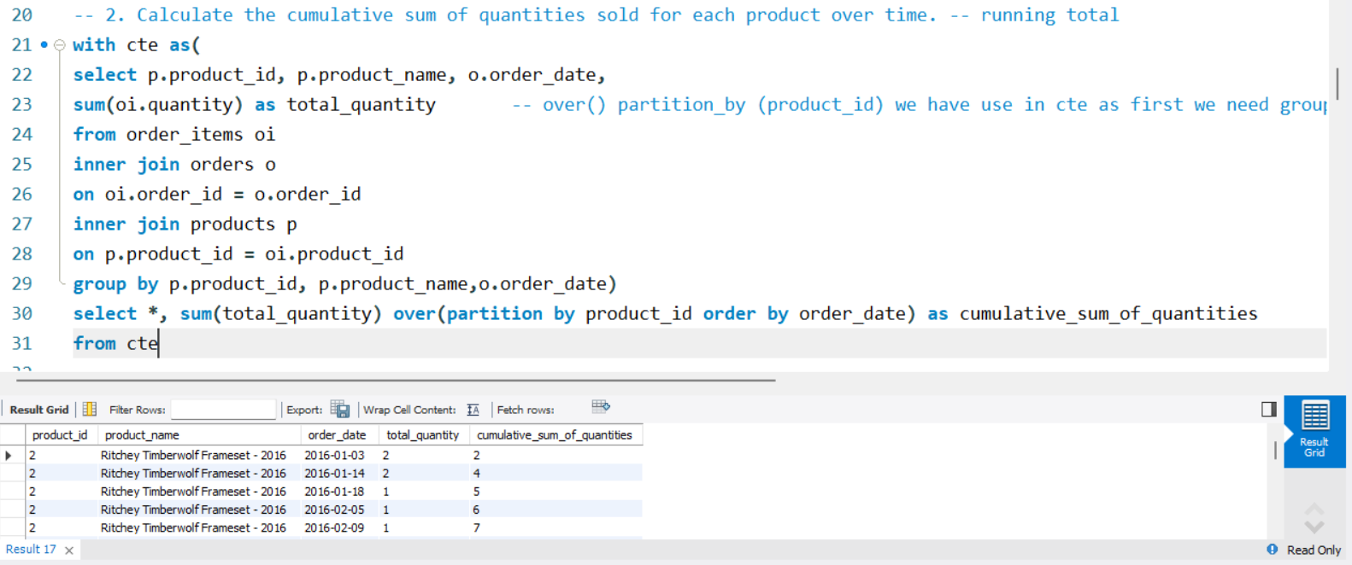
2. Calculate the cumulative sum of quantities sold for each product over time

Slide 4
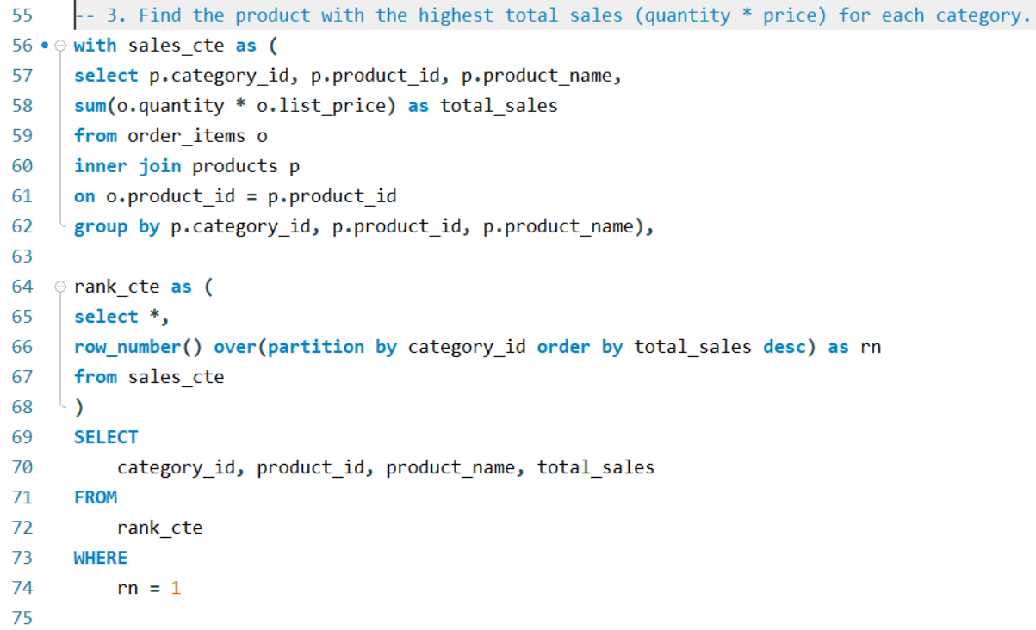
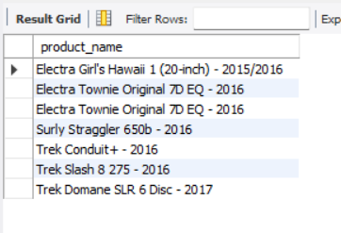
3. Find the product with the highest total sales (quantity * price) for each category

Slide 5
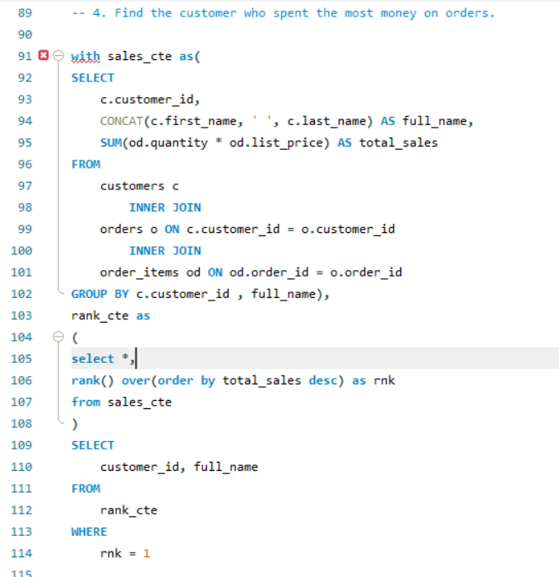
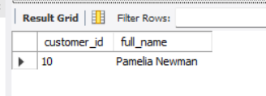
4. Find the customer who spent the most money on orders

Slide 6
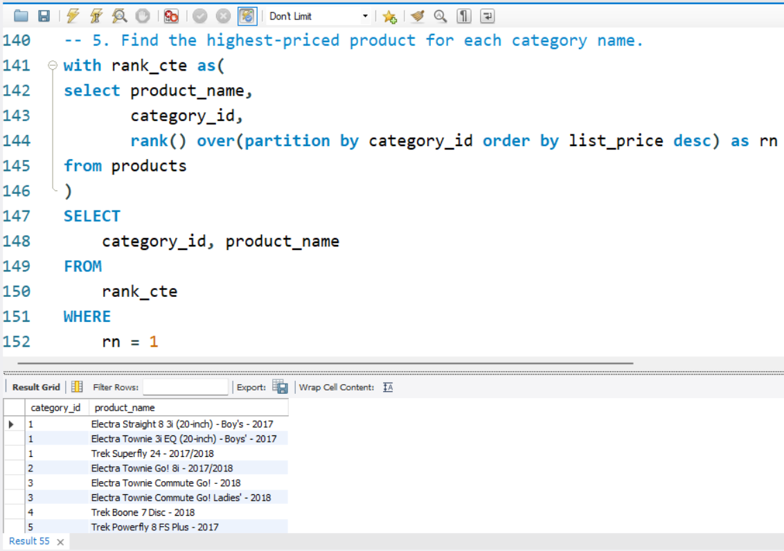
5. Find the highest-priced product for each category name

Slide 7
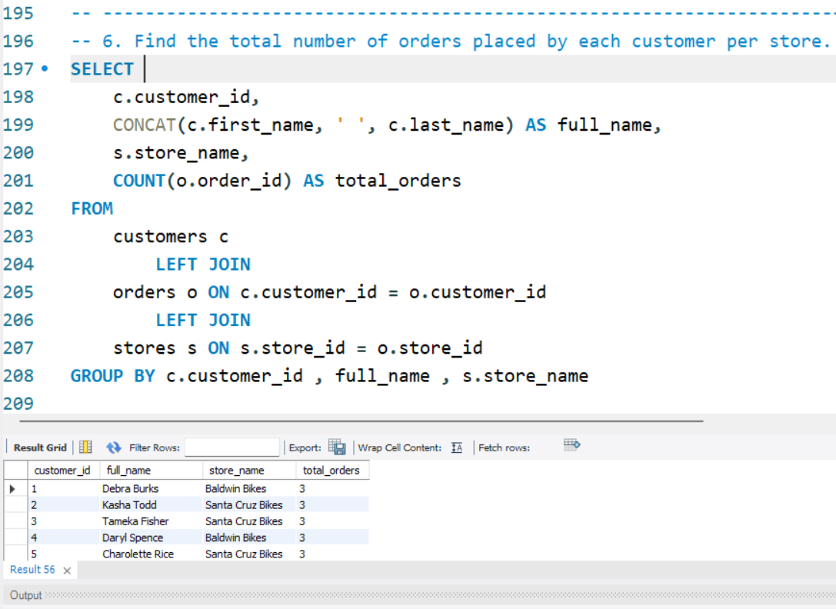
6. Find the total number of orders placed by each customer per store

Slide 8
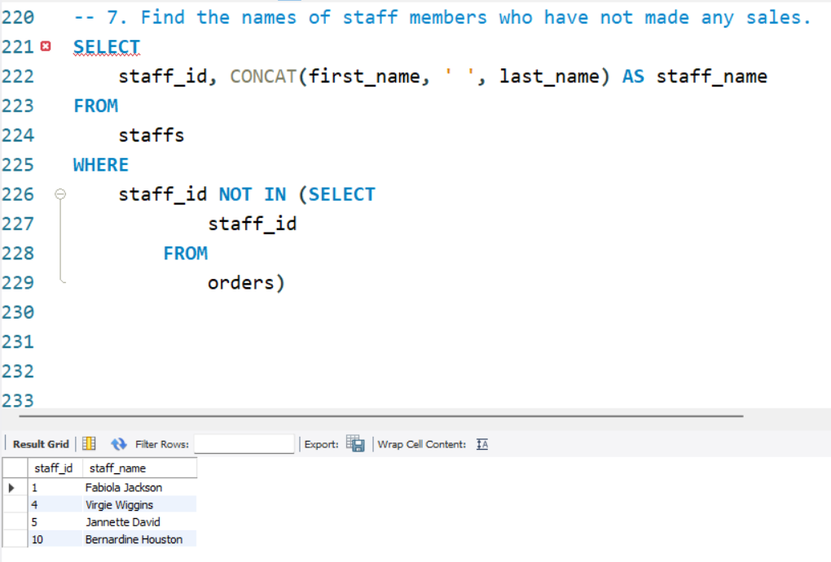
7. Find the names of staff members who have not made any sales

Slide 9
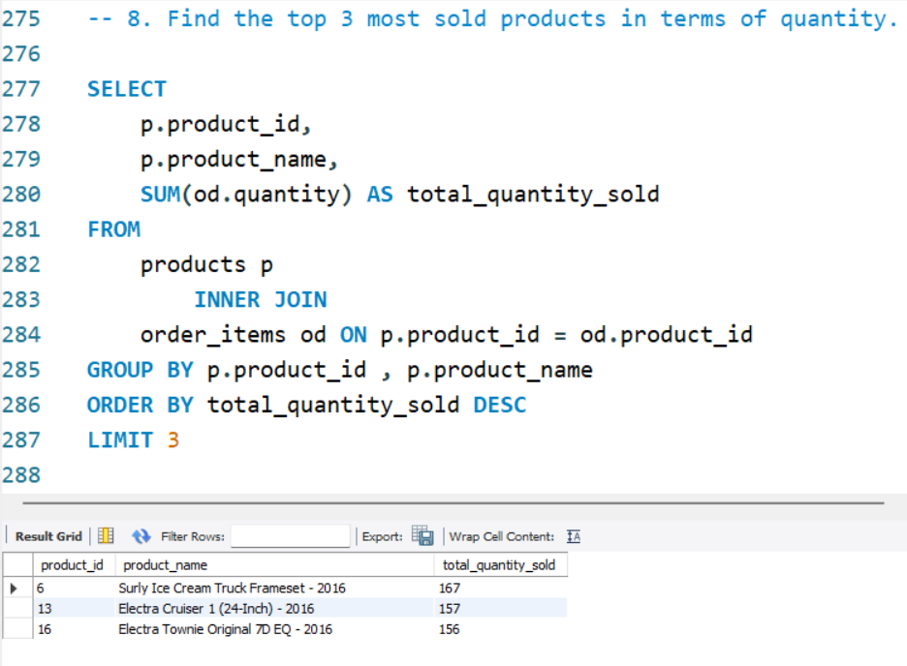
8. Find the top 3 most sold products in terms of quantity

Slide 10
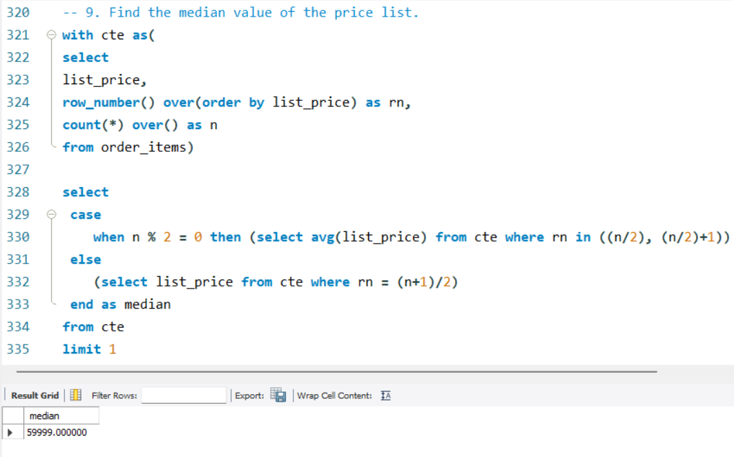
9. Find the median value of the price list

Slide 11
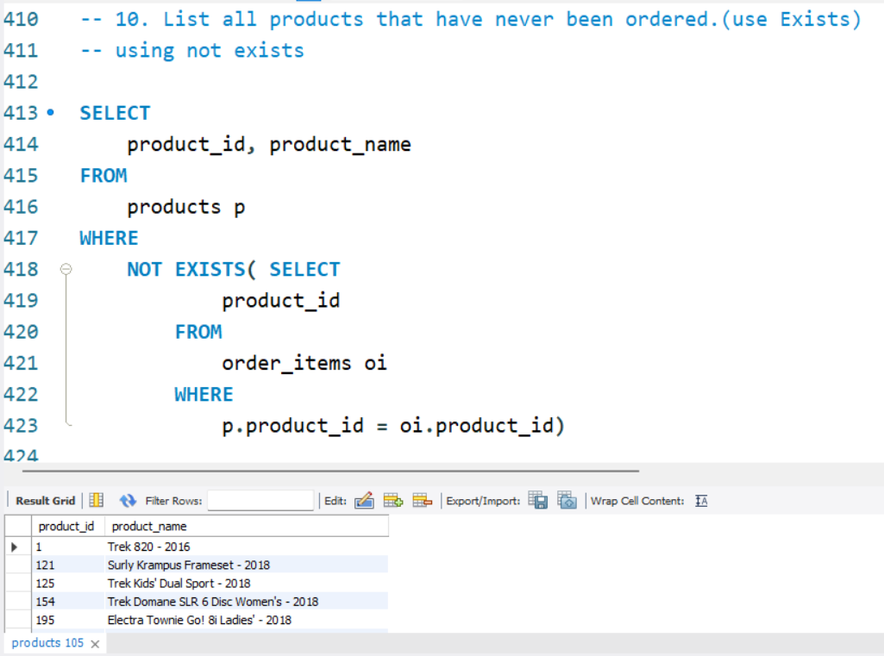
10. List all products that have never been ordered.(use Exists)

Slide 12
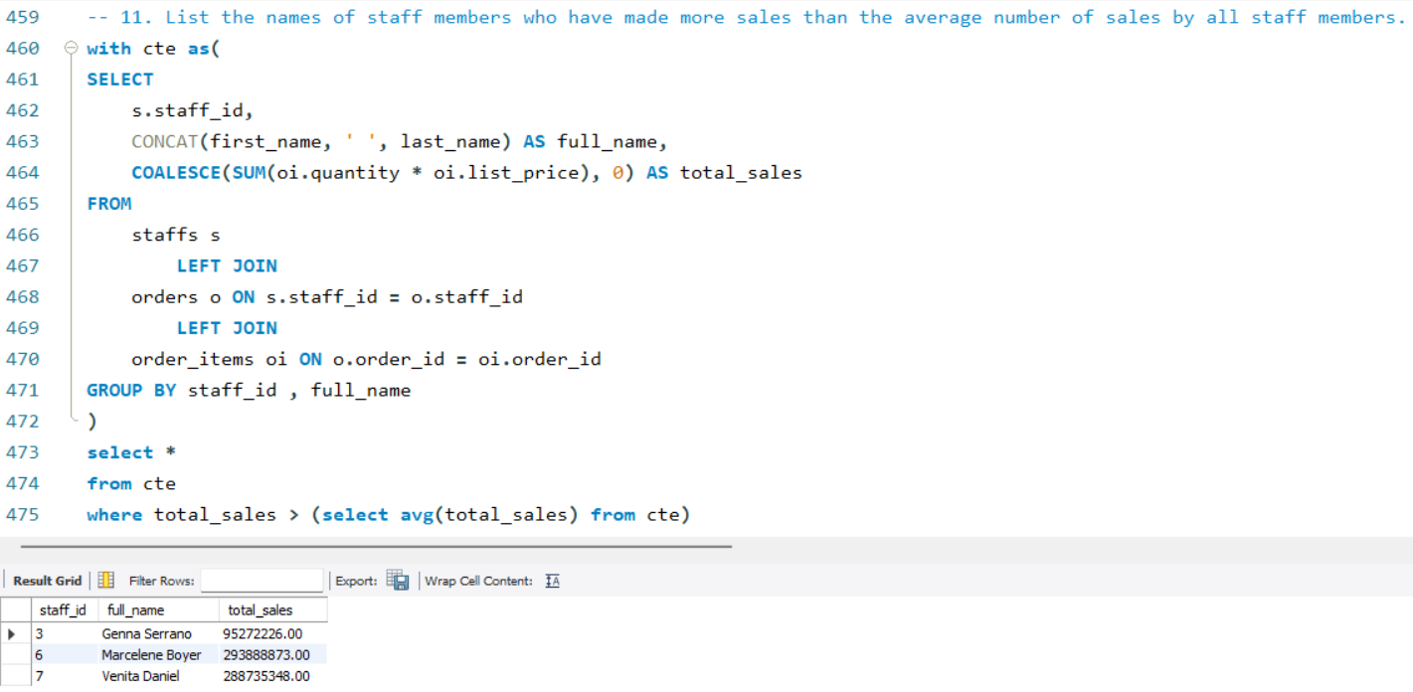
11. List the names of staff members who have made more sales than the average number of sales by all staff members

Slide 13
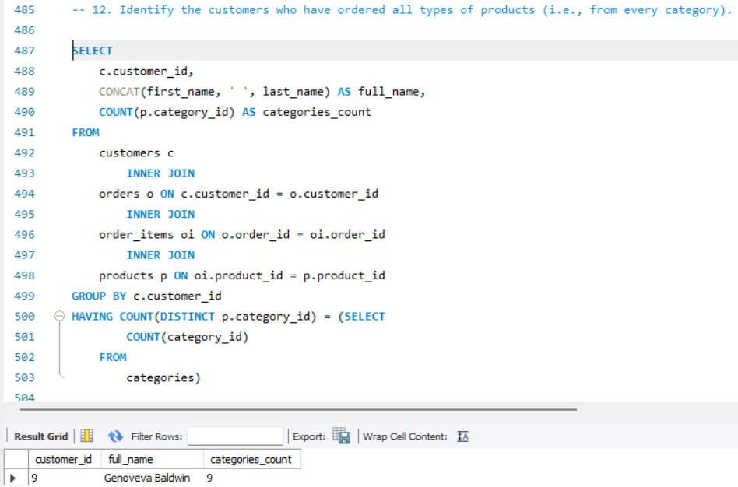
12. Identify the customers who have ordered all types of products (i.e., from every category)

